Slide 1
Displaced Photon
Background
Update
October 11, 2012

Slide 2
Data Set & Triggers
DataSets:
/SinglePhoton/Run2012C/Prompt-Reco V1&2
Int Lumi = 29632.1 mb
HLT Triggers:
HLT :HLT_Photon50_CaloIdVL_IsoL
HLT_DisplacedPhoton65_CaloIdVL_IsoL_PFMET25

Slide 3
Event Selection
Selection 1:
Gamma_Pt1(2) > 60(45)GeV/c
|eta| < 2.5, Jet_pt >35 GeV/c
Egamma VL Iso cuts
CSC Segment |eta| > 1.6
Selection 2:
|eta| < 2.4 , Jet_pt >30GeV/c
0.15 <Sminor <0.30 , Met >25 GeV
Halo tagged if dPhi(cscSeg, gamma) <0.6 + ALL TightHaloID(CSC, Ecal,Hcal,Beam ...)

Slide 4

What are these?
Cosmic Muons? Beam Halo Muons?

Slide 5

What are these?
Cosmic Muons? Beam Halo Muons?

Slide 6
ID Strategy
NOT NEW
David Petyt : https://indico.cern.ch/getFile.py/access?contribId=1&resId=0&materialId=slides&confId=101219
Andrew Askew: https://indico.cern.ch/getFile.py/access?contribId=0&resId=0&materialId=slides&confId=189177
Our Strategy:
1) Use CSC Segment + CSCHaloTrack matching + BeamHaloCleaning (later slides).
2) Use shower shape( reducedRechits collection) ( next step)

Slide 7
Definition
Egamma Photon :
* Egamma Iso selection criteria + Sminor.
Halo Photon :
Tag as HaloPhoton if either:
*CSC Segment matching: dphi(cscsegment, gamma) < 0.6
* csc, Ecal, Hcal, Beam halo TightID
*CSC Track matching: dphi(cscTrk – gamma) < 0.18

Slide 8
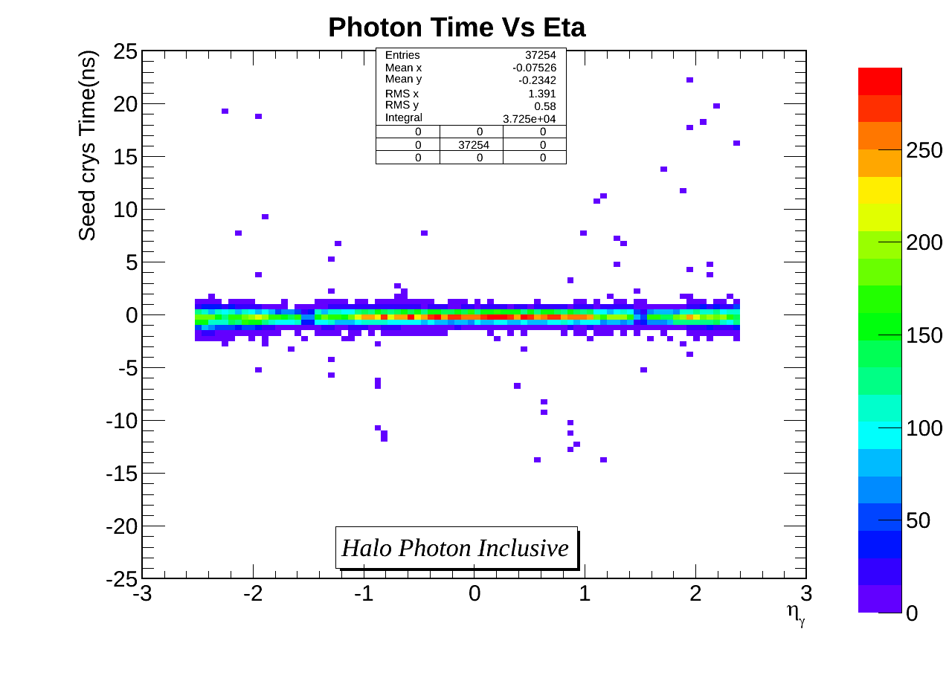
Results
Limited statistics in 2012C dataset

Slide 9
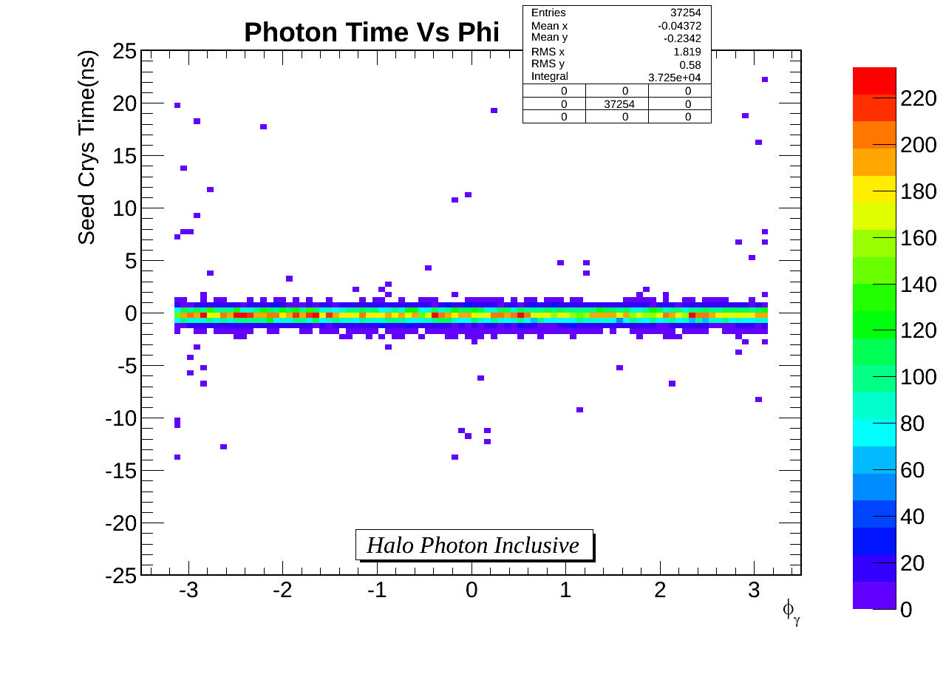
Results
Limited statistics in 2012C dataset

Slide 10
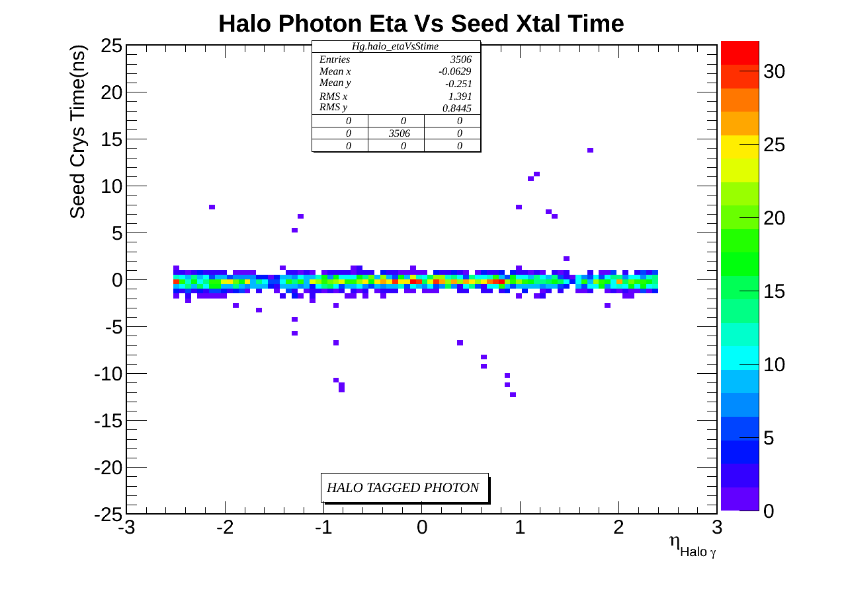
Results
Halo Tagged Photon

Slide 11
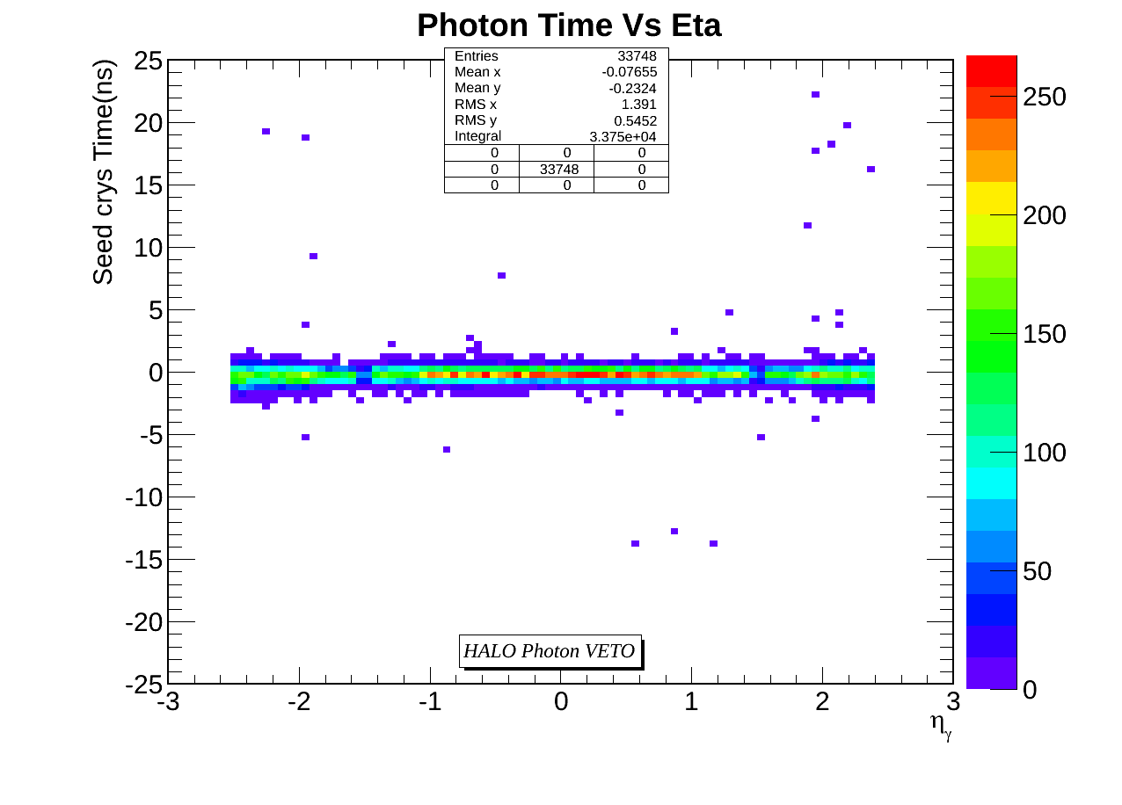
Results
Egamma (Real) Photon -(Halo photon removed)

Slide 12
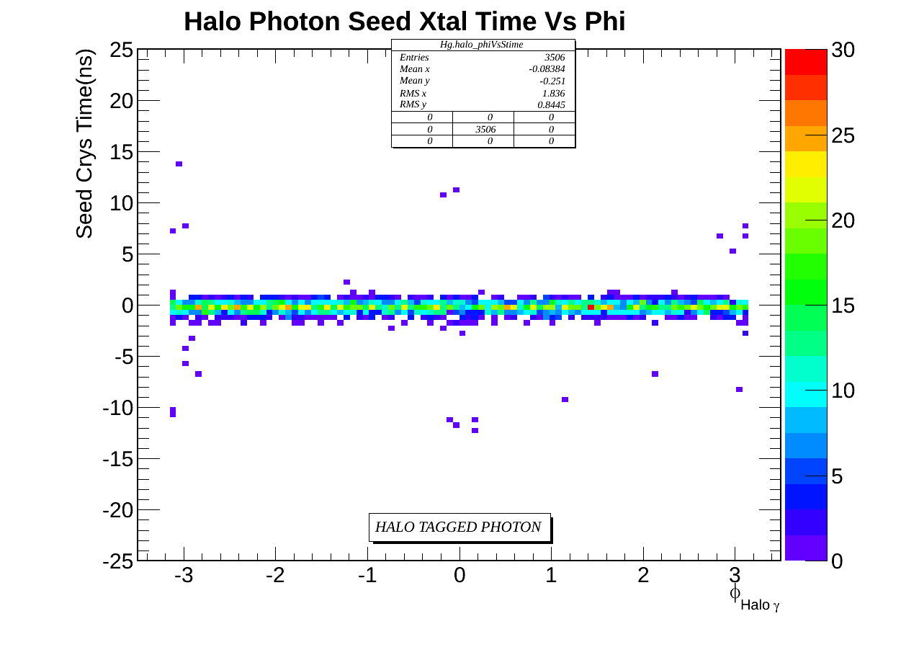
Results
Halo Tagged Photon

Slide 13
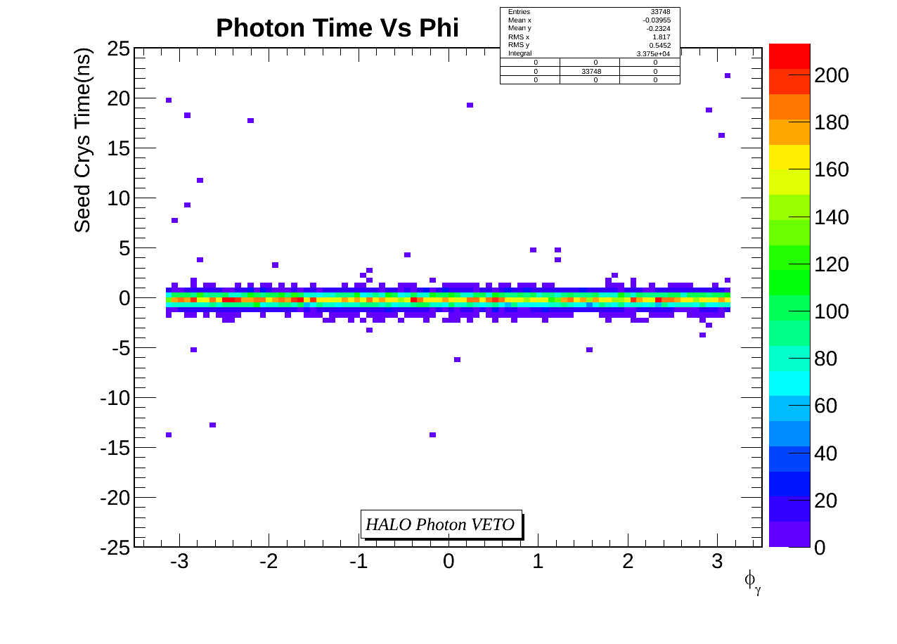
Results
Egamma (Real) Photon -(Halo photon removed)

Slide 14
Legend of Next slides
RED = Combined Real + Halo Tagged Photon
GREEN = Real Photon
BLUE/BLACK = Halo Tagged Photon

Slide 15
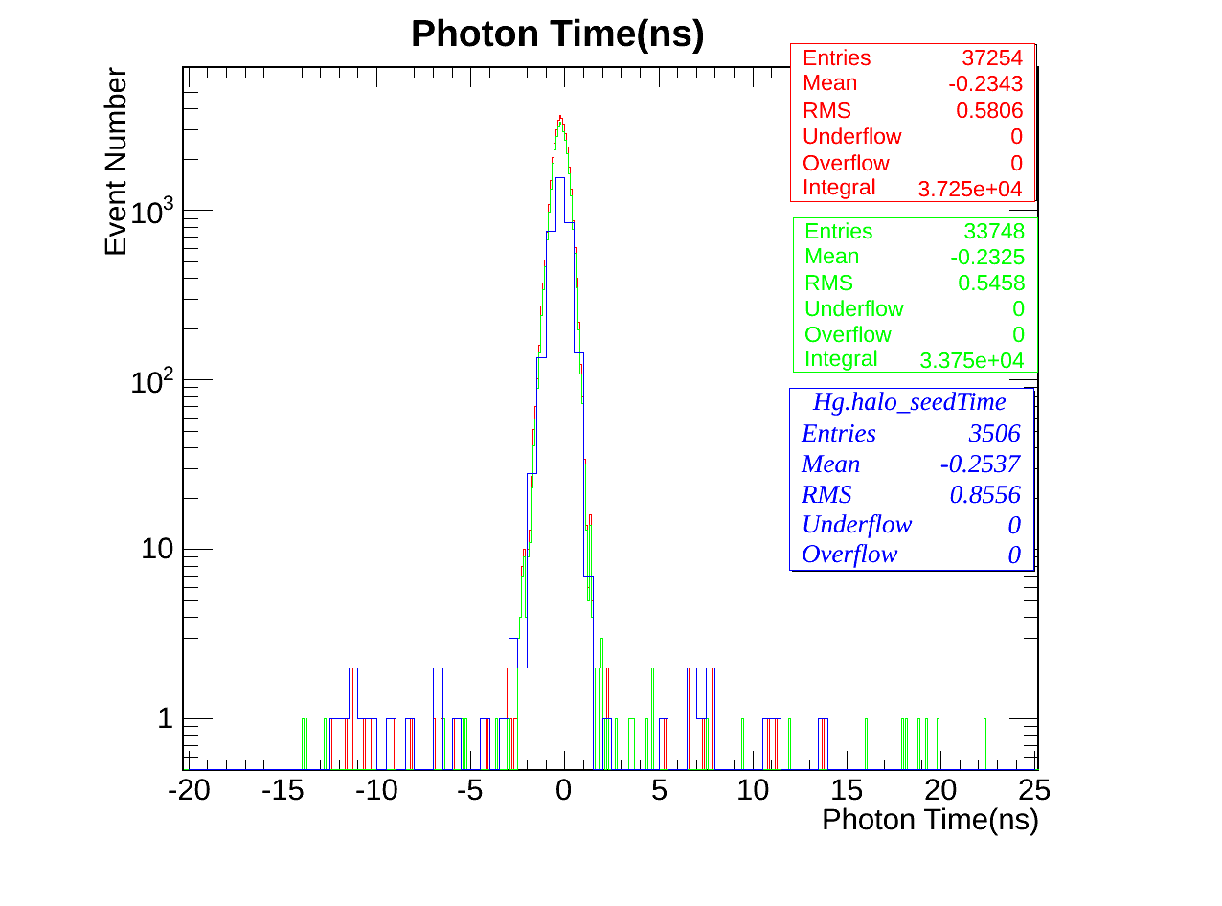
Results
Seed crystal photon time.

Slide 16
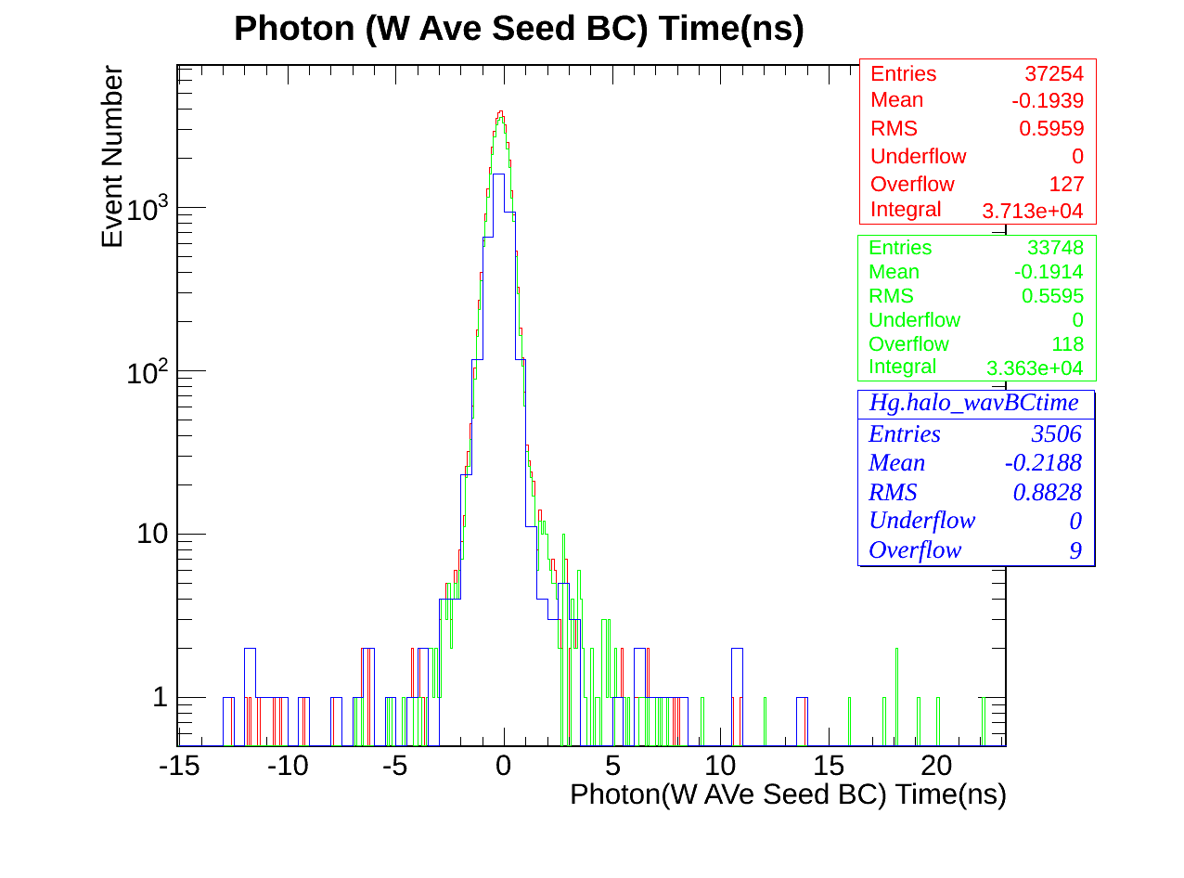
Results
W. Ave seed BC photon time.

Slide 17
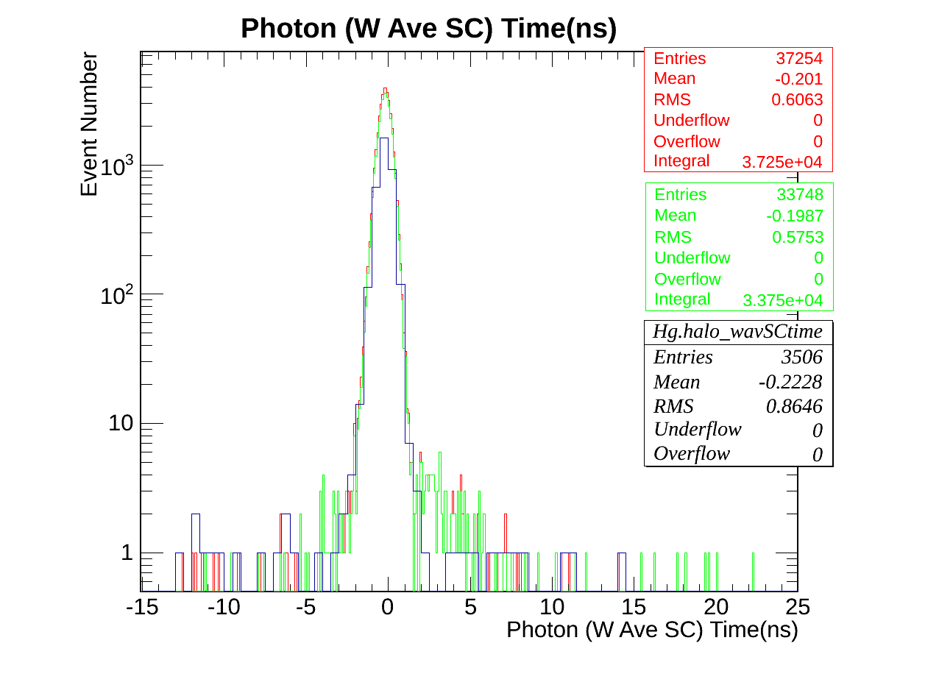
Results
W. Ave SC photon time.

Slide 18
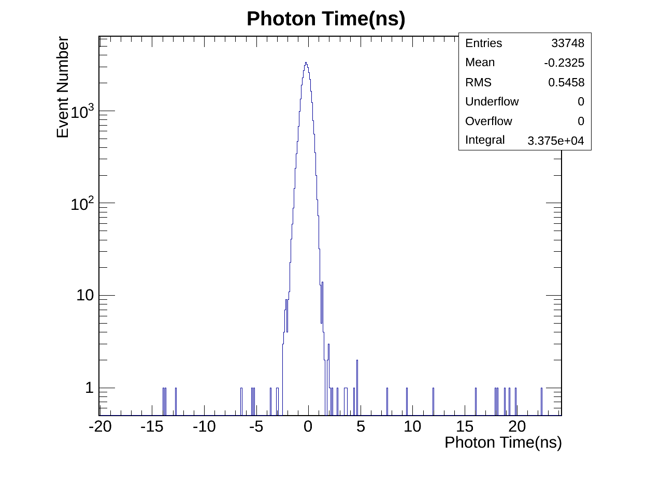
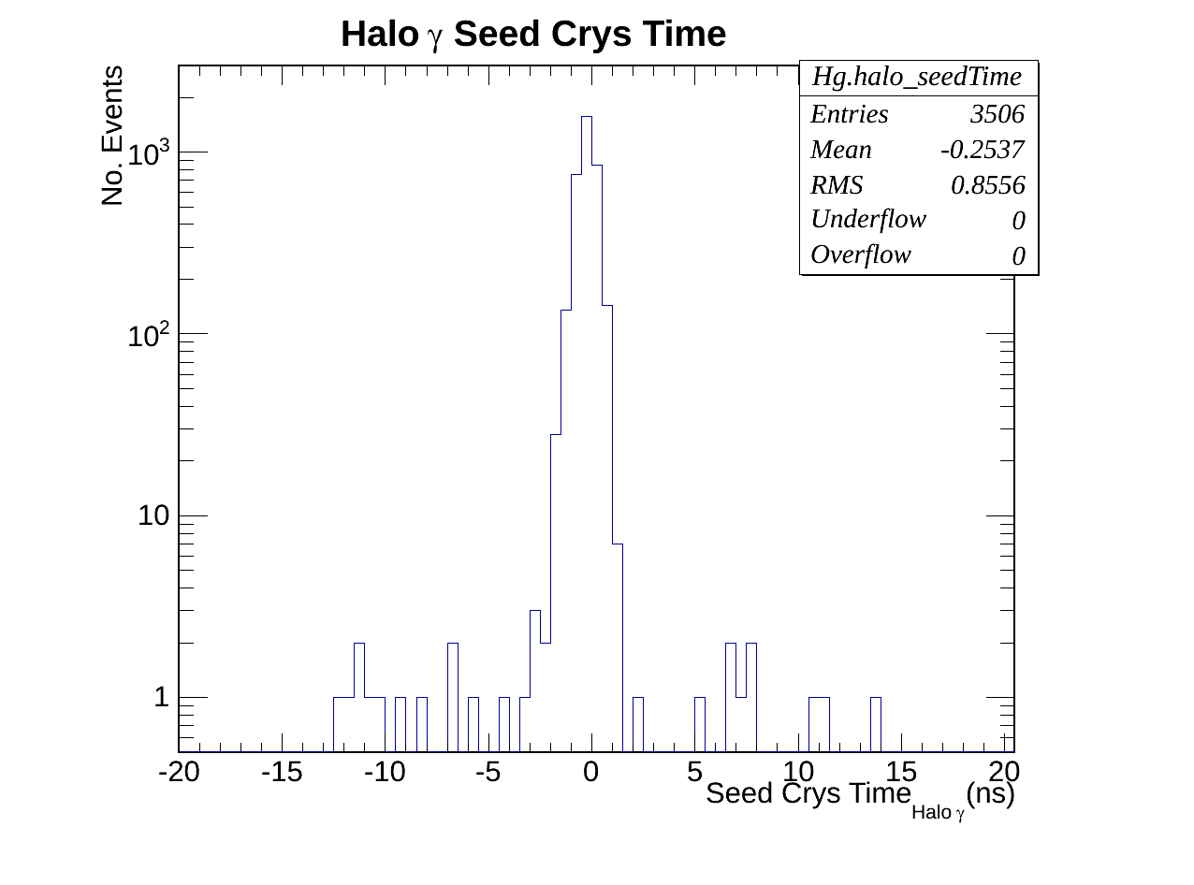
Results
Real photon(left) Vs Halo photon(right)

Slide 19
Halo Rejection & Real Photon Selection Eff
 | Before Selection | After Event Selection 1 | After Event Selection 2 | After Halo Tagging (real photons) | Halo Tagged Photons
Total number of events | 22919173 | 3441614 | 37254 | 33748 | 3506
After event selection 1 and halo tagging:
Halo tagging efficiency : 9.04%
Photo selection efficiency: 90.5%
Not dramatic but we could improve.

Slide 20
Conclusion
CSC Segment tagging seems to be improving halo cleaning ( 9.0% rejection efficiency)
Need to do better (SS or use reduceRechits)
Run on 2012B dataset (with all its complication and find out what happens).
Still have to debug why 2012C dataset has very low statistics( CRAB? ).
Do halo rejection/photon selection efficiency for t < 0, t > 0 and t=0 events or timing bin.

