Slide 1
Displaced Photon Background Studies Update
LL Meeting Nov 02 2012
Tambe E. Norbert, Shin-chuan Kao,Yuichi Kubota, Giovanni Franzoni, Roger Rusack

Slide 2
DataSet & Triggers
DataSets:
/SinglePhoton/Run2012C/Prompt-Reco V1&2
Int Lumi =
HLT Triggers:
HLT_DisplacedPhoton65_CaloIdVL_IsoL_PFMET25

Slide 3
Event Selection
Selection :
Gamma_Pt1(2) > 60(45)GeV/c
|eta| < 2.5, Jet_pt >35 GeV/c
Egamma VL Iso cuts,
Met > 0 GeV
Photon Tagging:
CSC Segment |eta| > 1.6
Halo tagged if dPhi(cscSeg, gamma) < 0.6

Slide 4

What are these?
2012B DataSet
Cosmic Muons? Beam Halo Muons?

Slide 5

What are these?
2012B DataSet
Cosmic Muons? Beam Halo Muons?

Slide 6
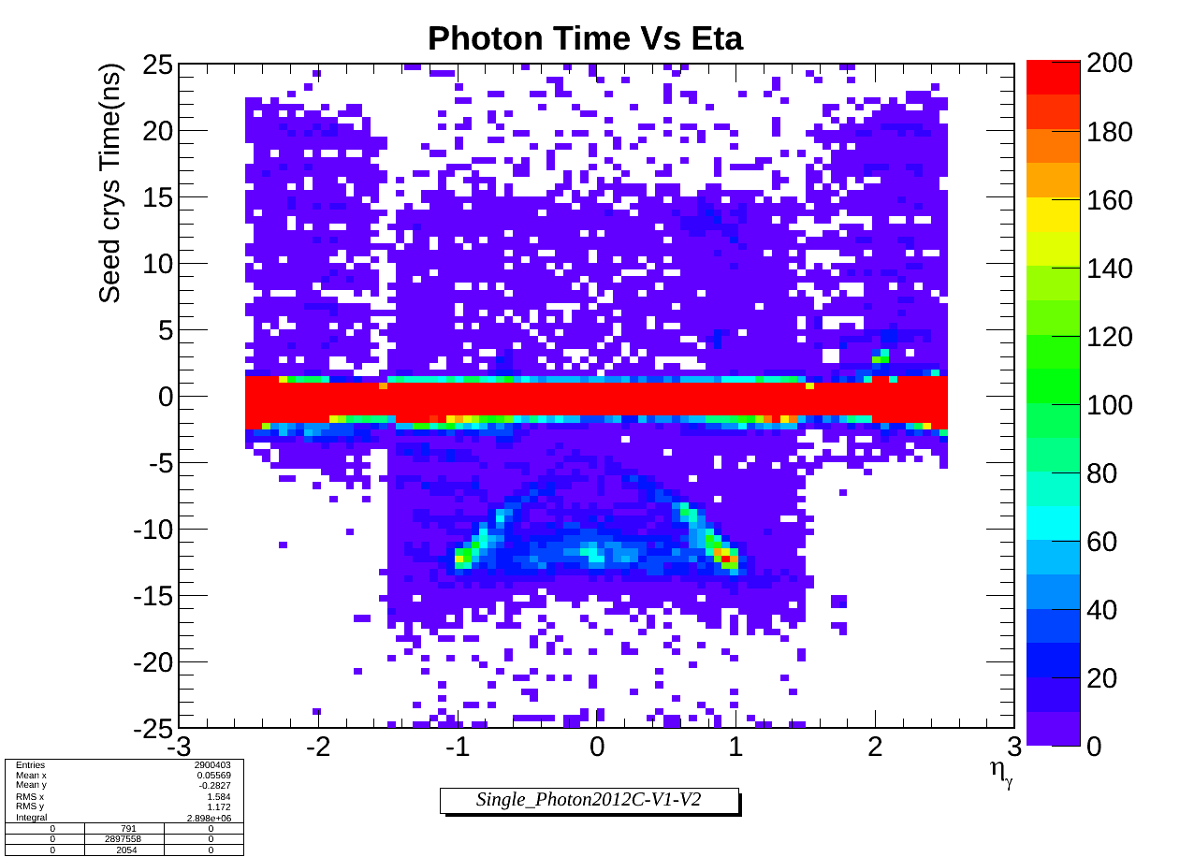
What are these?
2012C DataSet
Cosmic Muons? Beam Halo Muons?

Slide 7
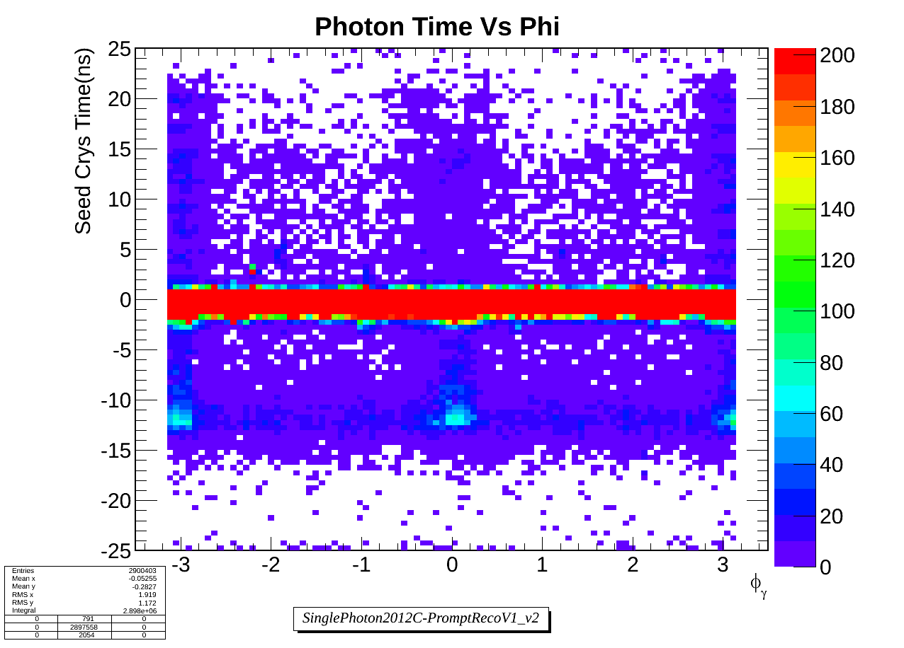
What are these?
2012C DataSet
Cosmic Muons? Beam Halo Muons?

Slide 8
Definition
Egamma Photon :
* Egamma Iso selection criteria + Sminor.
Halo Photon :
Tag as Halo photon if:
* CSC Segment matching: dphi (cscsegment, gamma) < 0.6

Slide 9
2012B DataSet

Slide 10
Halo Rejection & Real Photon Selection Eff
 | Before Selection | After Event Selection 1 | After Event Selection 2 | After Halo Tagging (real photons) | Halo Tagged Photons
Total number of events
After event selection 1 and halo tagging:
Halo tagging efficiency : 9.04%
Photo selection efficiency: 90.5%
Not dramatic but we could improve.

