Slide 1
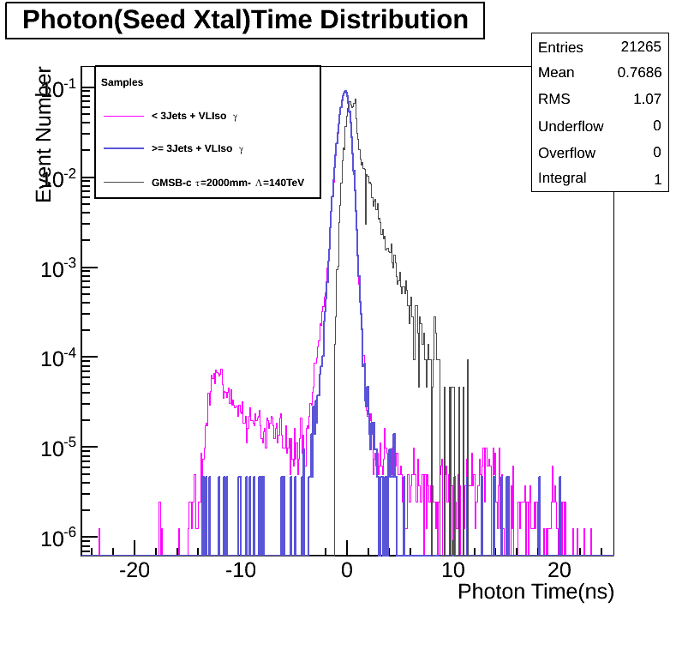
Photon Time
NO MET CUT

Slide 2
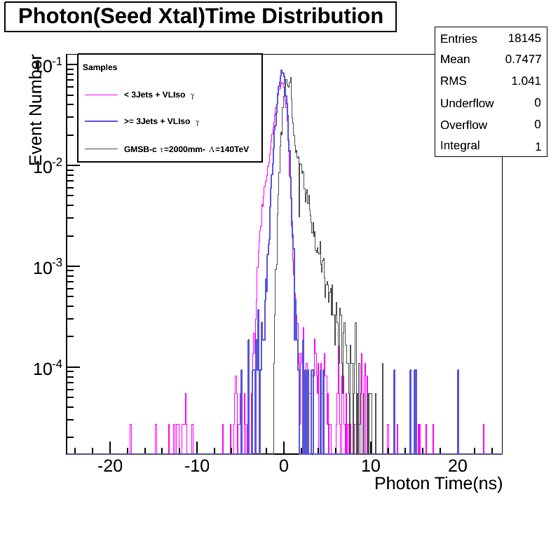
Photon Time
MET > 60GeV

Slide 3
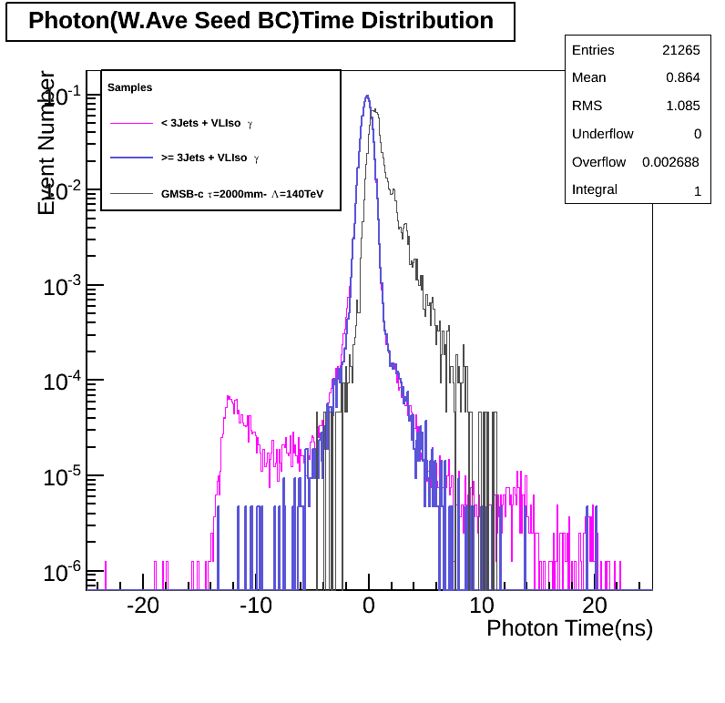
Photon Time
No MET CUT

Slide 4
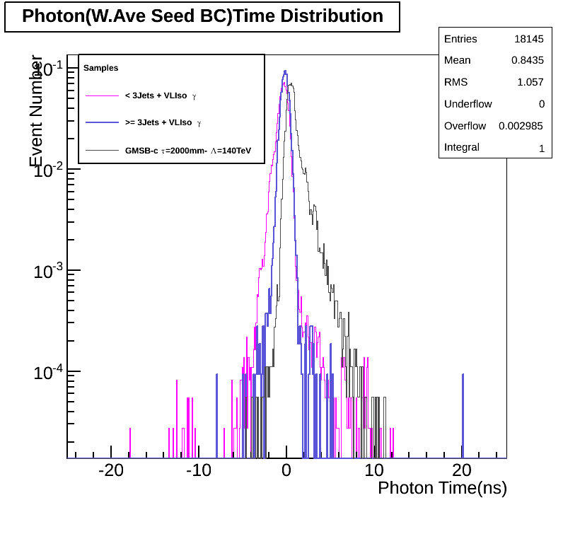
Photon Time
MET > 60GeV

Slide 5
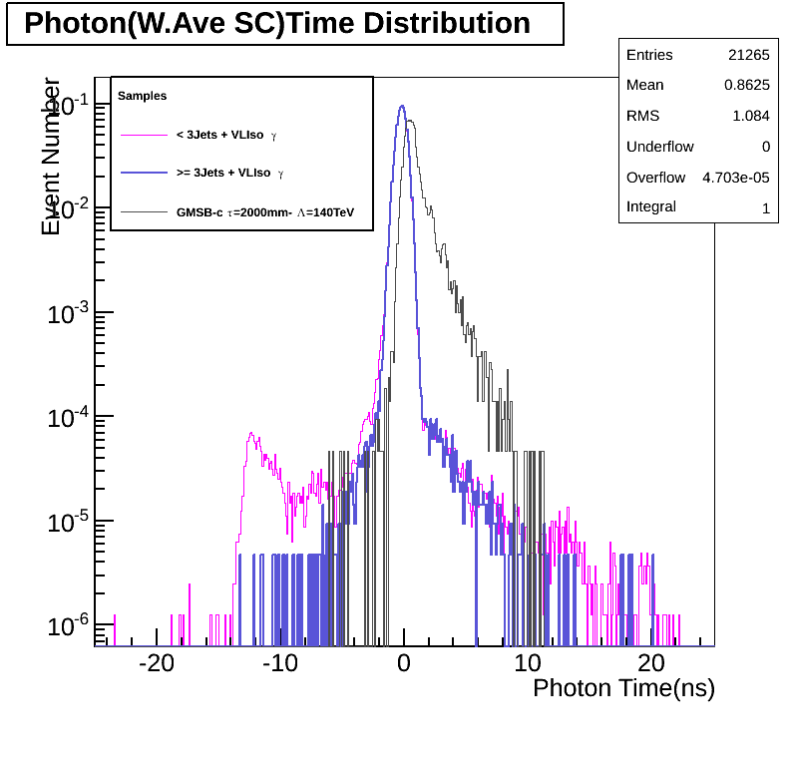
Photon Time
No MET CUT

Slide 6
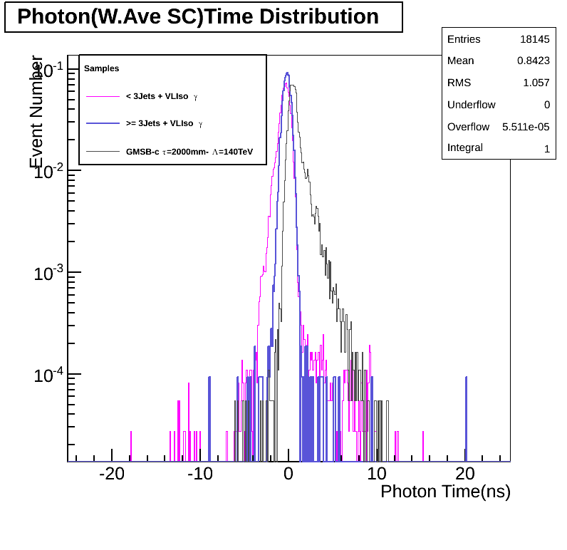
Photon Time
MET > 60GeV

Slide 7
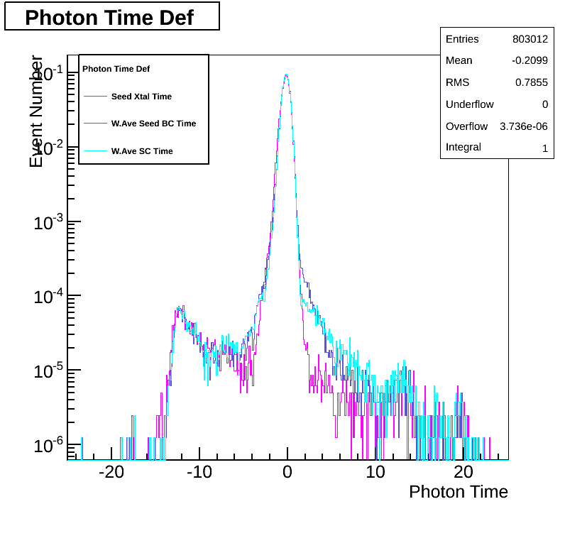
Photon Time Def on A:
No MET CUT

Slide 8
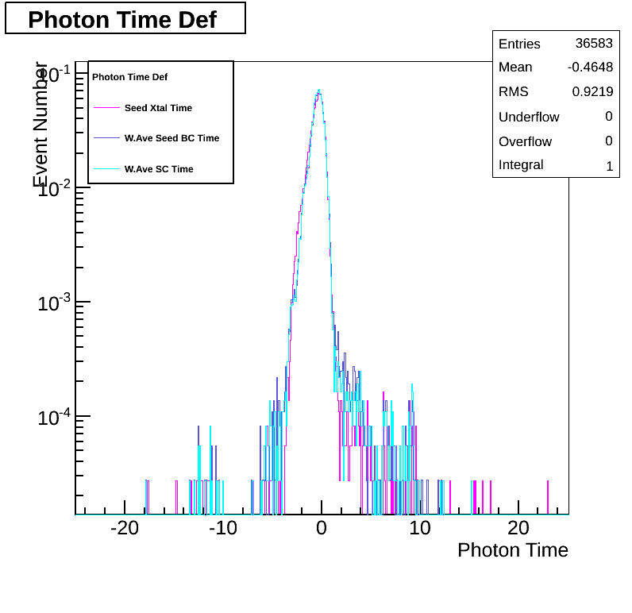
Photon Time Def on A:
MET > 60 GeV

Slide 9
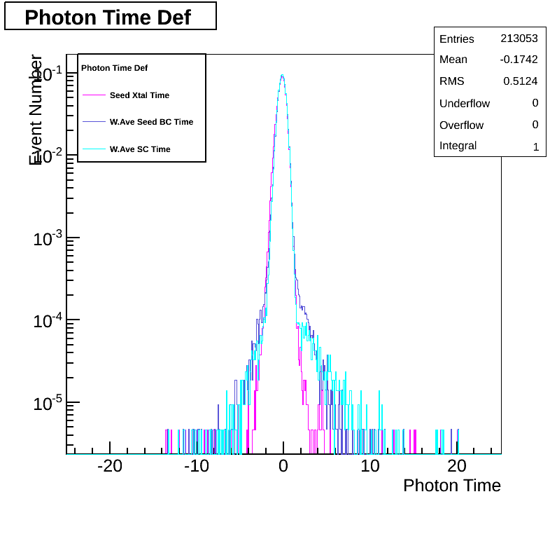
Photon Time Def on B:
No MET CUT

Slide 10
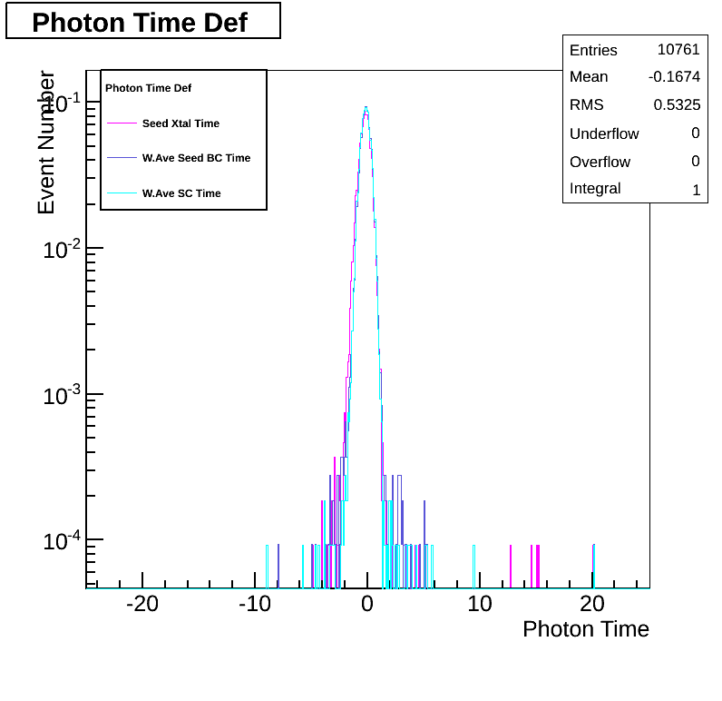
Photon Time Def on B:
MET > 60 GeV

Slide 11
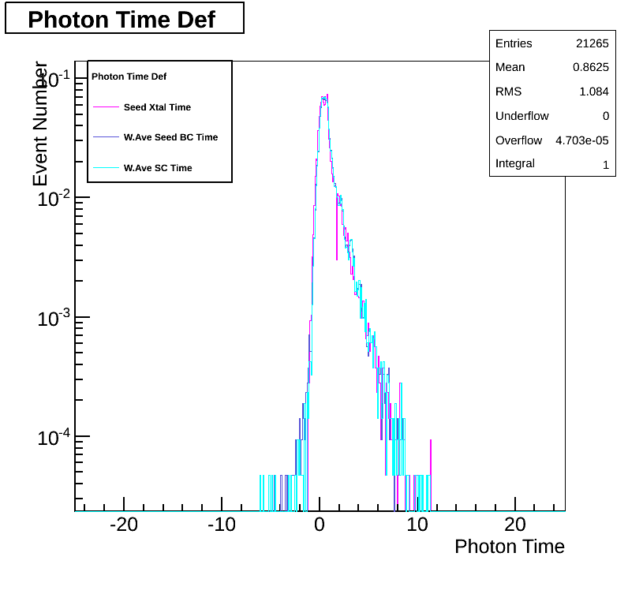
Photon Time Def on MC:
No MET CUT

Slide 12

Photon Time Def on MC:
MET > 60GeV

Slide 13
My Take
Above all, applying the MET > 60GeV, really does reduce the number of “spike-like” events in the photon timing tails.
BUT it does not completely clean out these objects and leaves room for the interpretation that, if the event statistics were high enough, these tails could still reappear even after MET cut have been applied.
It would be nice to look at these distributions for a pure NO MET sample like MC/Data QCD since for GMSB event sample, there does not seem to be much difference on the photon time before and after MET CUT.

