Slide 1
Displaced Photon Background Studies Update
LL Meeting Nov 02 2012
Tambe E. Norbert, Shin-chuan Kao,Yuichi Kubota, Giovanni Franzoni, Roger Rusack

Slide 2
DataSet & Triggers
DataSets:
/SinglePhoton/Run2012C/Prompt-Reco V1&2
Int Lumi =
HLT Triggers:
HLT_DisplacedPhoton65_CaloIdVL_IsoL_PFMET25

Slide 3
Event Selection
Selection :
Gamma_Pt1(2) > 60(45)GeV/c
|eta| < 2.5, Jet_pt >35 GeV/c
Egamma VL Iso cuts,
Met > 0 GeV
Photon Tagging:
CSC Segment |eta| > 1.6
Halo tagged if dPhi(cscSeg, gamma) < 0.6

Slide 4

What are these?
2012B DataSet
Cosmic Muons? Beam Halo Muons?

Slide 5

What are these?
2012B DataSet
Cosmic Muons? Beam Halo Muons?

Slide 6
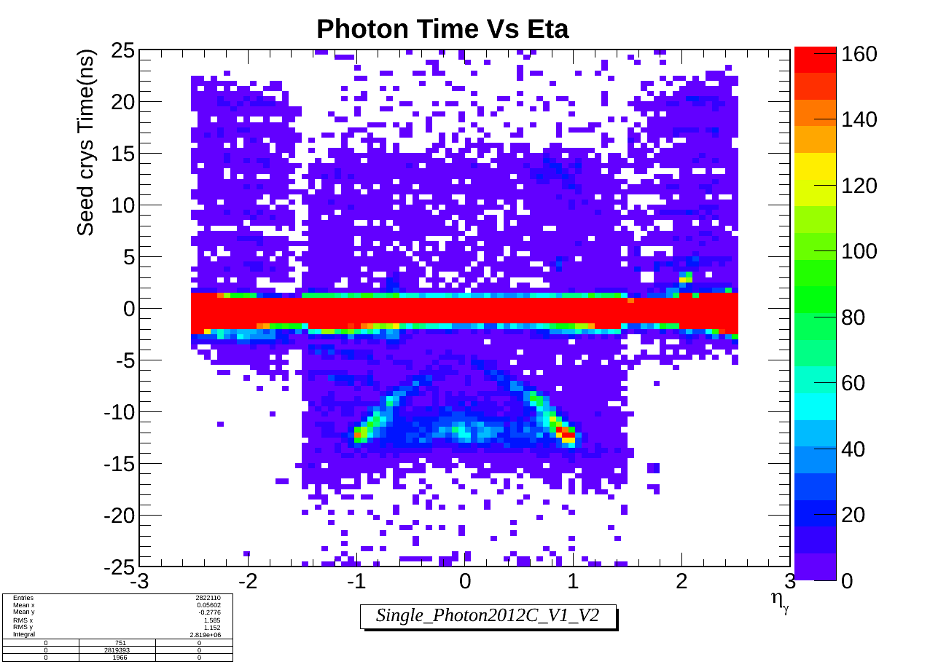
What are these?
2012C DataSet
Cosmic Muons? Beam Halo Muons?

Slide 7
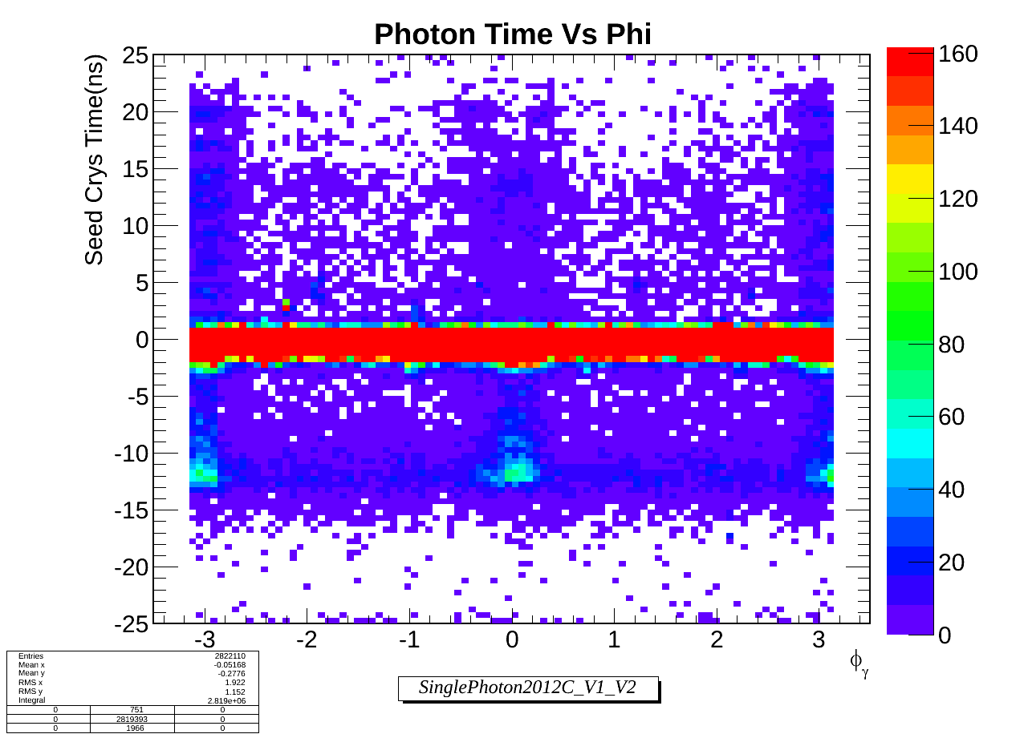
What are these?
2012C DataSet
Cosmic Muons? Beam Halo Muons?

Slide 8
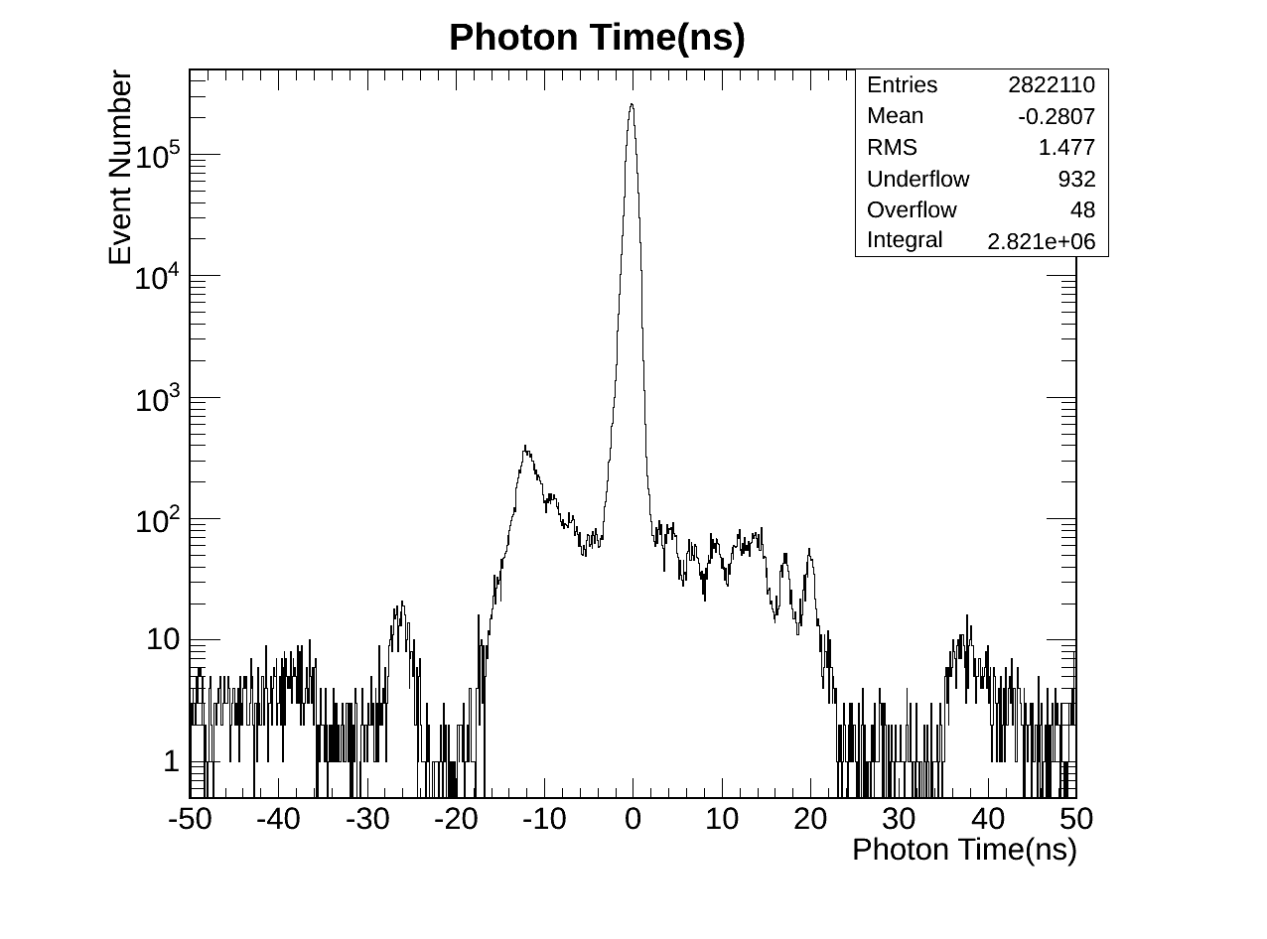
Photon Time
Cosmic, spikes, halo, and what else? All here!

Slide 9
Definition
Egamma Photon :
* Egamma + VL Iso selection criteria + Sminor.
Halo Photon :
Tag as Halo photon if:
* CSC Segment matching: dphi (cscsegment, gamma) < 0.6

Slide 10
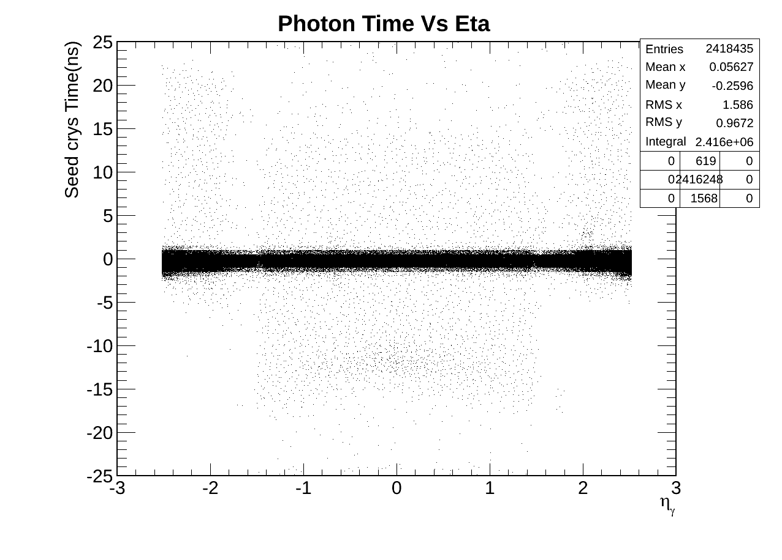
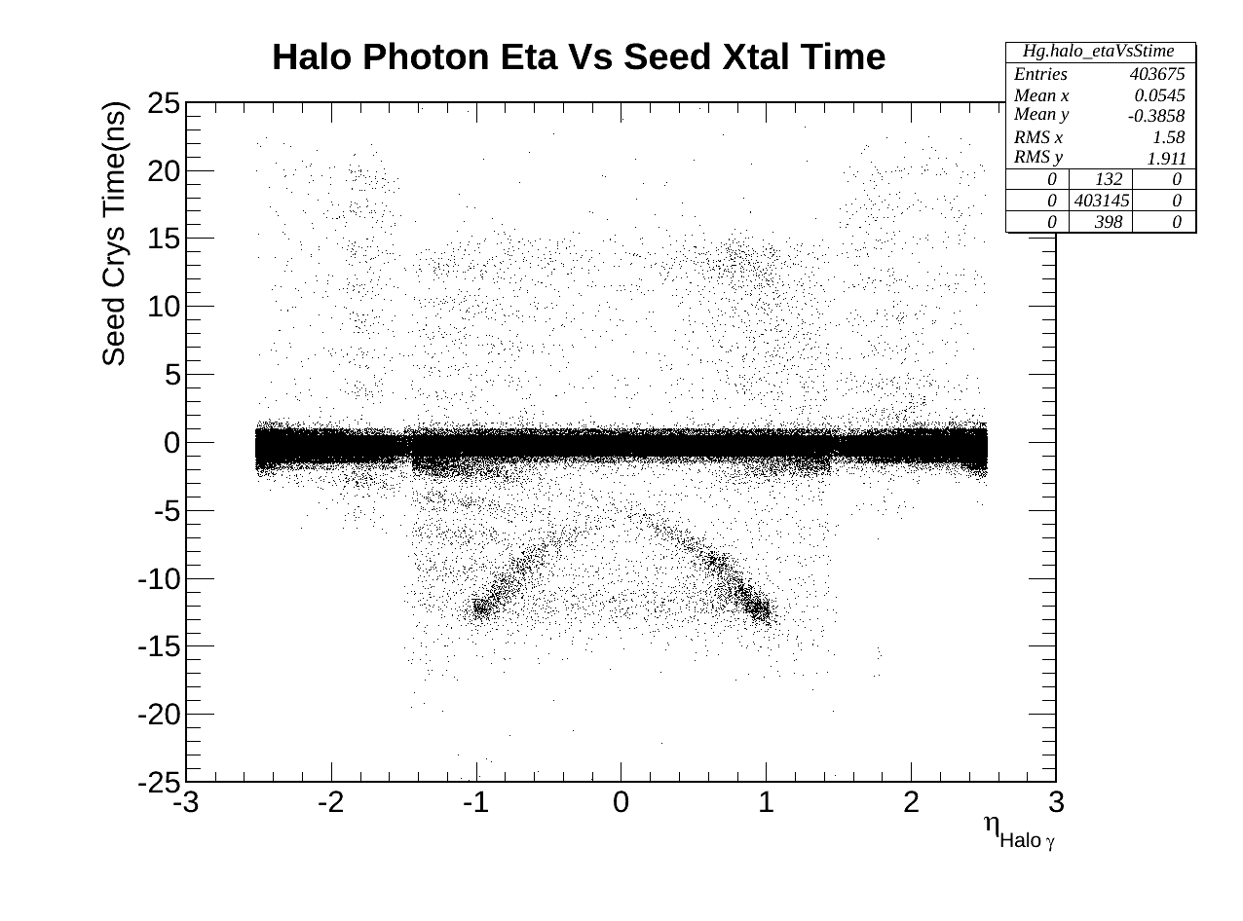
EB & EE Photons
Egamma Photon
Halo Photon

Slide 11
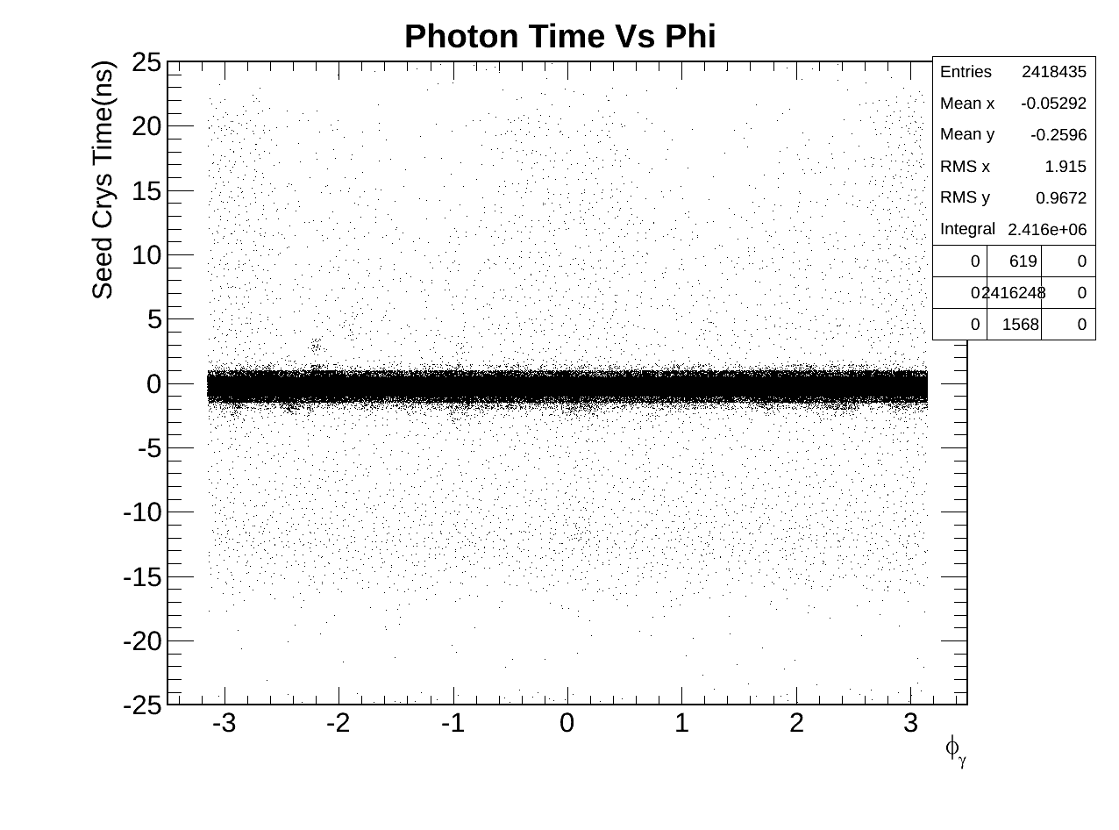
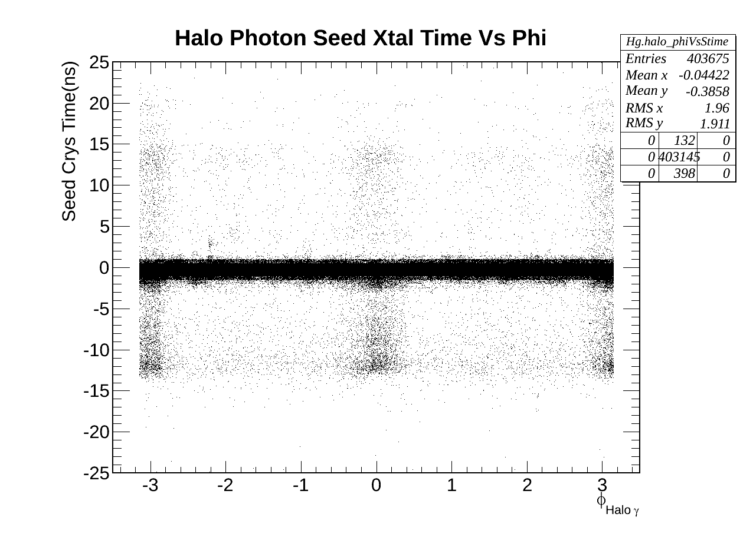
EB & EE Photons
Egamma Photon
Halo Photon

Slide 12
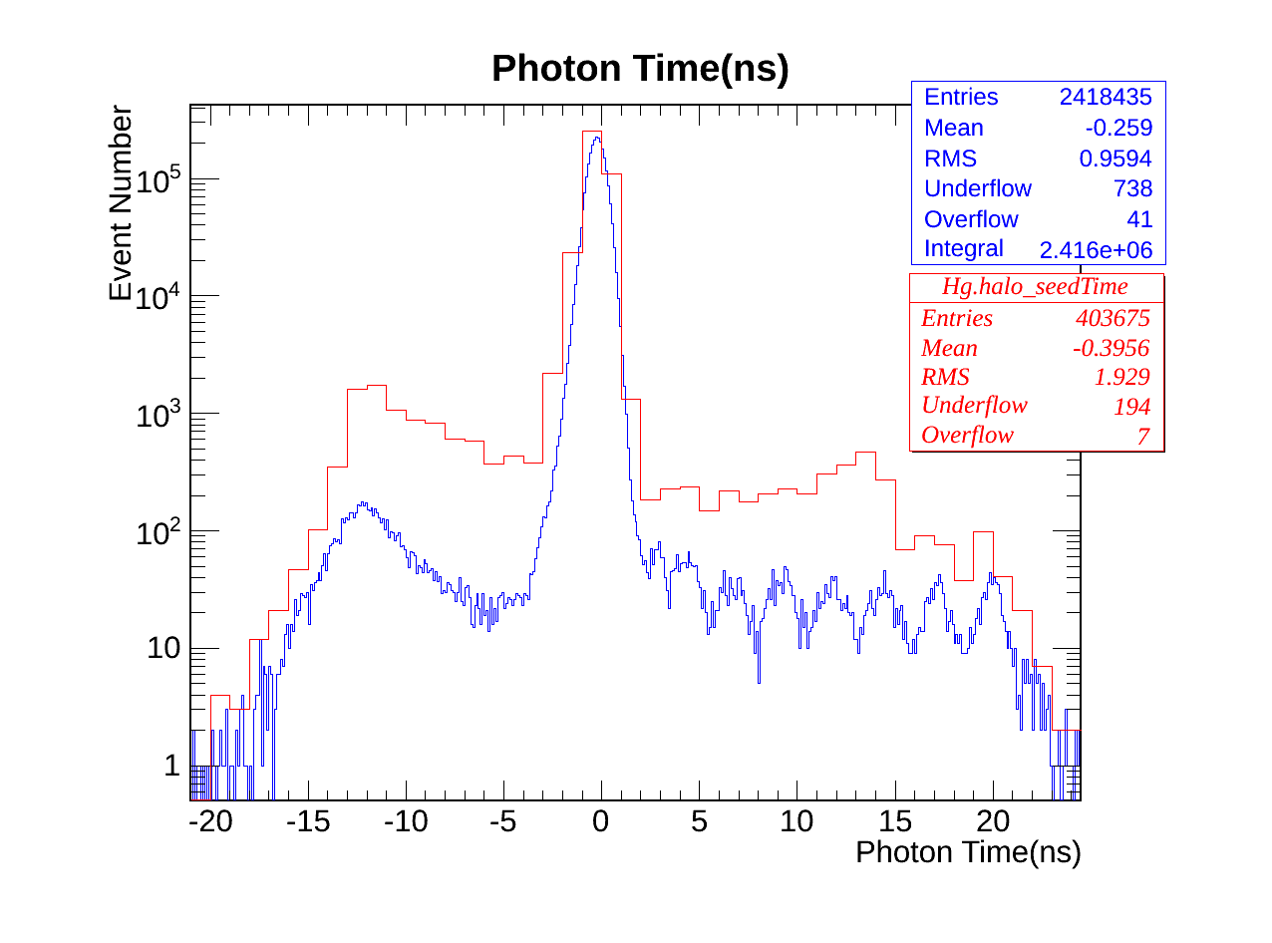
Photon Time EB & EE
Strange Structure in later time

Slide 13
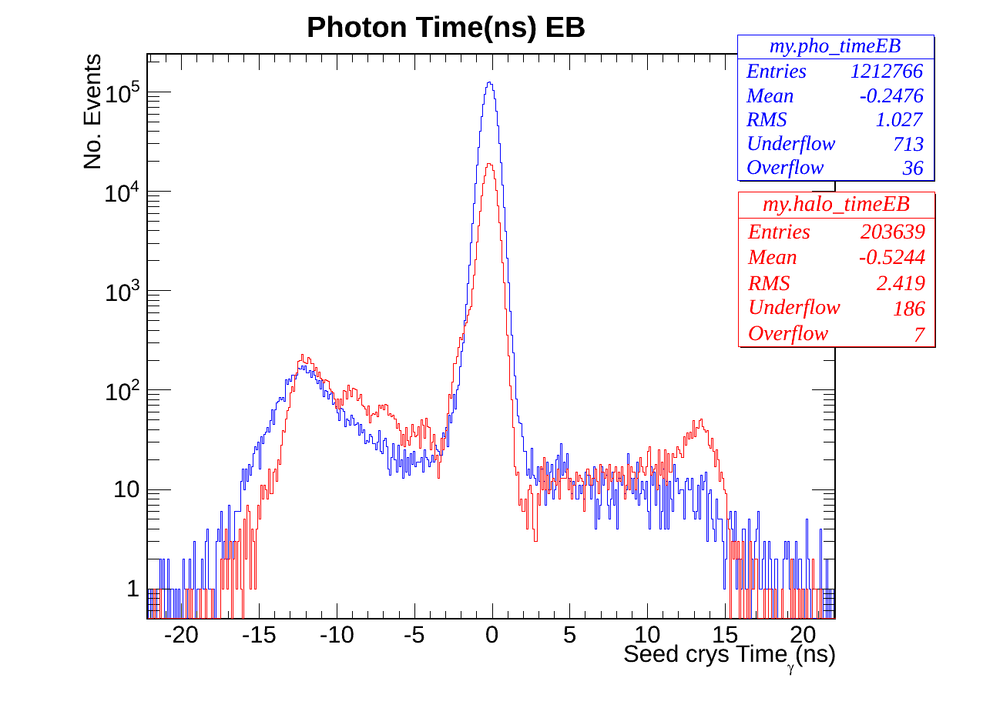
Photon Time EB
Egamma(Blue) Halo(Red) Photon Ecal time

Slide 14
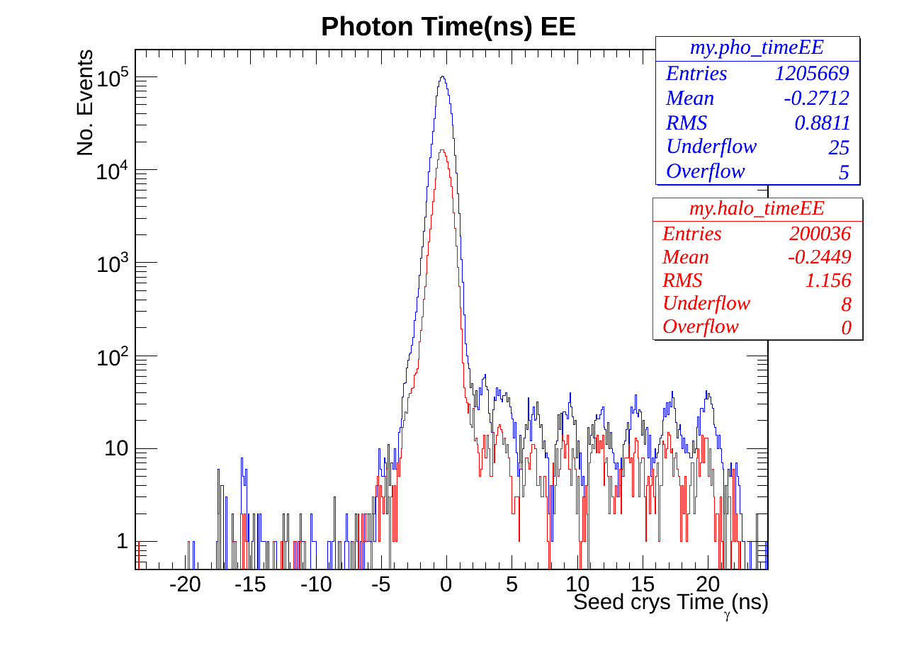
Photon Time EE
Stange EE Timing
Egamma(Blue) Halo(Red) Photon Ecal time

Slide 15
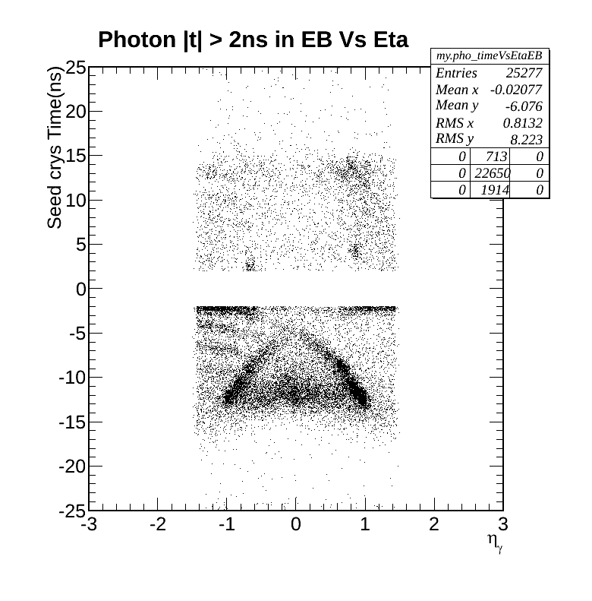
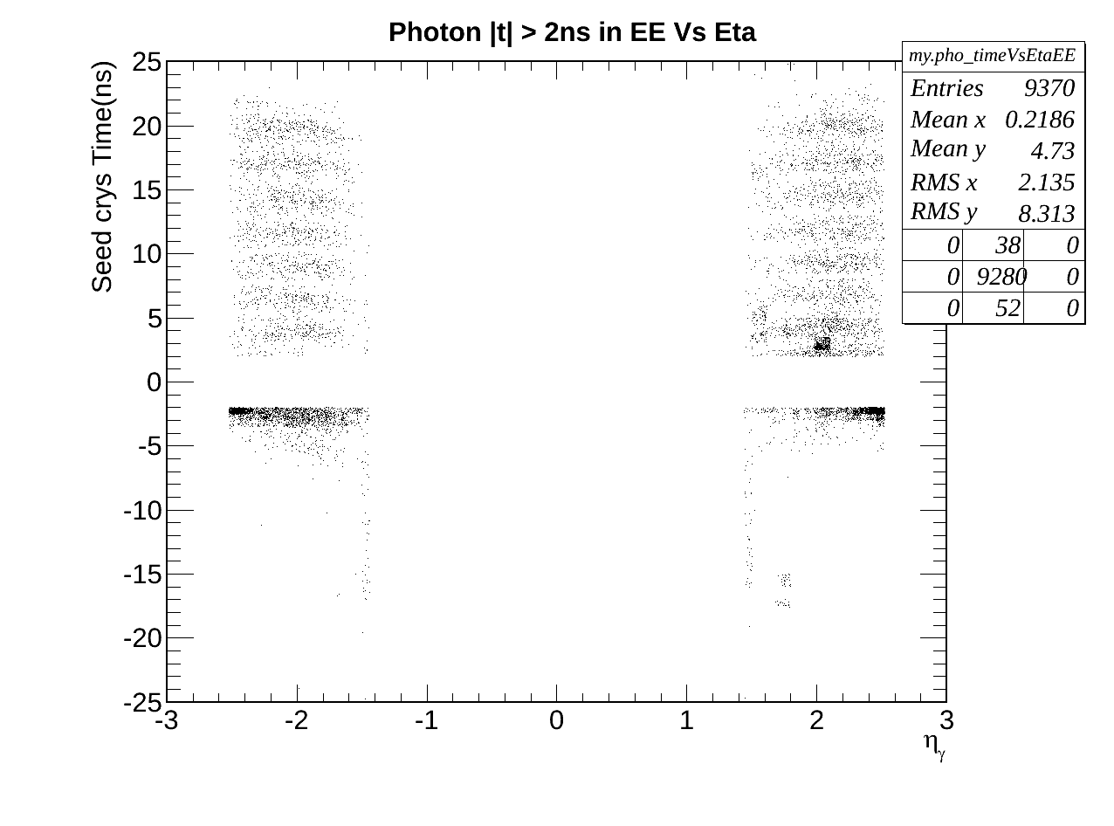
Region of Interest EB & EE
Egamma + Halo Photons time Vs Eta

Slide 16
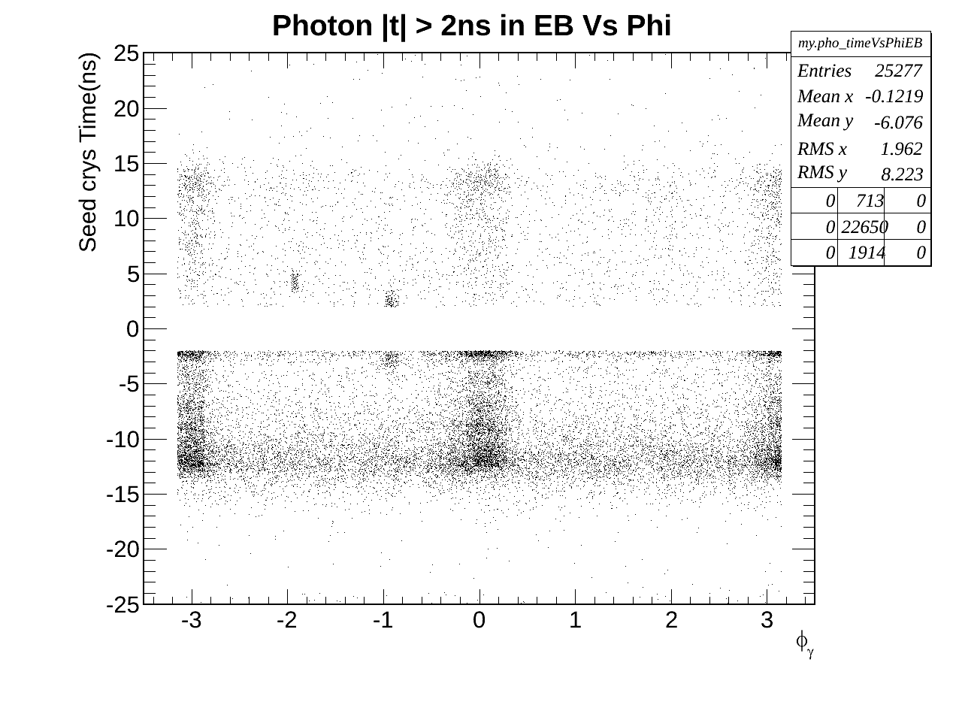
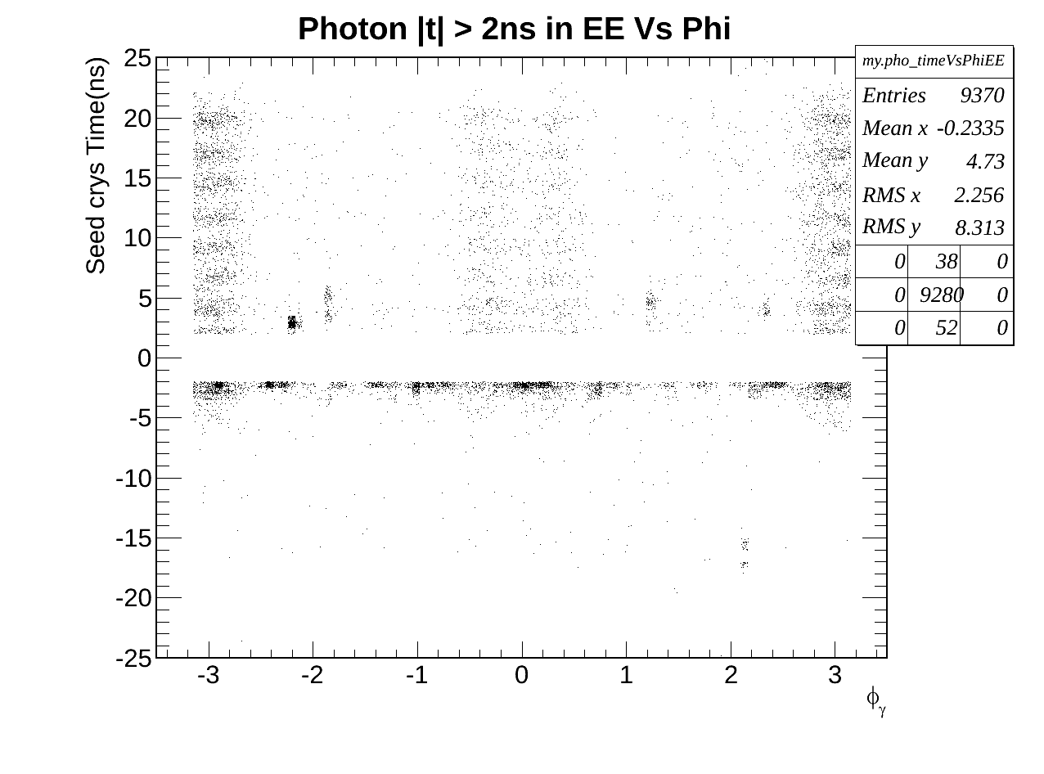
Region of Interest EB & EE
Egamma + Halo Photons time Vs Phi

Slide 17
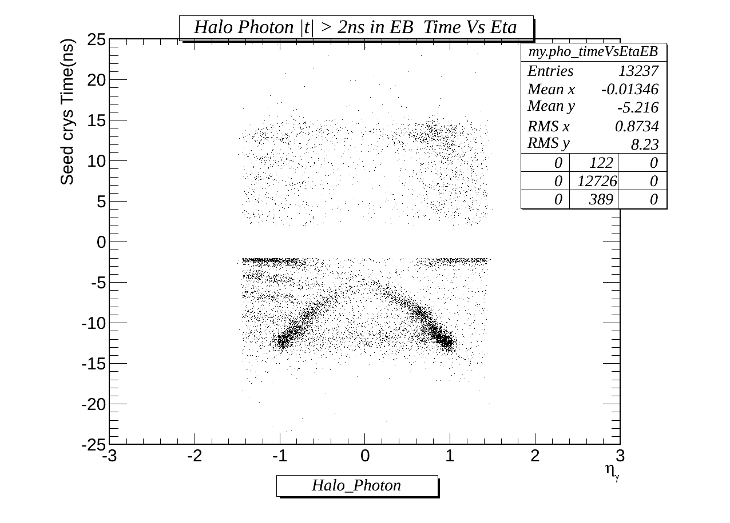
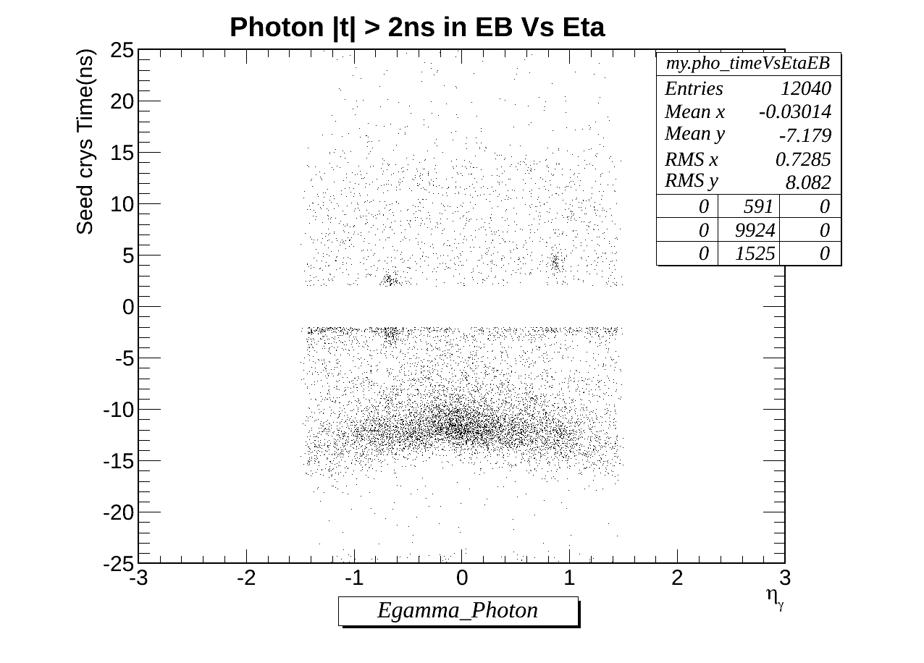
Region of Interest: EB
Spikes?
Beam Halos
Egamma photons
Halo photons.

Slide 18
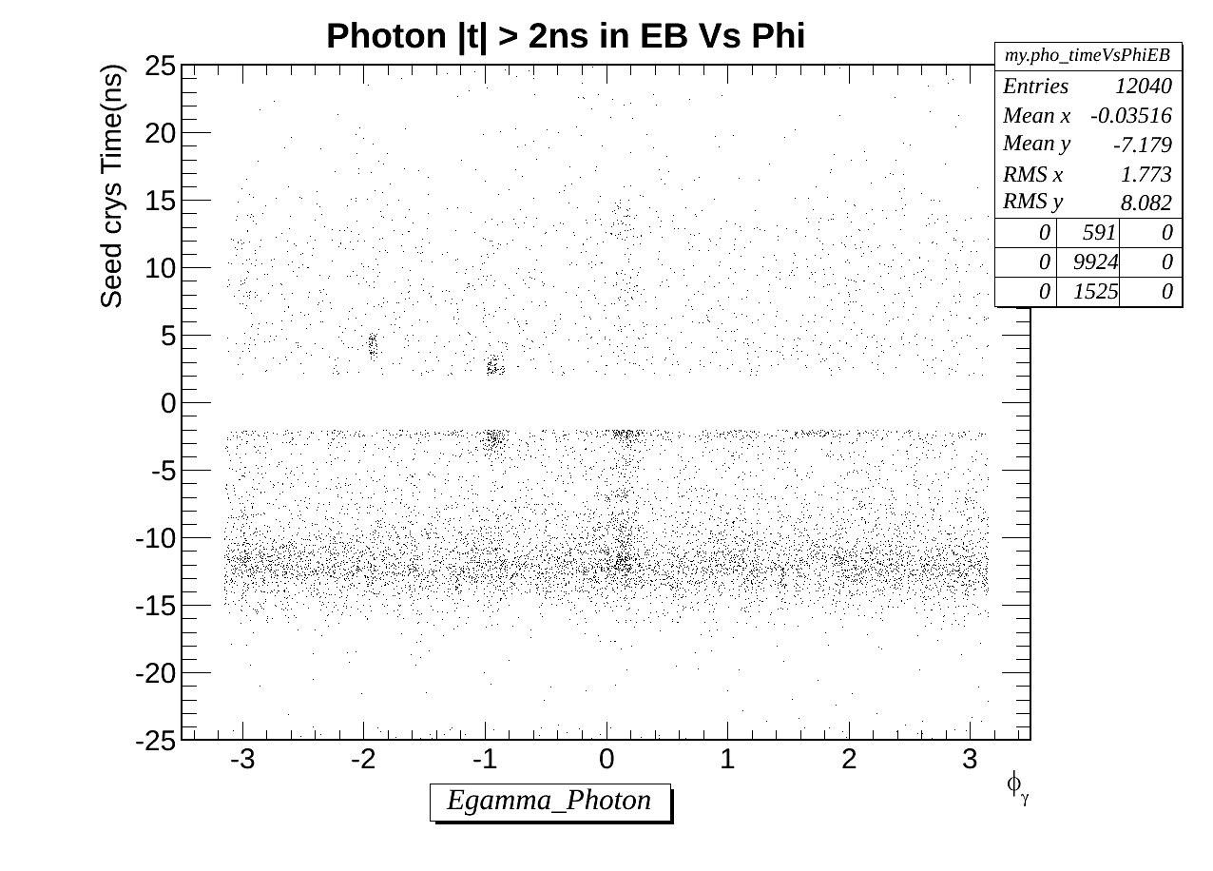
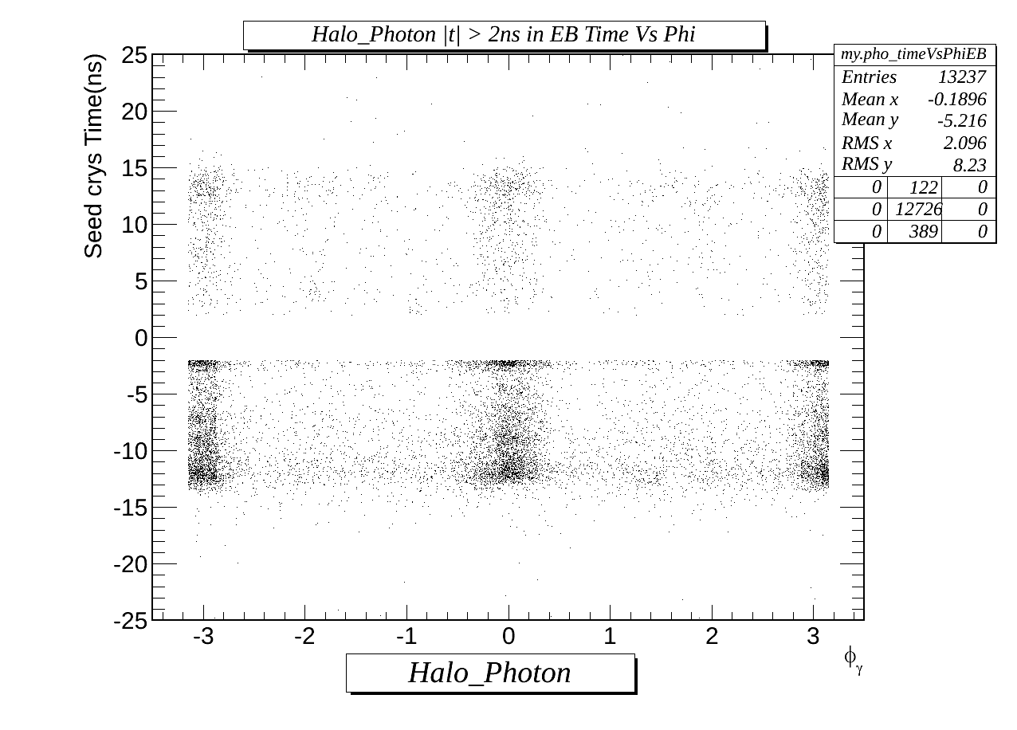
Region of Interest: EB
Spikes?
Beam Halos
Egamma photons
Halo photons.

Slide 19
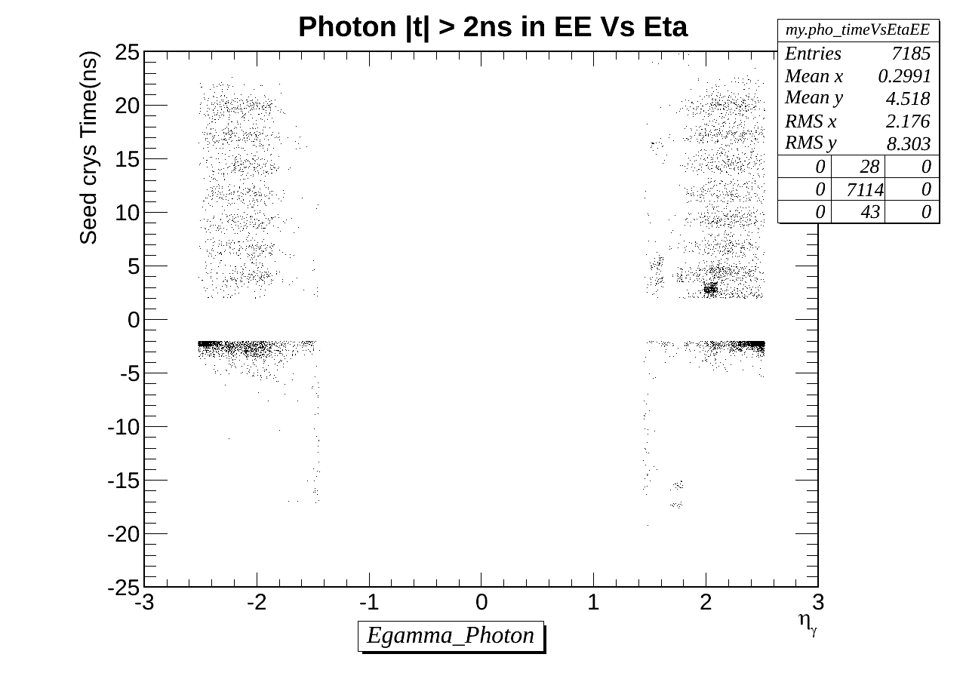
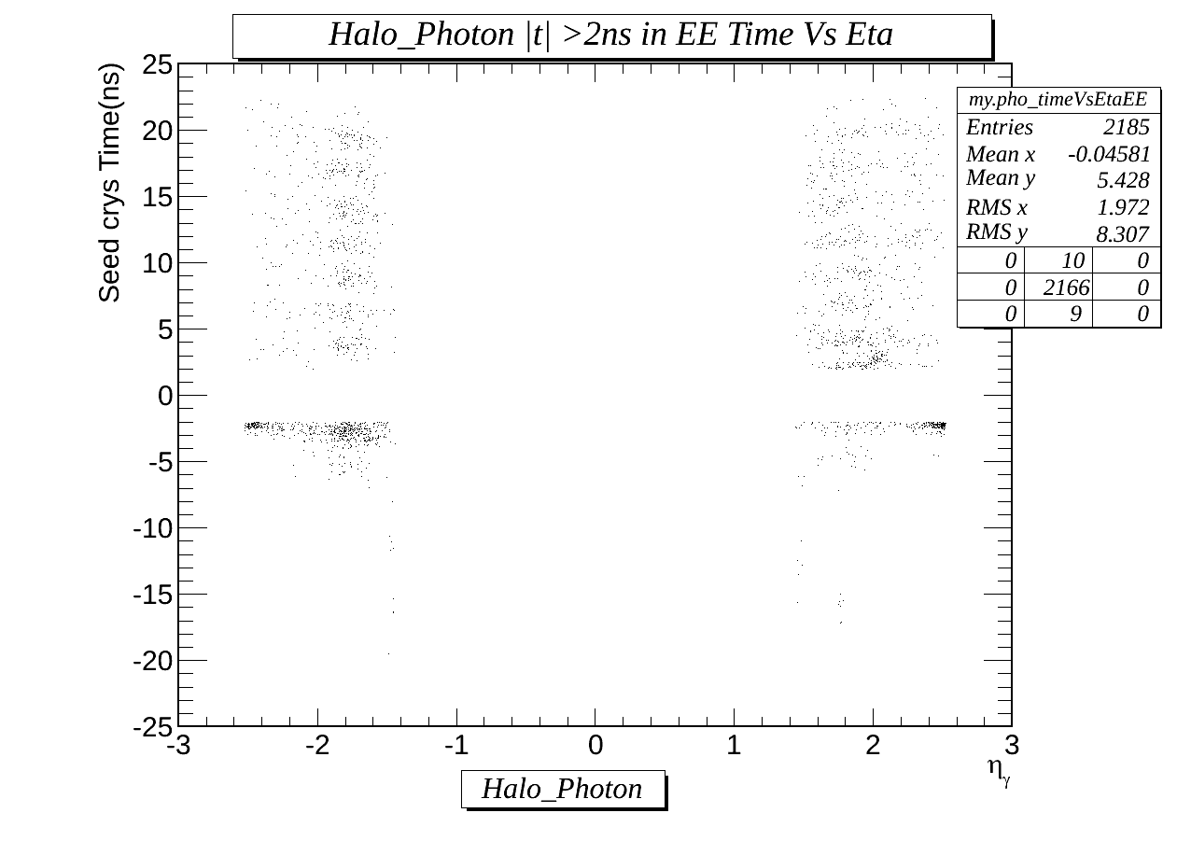
Region of Interest: EE
Few early time Halo photon than in EB
Egamma photons
Halo photons.

Slide 20
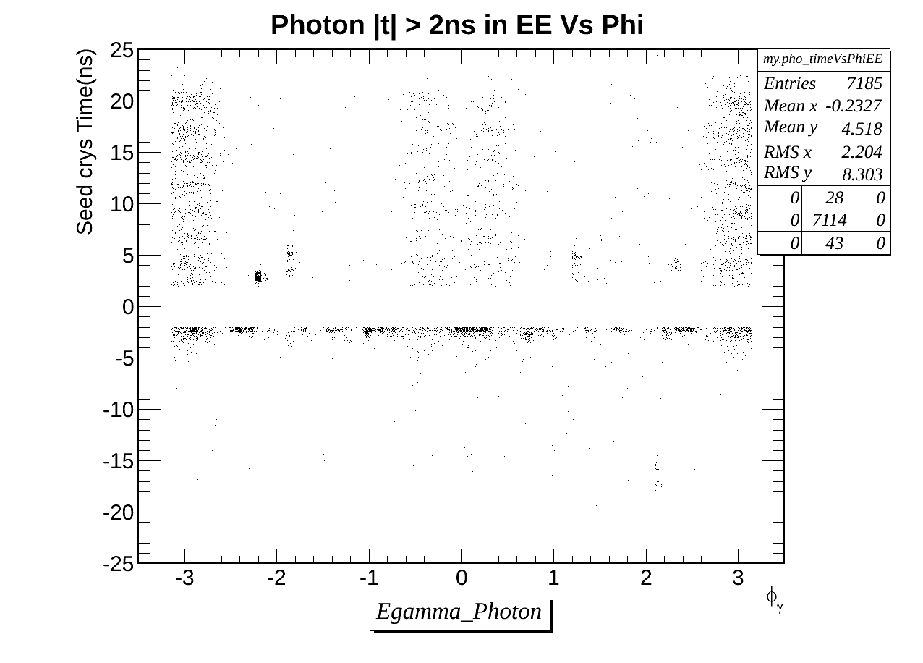
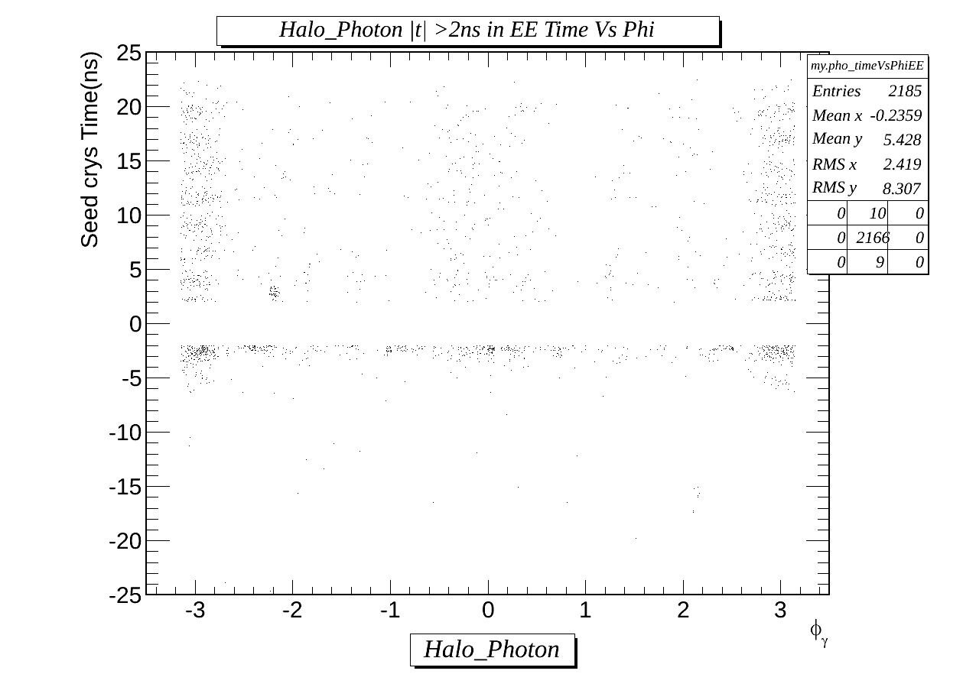
Region of Interest: EE
Few early time Halo photon than in EB
Egamma photons
Halo photons.

Slide 21
Halo Rejection & Real Photon Selection Eff
 | Before Selection | After Event Selection 1 | After Event Selection 2 | After Halo Tagging (real photons) | Halo Tagged Photons
Total number of events
After event selection 1 and halo tagging:
Halo tagging efficiency : 9.04%
Photo selection efficiency: 90.5%
Not dramatic but we could improve.

Slide 22
Conclusion
There are many non trivial background sources to delayed photon time.
CSC tagging can be use to reject beam halo photons with good efficiency, however not every background photon.
Egamma photon Isolation variable cannot reject these background photons( see BU slide).
With current understanding we are ready for Monriond however, discovery will require excellent understanding on these background sources.

Slide 23
BACK UP

Slide 24
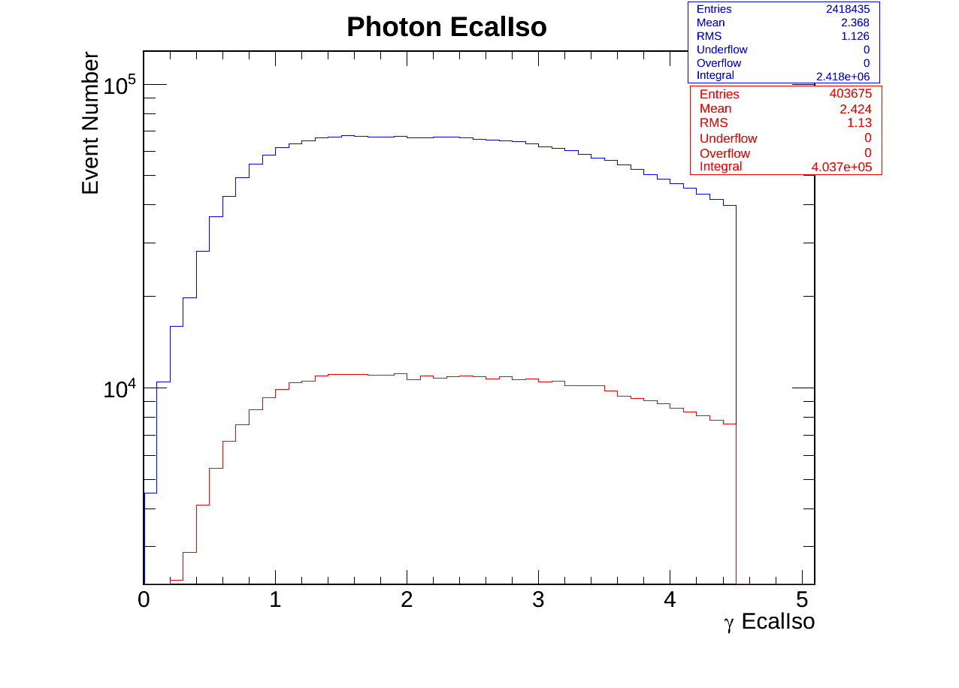
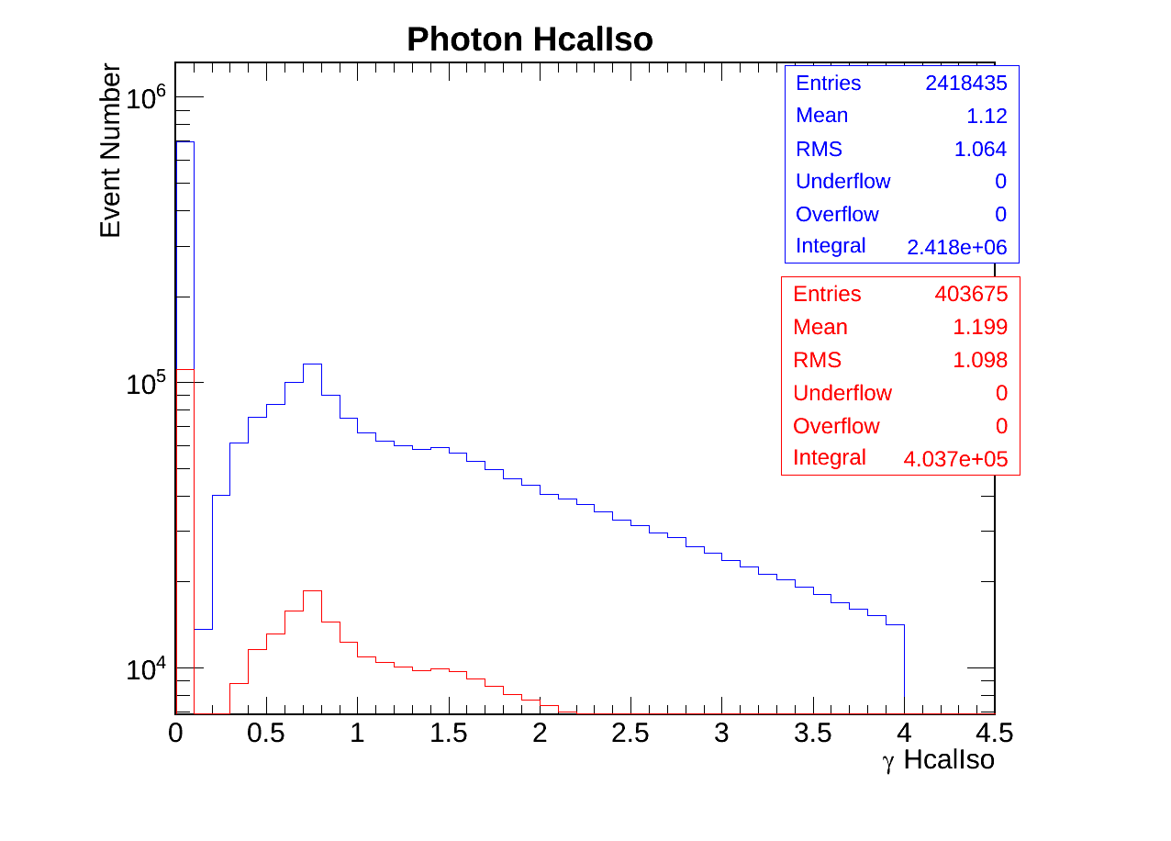
Egamma Photon Id variables.
Ecal Isolation
Hcal Isolation
Egamma(Blue) Halo(Red) Photon

Slide 25
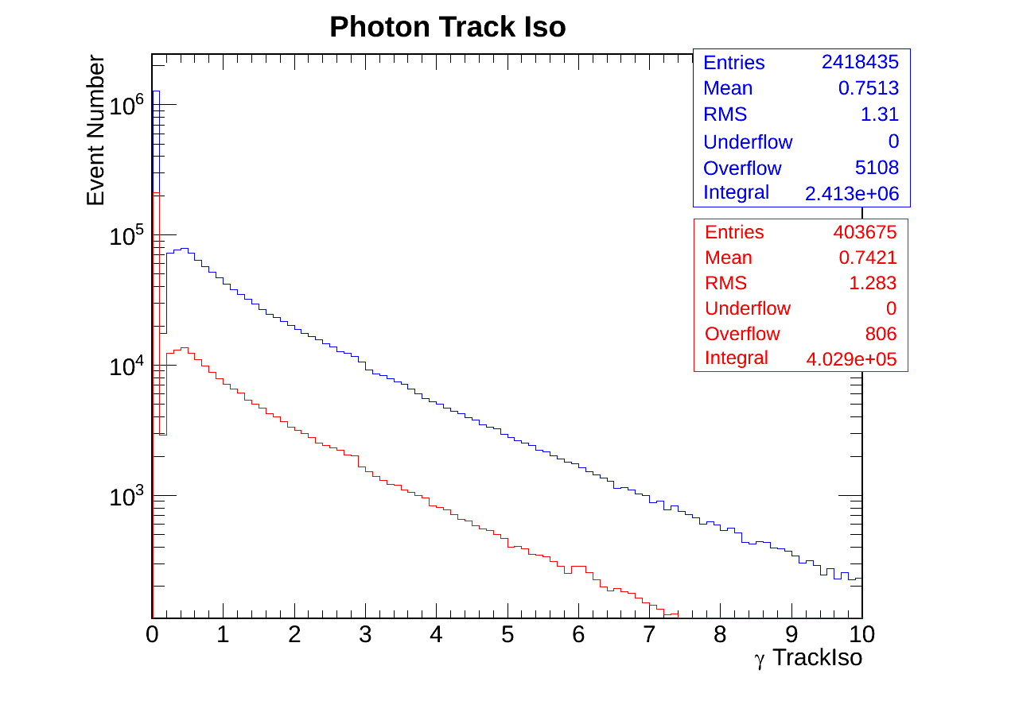
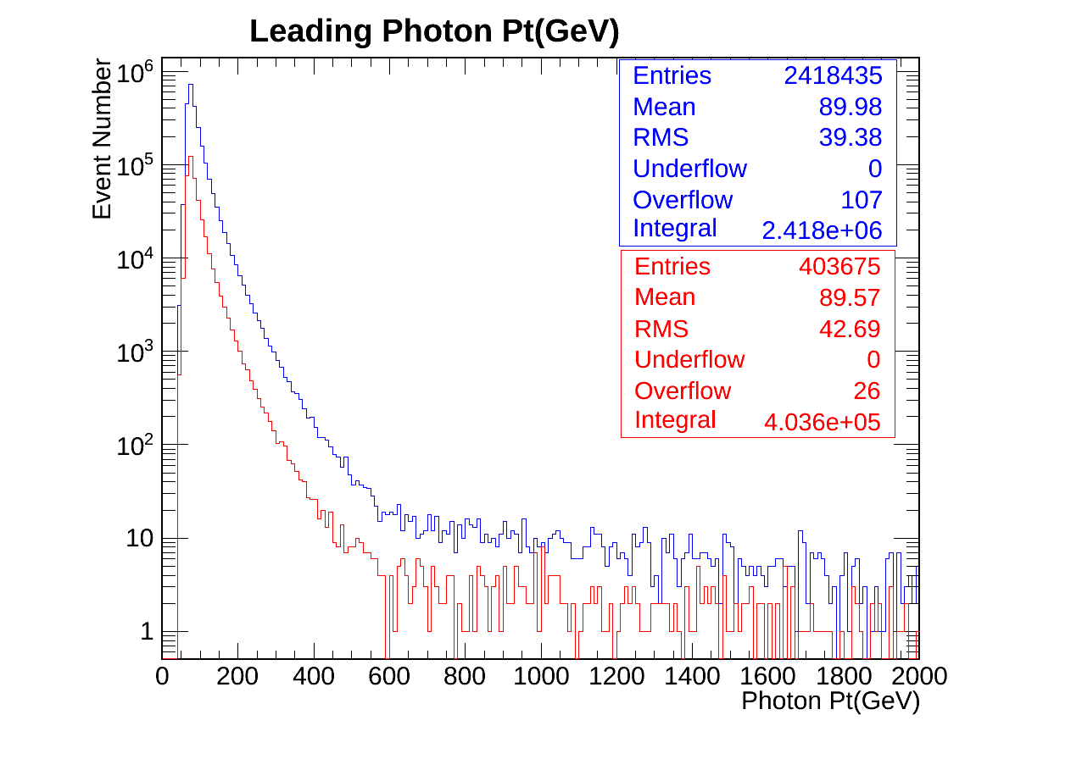
Egamma Photon Id variables.
Track Isolation
Leading photon pt
Egamma(Blue) Halo(Red) Photon

Slide 26
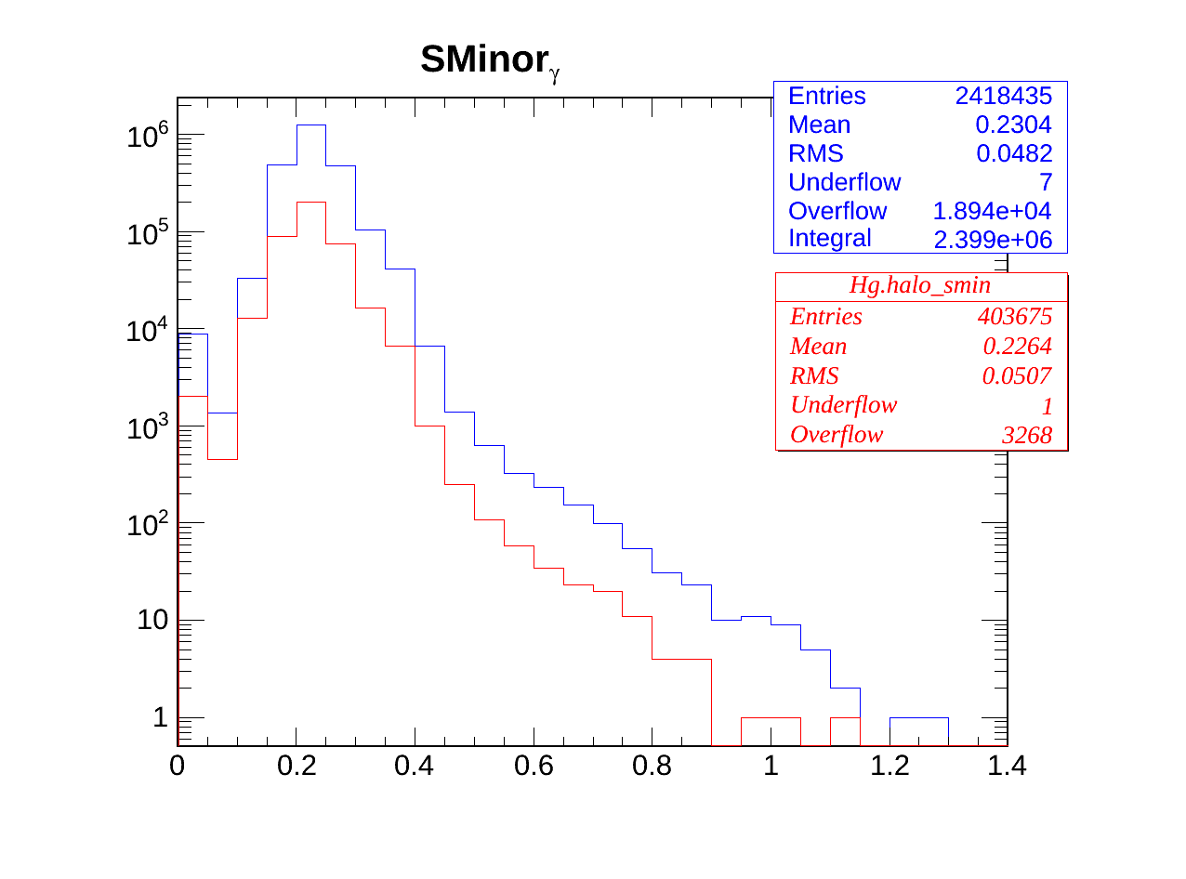
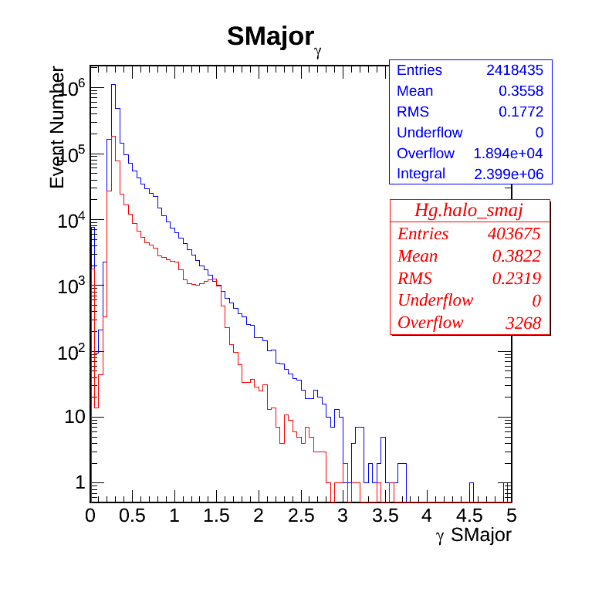
Egamma Photon Id variables.
SMinor
SMajor
Egamma(Blue) Halo(Red) Photon

Slide 27
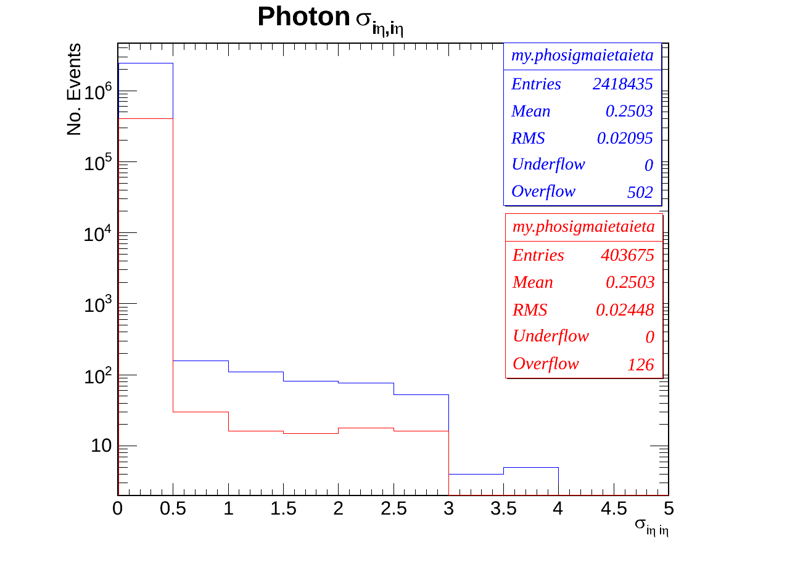
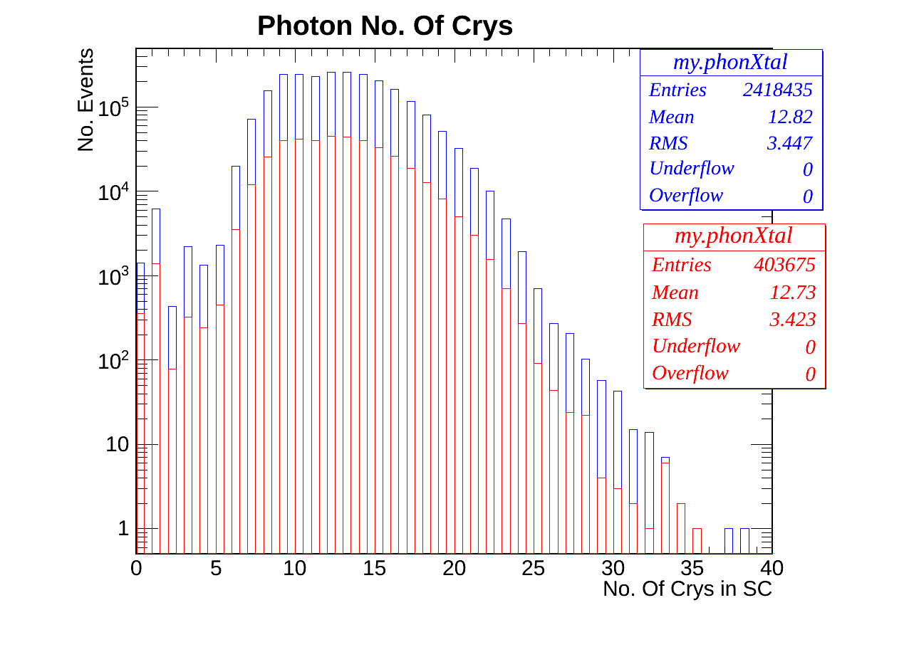
Egamma Photon Id variables.
Sigma Ieta Ieta
Number of Crystals in BC
Egamma(Blue) Halo(Red) Photon

Slide 28
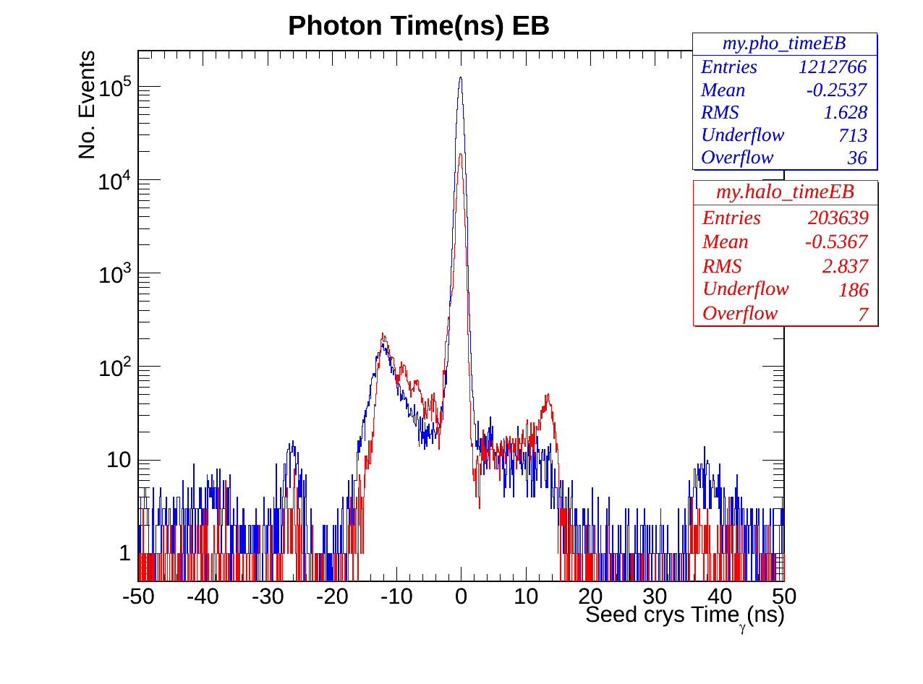
Photon Time EB
Egamma(Blue) Halo(Red) Photon Ecal time

Slide 29
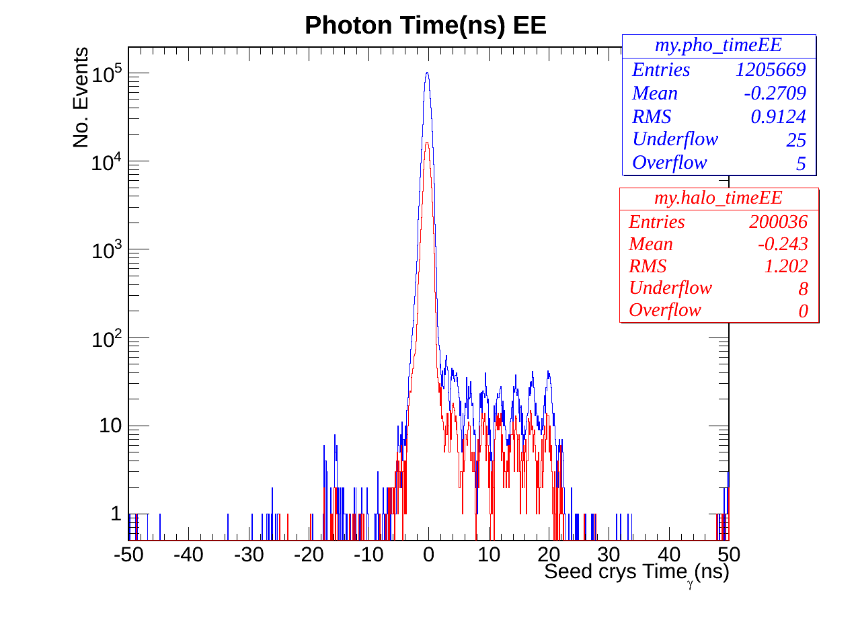
Photon Time EE
Stange EE Timing
Strange structure occurs within 0 and 20ns.

