Slide 1
Displaced Photon Background Studies Update
LL Meeting Nov 02 2012
Tambe E. Norbert, Shin-chuan Kao,Yuichi Kubota, Giovanni Franzoni, Roger Rusack

Slide 2
DataSet & Triggers
DataSets:
/SinglePhoton/Run2012C/Prompt-Reco V1&2
Int Lumi =
HLT Trigger:
HLT_DisplacedPhoton65_CaloIdVL_IsoL_PFMET25

Slide 3
Signal from Background
Ecal Time Calibration:
but
2 Types of Backgrounds
Collision :
Non-Collision:
Left B1 w/ Right B2
Left B2 w/ Right B1
LeftB2 w/ Right B2
Beam halo (beam dump or P+Gas -> muons which Brem/shower in ECAL.
Cosmic muons.

Slide 4
Event Selection
Selection :
Gamma_Pt1(2) > 60(45)GeV
|eta| < 2.5, Jet_pt > 35 GeV
Egamma VL Iso cuts,
MET > 0 GeV
Photon Tagging:
CSC Segment |eta| > 1.6
Halo tagged if dPhi(cscSeg, gamma) < 0.6

Slide 5

Photon time vs Phi
Cosmic muons?
Observed in 2012B dataset
High intensity in
Phi = 0 +/- pi
Most photons arriving early in Ecal time indicate source is not unique.
Beam halo muons?

Slide 6

Photon time vs Eta
Cosmic muons?
Intense at impact point in EB then slowly decreases towards IP.
Eta dependence in early Ecal time.
Surely photons do not all come from a unique source.
Beam halo muons?

Slide 7
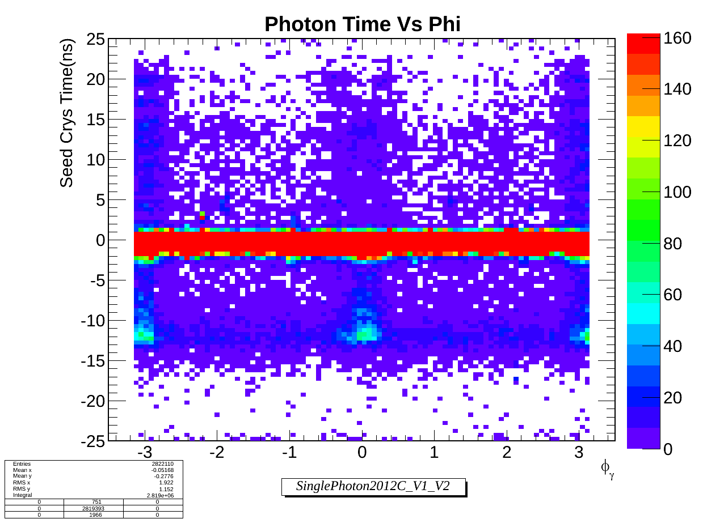
Photon time vs Phi
Cosmic muons?
Similar phenomenon in 2012C dataset.
Increased intensity with luminosity.
Phi dependence in Ecal time of photons.
Beam halo muons?

Slide 8
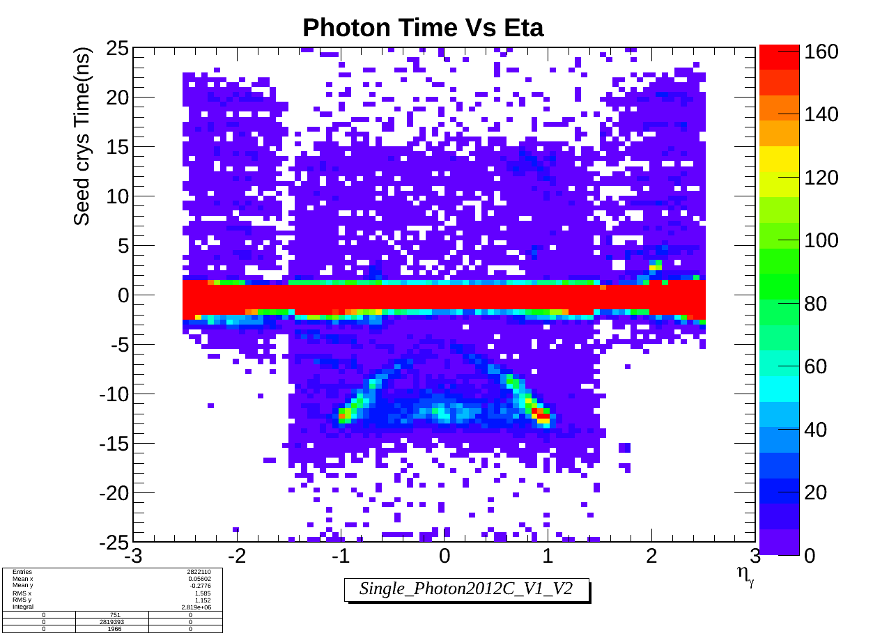
Photon time vs Eta
Cosmic muons?
Similar phenomenon in 2012C dataset.
Increased intensity with luminosity.
Must be spikes failing spike cleaning.
Beam halo muons?

Slide 9
Definition
Egamma Photon :
* Egamma + VL Iso selection criteria + Sminor.
Halo Photon :
Tag as Halo photon if:
* CSC Segment matching: dphi (cscsegment, gamma) < 0.6

Slide 10
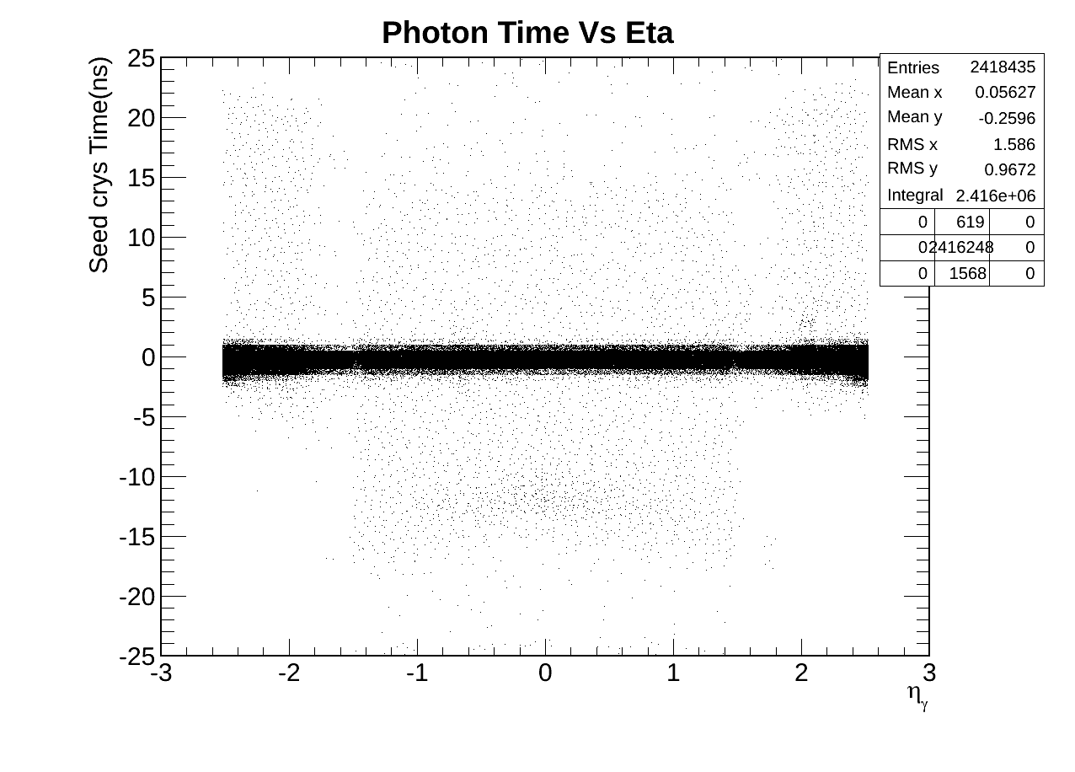
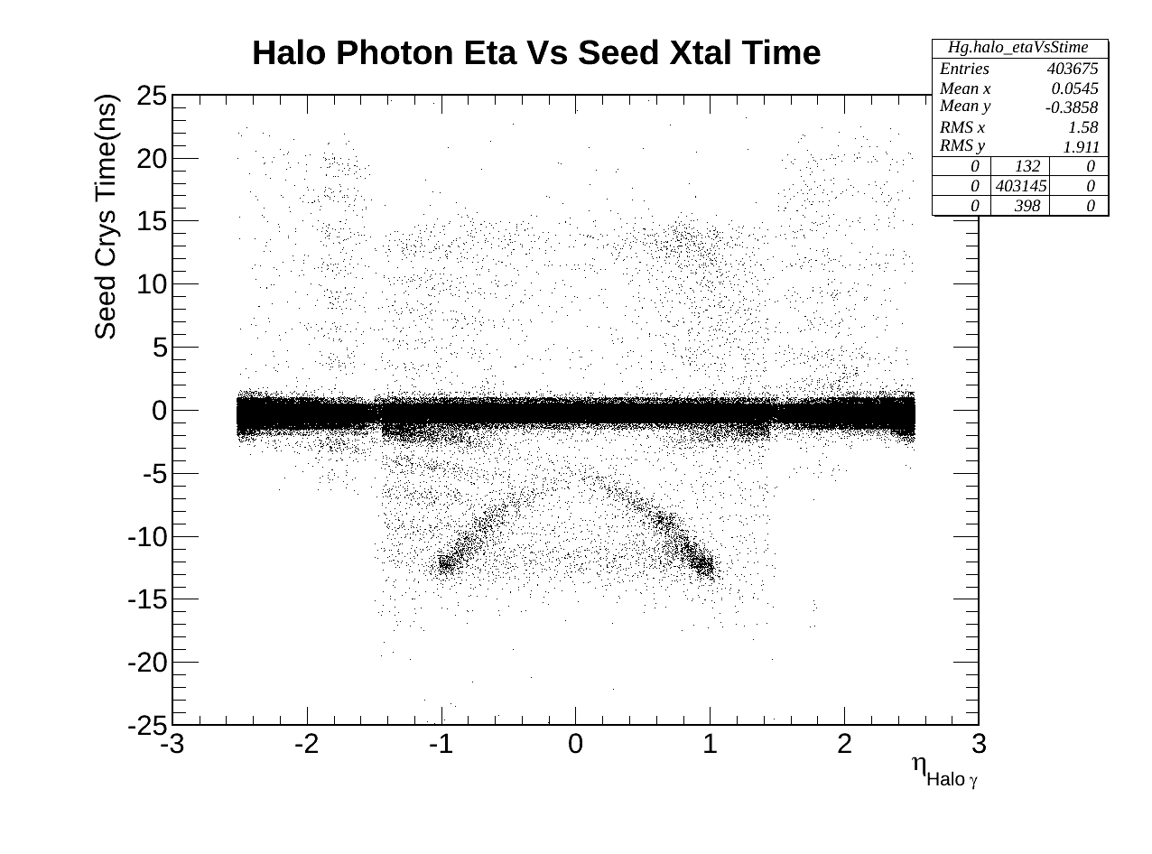
EB & EE Photons
Egamma Photon
Halo Photon

Slide 11
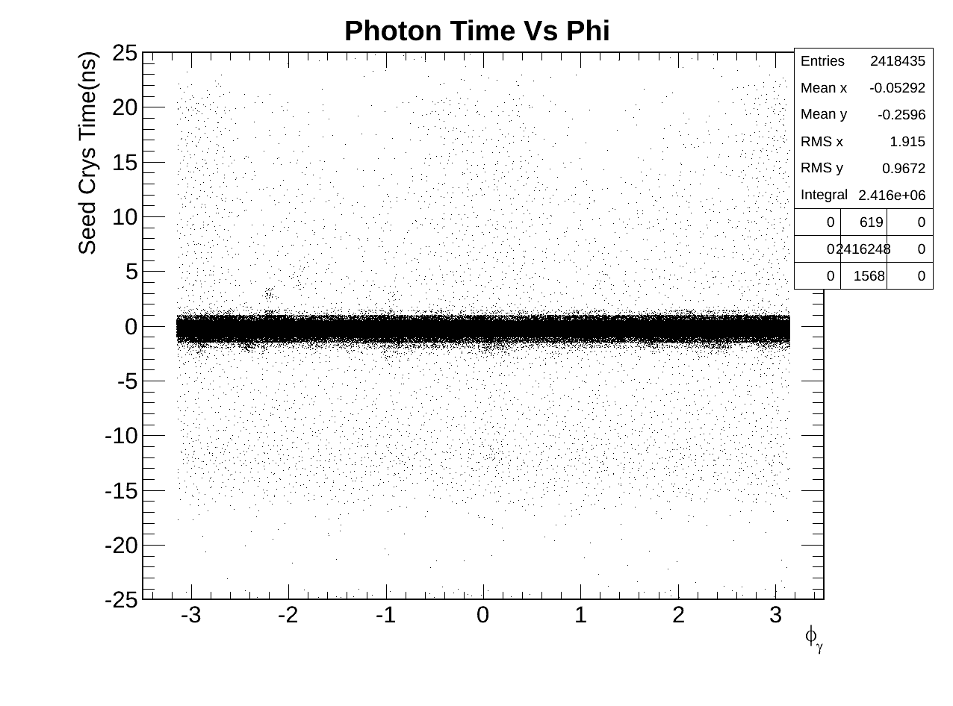
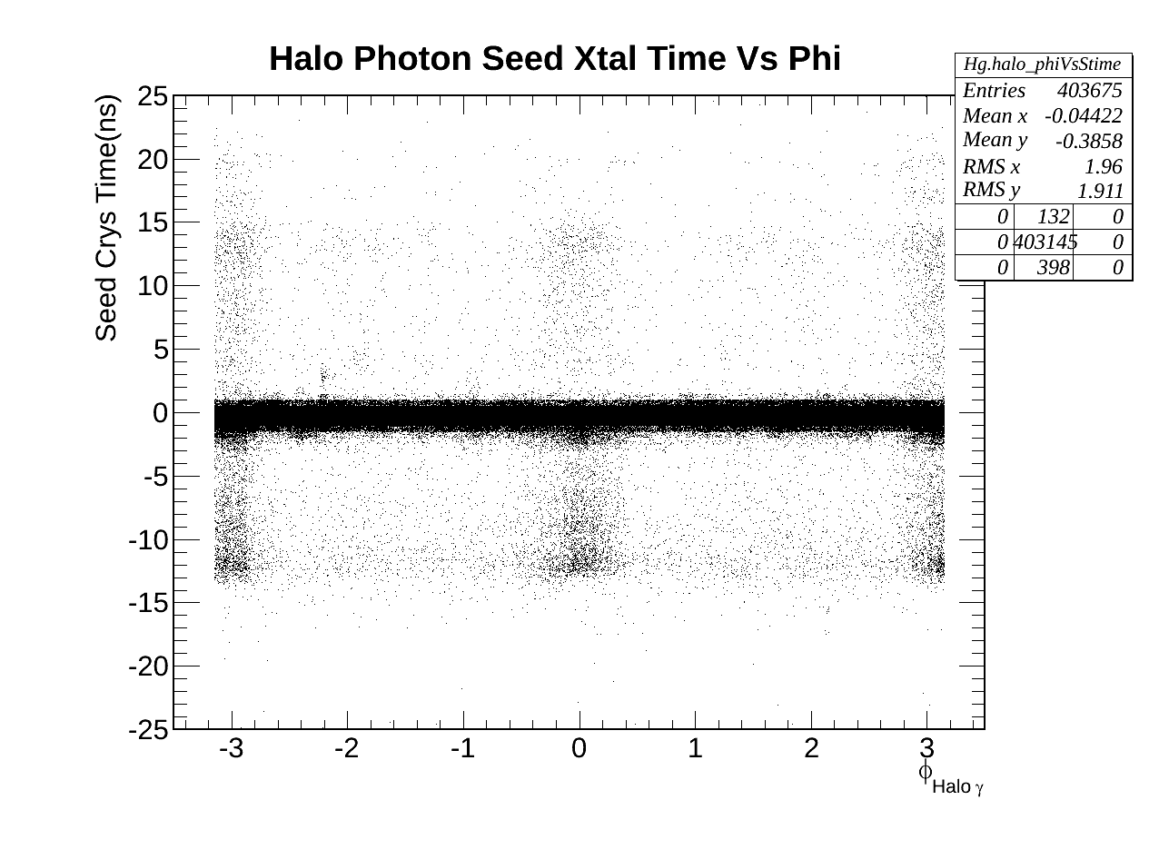
EB & EE Photons
Egamma Photon
Halo Photon

Slide 12
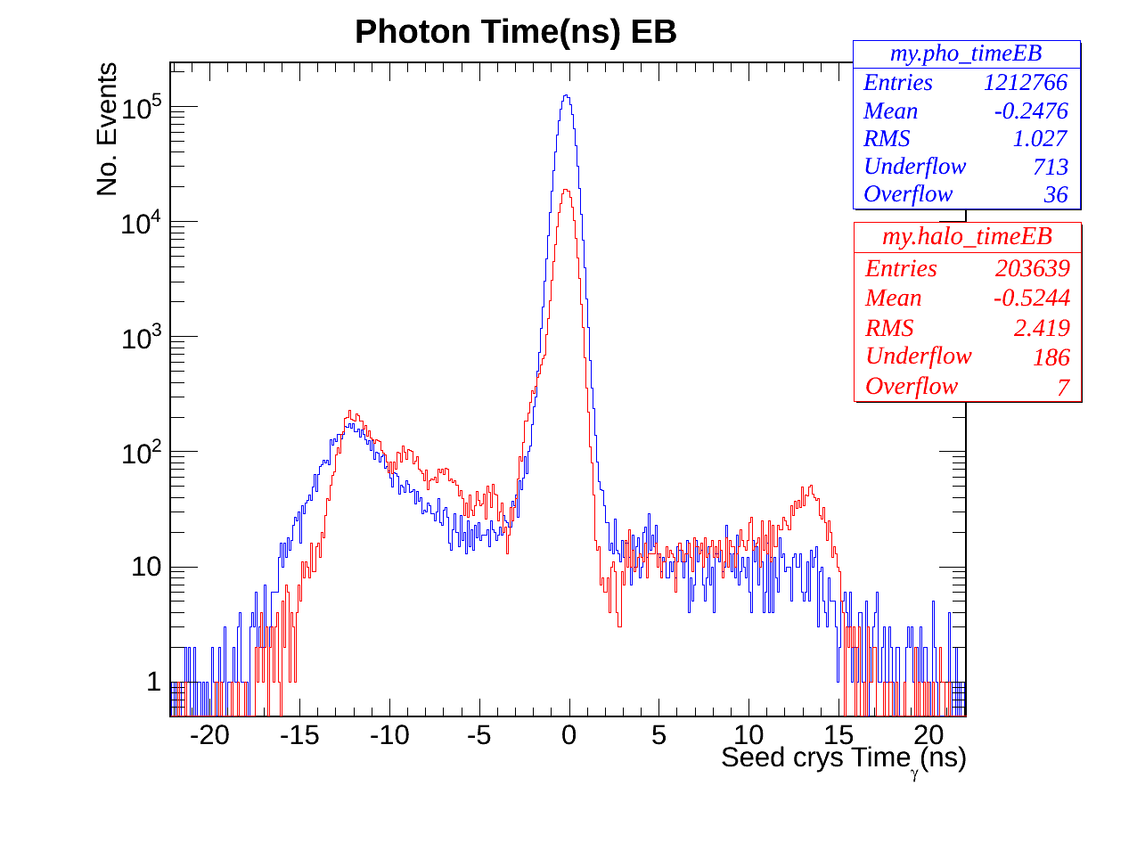
Photon Time EB
Egamma(Blue) Halo(Red) Photon Ecal time

Slide 13
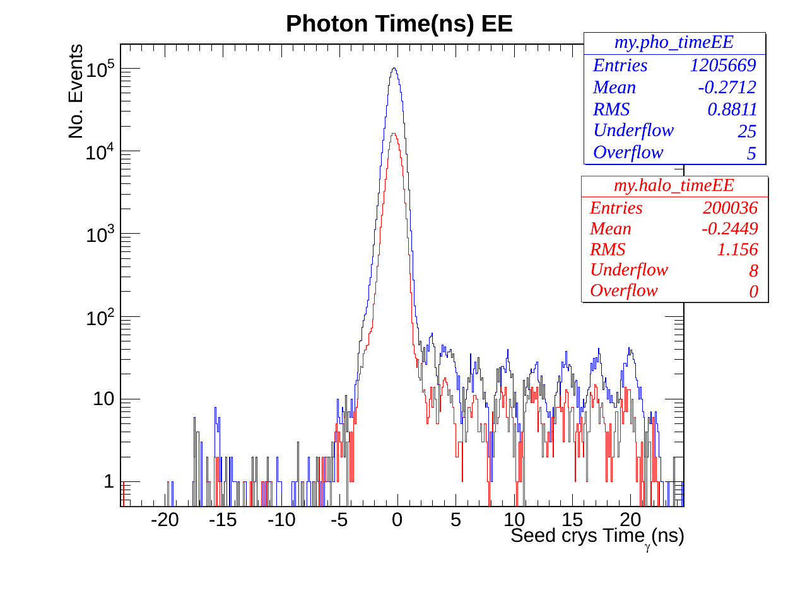
Photon Time EE
Stange EE Timing
Egamma(Blue) Halo(Red) Photon Ecal time

Slide 14
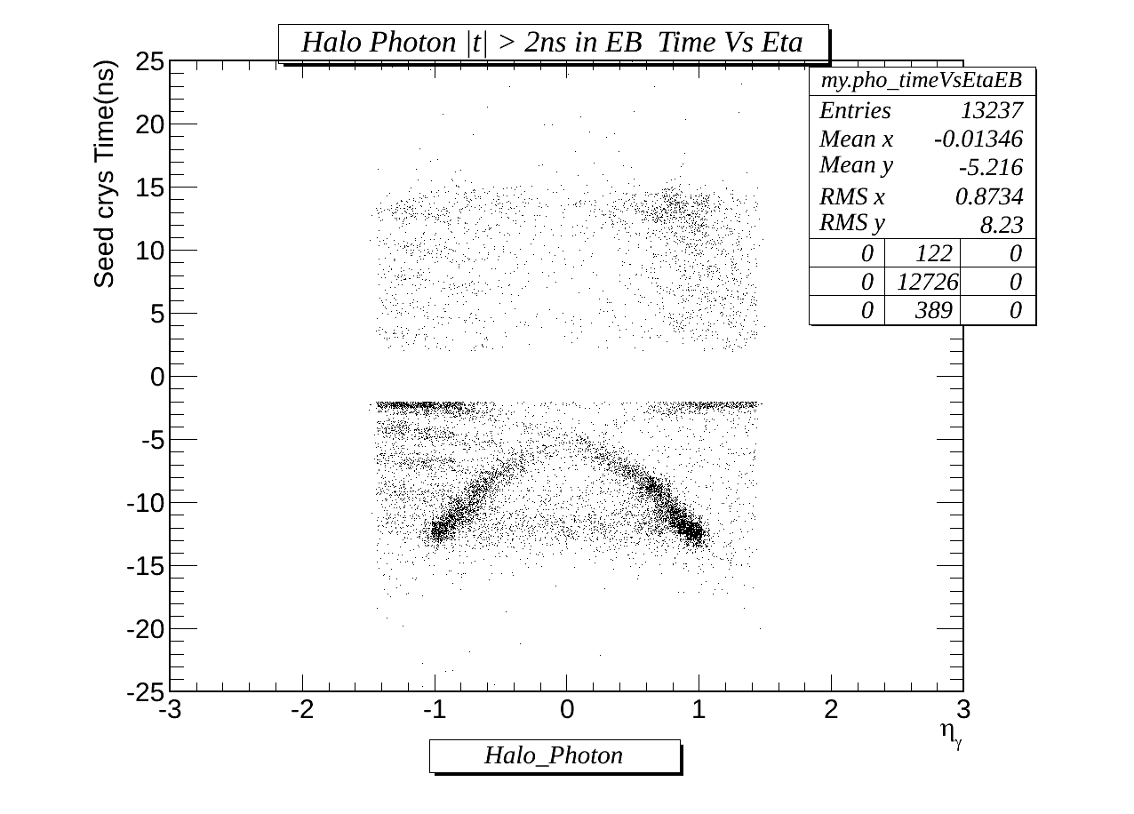
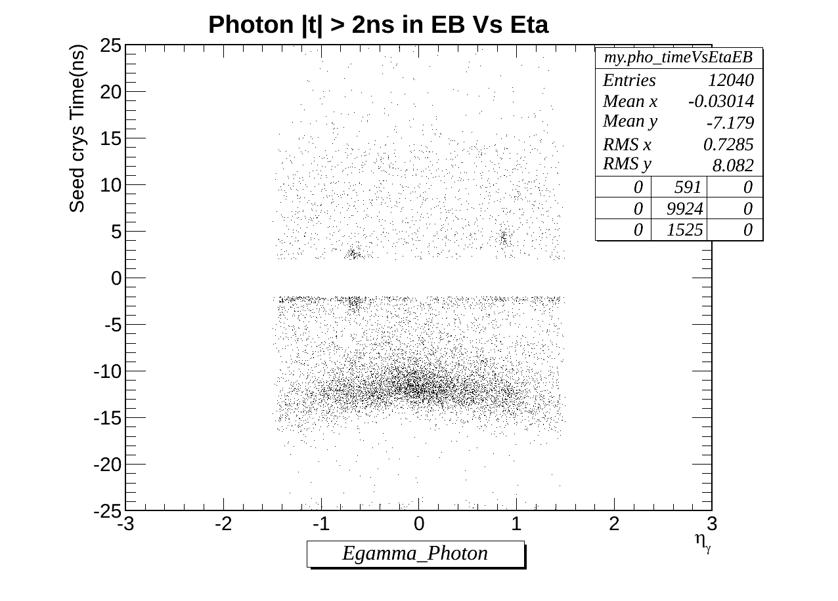
Region of Interest: EB
Spikes?
Beam Halos
Egamma photons
Halo photons.

Slide 15
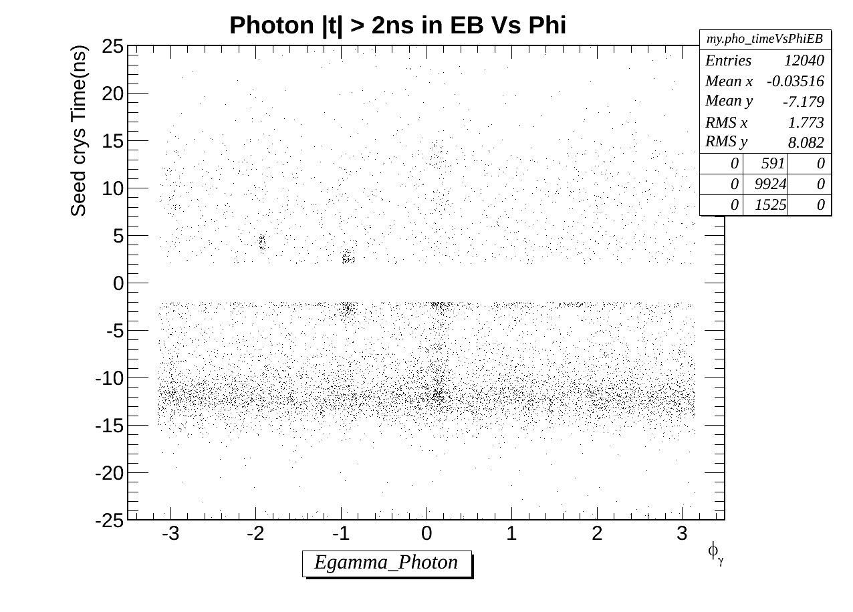
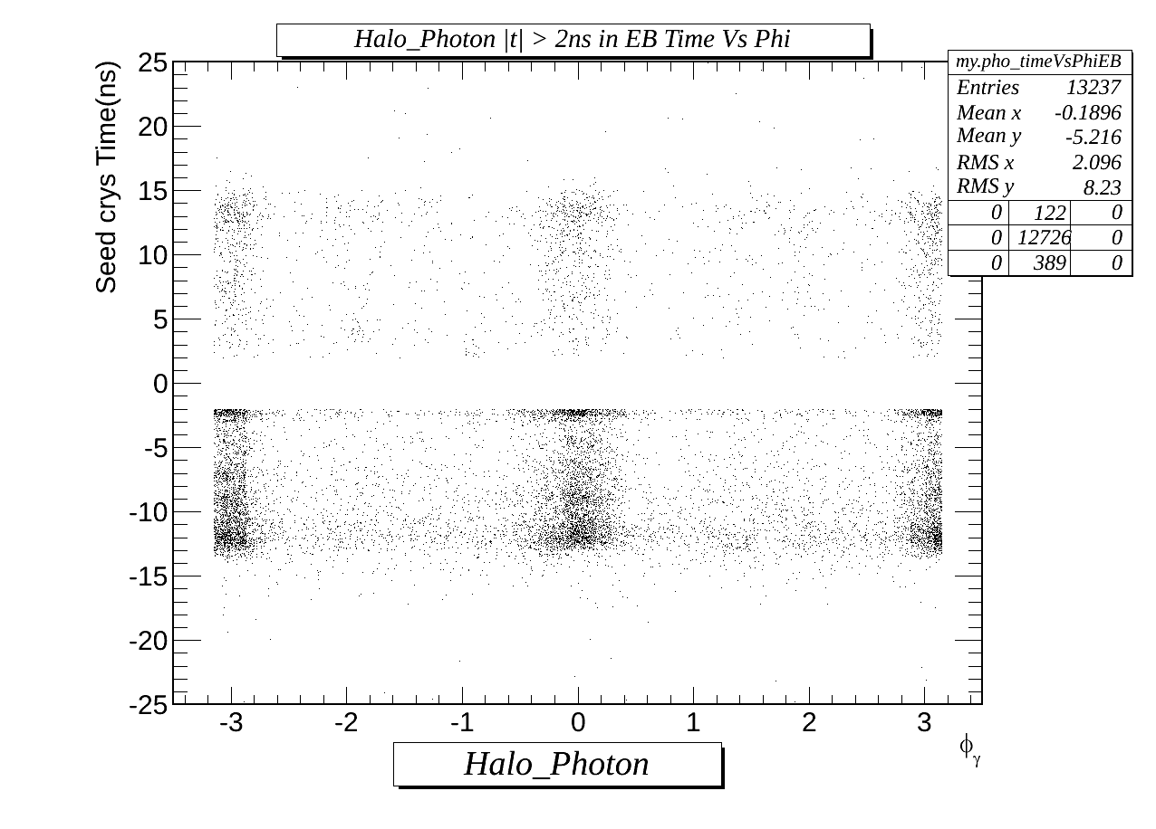
Region of Interest: EB
Spikes?
Beam Halos
Egamma photons
Halo photons.

Slide 16
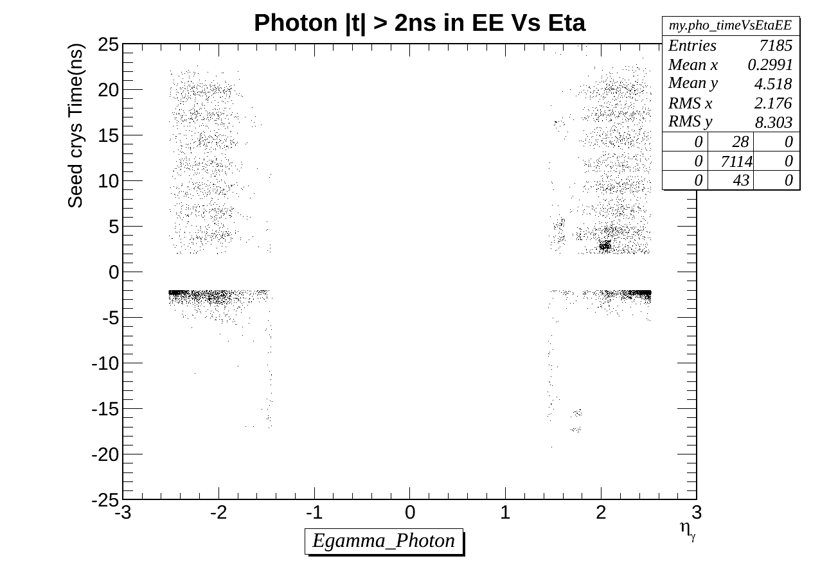
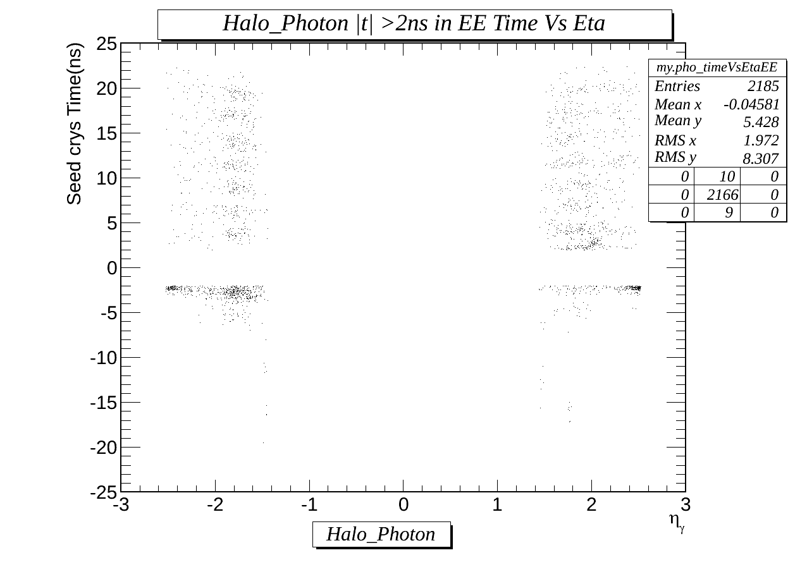
Region of Interest: EE
Few early time Halo photon than in EB
Egamma photons
Halo photons.

Slide 17
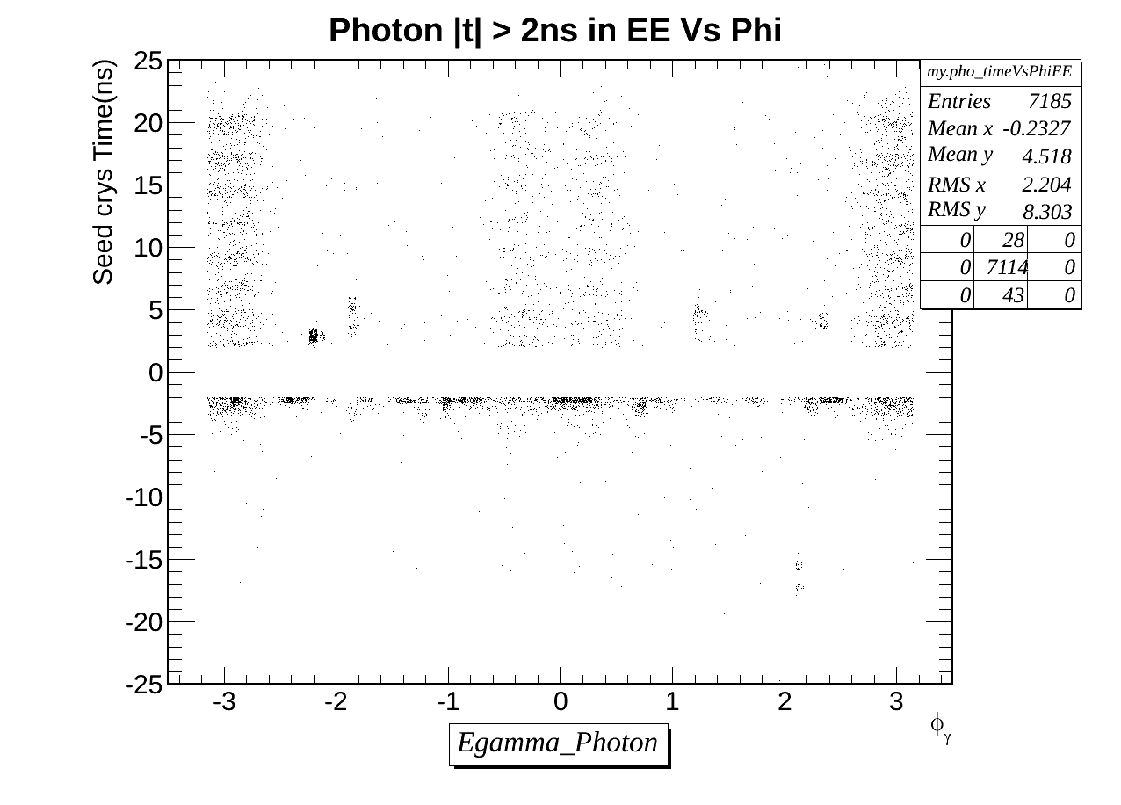
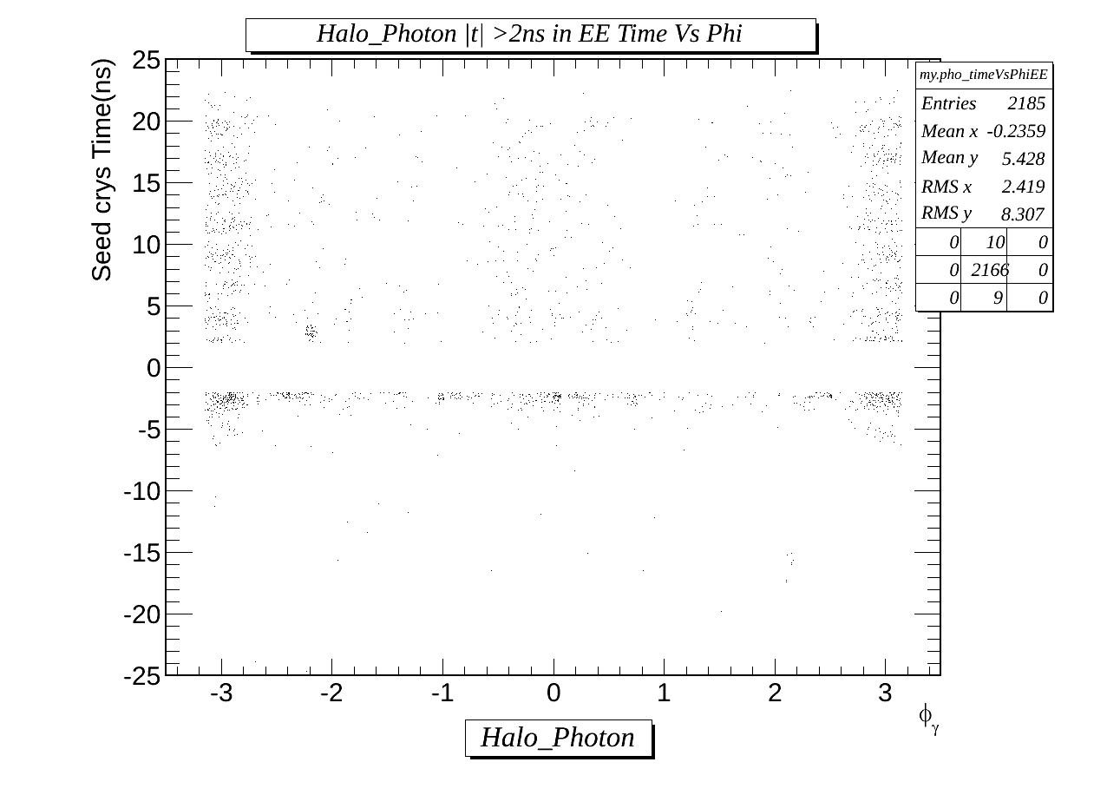
Region of Interest: EE
Few early time Halo photon than in EB
Egamma photons
Halo photons.

Slide 18
Halo Tagging & Egamma Photon Selection Efficiency.
|t| > 2ns | Total Number of Photons | Egamma Photons | % of Non-Halo- candidates | CSC Halo Tagged Photons | % of Halo candidates.
EB | 25277 | 12040 | 48 | 13237 | 52
EE (|eta| < 2.5 ) | 9370 | 7185 | 77 | 2185 | 23
For photons with time outside 2ns window:
Halo tagging efficiency : EB(EE) = 52 (23)%
Egamma selection efficiency: EB(EE) = 48 (77)%

Slide 19
Summary
There are many non trivial background sources to delayed photon.
CSC tagging can be use to reject beam halo photons with good efficiency, however not every background photon.
With current background understanding, we are ready for Moriond although identifying the different sources is yet to come, nevertheless, we are working on it.

Slide 20
BACK UP

Slide 21
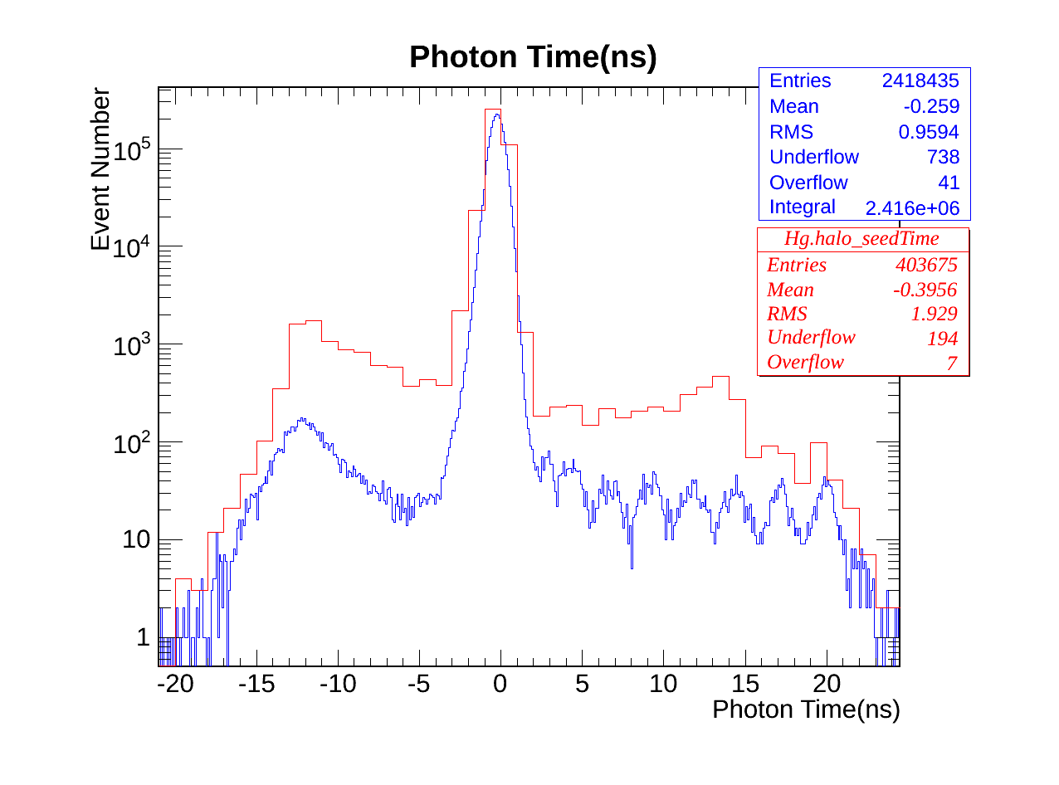
EB & EE Photon Time
Strange structure in later time

Slide 22
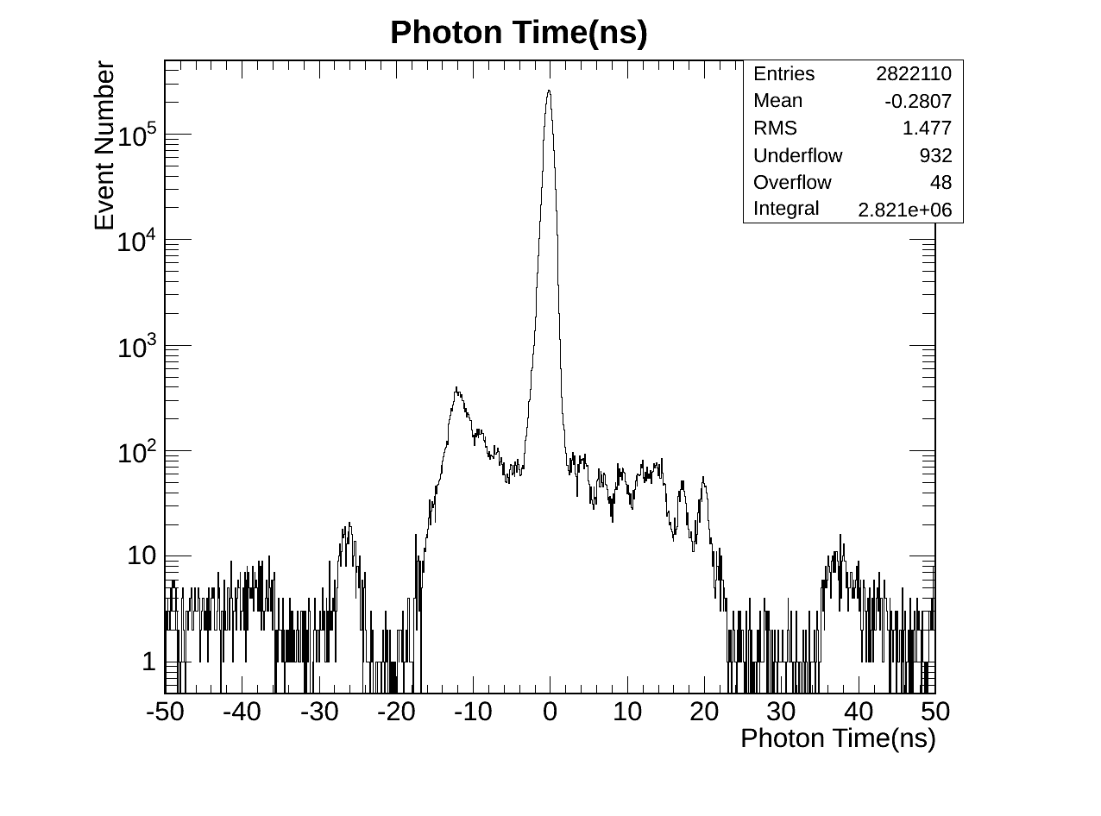
Photon Time
Cosmic, spikes, halo, and what else? All here!

Slide 23
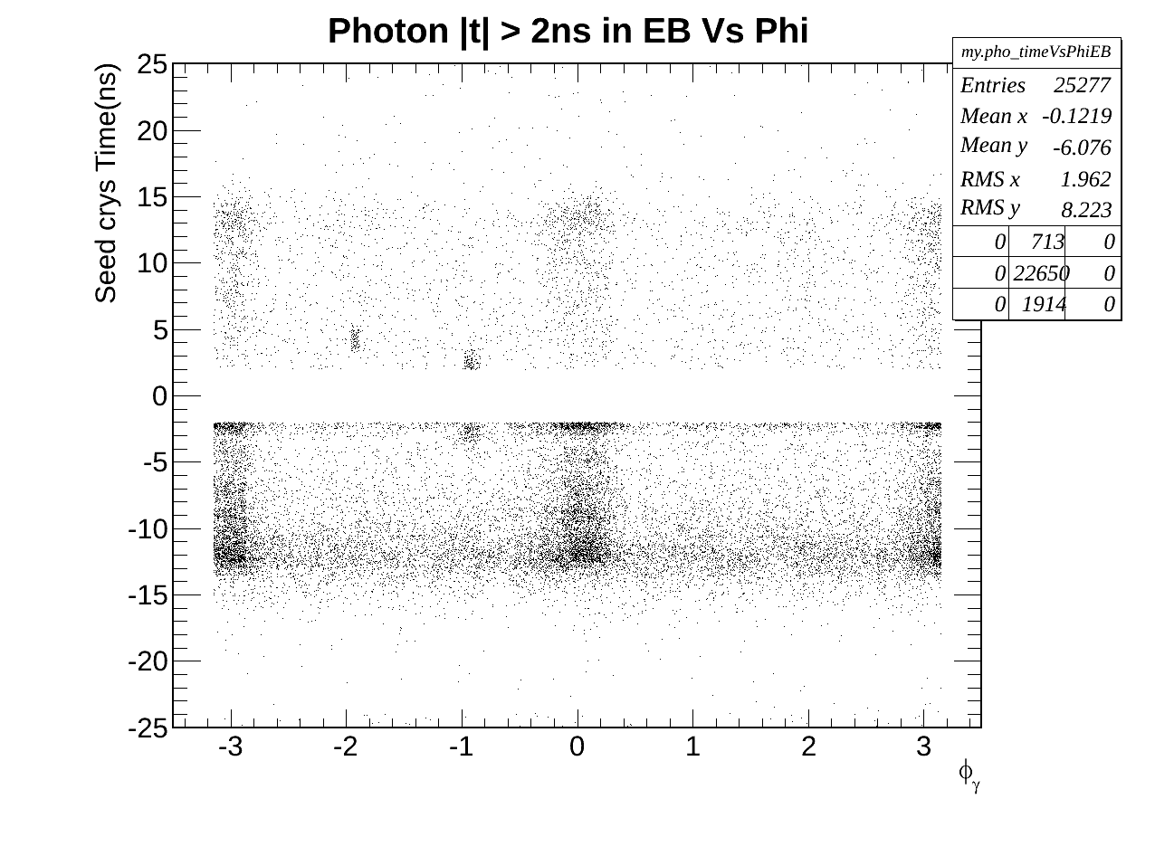
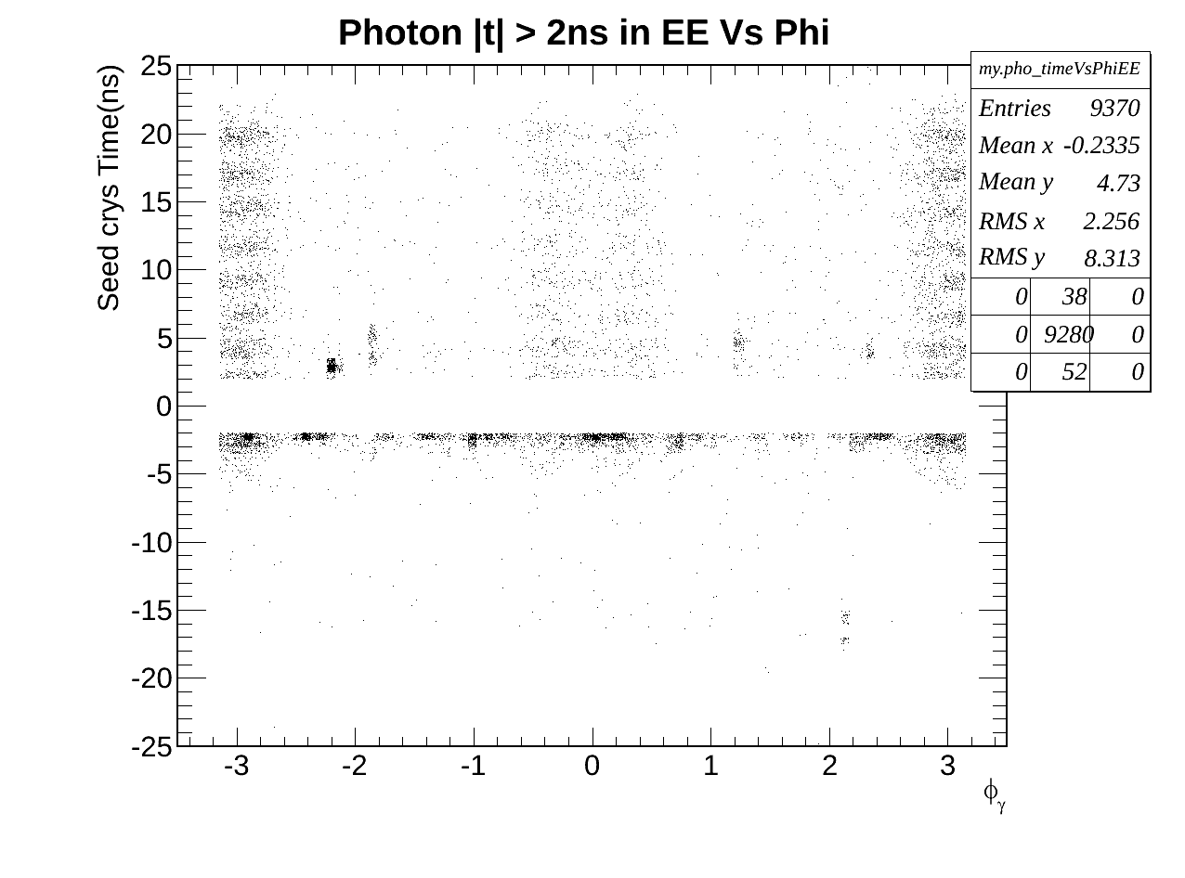
Region of Interest EB & EE
Egamma + Halo Photons time Vs Phi

Slide 24
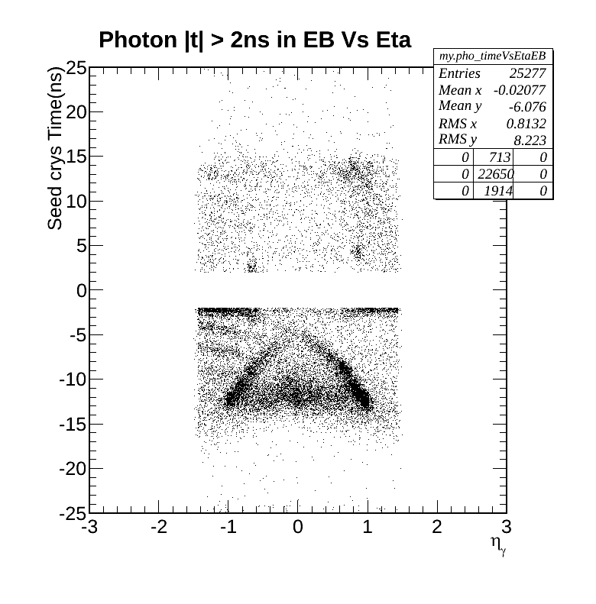
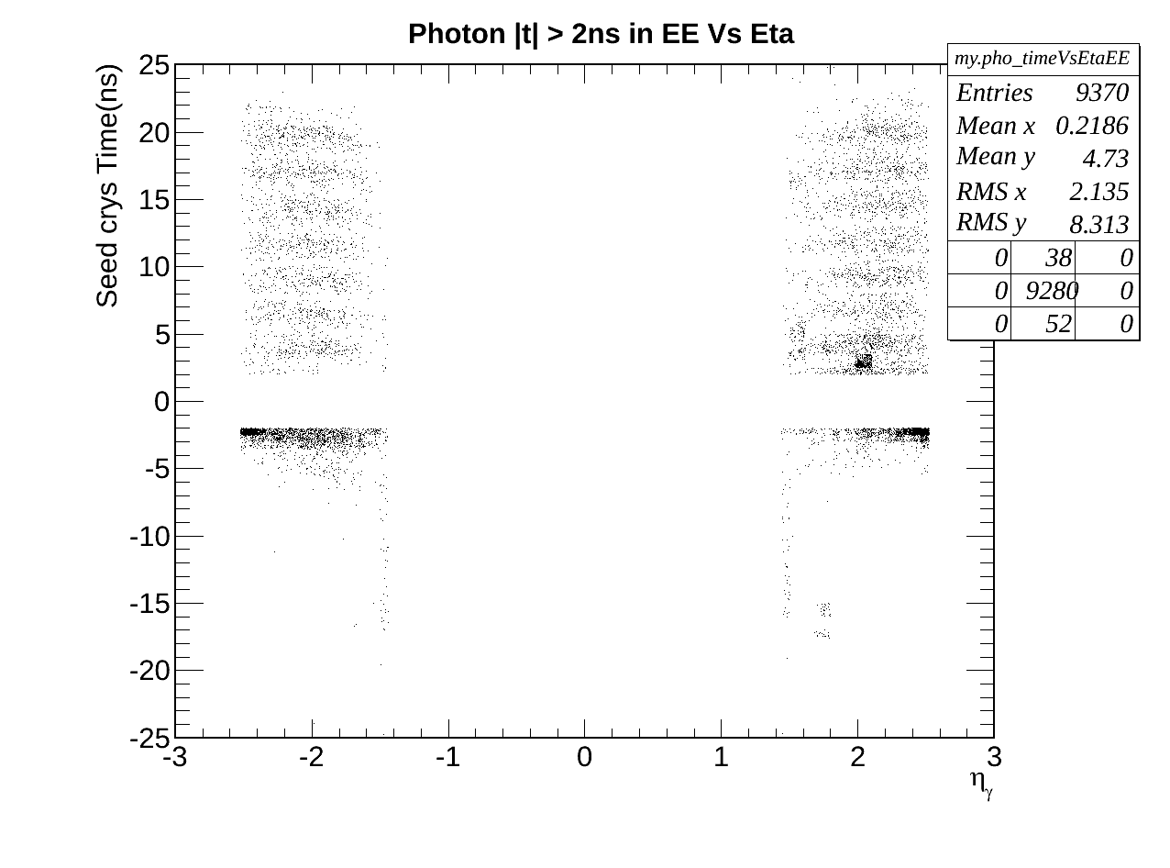
Region of Interest EB & EE
Egamma + Halo Photons time Vs Eta

Slide 25
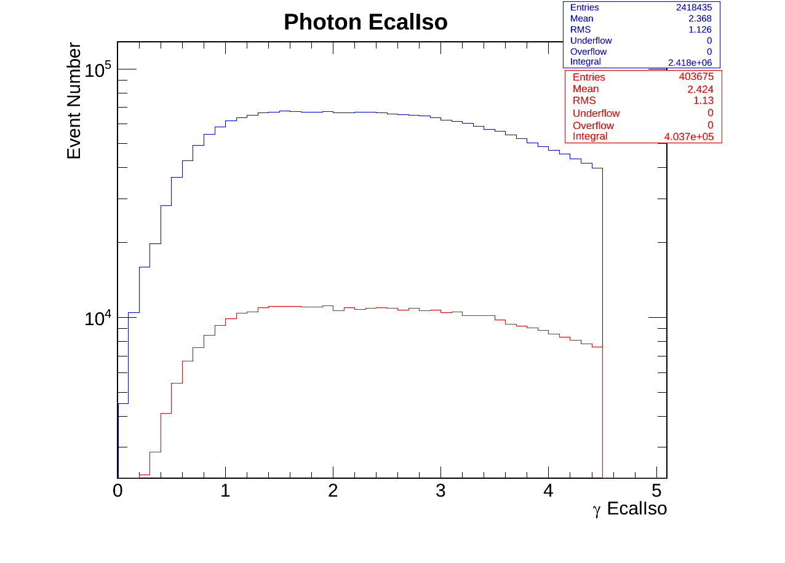
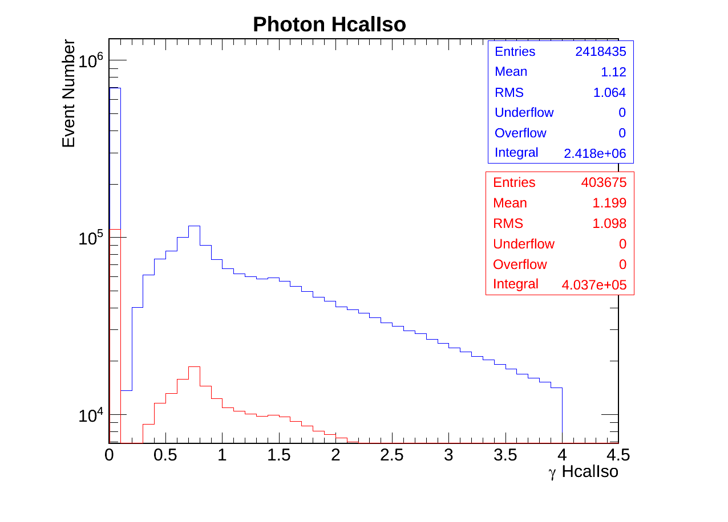
Egamma Photon Id variables.
Ecal Isolation
Hcal Isolation
Egamma(Blue) Halo(Red) Photon

Slide 26
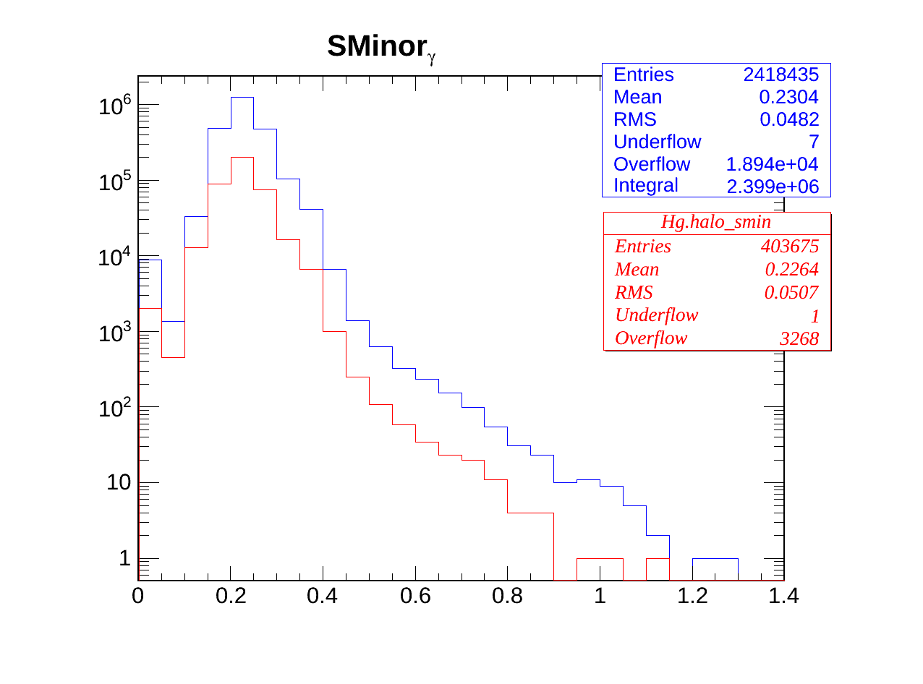
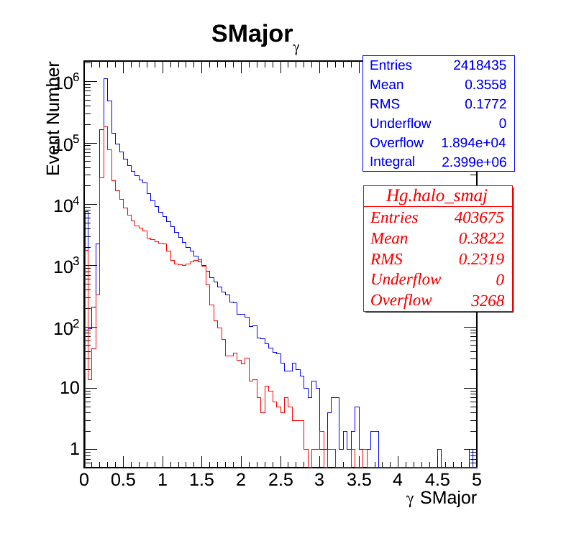
Photon Iso and Id variables.
SMinor
SMajor
Egamma and Halo have very similar isolation criteria.
Egamma(Blue) Halo(Red) Photon

Slide 27
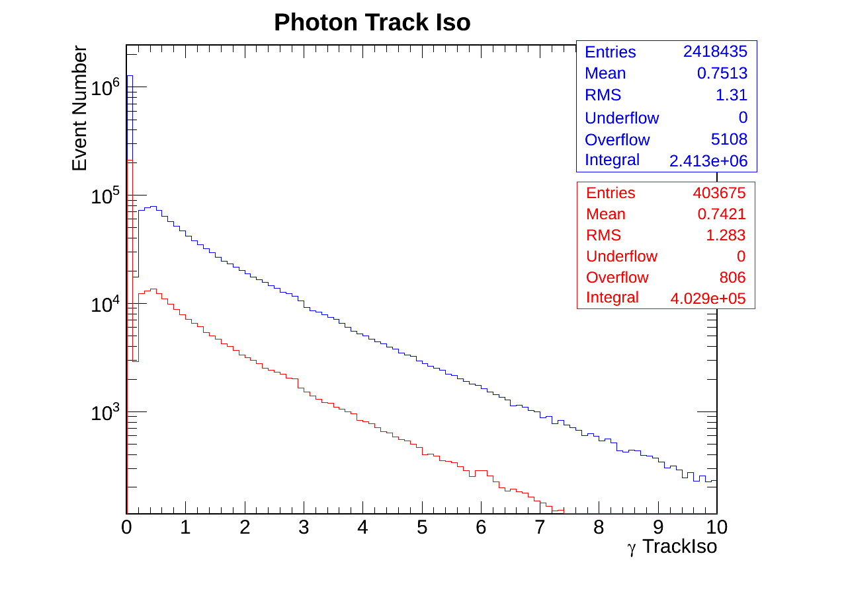
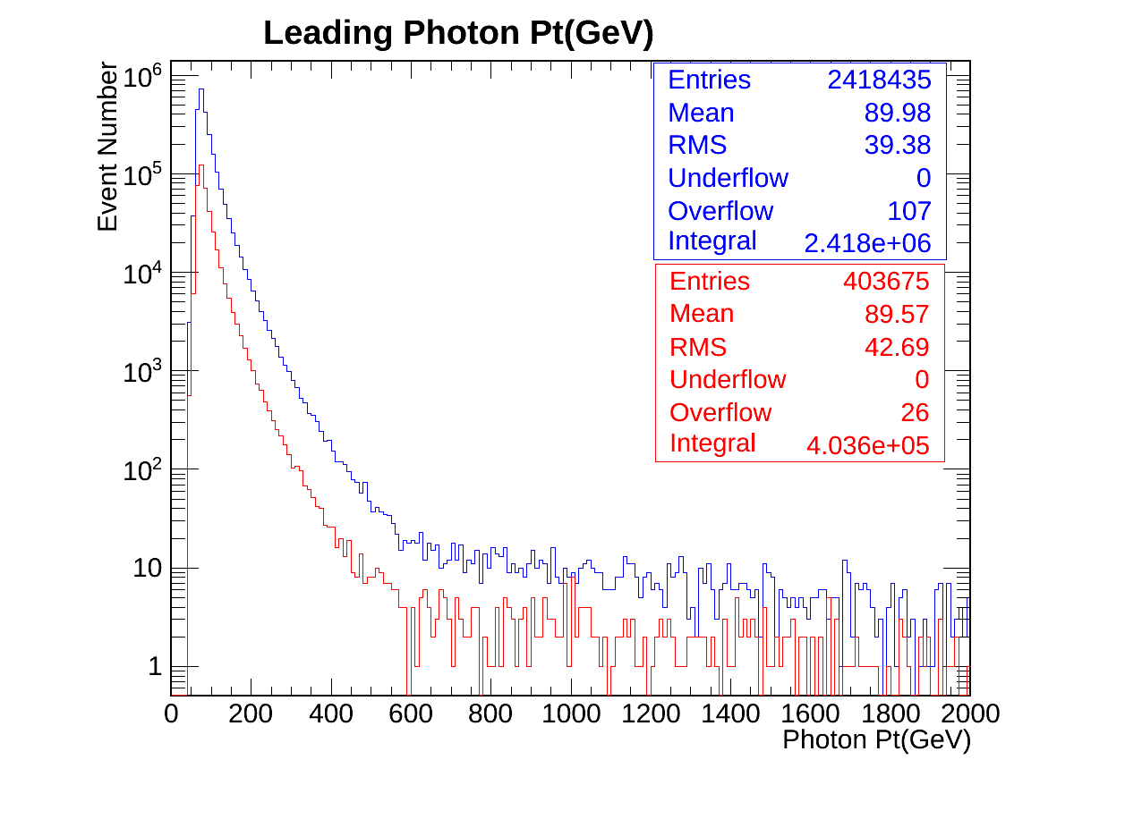
Egamma Photon Id variables.
Track Isolation
Leading photon pt
Egamma(Blue) Halo(Red) Photon

Slide 28
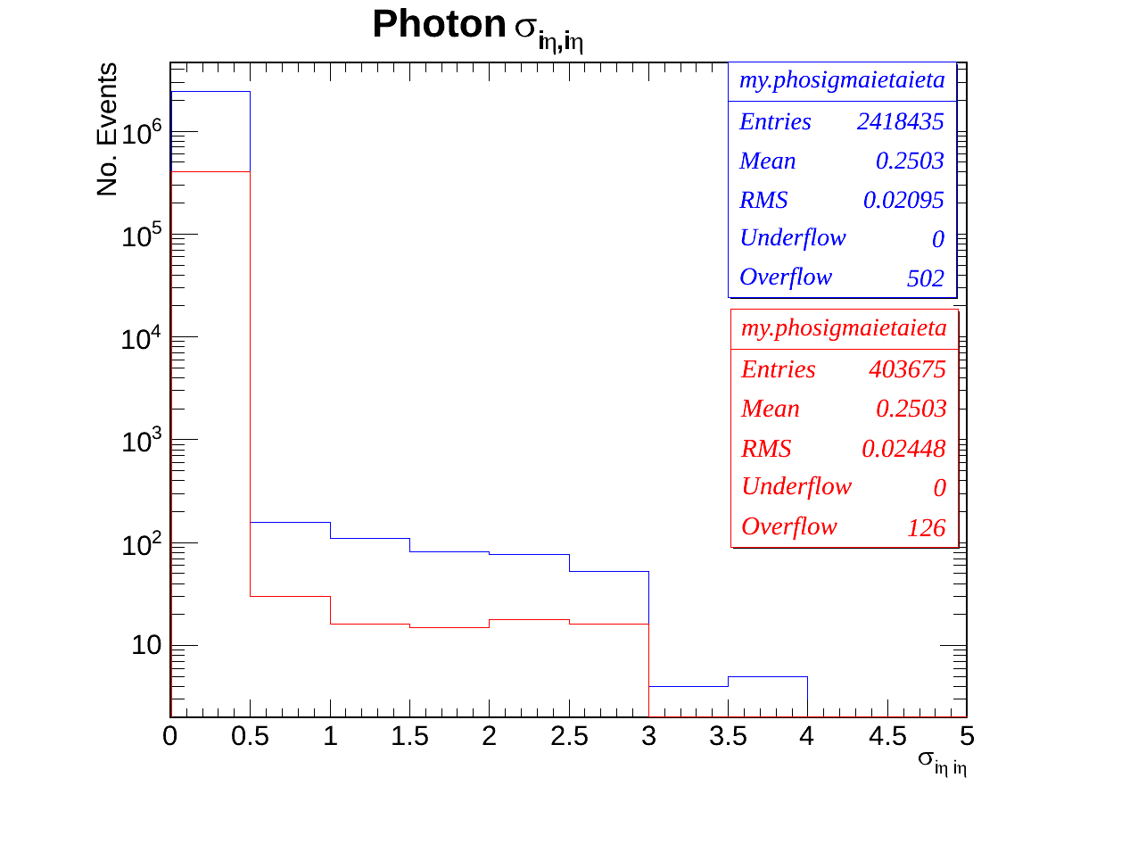
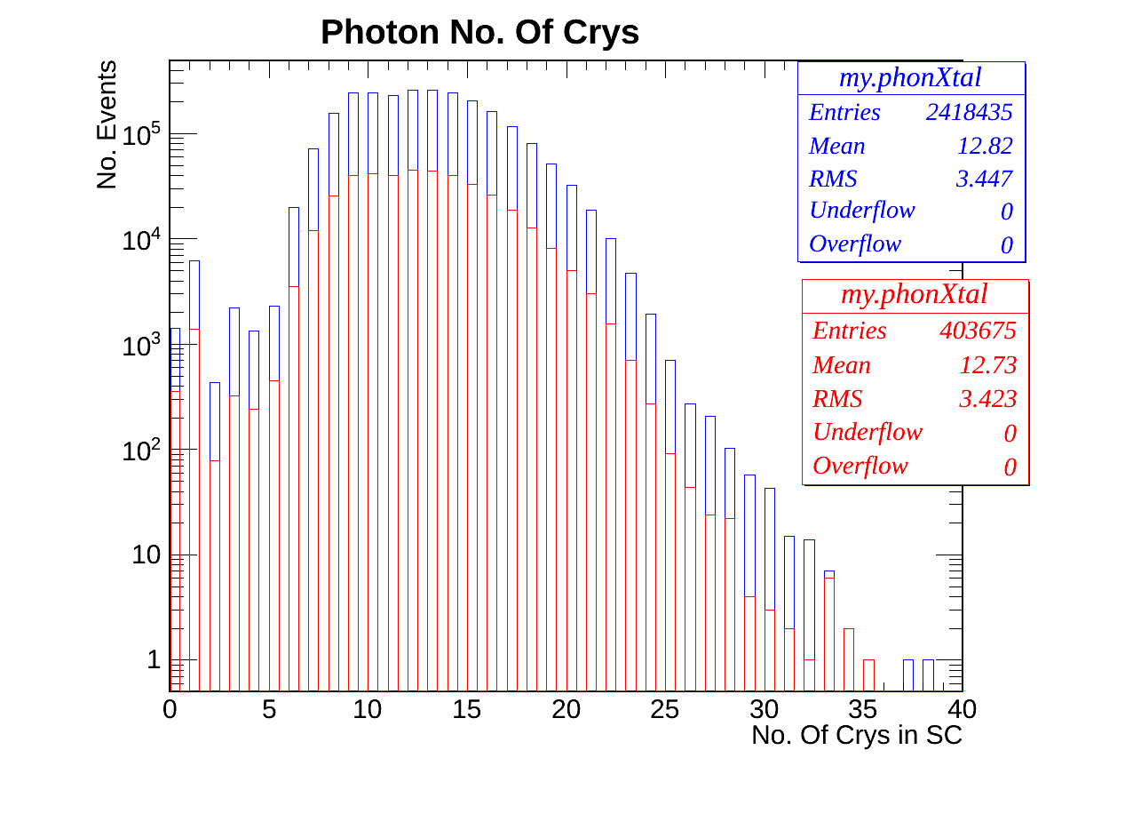
Egamma Photon Id variables.
Sigma Ieta Ieta
Number of Crystals in BC
Egamma(Blue) Halo(Red) Photon

Slide 29
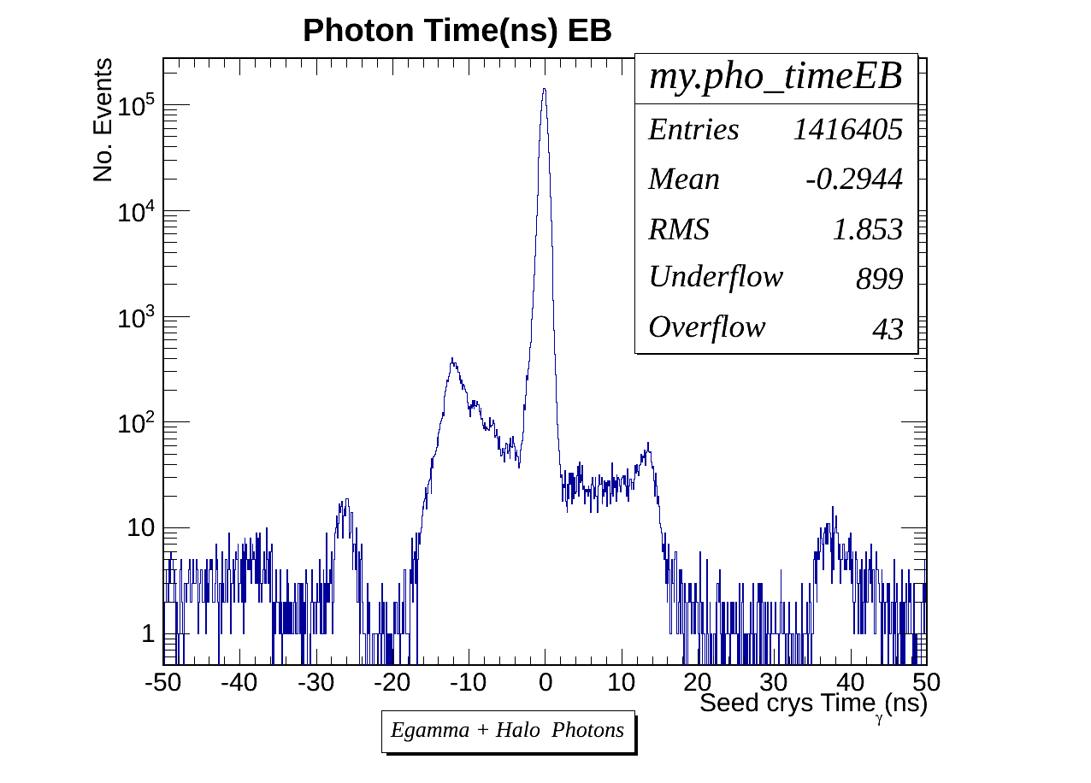
Halo + Egamma Photon time EB

Slide 30
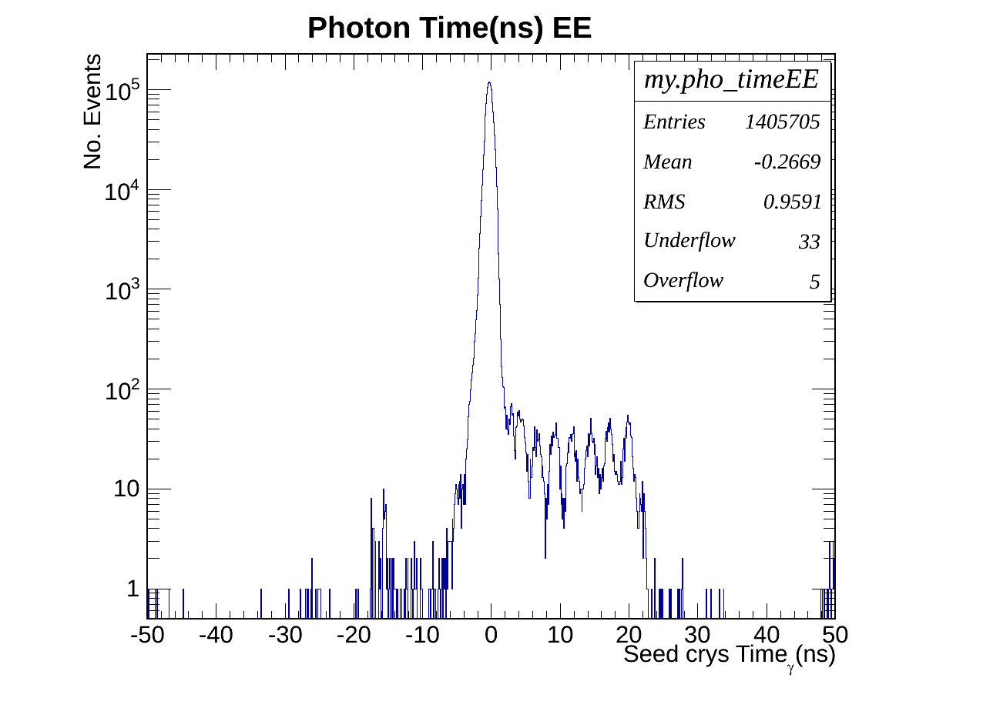
Halo + Egamma Photon time EE

Slide 31
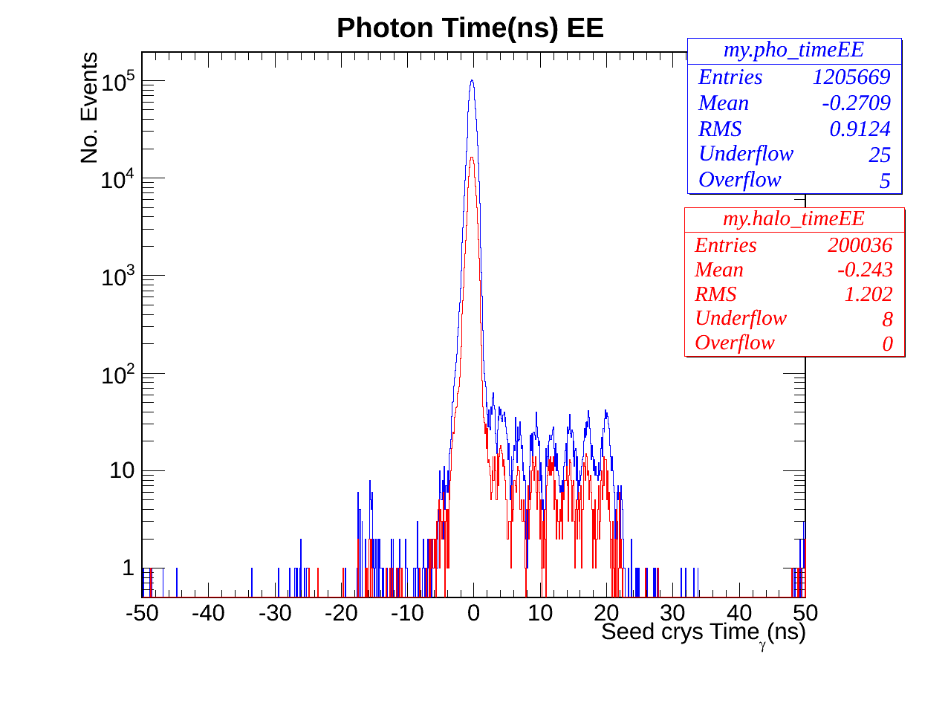
Photon Time EE
Stange EE Timing
Strange structure occurs within 0 and 20ns.

