Slide 1
Delayed Photon
Bgd Studies Update
Sept 05 2012

Slide 2
DataSet & HLT
Data Sets :
Run2012B/SinglePhoton/RECO/PromptReco-v1/
Run2012B/PhotonHad/RECO/PromptReco-v1/
HLT Trigger
HLT_DisplacedPhoton65_CaloIdVL_IsoL_PF MET25
HLT_Photon50_CaloIdVL_IsoL_

Slide 3
Event Selection
Pt_Lead photon(Trailing) > 70 (40) GeV/c .
|Eta| < 2.4 .
0.15 < Sminor < 0.30 .
MET Offline (HLT) > 0 (25) GeV.
Pt_Jet > 30 GeV.
Very Loose Iso Photon Criteria by Egamma.
Events pass DP Trigger or AND Photon50 Trigger.

Slide 4
Addressing Anomalous Photons(AP)
Anomalous photon :
Distribution is dataset dependent ? Photon_Had2012B Vs Single_Photon2012
Is mostly from large timing photons? Look at Eta and Phi of photons with time < -10.0 ns & time > 10.0ns
Is jet multiplicity dependent ? Look at photon time for different number of jets events.

Slide 5
1) Data Set Dependence:
Single_Photon2012B Vs Photon_Had 2012B DataSet.

Slide 6
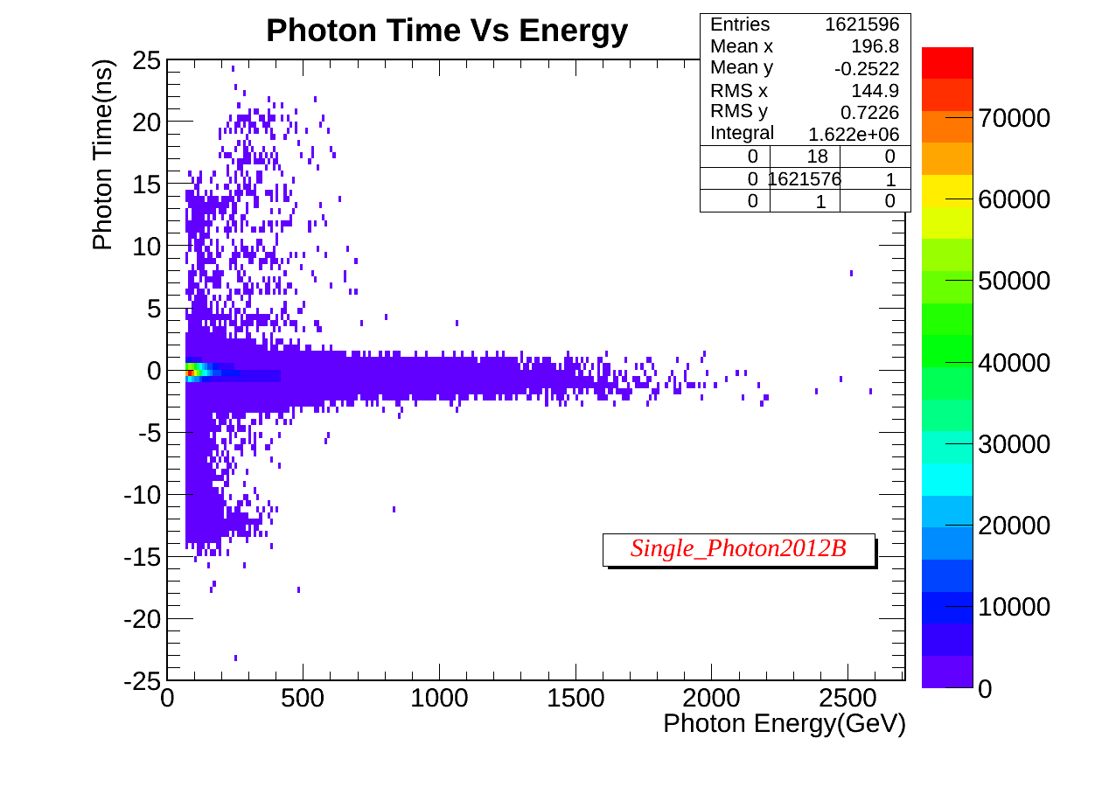
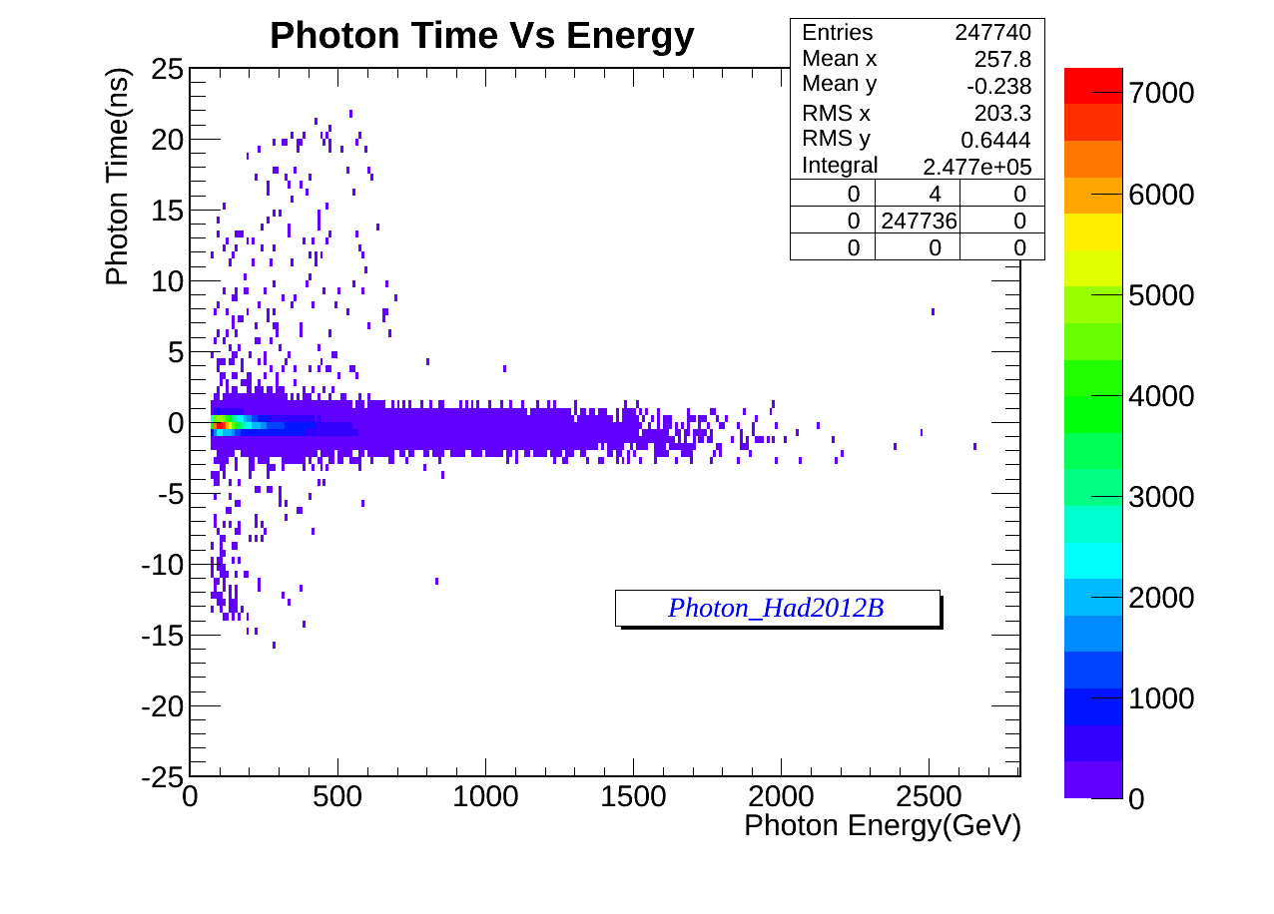
Data Set Dependence?
Many early photons.

Slide 7
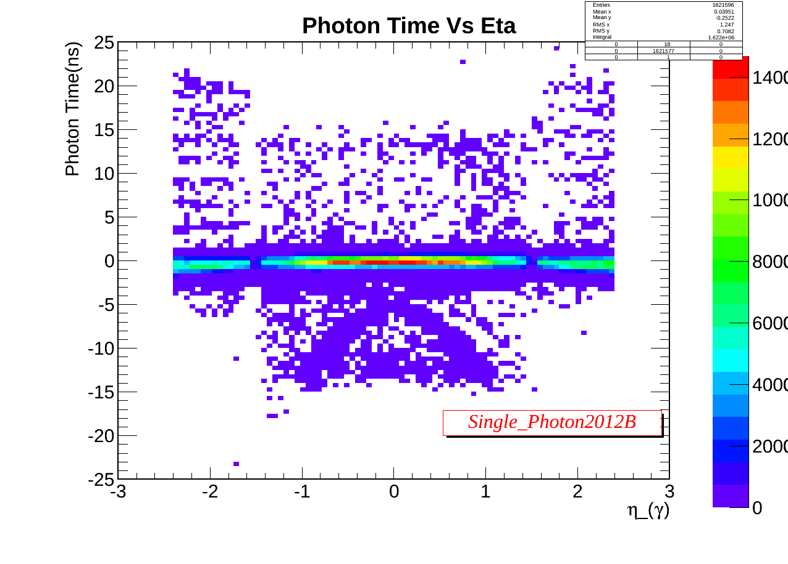
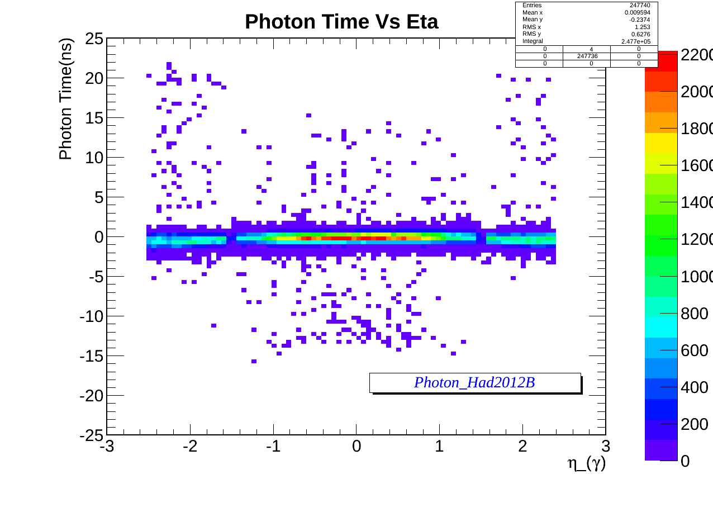
Data set Dependence?
A “strange” structure in early photons!

Slide 8
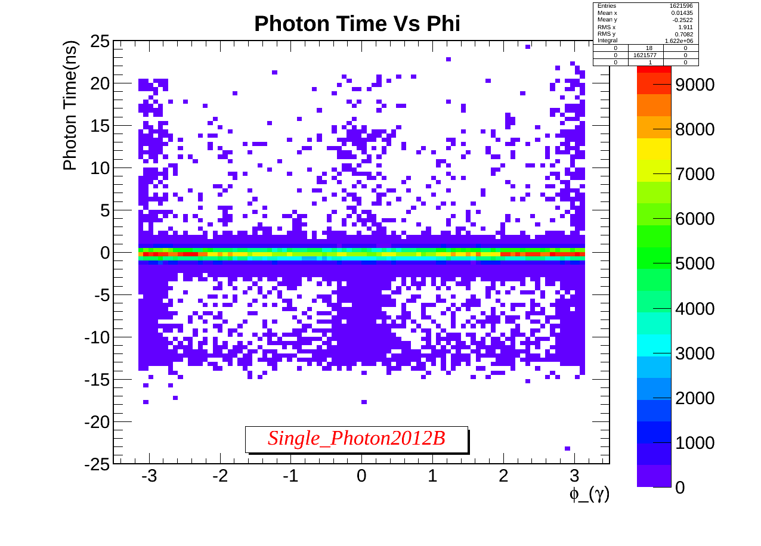
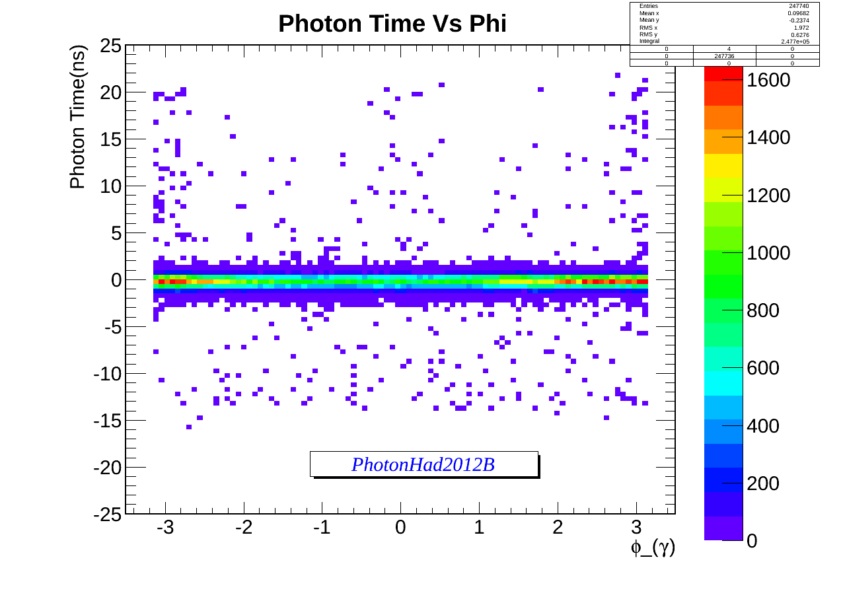
Data set Dependence?
A “strange” structure in early photons!

Slide 9
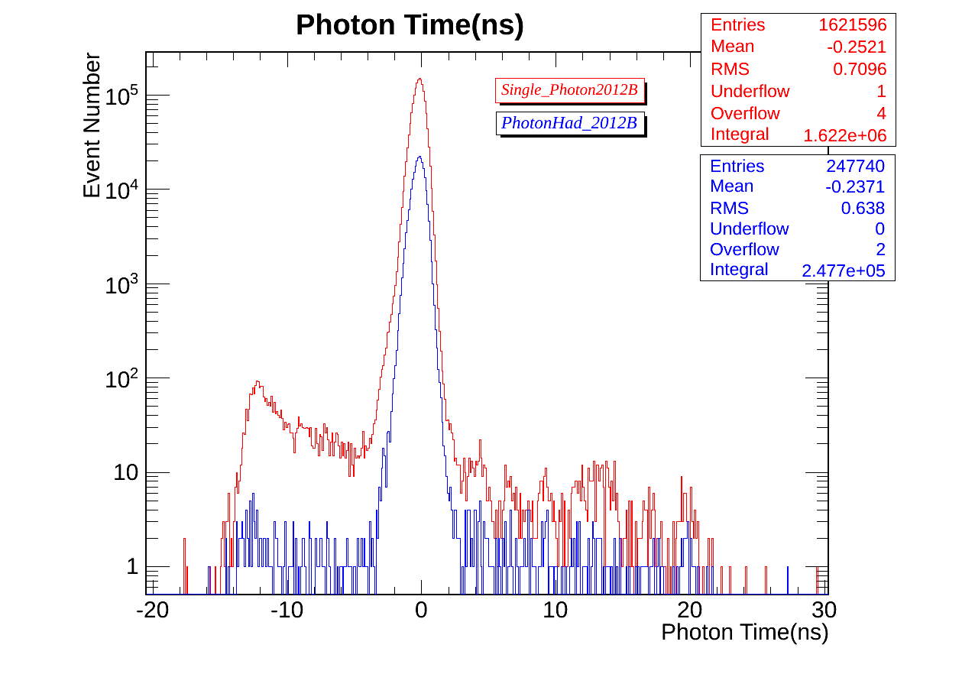
Data set Dependence?
Photon time
Anomalous signal on both datasets.

Slide 10
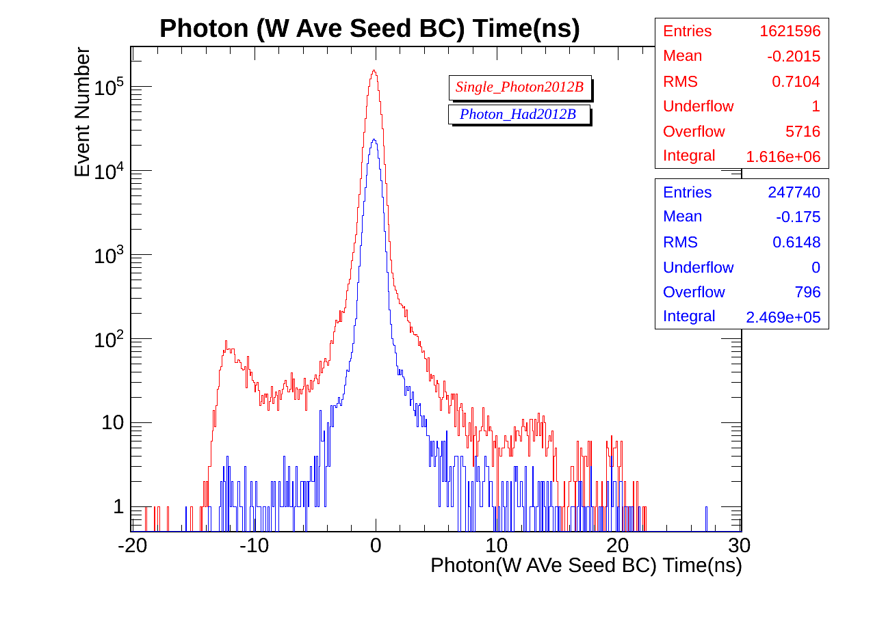
Data set Dependence?
Photon time
Anomalous signal on both datasets.

Slide 11
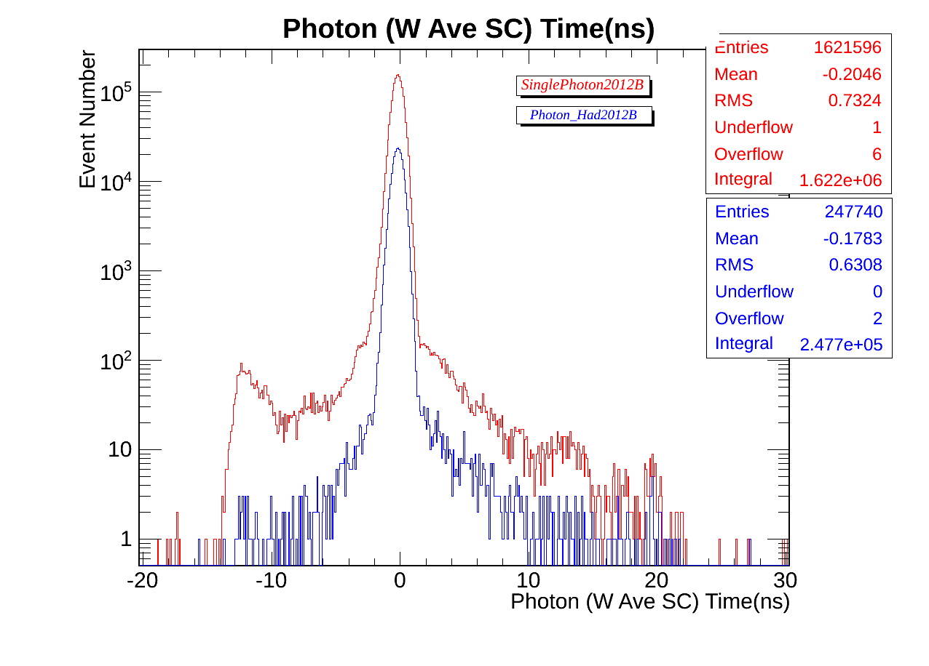
Data set Dependence?
Photon time
Anomalous signal on both datasets.

Slide 12
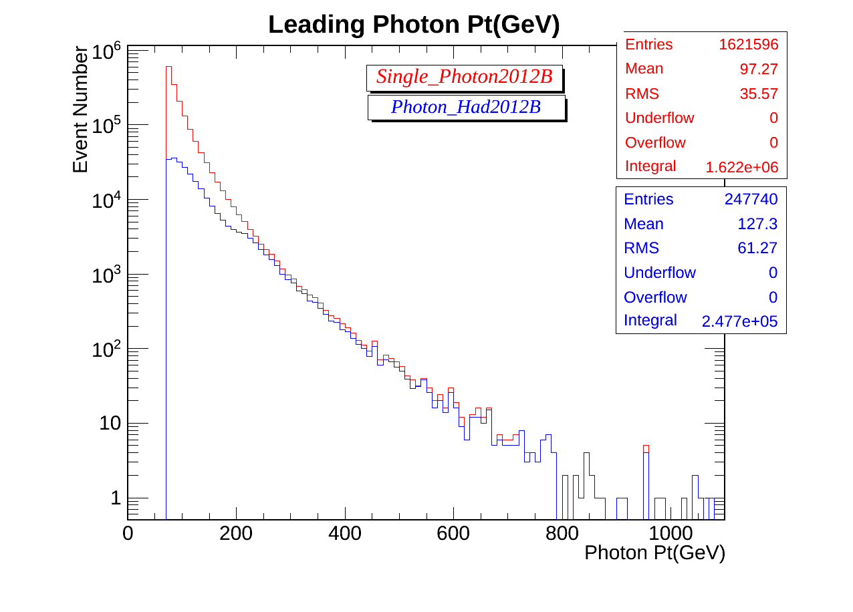
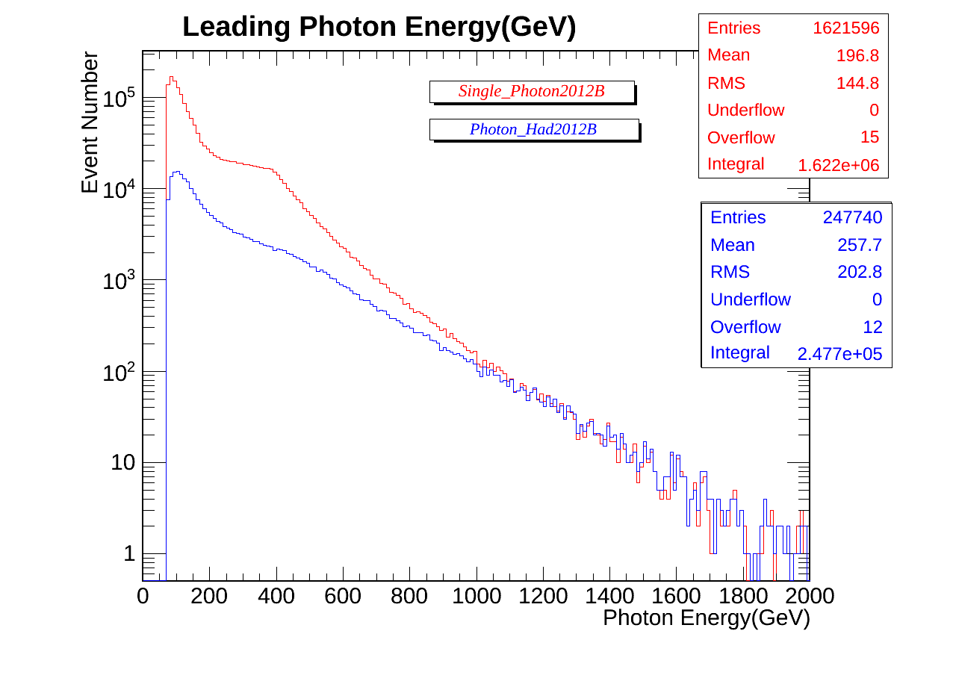
Data set Dependence?
Photon kinematics
Photon Pt and E not so similar in both DS.

Slide 13
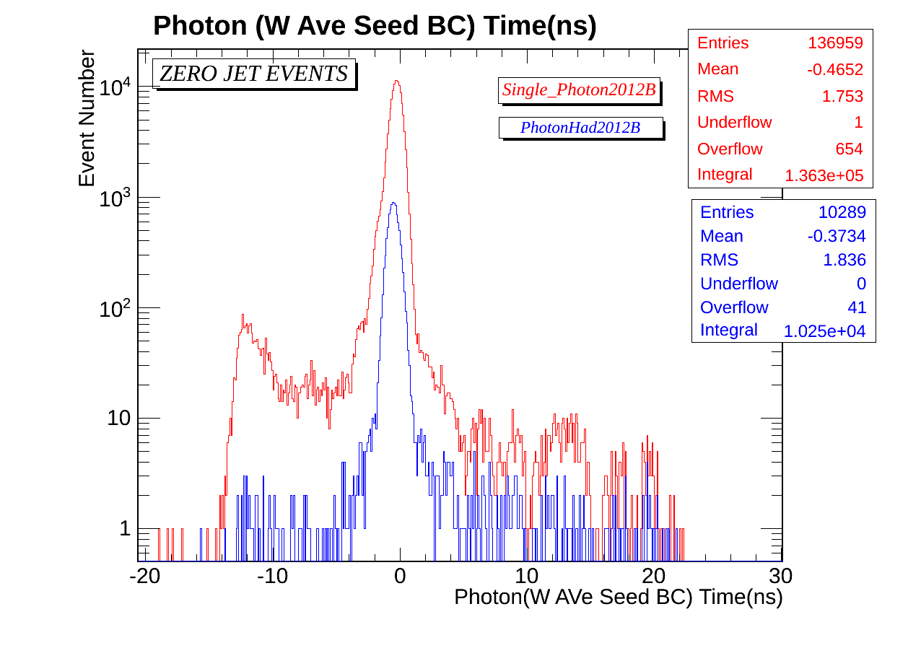
Data set Dependence?
Zero Jet Events
Photon statistics not enough but AP present.

Slide 14
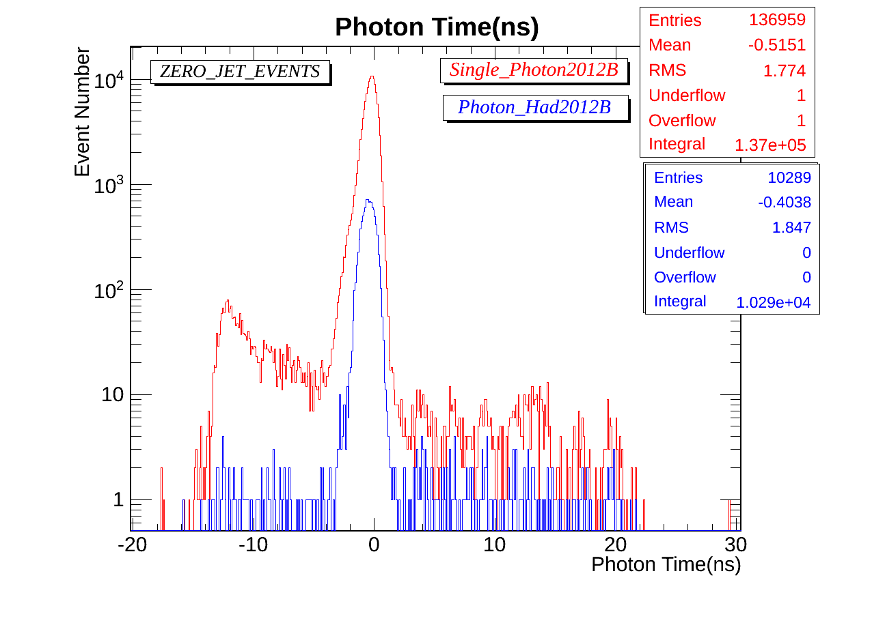
Data set Dependence?
Zero Jet Events
Photon statistics not enough but AP present.

Slide 15
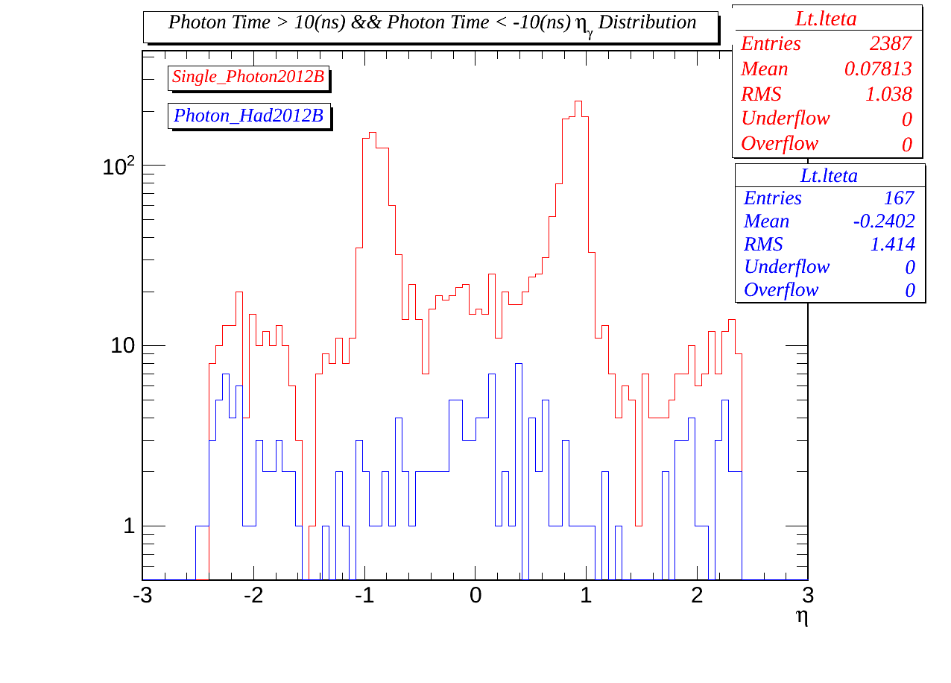
Data set Dependence?
|Time|> 10ns events
Strange eta distribution for Single_Photon DS.

Slide 16
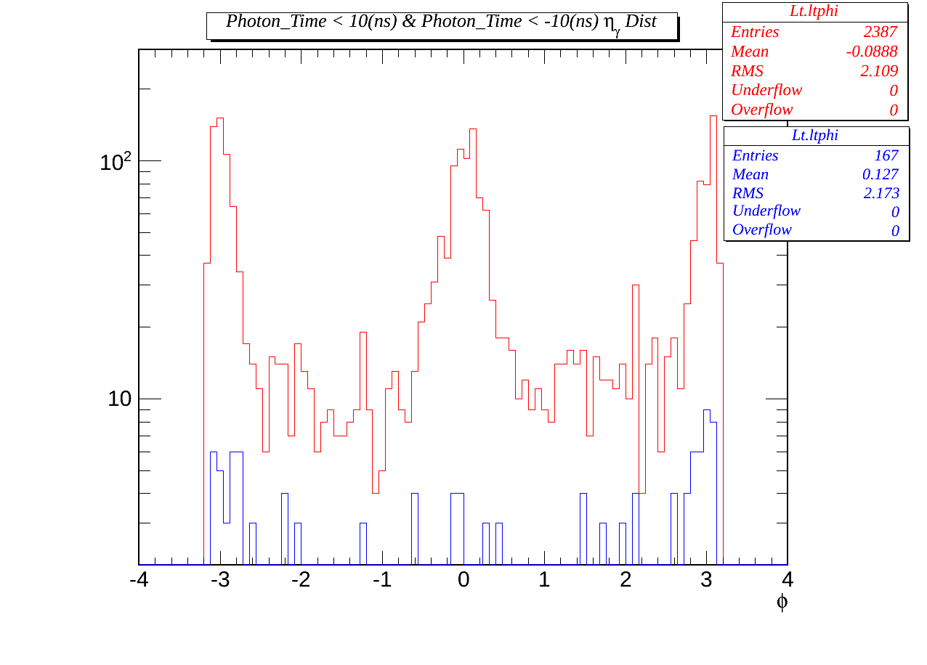
Data set Dependence?
|Time|> 10ns events
Strange Phi distribution for Single_Photon DS.

Slide 17
2) Large Timing Photons {
Time < -10 (ns) & Time > 10(ns) }
On Single Photon2012B DataSet.

Slide 18
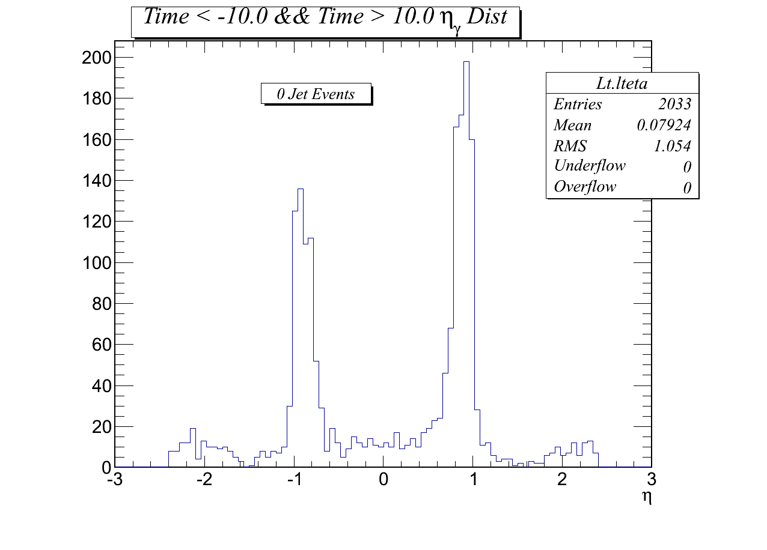
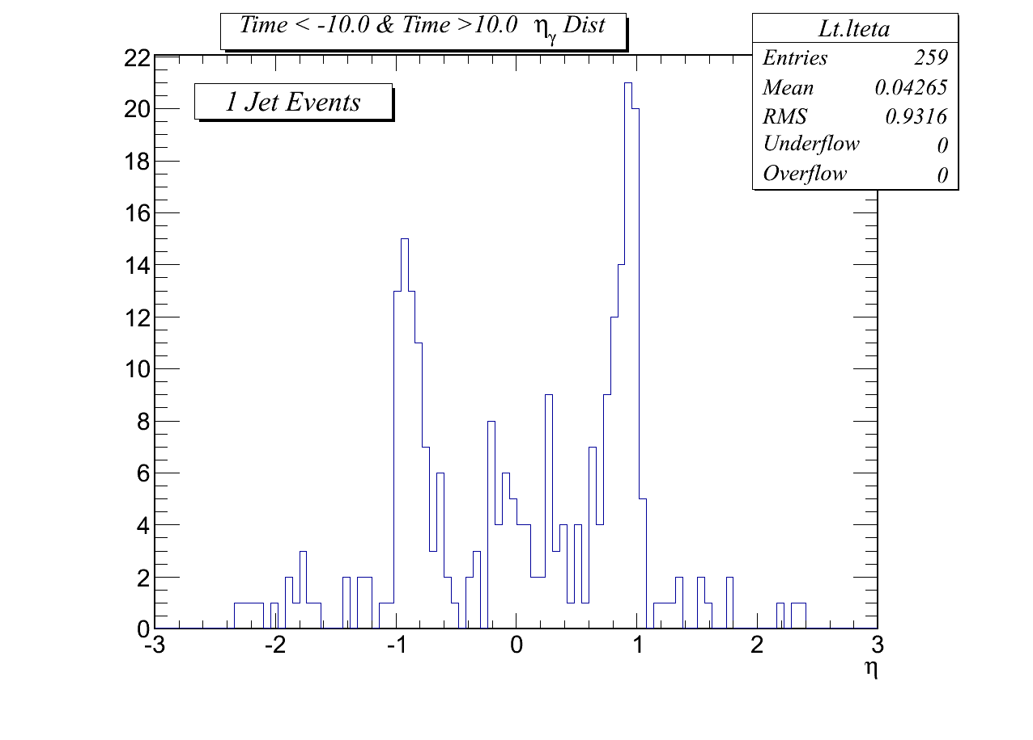
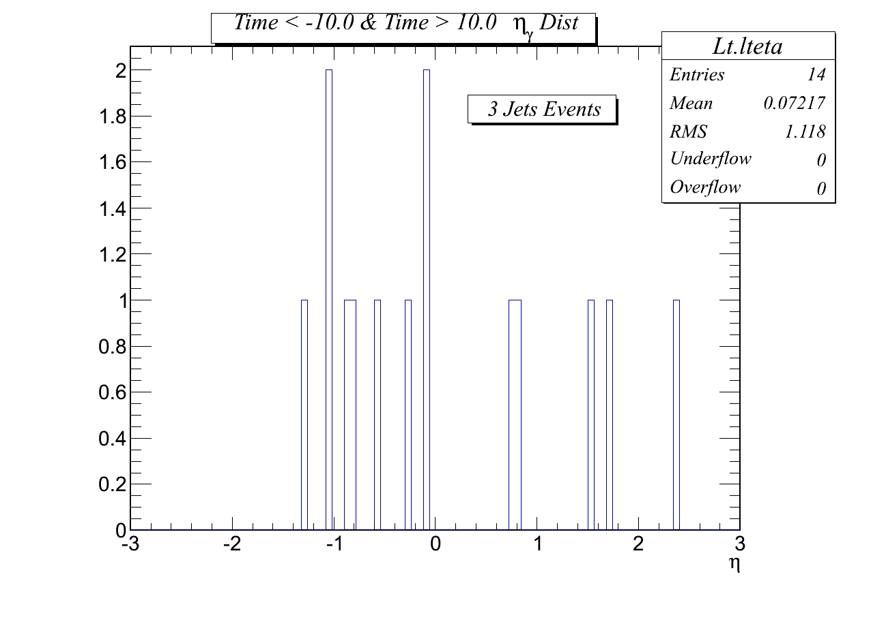
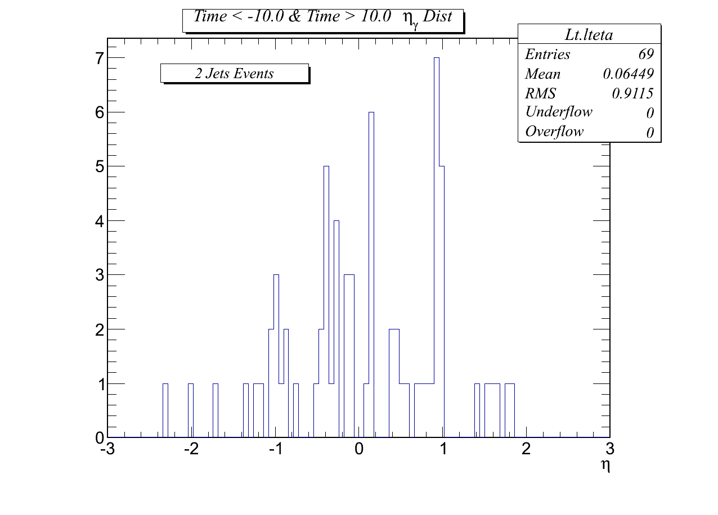
Large time Photons :
Eta for different jet multiplicity events.
1 jet events do have strange eta distribution.

Slide 19
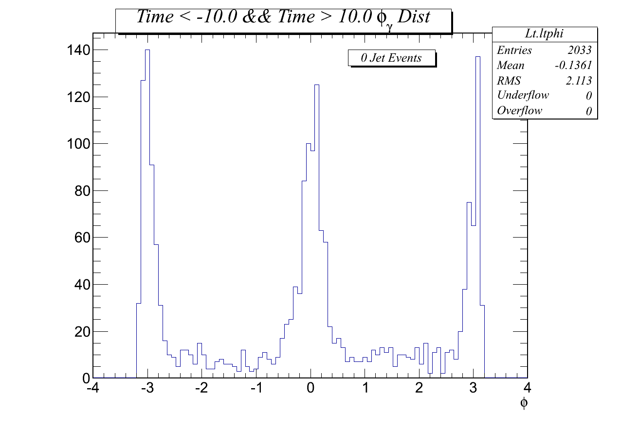
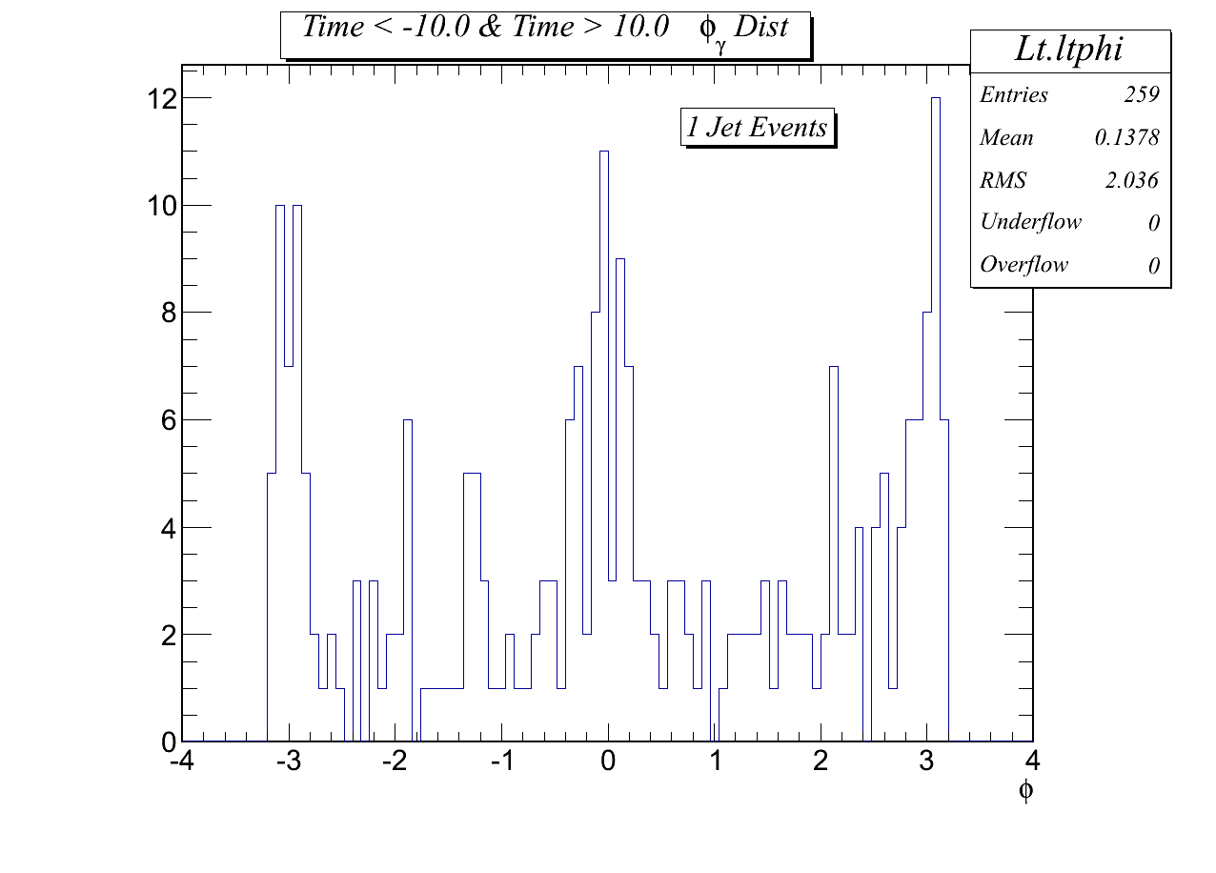
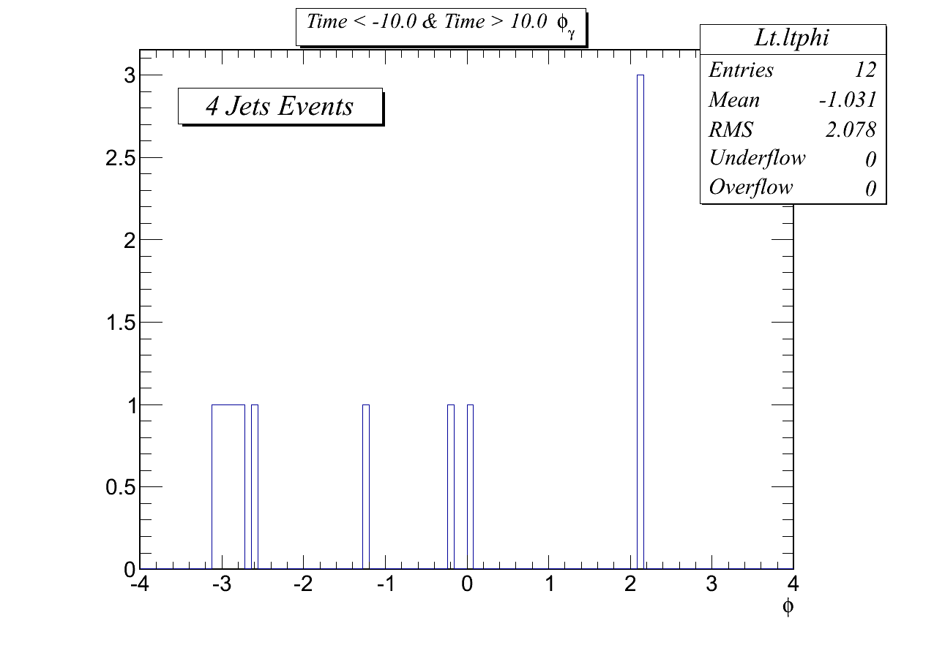
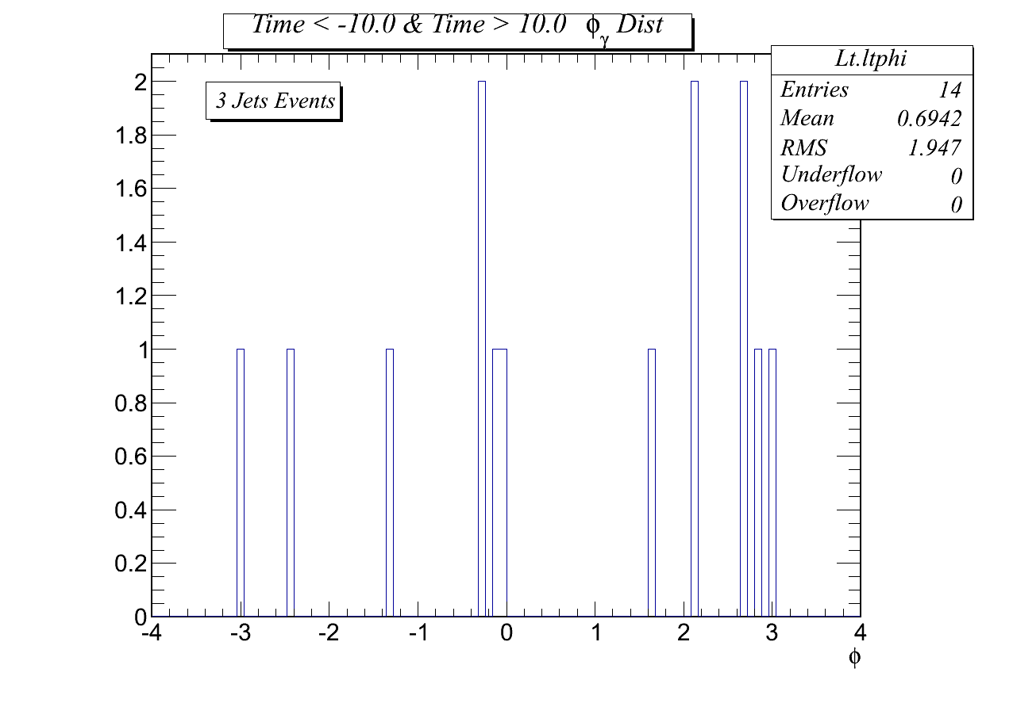
Large time Photons :
Phi for different jet multiplicity events.
1 jet events do have strange phi distribution.

Slide 20
2) Jet Multiplicity :
On Single Photon2012B DataSet.

Slide 21
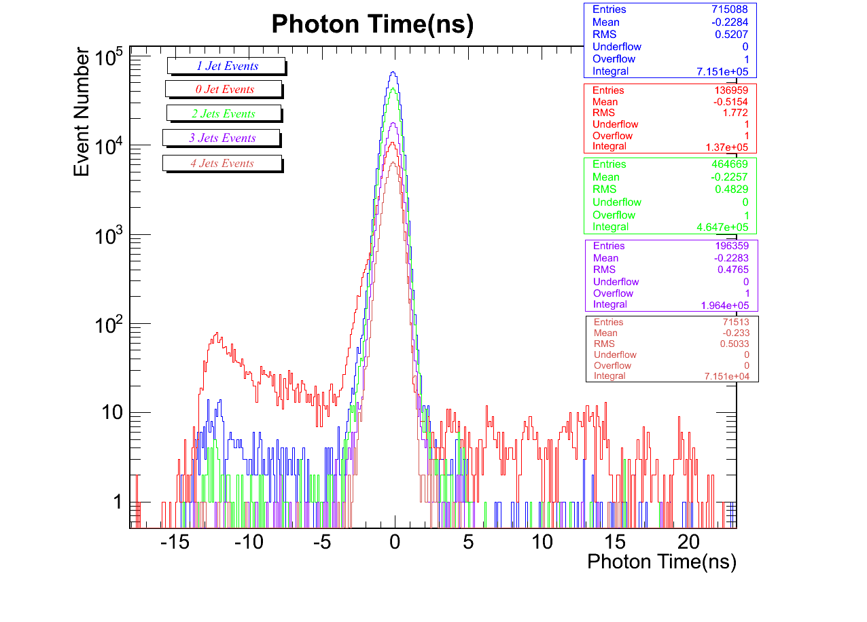
Jet Multiplicity on :
Photon Time
AP exists also in 1 & 2 jet multiplicity events.

Slide 22
Conclusion
Understanding origin of anomalous photons might need much detail studies.
At the moment, we can either :
A) Select njets >= 3 events since anomalous photon statistics is low .
Or
B) Develop a robust Filter for these anomalous photons.

