Slide 1


Search for Long-Lived Neutral Particles in Final States with Delayed Photons and Missing Transverse Energy in proton-proton collisions @
Norbert Tambe Ebai
Oral Exam
Nov 6th, 2015

Slide 2
MENU
Introduction
ECAL Timing
Search Analysis
Result
Summary
2

Slide 3
Introduction
3

Slide 4
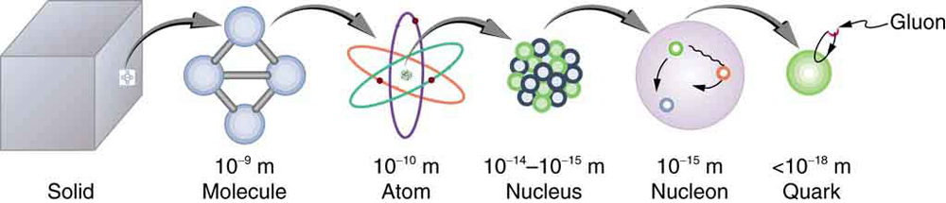
Introduction
Matter description at lengths of about one billionth of a billionth of a meter.
4

Slide 5
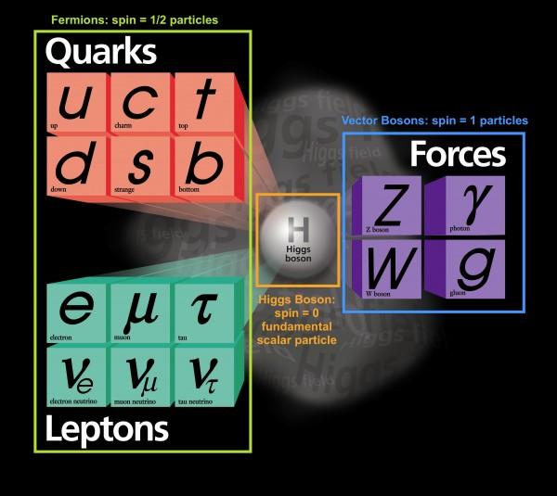
The Standard Model
Describes visible matter in the entire universe.
5

Slide 6
SM: Interactions & Lifetimes
Boson | Interaction | Symmetry | Lifetime
W, Z | Weak
Photon | Electromagnetic
Gluons | Strong
The SM does not describe gravity for which the typical lifetime is about the age of the universe(about 13.7 billion years).
6

Slide 7
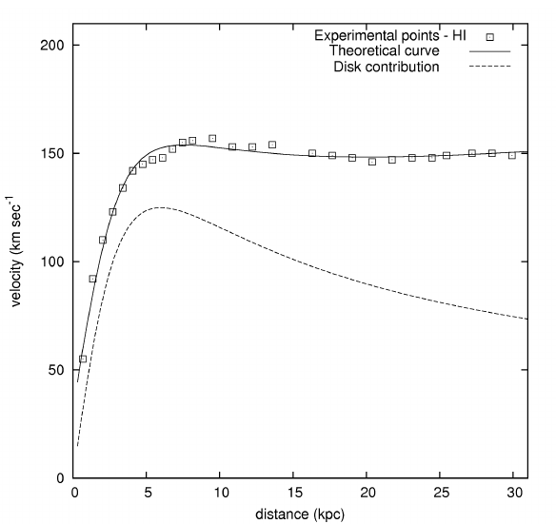
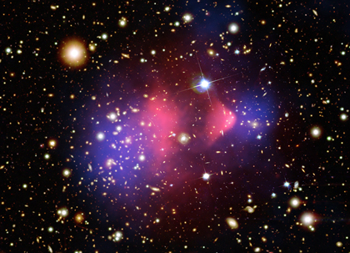
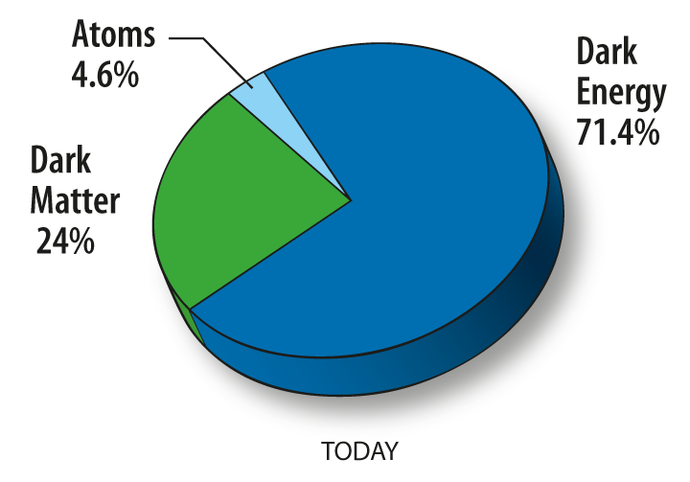
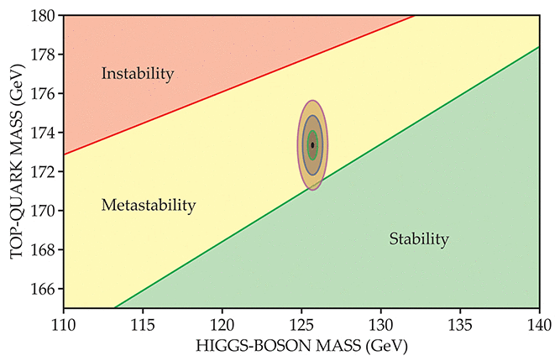
Exotic Forms of Matter
Non-Visible or Dark Matter.
Massive Long-Lived Particles.
Mass > 1 GeV/cc,
Lifetimes from one billionth of a second to 13.7 billion years,
Neutral or charged.
Meta-stable universe: V.Branchina et al: http://dx.doi.org/10.1007/JHEP09(2014)182
7

Slide 8
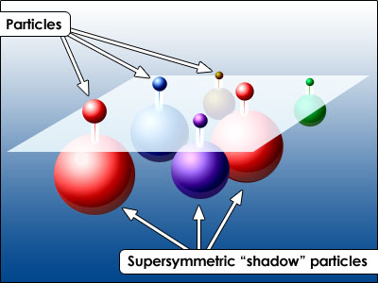
Long-Lived Particles Models
Supersymmetry (SUSY):
Gauge Mediated SUSY Breaking:
U(1) Gauge
N msgr fields, mass = M
Breaking sector
Visible sector
8

Slide 9
GMSB Long-Lived Models
Model parameters:
Typical lifetime of the NLSP with mass m is:
9

Slide 10
SPS8 Benchmark GMSB Model
Choice of parameters:
Lightest Neutralino is the Next-To-Lightest Supersymmetric Particle(NLSP) which is long-lived,
Gravitino is the Lightest Supersymetric Particle(LSP).
Lifetime of NLSP varies from few nanoseconds to several meters.
10

Slide 11
ECAL Timing
11

Slide 12
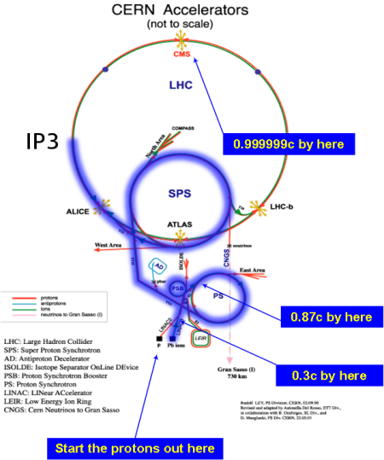
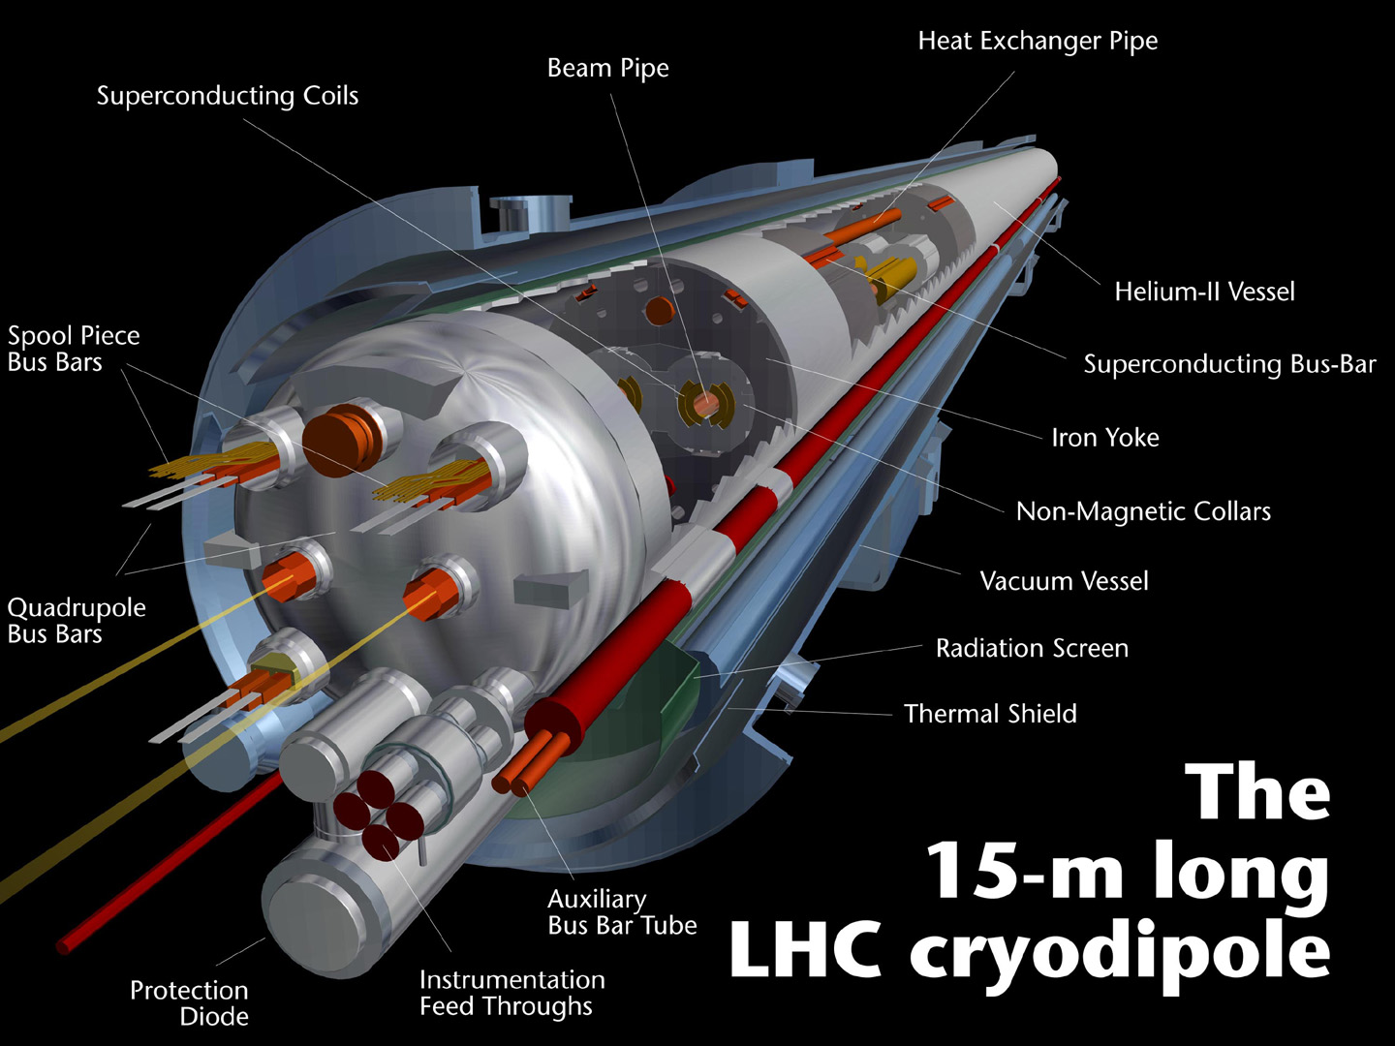
Large Hadron Collider
Aim is to search for Signatures of :
Origin of mass
Supersymmetry
Dark matter
Designed Specifications :
Proton-Proton bunch circulating in 26659m circumference synchrotron.
Accelerate protons up to 7TeV.
1.1 x10^11 protons collide every 25ns.
Dipole and quadrupole magnets steer proton beams.
12

Slide 13
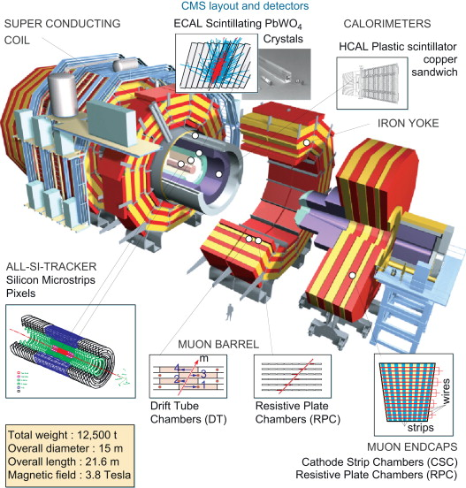
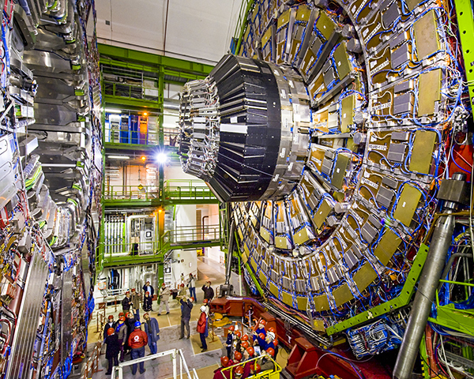
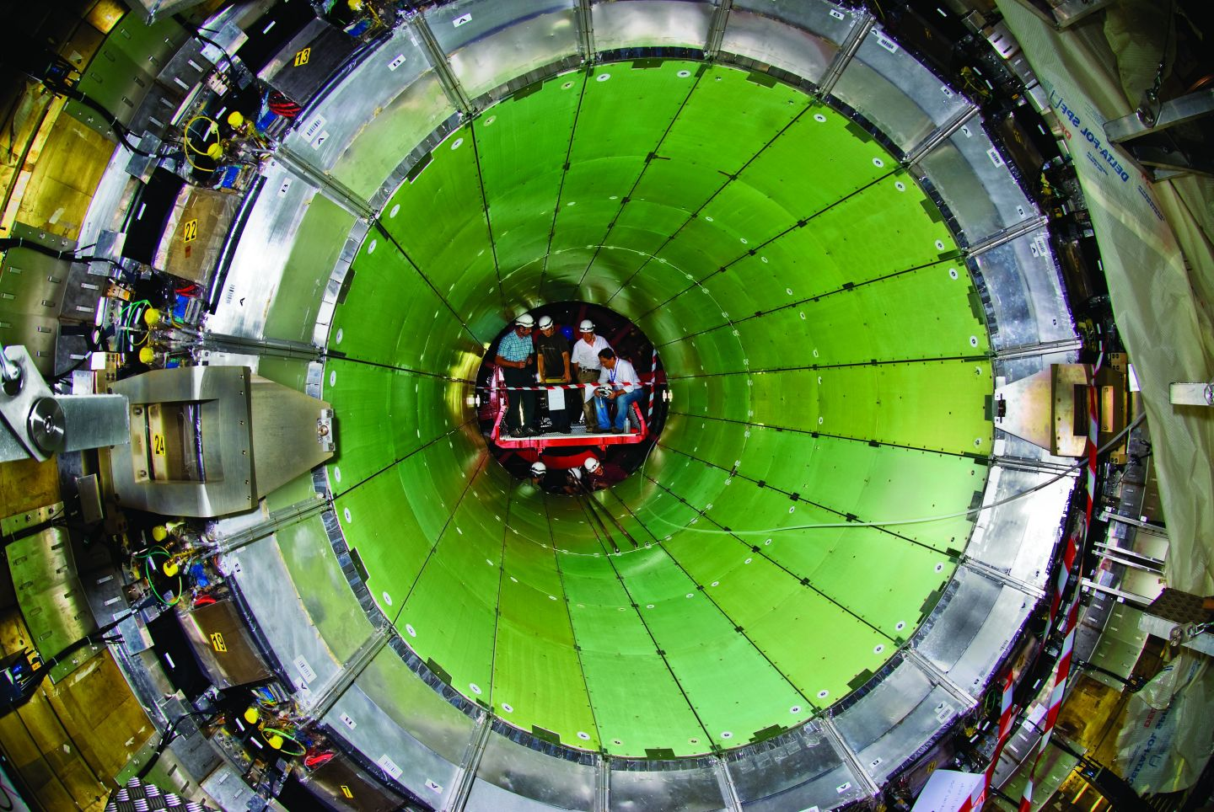
Compact Muon Solenoid
13

Slide 14
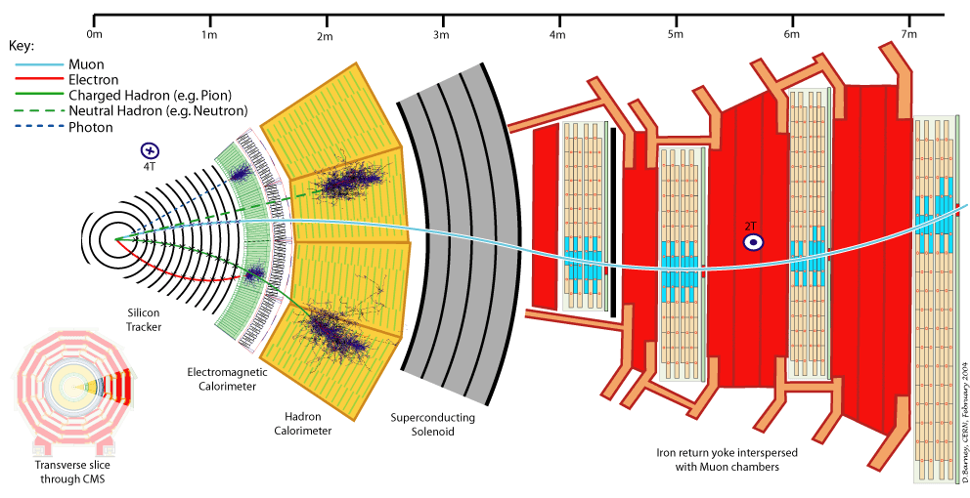
Particle Detection
14

Slide 15
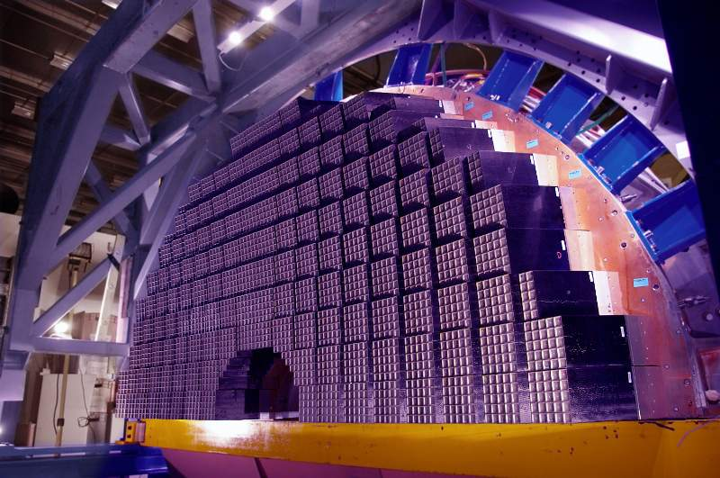
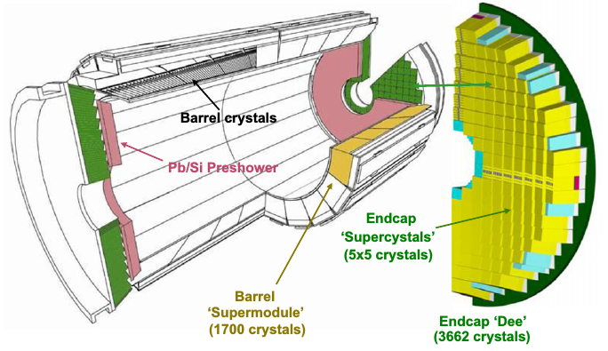
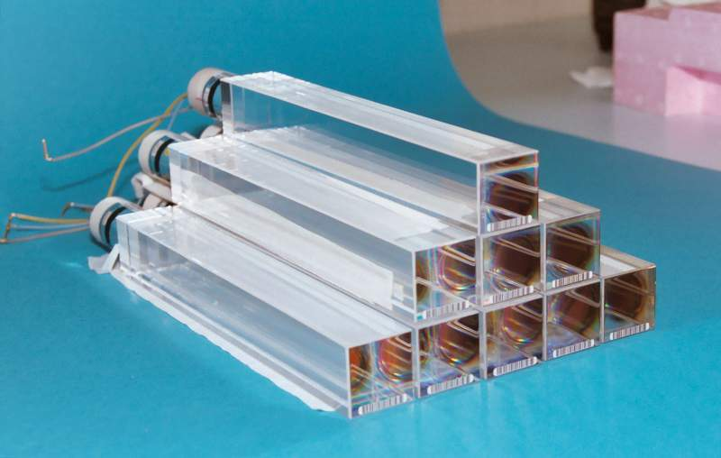
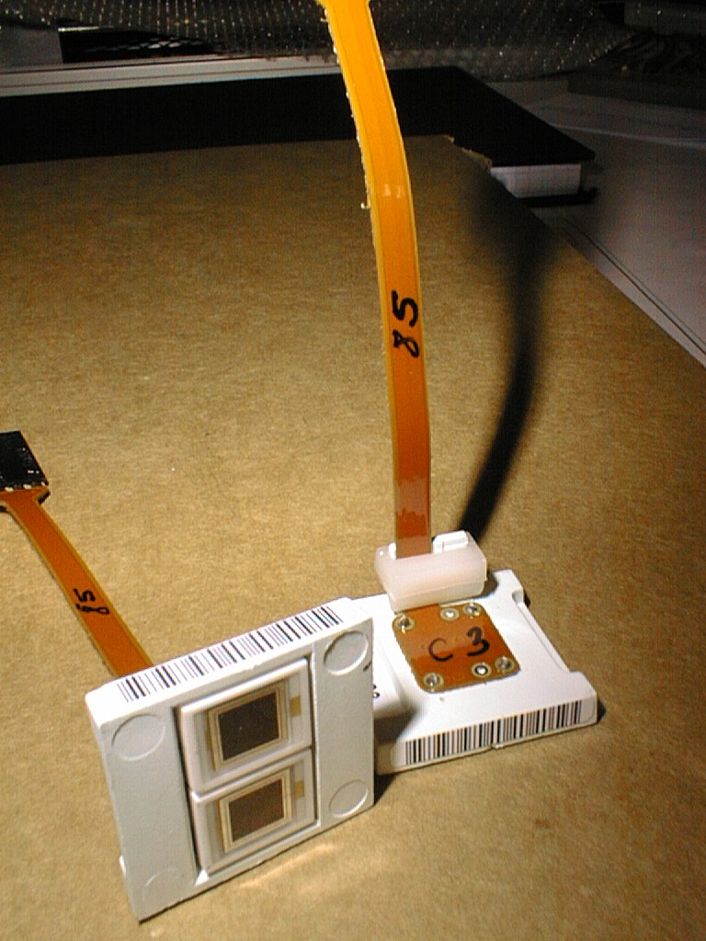
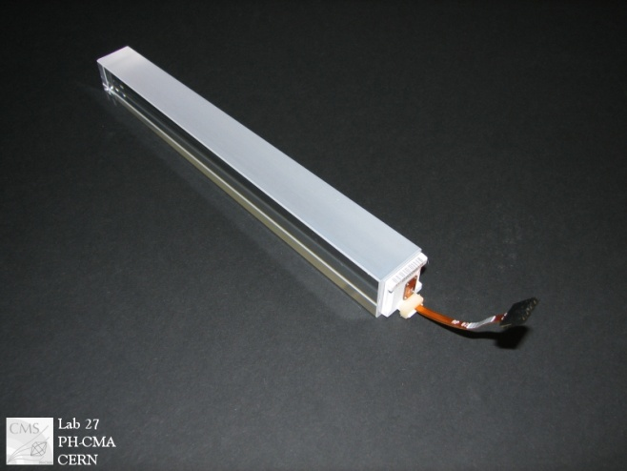
Electromagnetic Calorimeter
Lead Tungstate Homogeneous crystal calorimeter
Barrel(EB)
61200 crystals
Covers |eta| < 1.48
Uses APDs
Preshower(ES)
Pb/Si sampling calorimeter
Covers 1.65 < |eta| < 2.6
137216 Silicon Strips
Endcap(EE)
2 Endcap sides each 7324 crystals
Covers 1.48 < |eta| < 3.0
Uses VPTs photodetectors
15

Slide 16
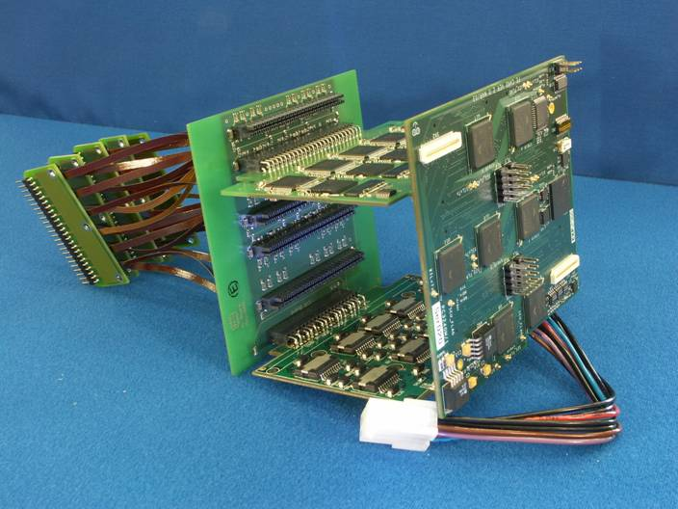
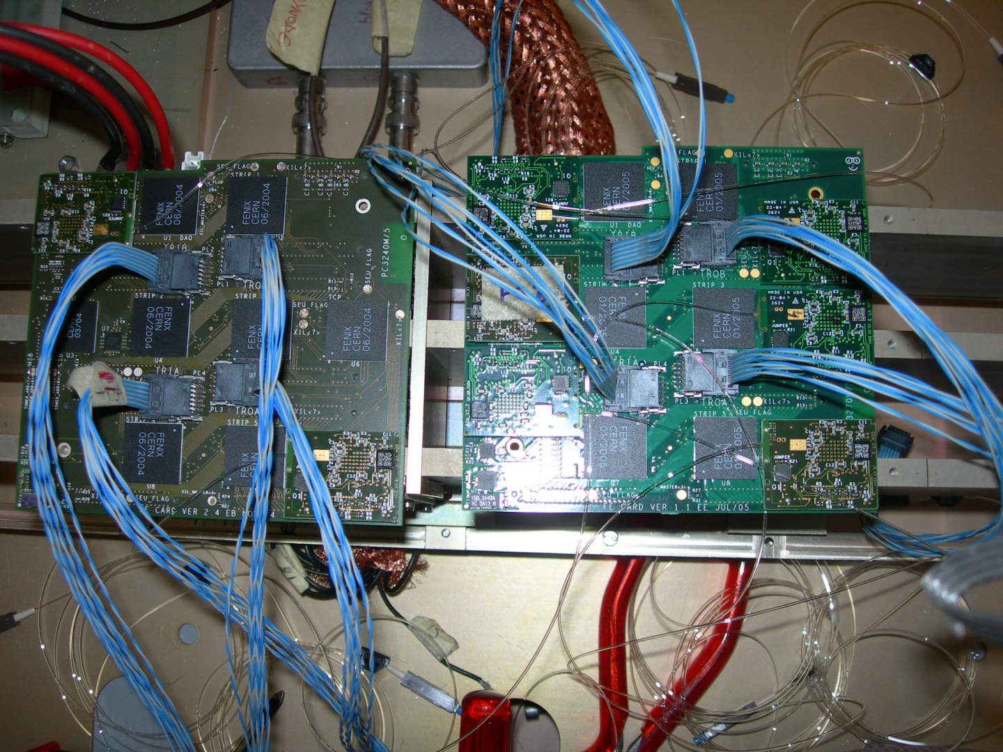
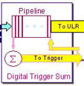
ECAL ReadOut Electronics
FE
VFE
LVR
MB
Energy
→
Light
Light
→
Current
Current
→
Voltage
Voltage
→
Bit
Bit
→
Light
DAQ
Optical Fiber
Crystal
APD
MB
MGPA
ADC
Trigger
VFE
FE
16

Slide 17
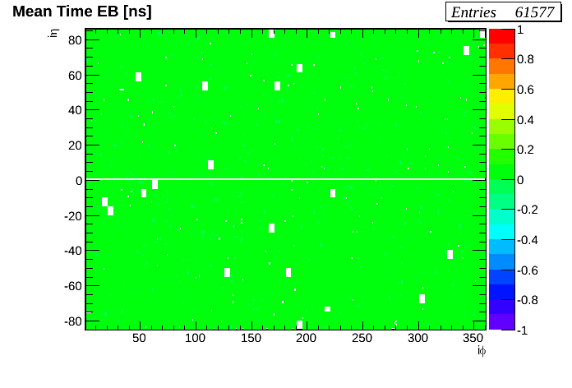
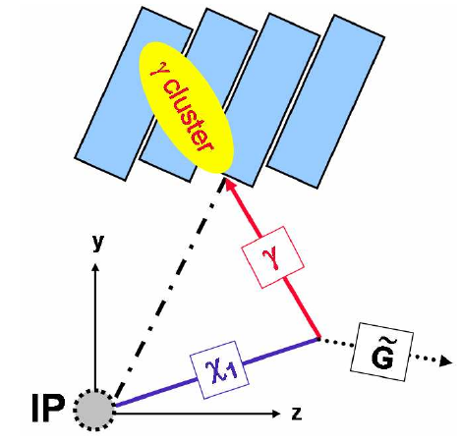
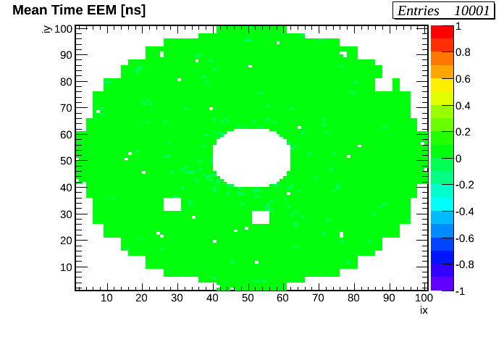
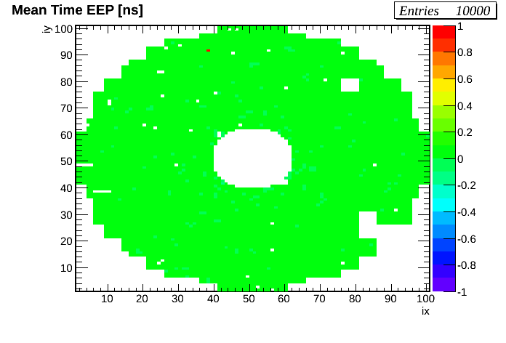
ECAL Time Measurement
ECAL timing resolution better than 400ps.
17

Slide 18
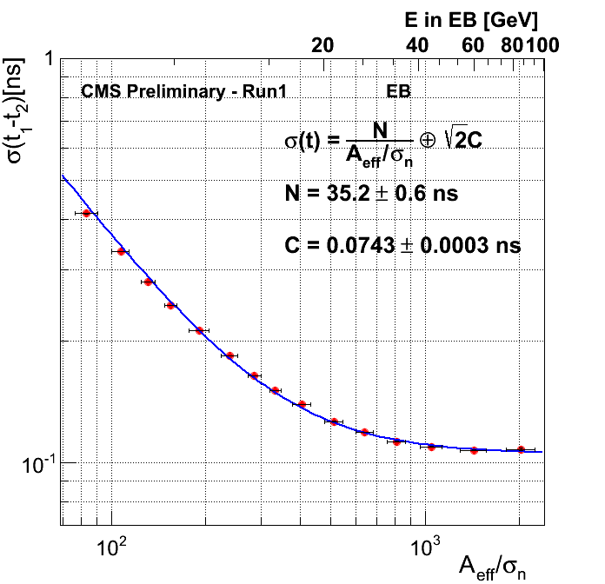
ECAL Timing Resolution
ECAL timing resolution better than 400ps.
18

Slide 19
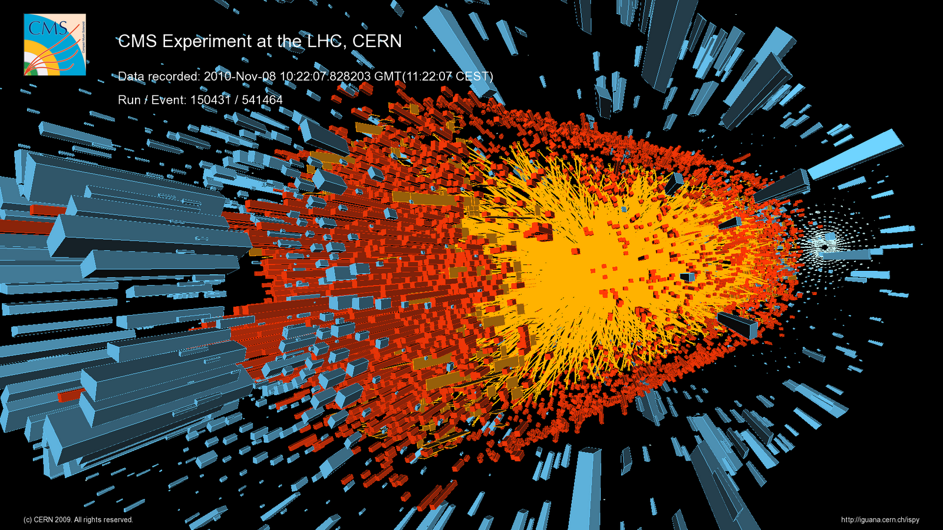
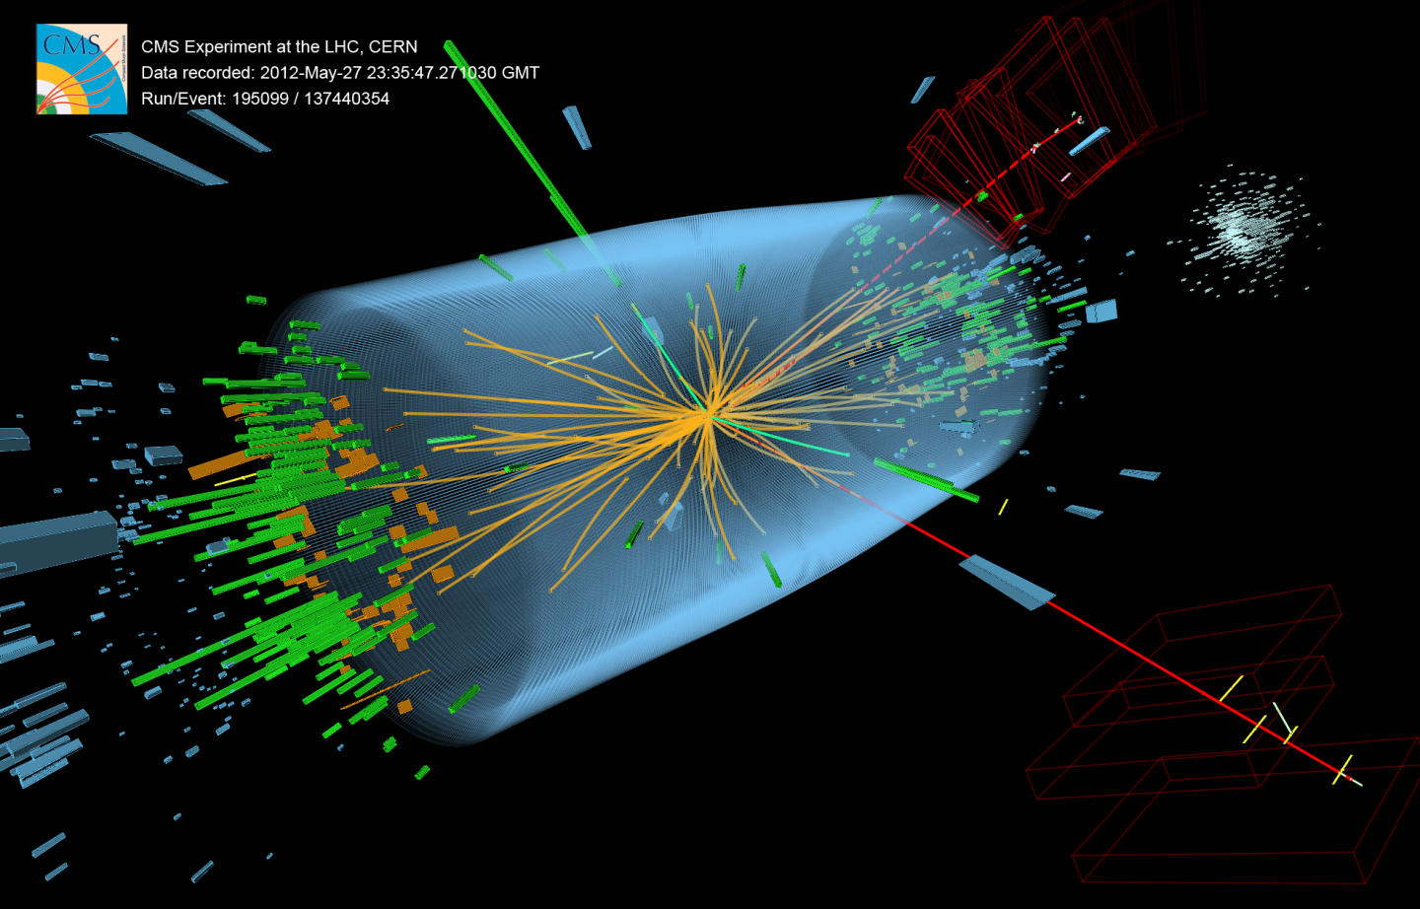
CMS Event Display
19

Slide 20
Search Analysis
20

Slide 21
GMSB-Theory Model
GMSB=Gauge Mediated Supersymmetry Breaking Model.
Long-lived particle is the supersymmetry Neutralino.
Neutralino disintegrate into a Delayed Photon and a weakly interacting particle called Gravitino observed in the detector as Missing Transverse Momentum(MET).
We use photon arrival time(TIME) at electromagnetic calorimeter to observed delayed photon.
Parameters Decay length (ctau[mm or ns]) and supersymmetry breaking energy scale,(Lambda[TeV]) determines the Lifetime[mm or ns] and Mass[GeV/c^2] and momentum[GeV/c] of neutralino.
17

Slide 22
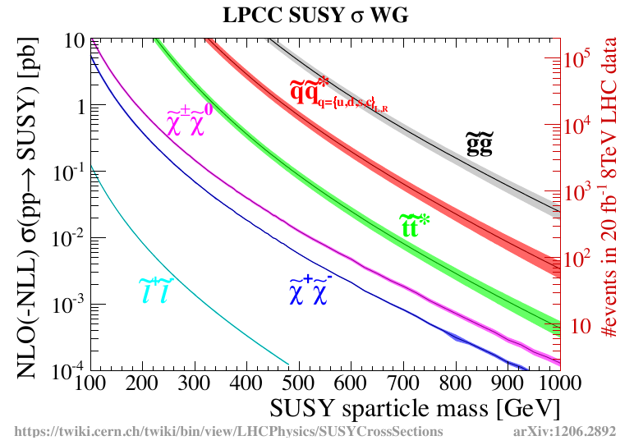
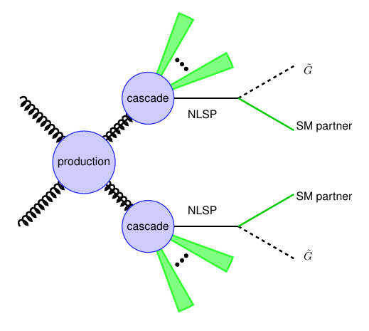
New Particles @ LHC
Event Rate = Cross Section(E)[cm^2]*Luminosity[/s cm^2]*Efficiency
1 barn[b] = 10^(-24)cm^2
Supersymmetry produced at LHC in strong interactions.
18

Slide 23
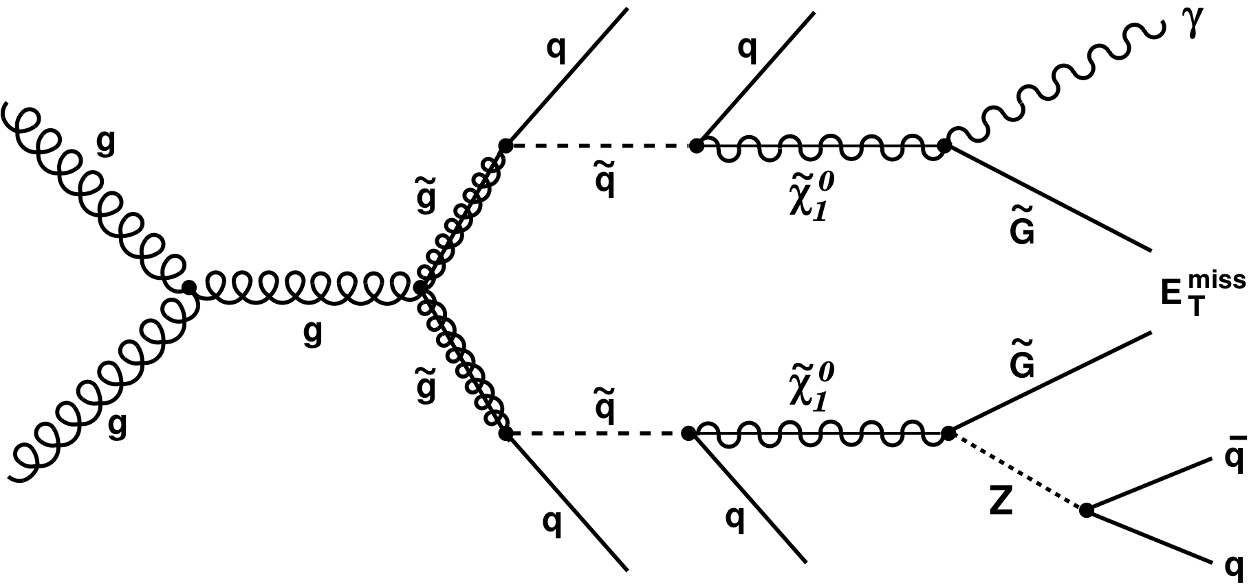
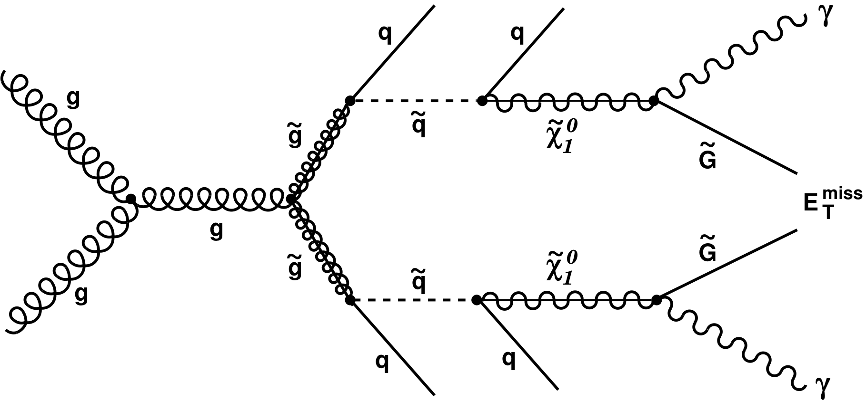
Signal & Background
Signal Events
>= 1 Late Photons +
>= 2 Jets +
Large MET
Background Events
Collision Events
Events with similar topology,
Anomalous events.
Non-Collision Events
Beam Halo Muon Events,
Cosmic Muon Events.
19

Slide 24
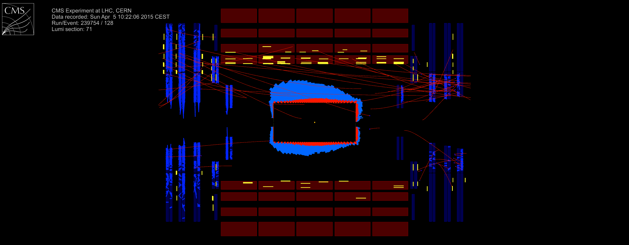
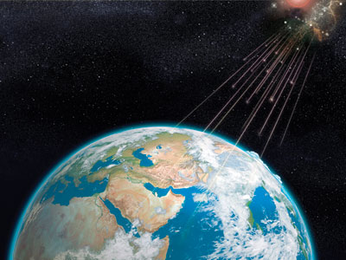
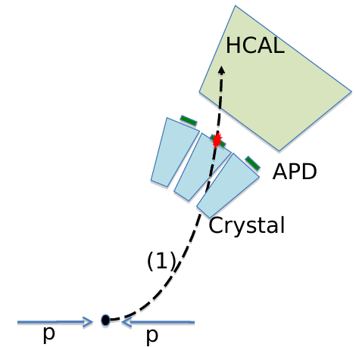
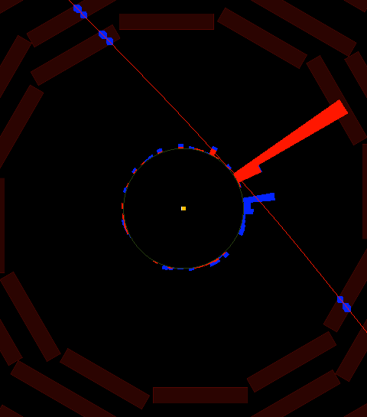
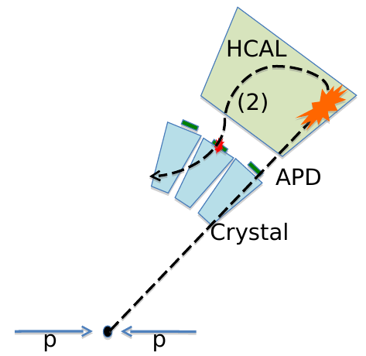
Non Collision Events
Can arrive late as delayed real photons.
Can also pass our event selection criteria.
Beam Halo Events
Cosmic Muon Events
Spike Events
20

Slide 25
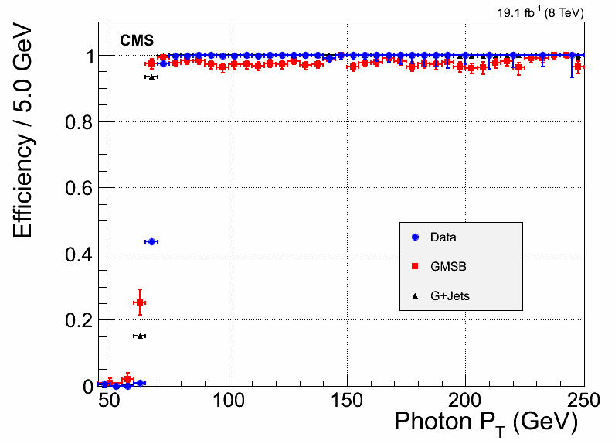
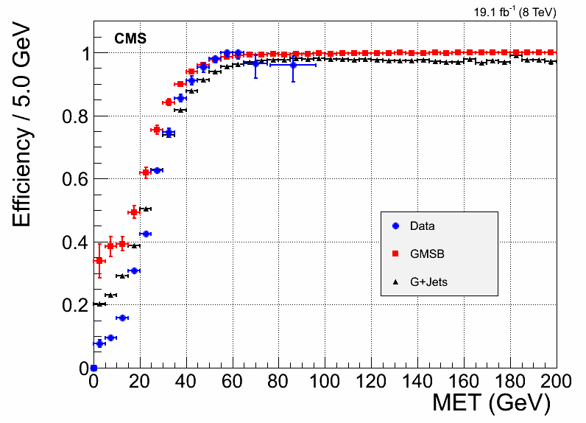
Data & Triggers
Triggered SinglePhoton DataSet Total = 19.1/fb
We select events by cutting where efficiencies become flat.
21

Slide 26
Event Selection
Signal candidate events are selected by applying selection cuts on event properties and observables.
Quantity Description | Variable | Selection Cuts
Photon Transverse Momentum | Pt | > 80 GeV/c
Detector Acceptance Region Other Quality events Cuts | | eta | | < 1.48
Jets Transverse Momentum Number Of Jets in Event | Jet Pt Njets | > 35 GeV/c >= 2
Missing Transverse Momentum | MET | > 60 GeV
Photon Arrival ECAL Time | ECAL Time | > 3 ns
22

Slide 27
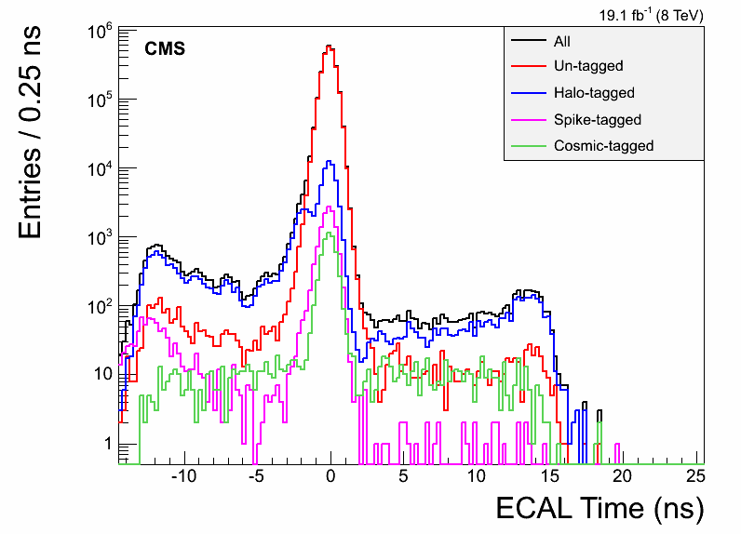
Background Estimation
After Event Selection & Tagging
Miss-Tag Event Rate
Beam Halo Muons. | 5 %
Cosmic Muons. | 6%
Anomalous or Spike. | 1.5%
Our selection still does not completely remove ALL background events.
23

Slide 28
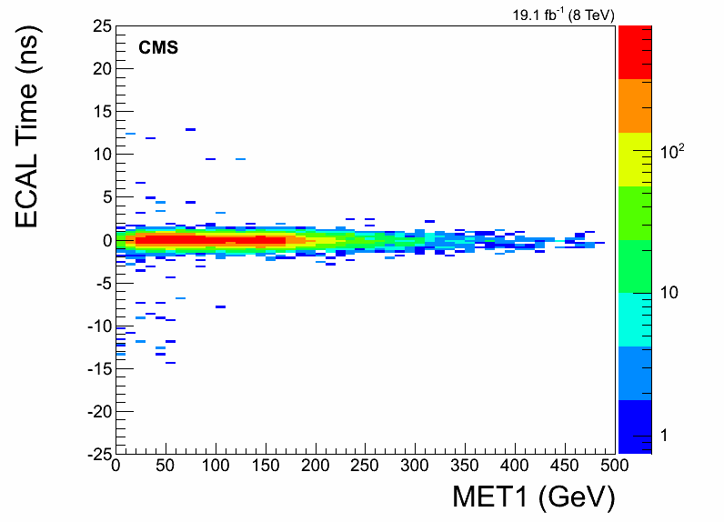
Background Estimation
ABCD background estimation using observed variables TIME and MET.
A
D
A/B = D/C
=>D = C*A/B
B
C
Compare D from expectation with D from observation to validate method.
24

Slide 29
Results
25

Slide 30
Results
Expected Number of Events = 0.088
Observed Number of Events = 1
This Observed event turns out to be a cosmic muon mimicking the signal of a new Long-lived particle.
We produce limit on the mass and lifetime of a long-lived neutralino decaying to a delayed photon in the GBSM model.
26

Slide 31
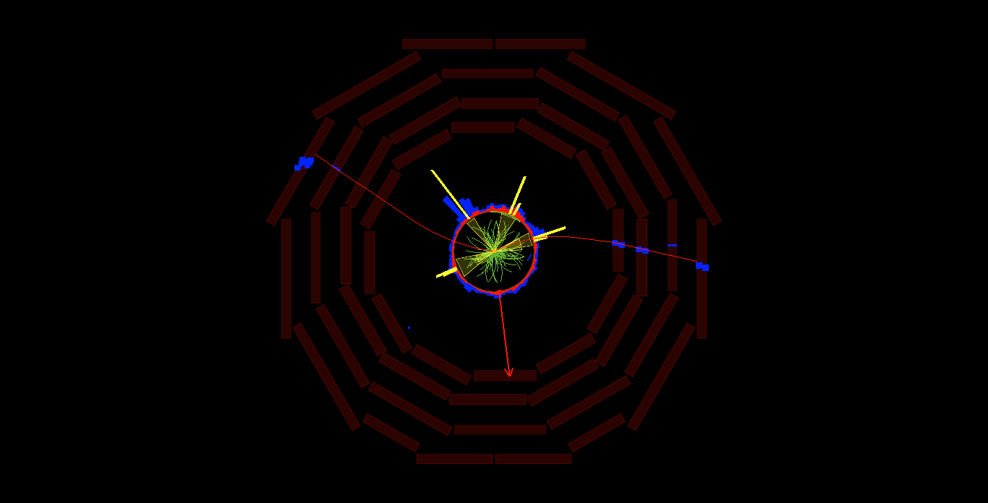
Observed Event Display
CMS Detector Transverse View
CMS event display of observed cosmic muon event in CMS detector.
27

Slide 32
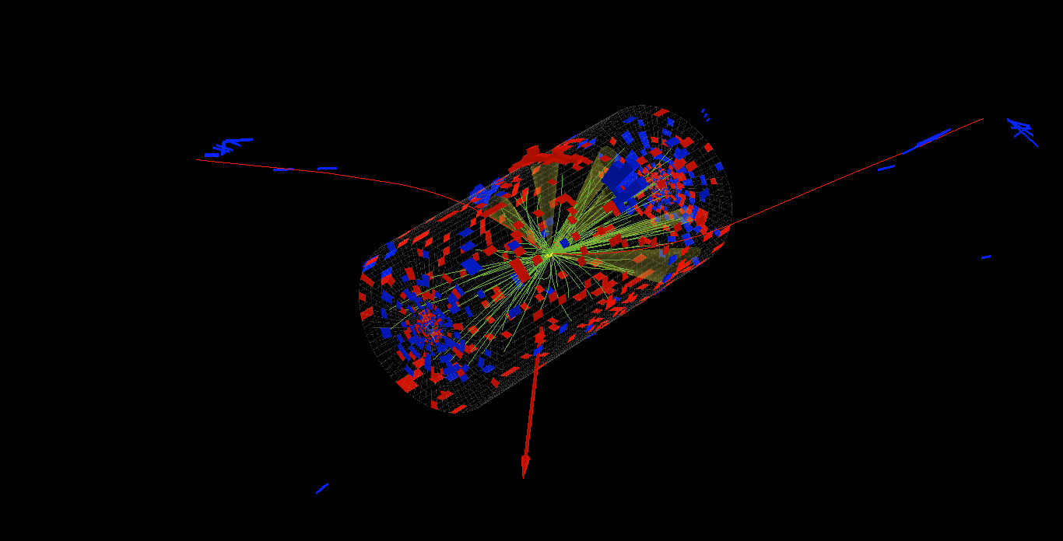
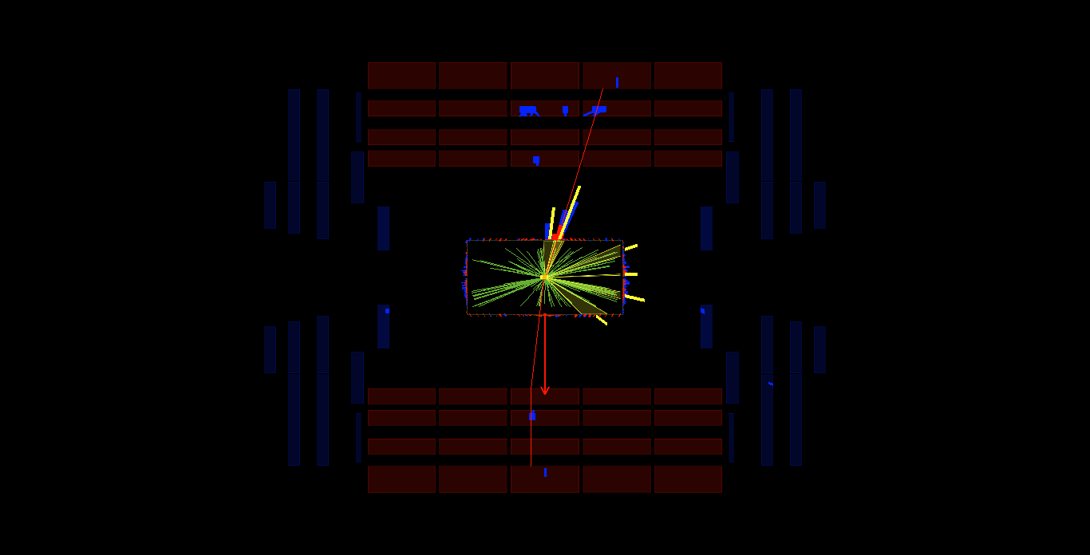
Observed Event Display
3D View
Rho – Z View
CMS event Display of observed Cosmic Muon event in CMS detector.
28

Slide 33
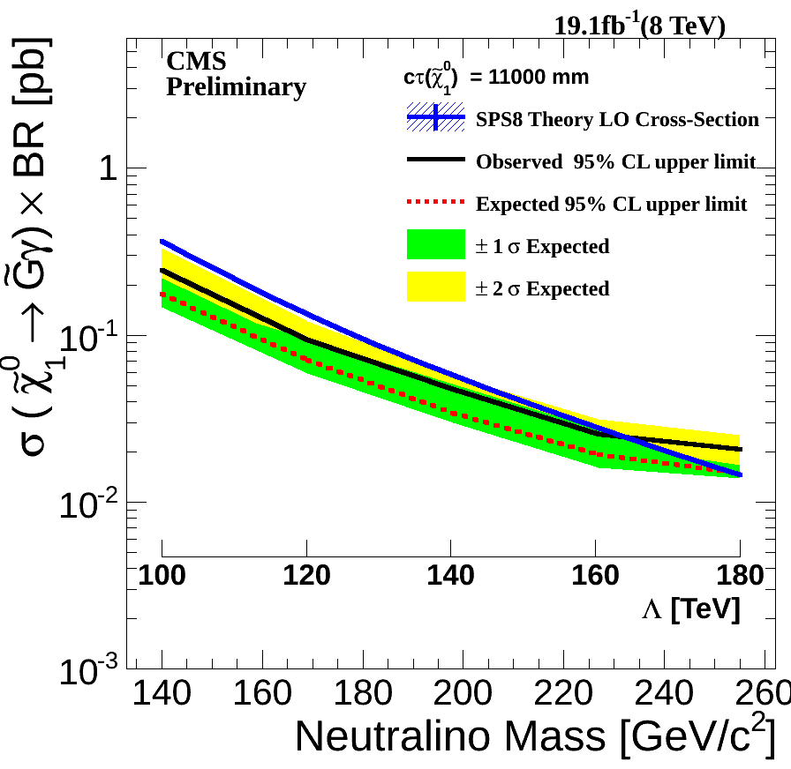
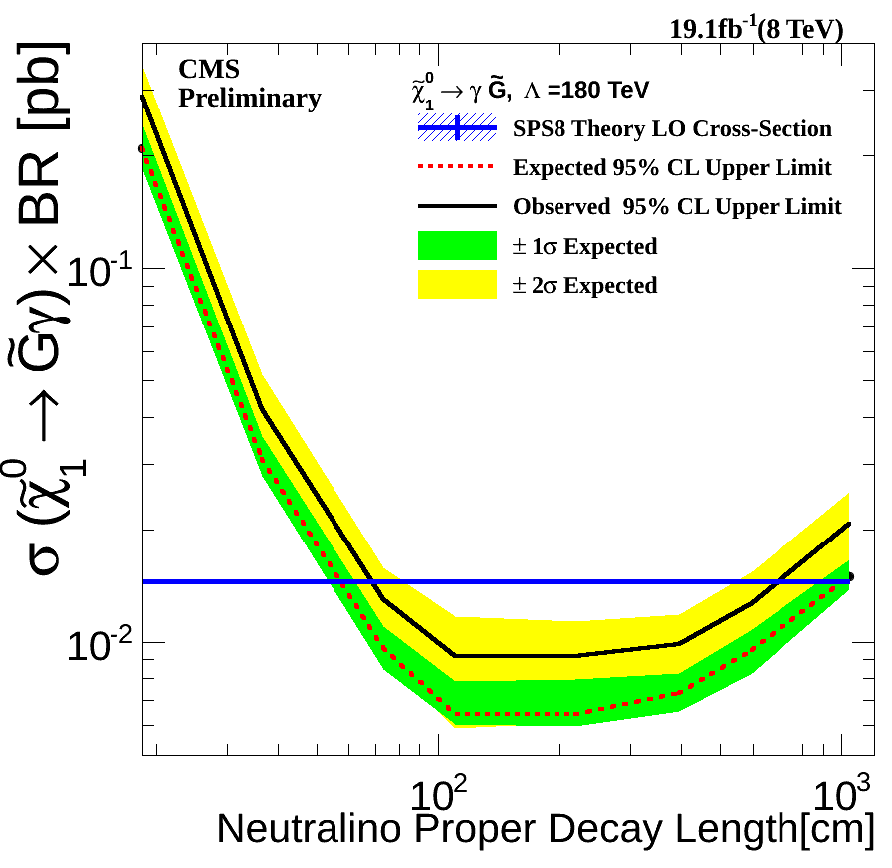
Limits: Mass & Lifetime
29

Slide 34
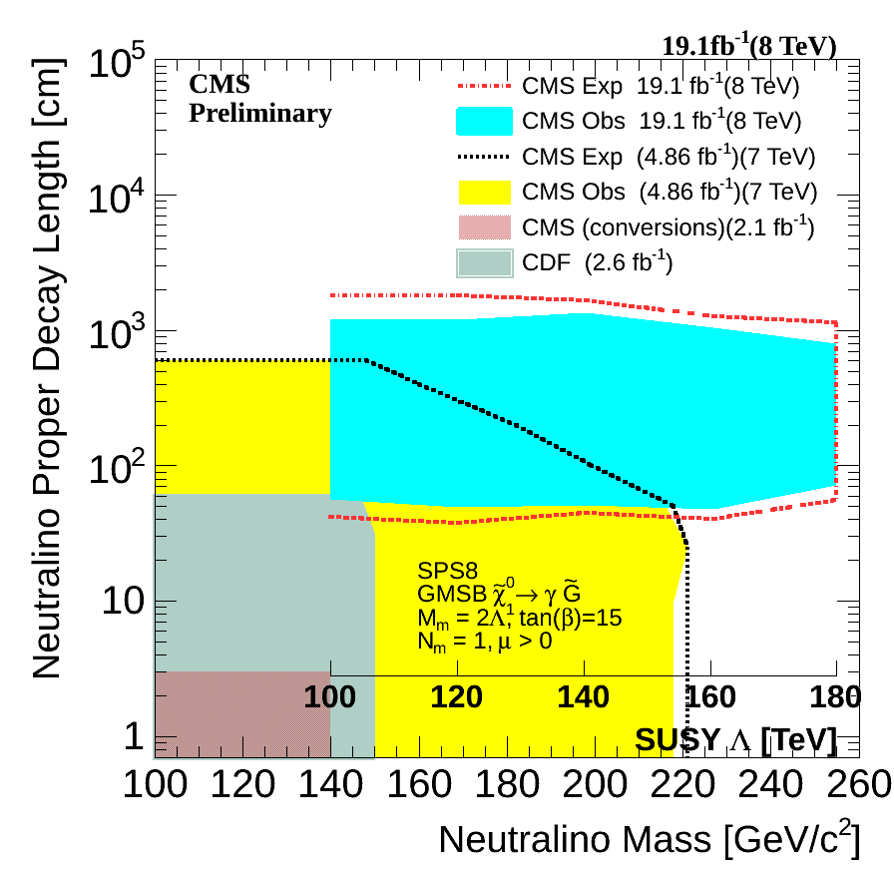
Limits: combined
Excluded Supersymmetry Neutralino particles with Mass < 258 GeV/C^2 and Lifetime < 35 ns.
30

Slide 35
Summary
31

Slide 36
Summary
Motivation for performing a search for long-lived neutral particles at LHC.
Brief description of LHC collider and CMS detector particularly the ECAL as used.
We presented a search analysis for neutralino as a long-lived particle decaying to photon using CMS detector. ECAL timing measurement of the photon arrival time is used for identifying the delayed photon.
The search result is presented and limits shown for neutralino mass and lifetime.
Excluded regions relevant for future similar search for neutralino is also presented.
32

Slide 37
Thanks A LOT!
33

Slide 38
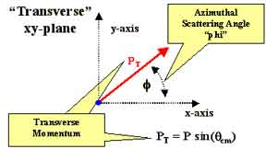
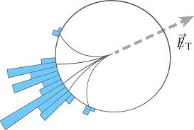
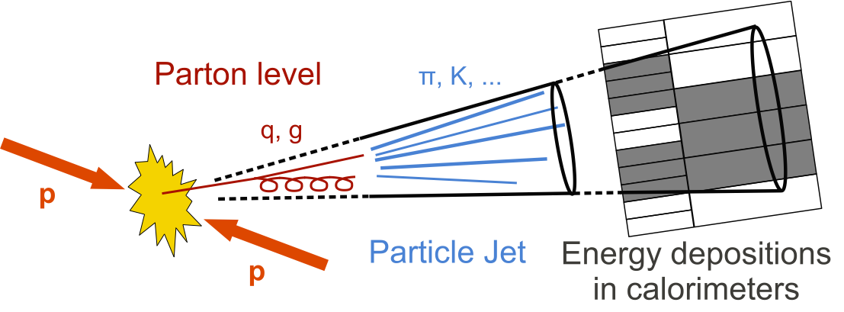


BackUp: Physics Objects in CMS
34

Slide 39


Efficiency & Acceptance
Transverse Detector Decay Length
Particle Inherent Decay Length
Efficiency and Acceptance determines our final Observed event rate.
35

Slide 40
Systematics
The possible sources of systematics considered in this search analysis and their contribution.
Systematic Uncertainties.
Systematic Source | Uncertainty(%)
Absolute Reference ECAL Time | 10% to 6%
Unclustered Energy | 10% to 4%
Photon Energy Scale | 4% to 2%
ECAL Timing resolution | 5% to 2%
Jet Energy Scale | 9% to 3%
Jet Energy Resolution | 9% to 2%
Luminosity and Choice of PDF | 2.6 and < 1%
36

Slide 41
Dark Matter?
Properties
Stable(long-lived).
Neutral; does not interact with light.
Light or massive?
Where are Dark Matter particles?
37

Slide 42


HCAL Electronics Upgrade
How data flow from HCAL-front-end to back-end electronics
HCAL Front-end Electronics
Current back-end (VME)
HCAL
Charge Integrator
(QIE)
Photo diodes
Fiber optic
link
HCAL Back-end Electronics (VME)
DAQ
Data Concentrator
Card
HCAL Trigger &
Readout Cards
Future back-end (μTCA)
Micro Telecommunication and Computing Architecture(uTCA) to handle high bandwidth for global DAQ. Current data transfer rate based on VME is 1.6Gbps compared to 4.8Gbps for uTCA.
13

