Slide 1
FoodBridge AI
AI for Sustainability
Reducing food waste by connecting safe surplus food with community needs
SDG 2 • Zero Hunger
SDG 12 • Responsible Consumption
SDG 13 • Climate Action
Project presentation
FoodBridge AI | React + TypeScript + Vite | IBM BOB prototype

Slide 2
1. The problem we are solving
Food waste and food insecurity exist at the same time
Food surplus
Community need
The gap
• Restaurants, homes and events may have edible surplus
• Food can become waste because it is not matched quickly
• Donors may not know who can receive it
• People and community groups need accessible food
• Manual coordination is slow and fragmented
• Urgent needs require prioritisation
A coordination and decision-support problem
FoodBridge AI | AI for Sustainability | 2

Slide 3
2. Our solution: FoodBridge AI
A prototype that supports safer decisions and faster community matching
1
2
3
4
Analyse food
Match needs
Track donation
Measure impact
Estimate freshness using food category + age
Filter suitable community recipients
Move from matched to completed
Update food and sustainability metrics
Human-in-the-loop: AI advises; people make the final donation decision
FoodBridge AI | AI for Sustainability | 3

Slide 4
3. System architecture
How the main parts of the prototype work together
React + TypeScript UI
Application services
Food Analyzer
Matching Service
Donation Store
Impact Metrics
Demo data + sessionStorage
The prototype is intentionally deterministic and explainable; external AI/RAG is not required for the demo.
FoodBridge AI | AI for Sustainability | 4

Slide 5
4. Where AI is used
AI is applied as decision support—not as an uncontrolled automatic decision-maker
Food freshness analysis
AI advisory explanation
Intelligent matching logic
• Inputs: food category
• Age / time since preparation
• Food-specific safety thresholds
• Output: Fresh / Caution / Stale / Spoilage
• Explains the detected condition
• Suggests whether donation is advisable
• Provides a reason the user can understand
• Keeps the final action with the human
• Category compatibility
• Quantity and availability
• Location / urgency factors
• Only valid matches are shown
Responsible AI principles: explainability • safety-first • deterministic demo • human oversight
FoodBridge AI | AI for Sustainability | 5

Slide 6
5. Flowchart: food safety analysis
The decision path used by the prototype
User enters food details
Identify food category
Compare age with category threshold
Fresh / Caution
Stale
Spoilage
Advisory result + explanation + recommended next step
Important: the prototype is a decision-support demo, not a substitute for professional food-safety inspection.
FoodBridge AI | AI for Sustainability | 6

Slide 7
6. Flowchart: from analysis to donation
How a safe food item becomes a tracked community donation
Food analysis complete
Find compatible recipients
Check availability + urgency
Create donation
Matched
Impact metrics update after completion
Accepted → In Transit → Completed
The lifecycle makes the impact measurable instead of relying on static demo numbers.
FoodBridge AI | AI for Sustainability | 7

Slide 8
7. How FoodBridge AI supports sustainability
The project connects a digital workflow to measurable social and environmental goals
SDG 2
SDG 12
SDG 13
Zero Hunger
Responsible Consumption
Climate Action
Helps route edible surplus toward community needs
Reduces avoidable food waste through better coordination
Avoided waste can reduce the emissions associated with wasted food
Better analysis
Faster matching
More completed donations
Less avoidable waste
FoodBridge AI | AI for Sustainability | 8

Slide 9
8. What we measure
The donation lifecycle turns activity into visible impact
Food analysed
Donations completed
Number of food checks completed
Only completed donations count toward impact
Meals supported
Waste diverted
Derived from completed donation quantities
Quantity associated with completed donations
Metrics are reactive: when a donation moves to Completed, the dashboard can update from stored lifecycle data.
FoodBridge AI | AI for Sustainability | 9

Slide 10
9. Suggested live demo
A short presentation sequence that tells the complete story
01
Dashboard
Show baseline metrics and the AI for Sustainability positioning
02
Food Analyzer
Enter a food category and age; explain the advisory result
03
Community Matching
Show how category, quantity, availability and urgency affect matches
04
Donation Status
Move Matched → Accepted → In Transit → Completed
05
Impact Dashboard
Return to the dashboard and show the completed donation reflected in metrics
FoodBridge AI | AI for Sustainability | 10

Slide 11
10. Responsible AI and limitations
What the prototype does—and what it does not claim
Responsible design choices
Limitations to state clearly
• Explainable outputs instead of black-box scores
• Food-category thresholds are visible and auditable
• Human approval remains part of the donation flow
• Demo uses deterministic logic and mock data
• Not a certified food-safety inspection system
• No guarantee that food is safe based only on age
• Matching is prototype logic, not a live NGO network
• External RAG / production AI integrations are future work
Trust comes from transparency, not from claiming that AI is perfect.
FoodBridge AI | AI for Sustainability | 11

Slide 12
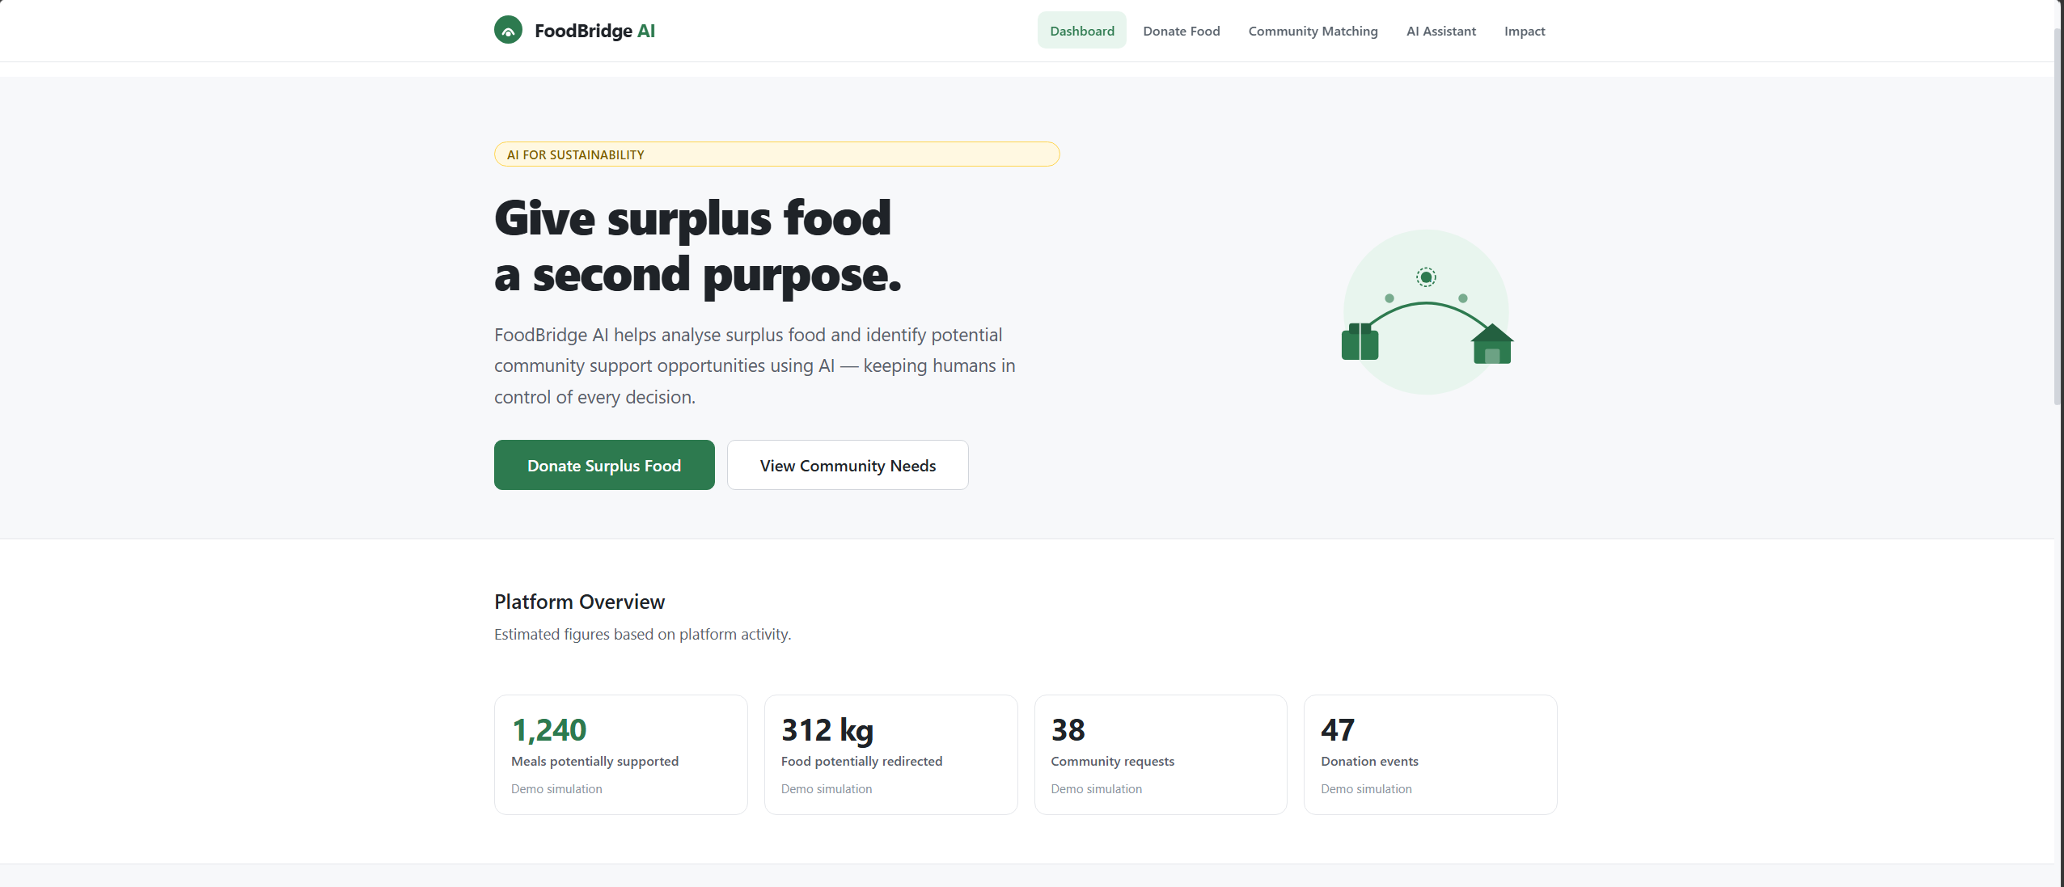
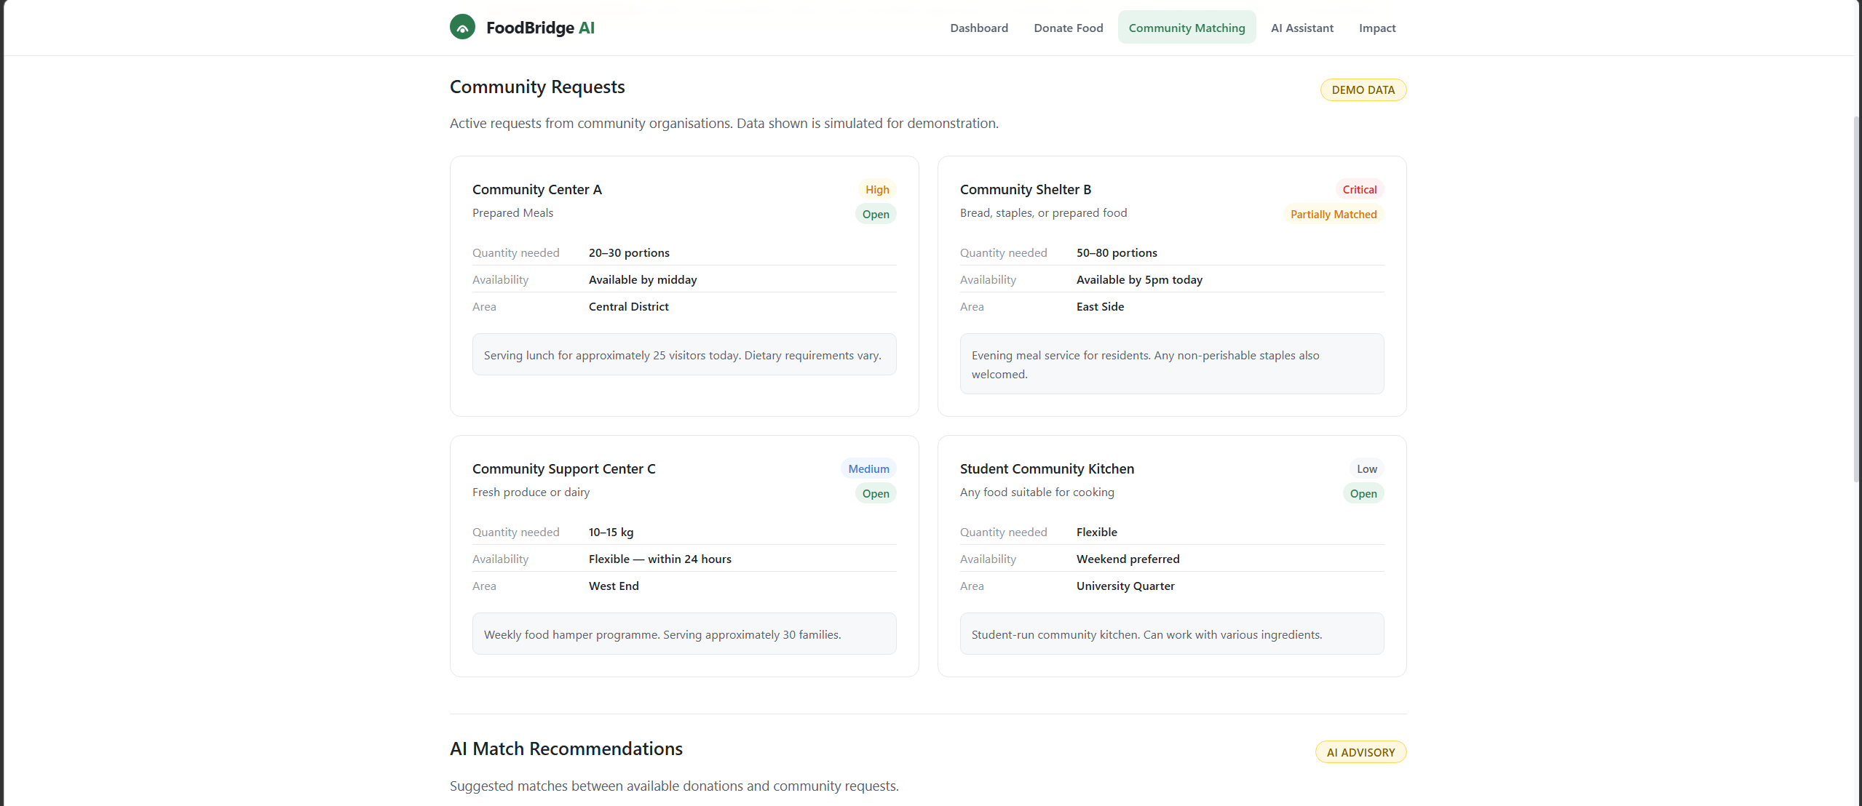
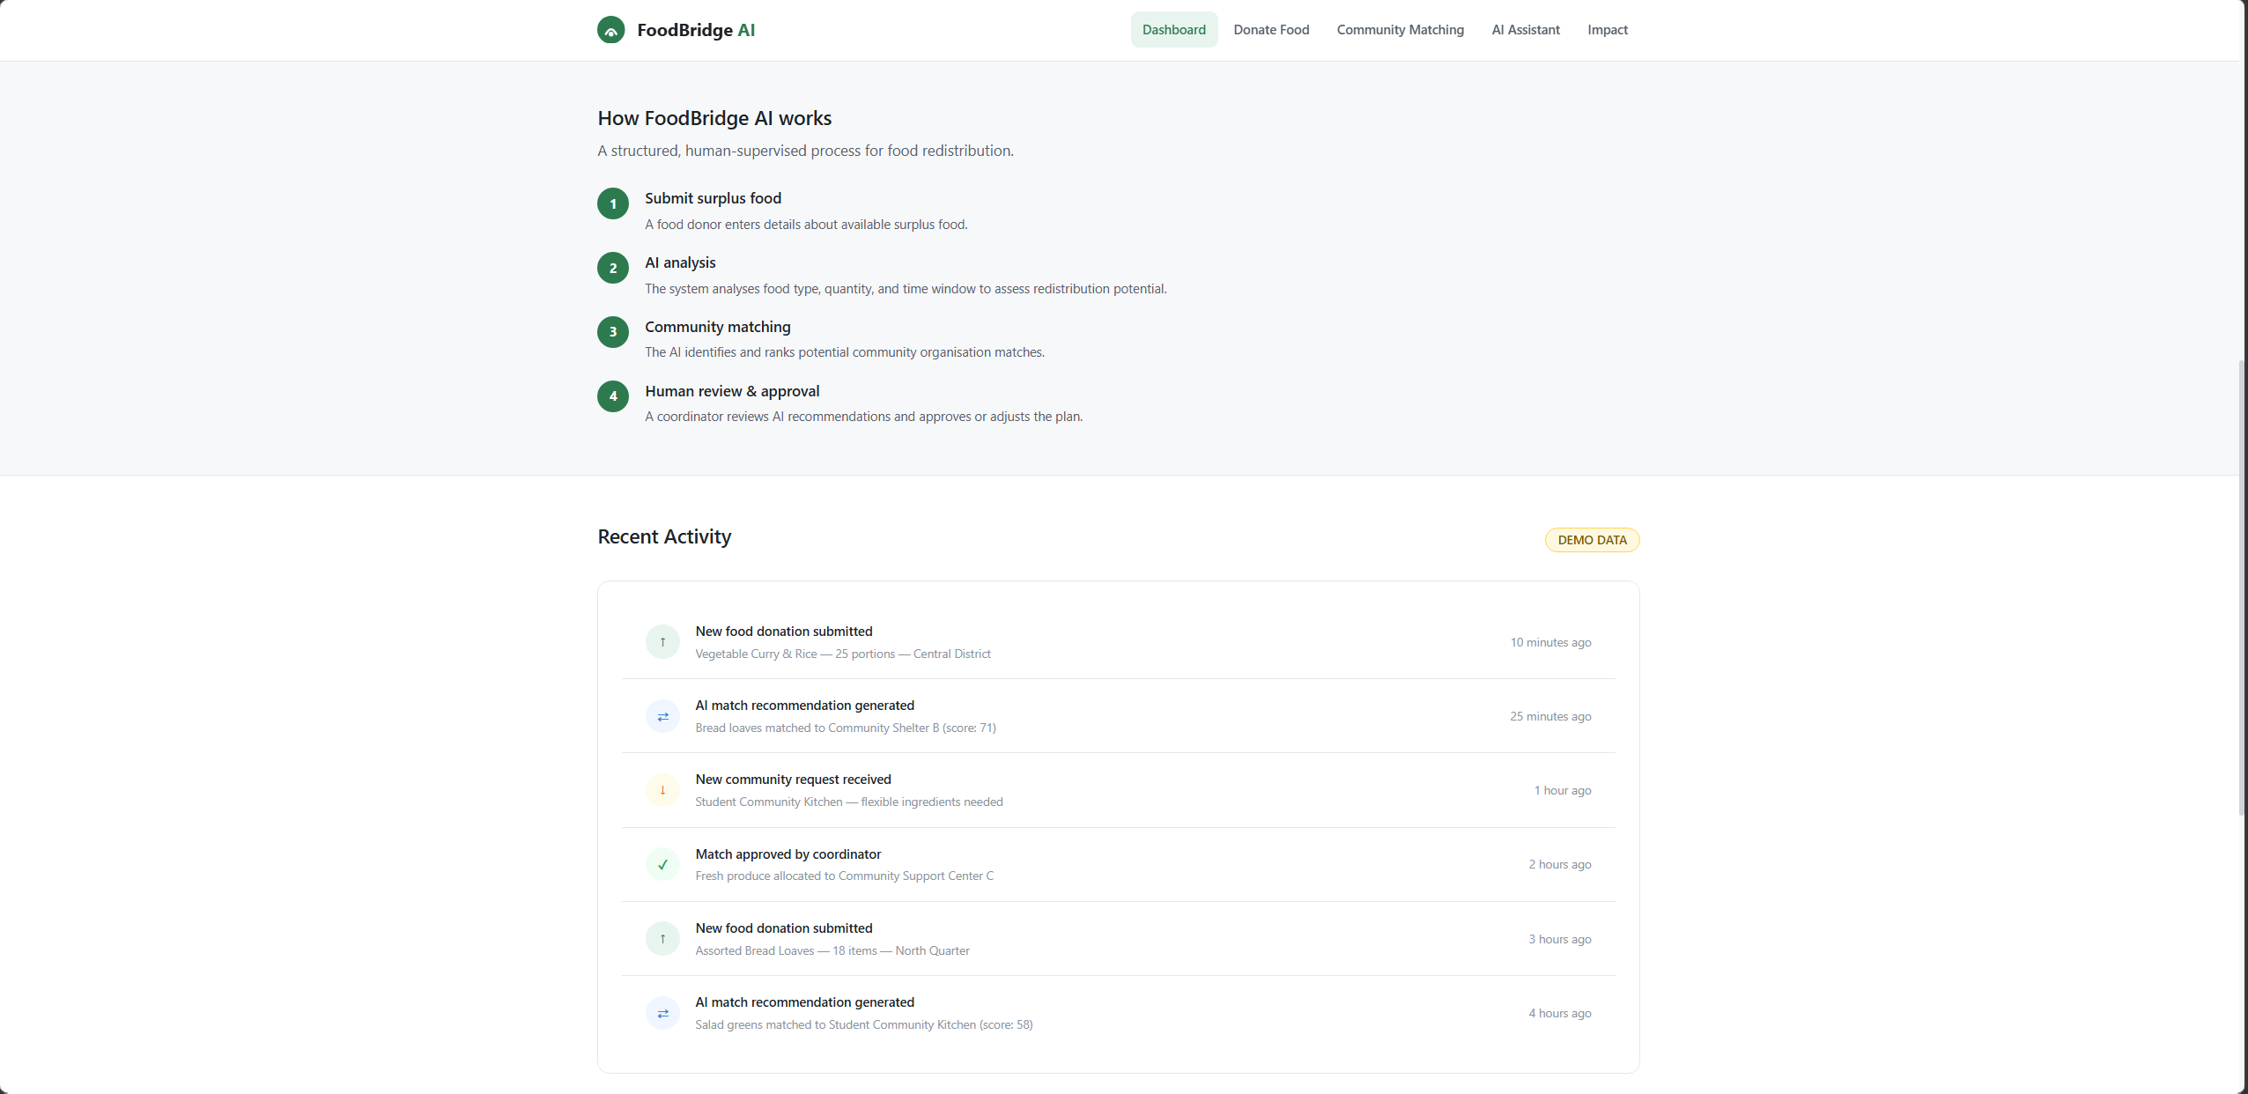
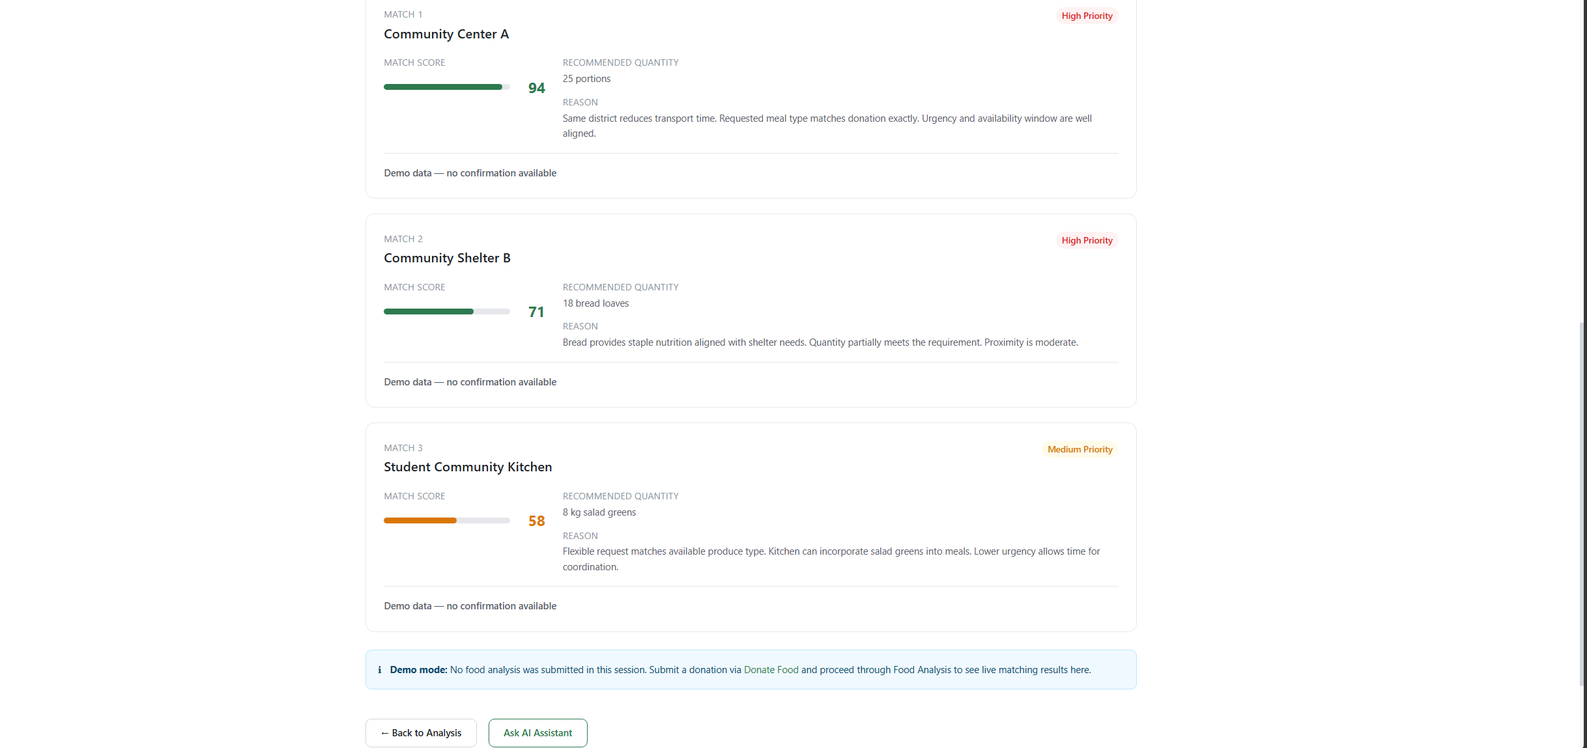
Project Screenshots
What the prototype does and what it does not claim
Image 1 Dashboard
Image 2 Community Dashboard
FoodBridge AI | AI for Sustainability | 12

Slide 13
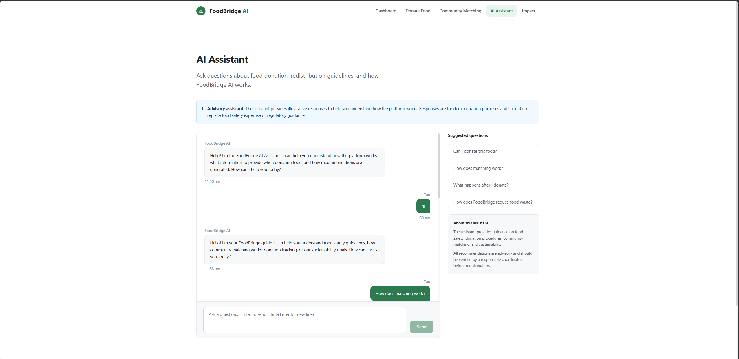
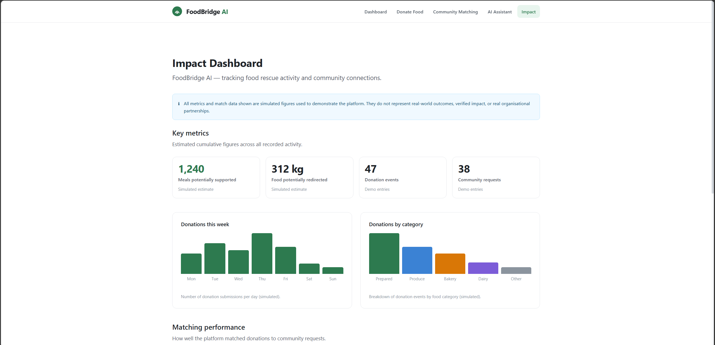
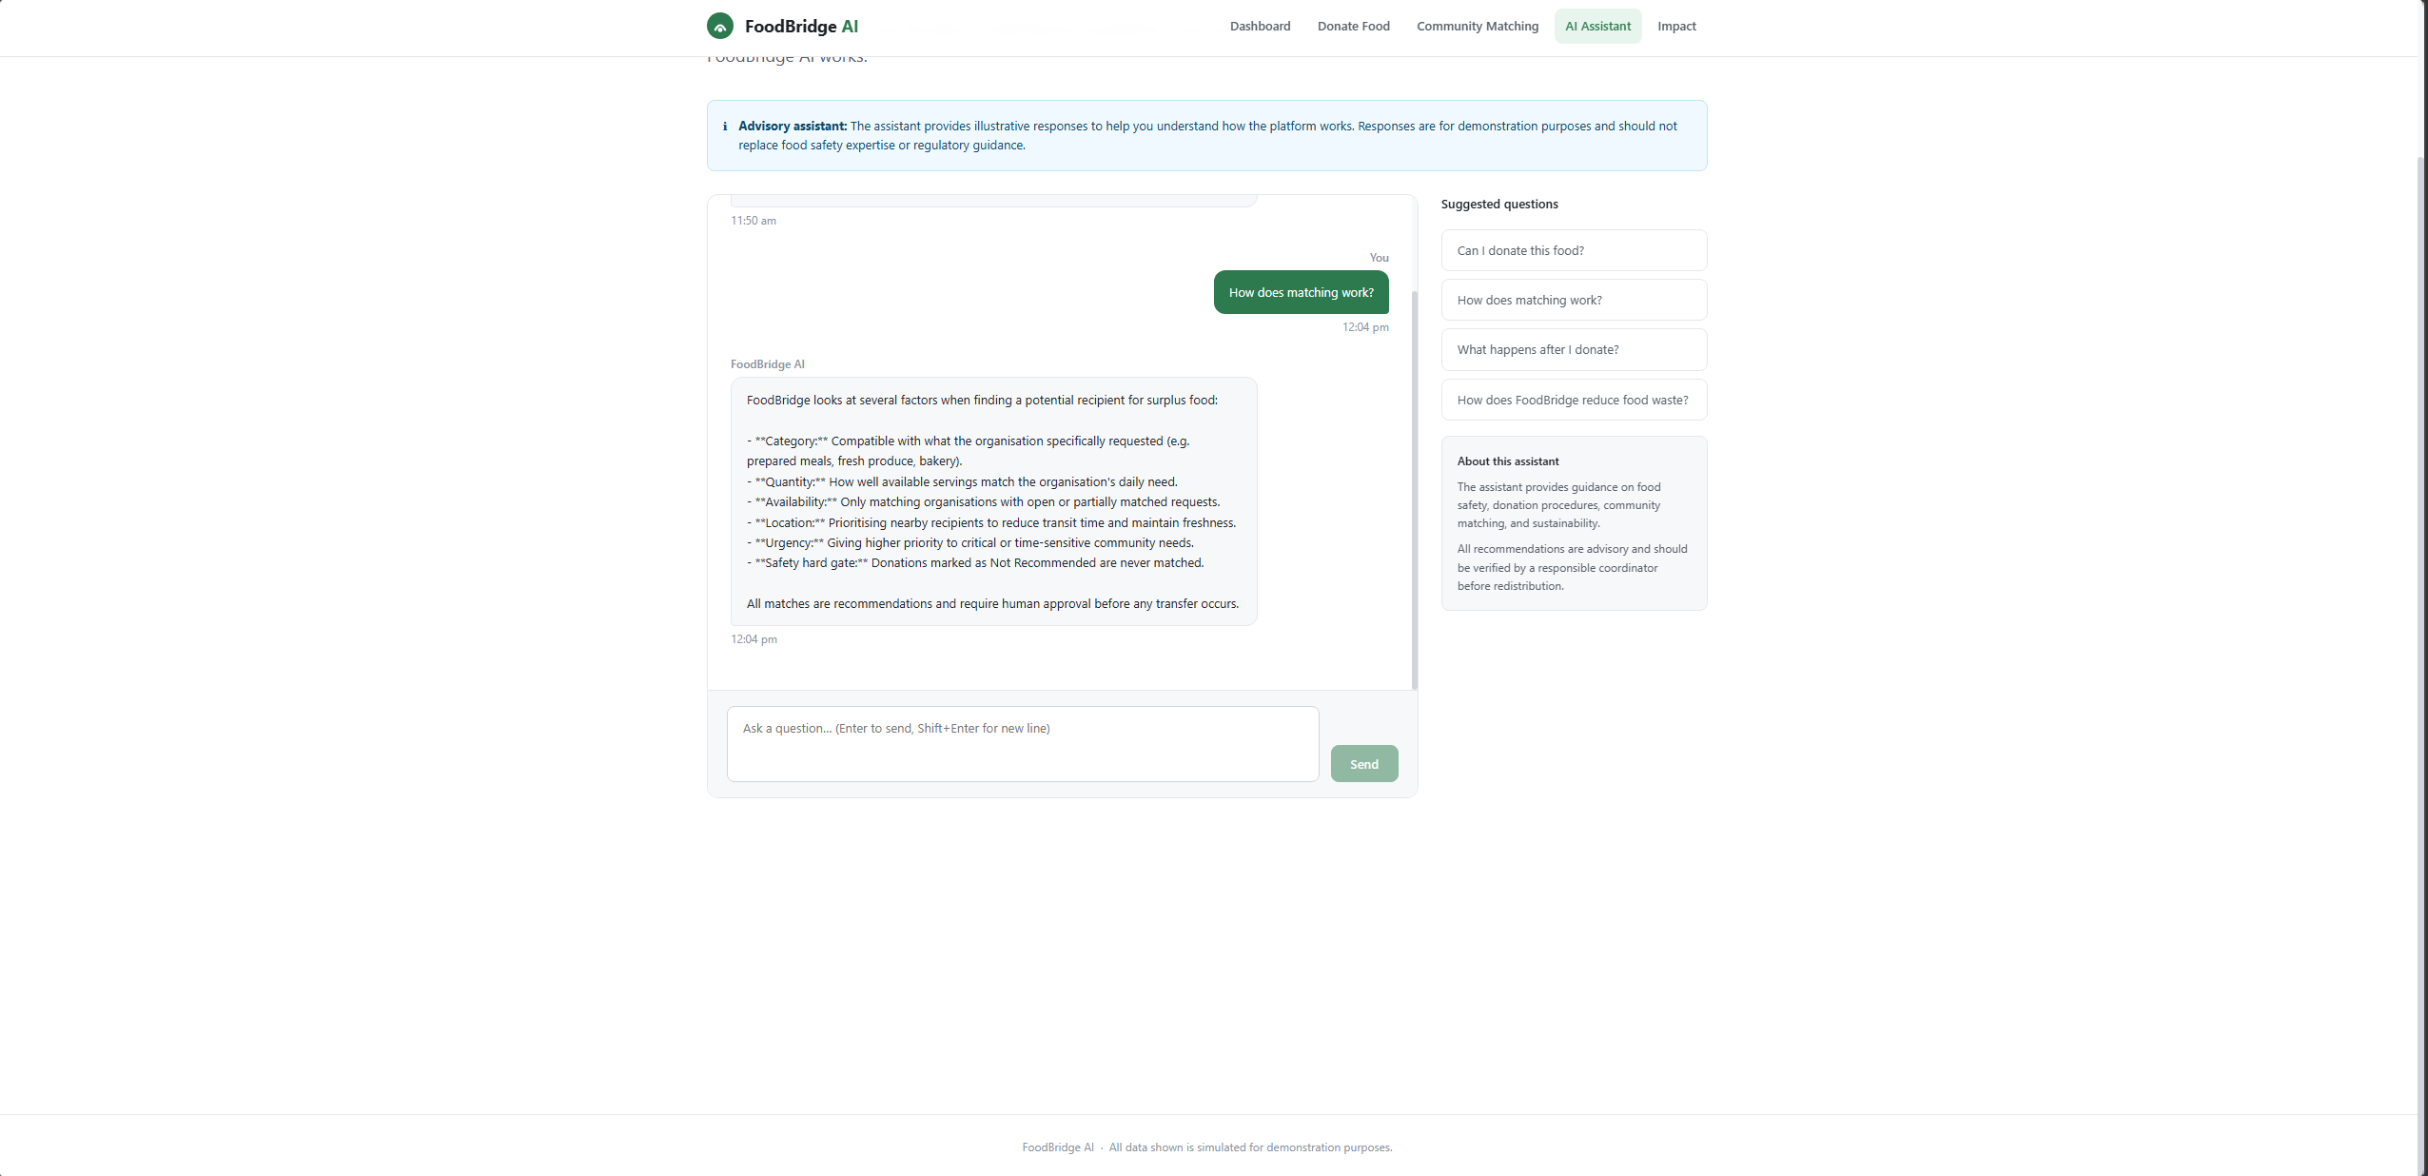
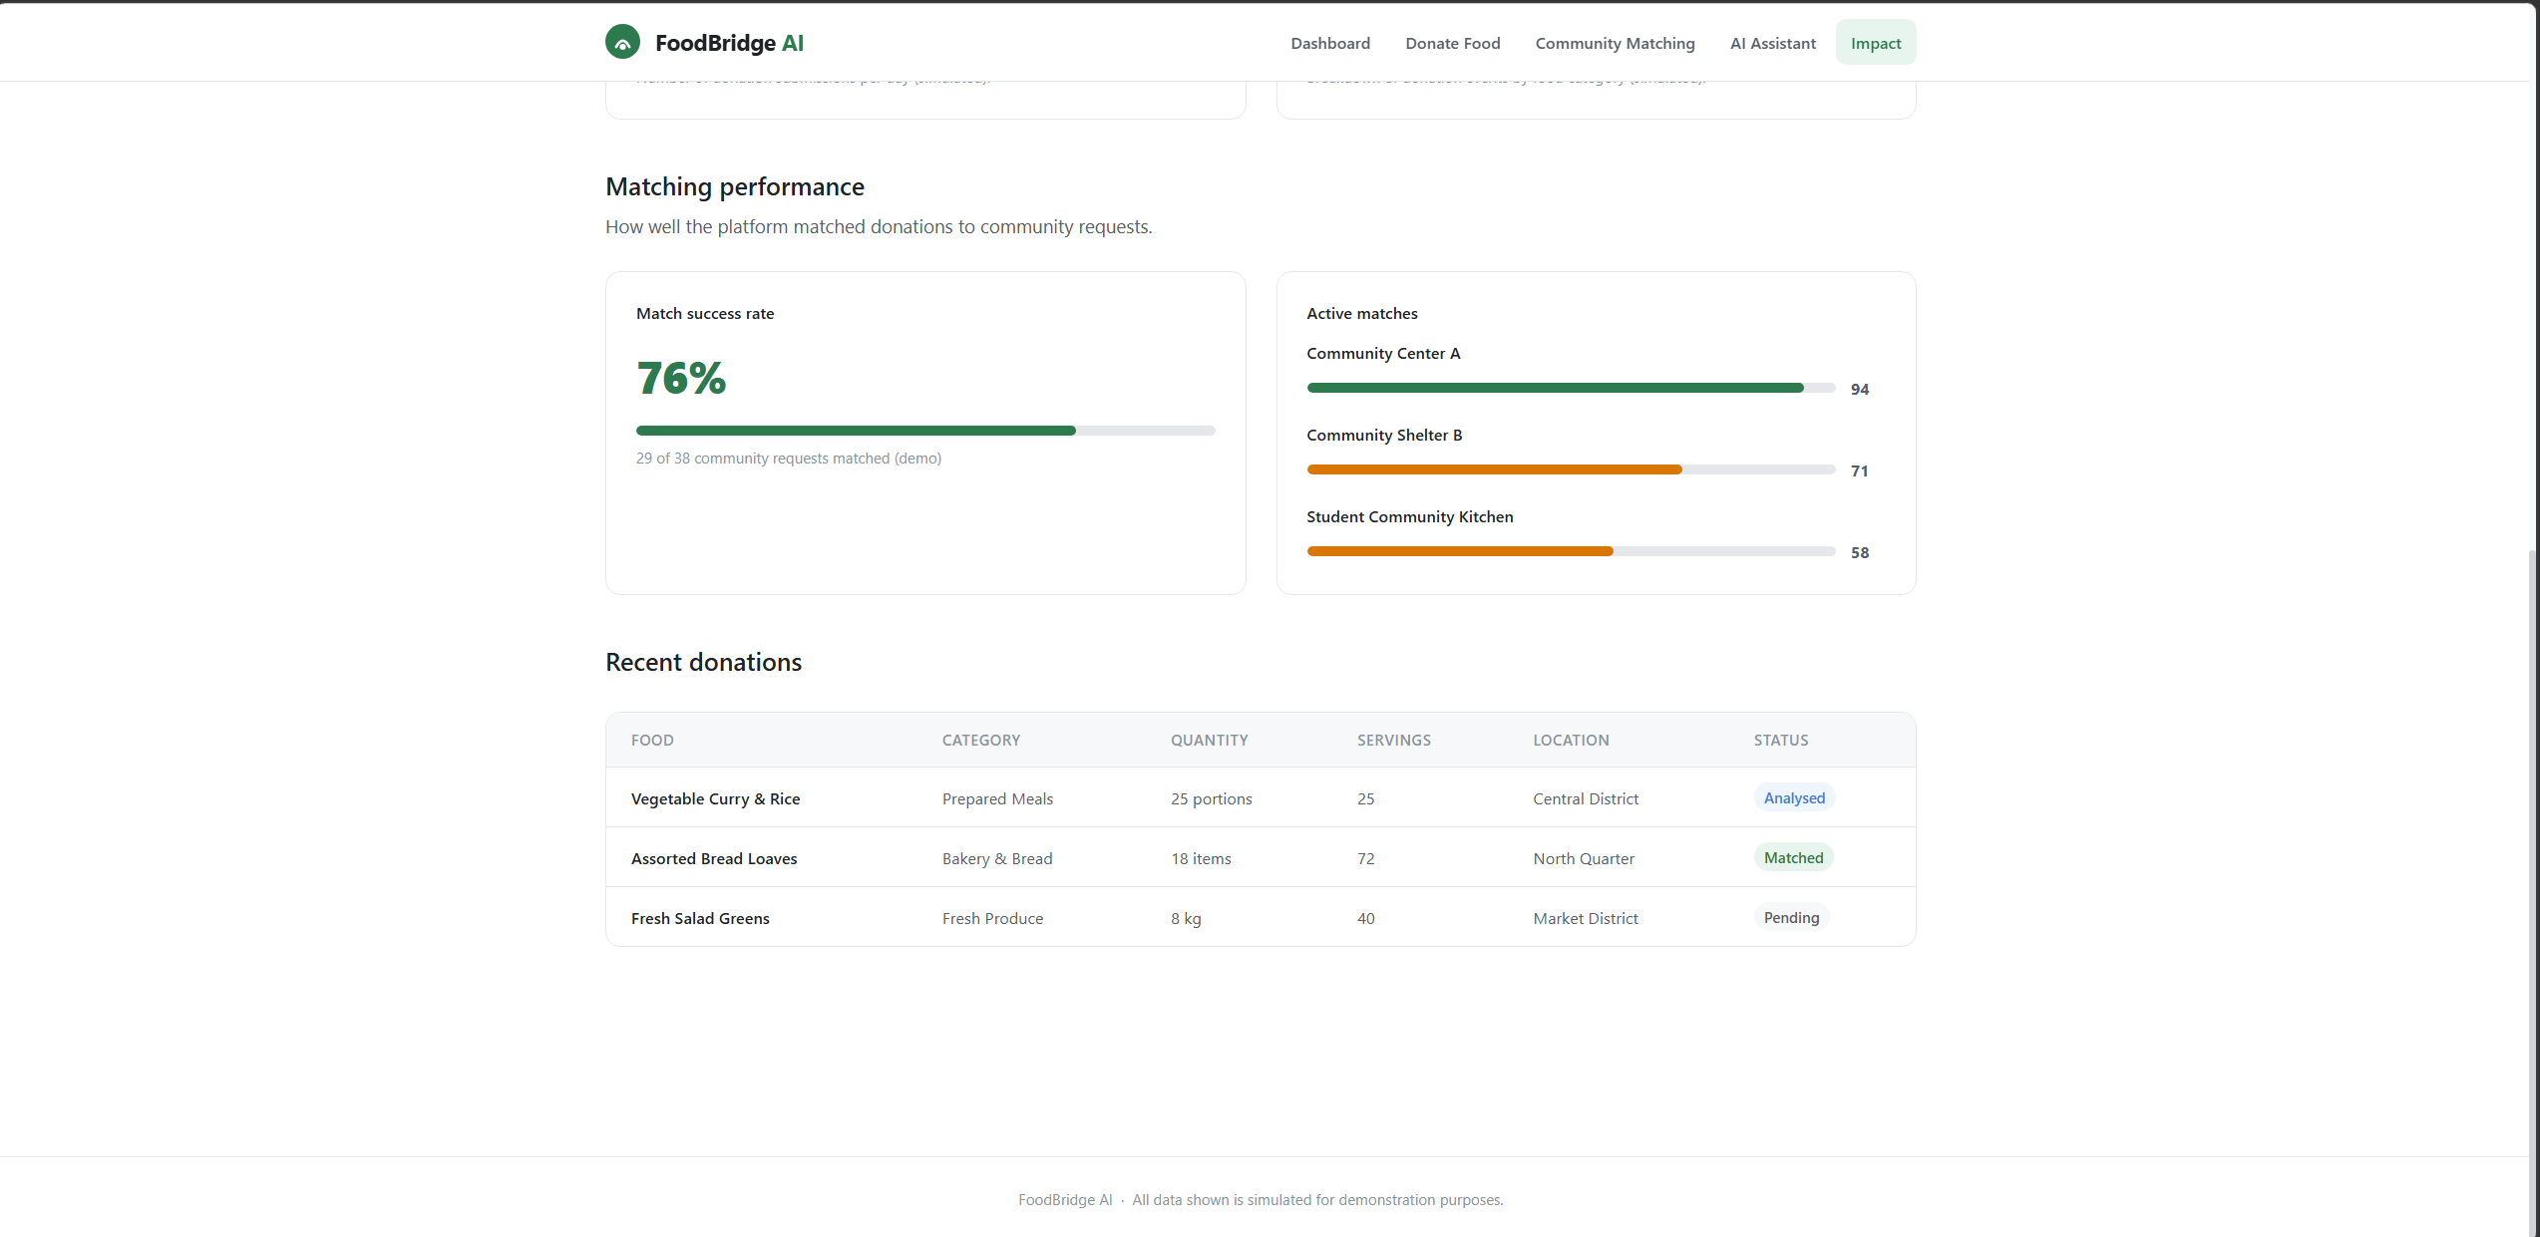
Project Screenshots
What the prototype does and what it does not claim
Image 4 Impact Dashboard
Image 3 AI Assistant
FoodBridge AI | AI for Sustainability | 13

Slide 14
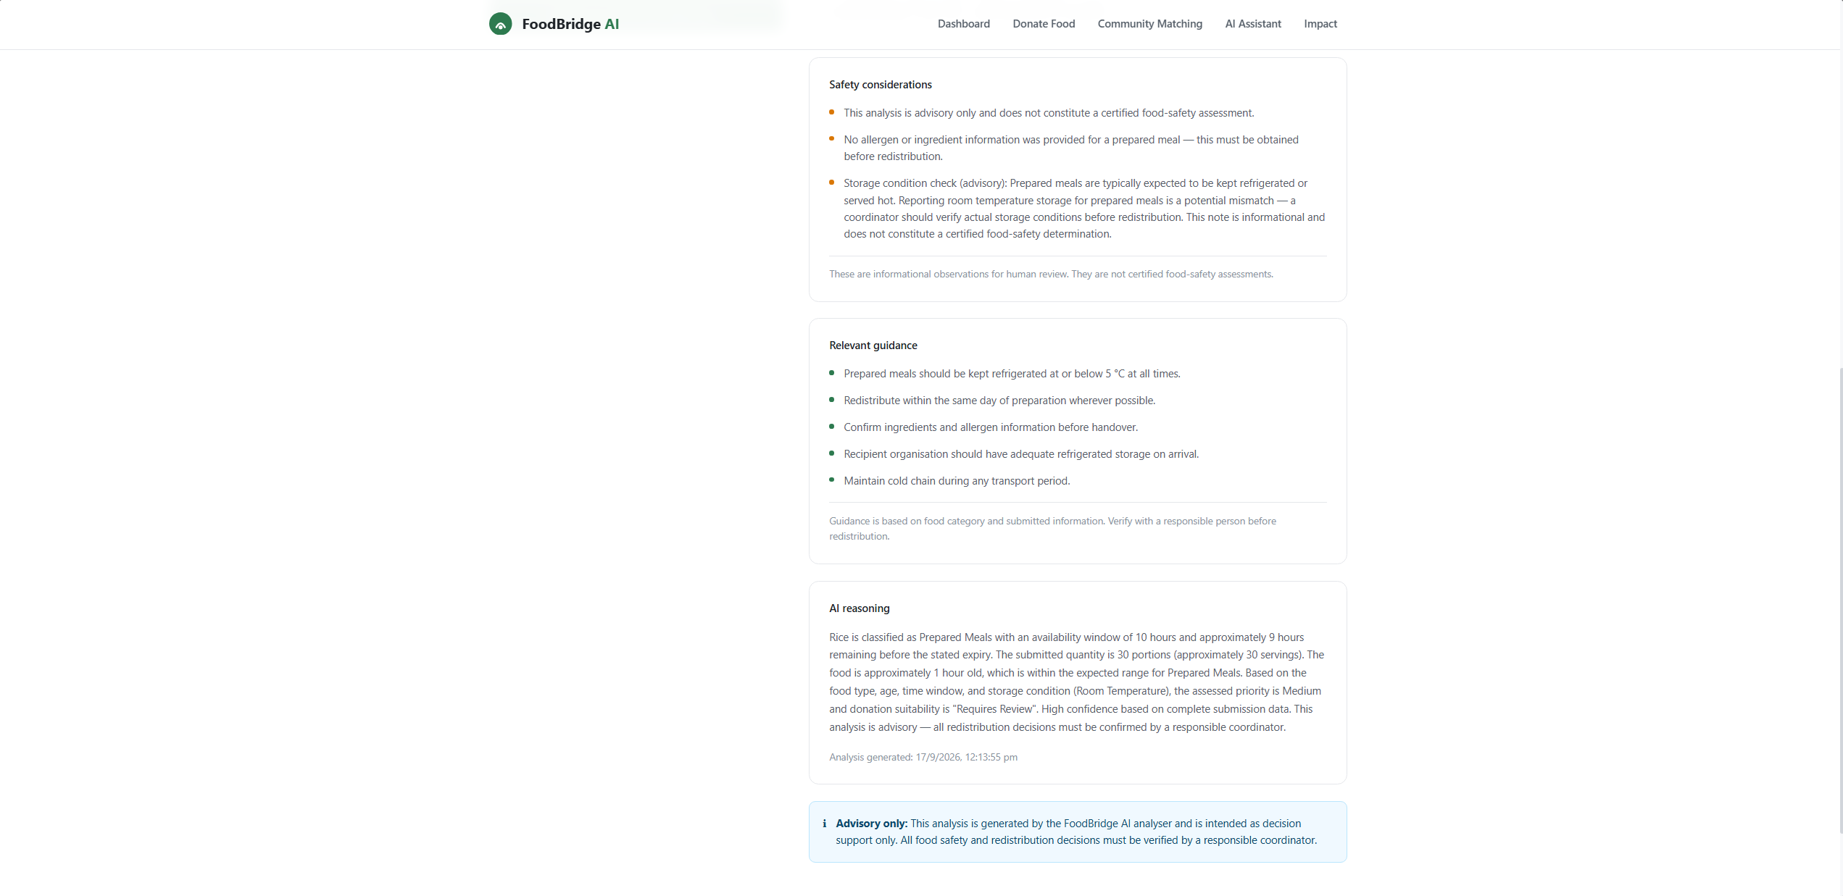
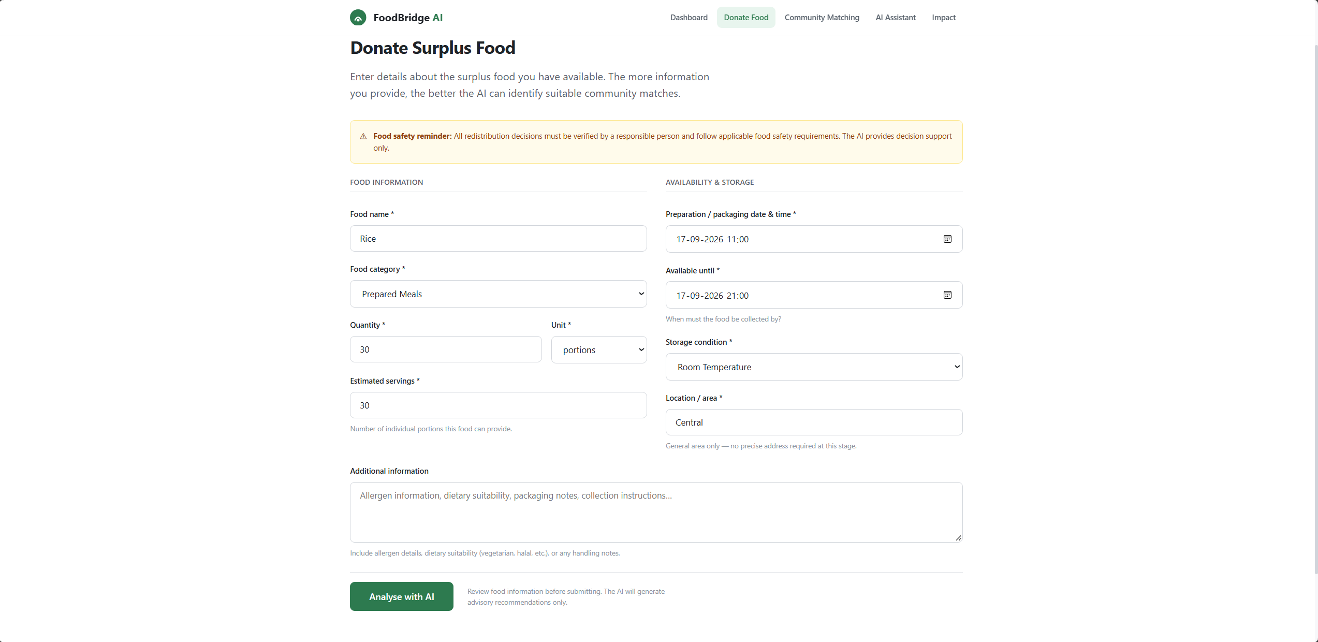
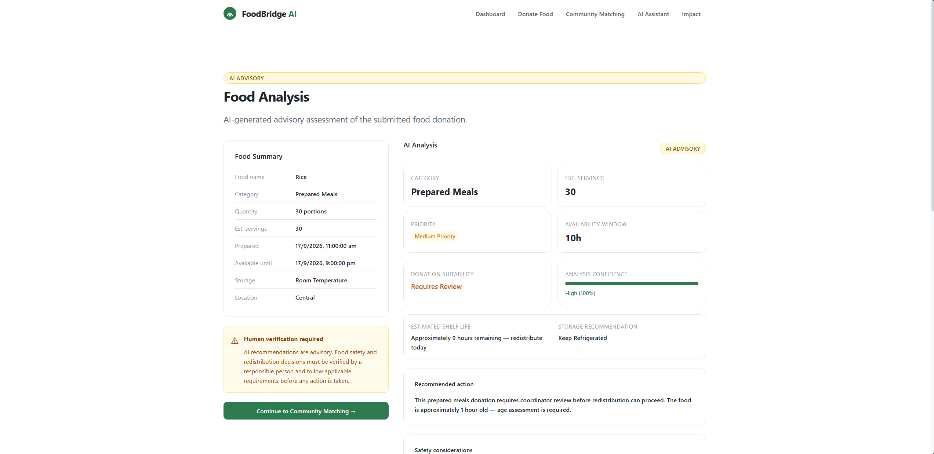
Project Screenshots
What the prototype does and what it does not claim
Image 5 Donation Workflow and AI Analysis
FoodBridge AI | AI for Sustainability | 14

Slide 15
11. Future scope
How the prototype could become a real-world platform
Live partner network
Real AI services
Notifications
Connect verified NGOs, shelters, food banks and volunteers
Add validated ML/RAG with monitoring and evaluation
Alert recipients and donors about urgent matches
Traceability
Impact reporting
Add pickup proof, timestamps and audit logs
Track meals, kg diverted, reach and SDG indicators
Prototype today → scalable sustainability platform tomorrow
FoodBridge AI | AI for Sustainability | 15

Slide 16
11.Test it yourself !!
How to test the prototype
Step1:- Copy this link in any browser
https://github.com/TERMINATOR7732/foodbridge-ai.git
Step2:- Download as zip from the repository
Step3:- Extract the zip file and open the folder in VS code or IBM BOB
Step4:- In Terminal of vs code or IBM Bob type npm run dev.
Step5:- A text will appear as localhost5173… click on that
Step6:- The prototype will open and you can test it.
Step7:- If any errors occur mail to manask.vinod@gmail.com
FoodBridge AI | AI for Sustainability | 16

Slide 17
FoodBridge AI
AI for Sustainability
Analyse safer. Match faster. Donate smarter. Measure impact.
Thank you
-Manas Kulkarni

