Slide 1


SMART Tool
Installation Guide

Slide 2
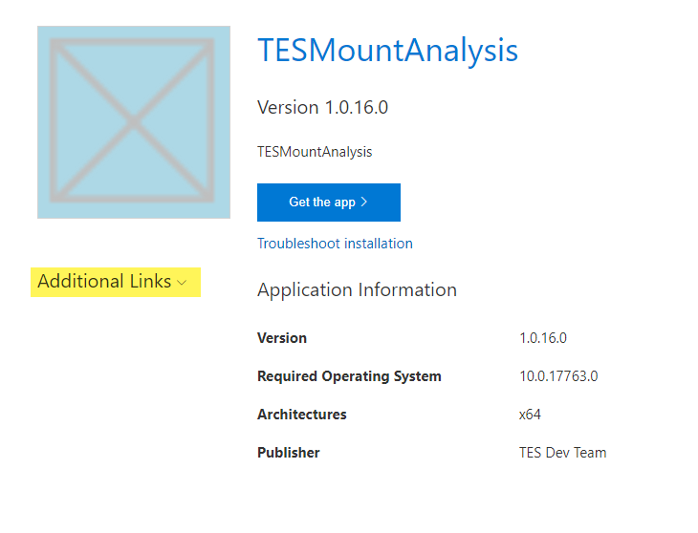
Step 1 – Go to download link
Installer

Slide 3
Step 2 – Open Additional Links
Installer

Slide 4
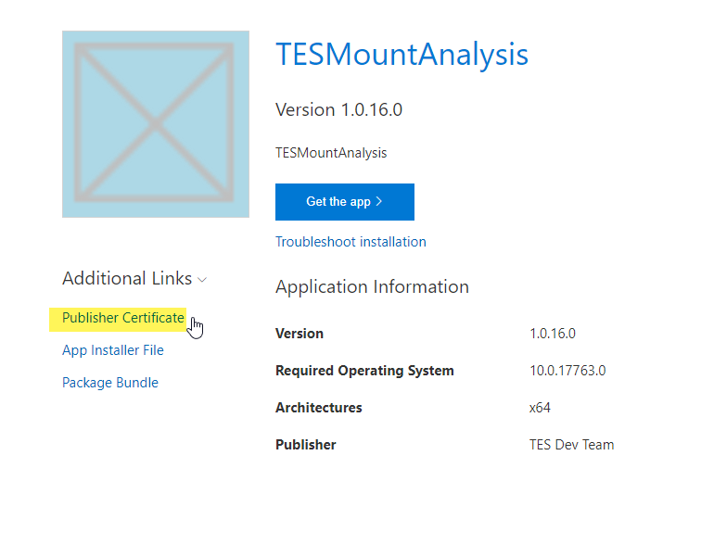
Step 3 – Click on “Publisher Certificate” to download the Certificate
Installer

Slide 5
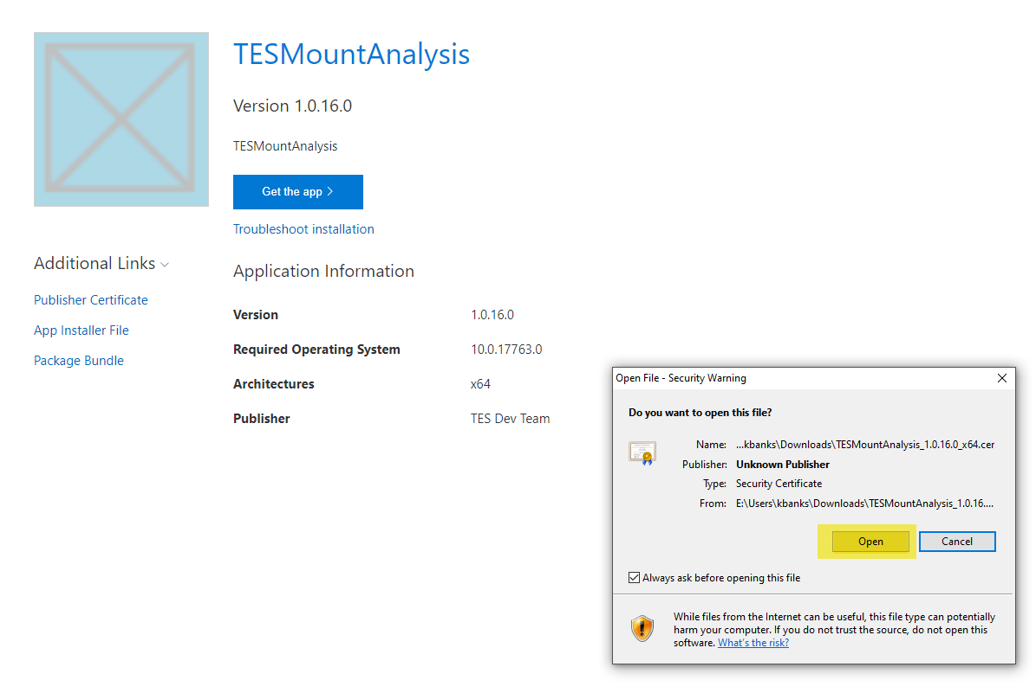
Step 4 – Double Click on Downloaded File
Installer

Slide 6
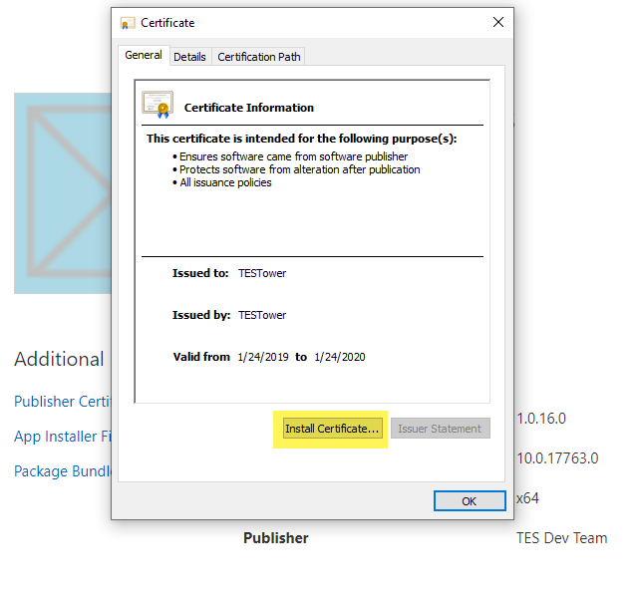
Step 5 – “Install Certificate”
Installer

Slide 7
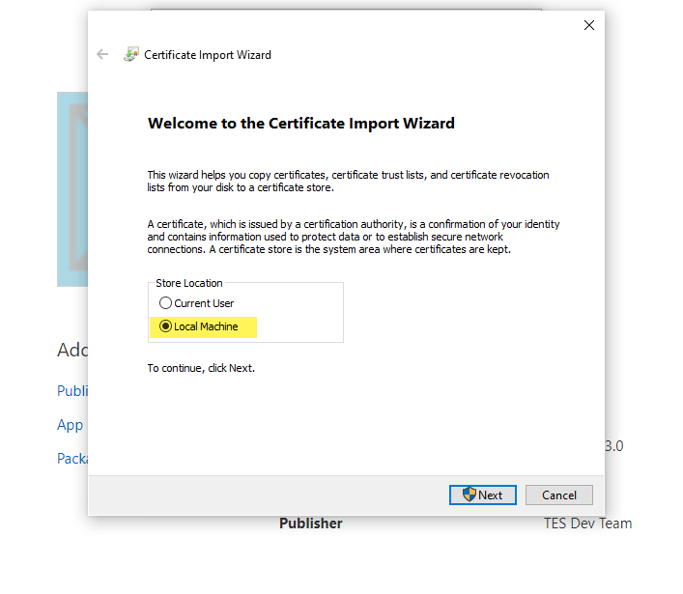
Step 6 – Select “Local Machine” → Next
Installer

Slide 8
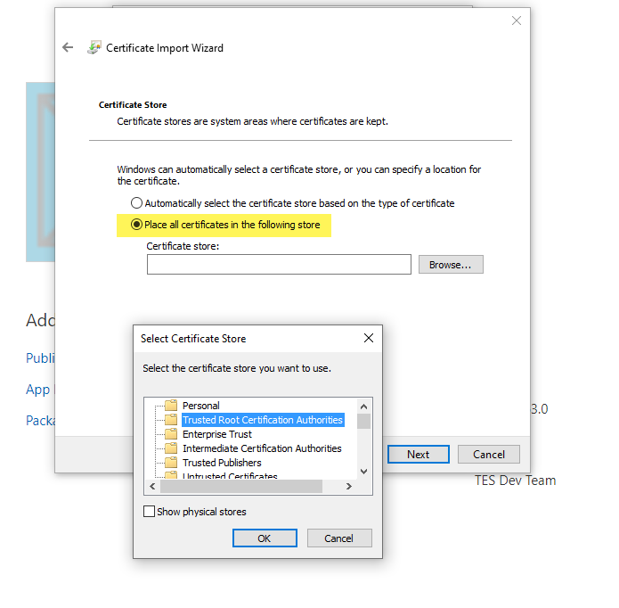
Step 7 – Select “Place all in store” → Browse “Trusted Root Certification” → OK
Installer

Slide 9
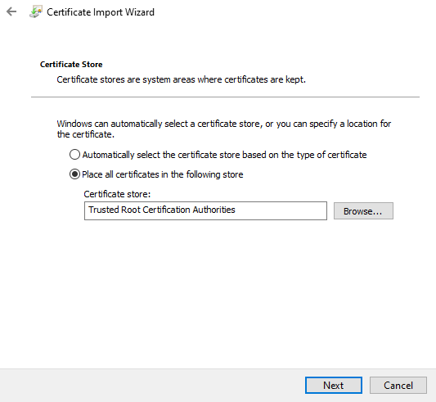
Step 8 – Click Next and Finish
Installer

Slide 10
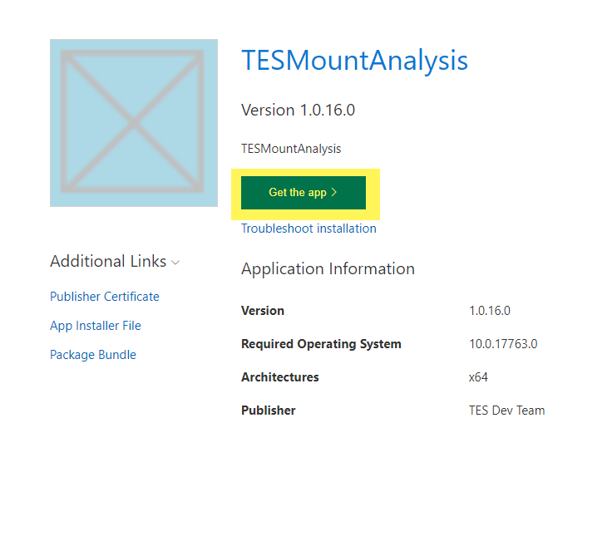
Step 9 – Run Installer → “Get the App”
Installer

Slide 11
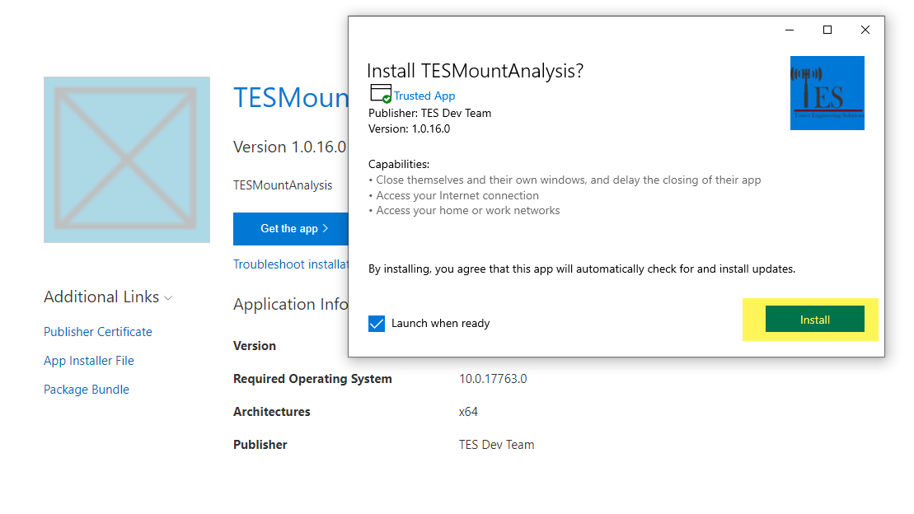
Step 9 – “Install”, “ReInstall”, “Update”, “Launch” will be available as appropriate
Installer

Slide 12
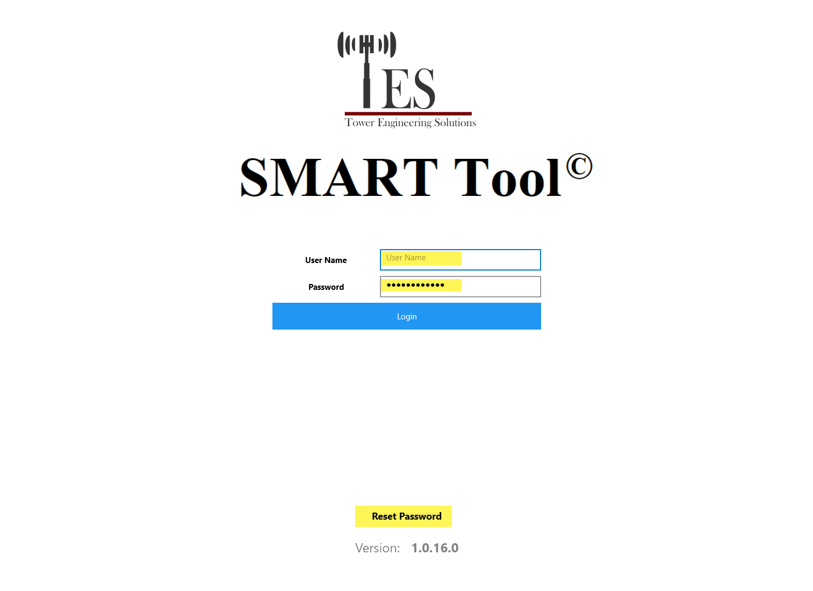
Step 10 – Login or Reset Password
Installer

