Slide 1
Length-stratified sampling and growth PARAMETER estimates: does it matter?
Andrea Perreault – DFO Science NL Region
TESA Ageing best practices workshop 2023

Slide 2

Fitting growth models
Recall the vonB model:
$$L_{a} =L_{∞}\left(1−e^{−k\left(a−t_{o}\right)}\right)$$
where $L_{a}$is mean length at age $a$
$L_{∞}$ is theoretical max average length
$k$ is exponential rate of approach to $L_{∞}$
$t_{o}$ is the model intercept
Let’s look at another example!

Slide 3
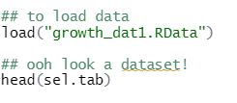
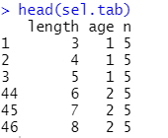
Ex: we’re given a dataset of ages and lengths

Slide 4
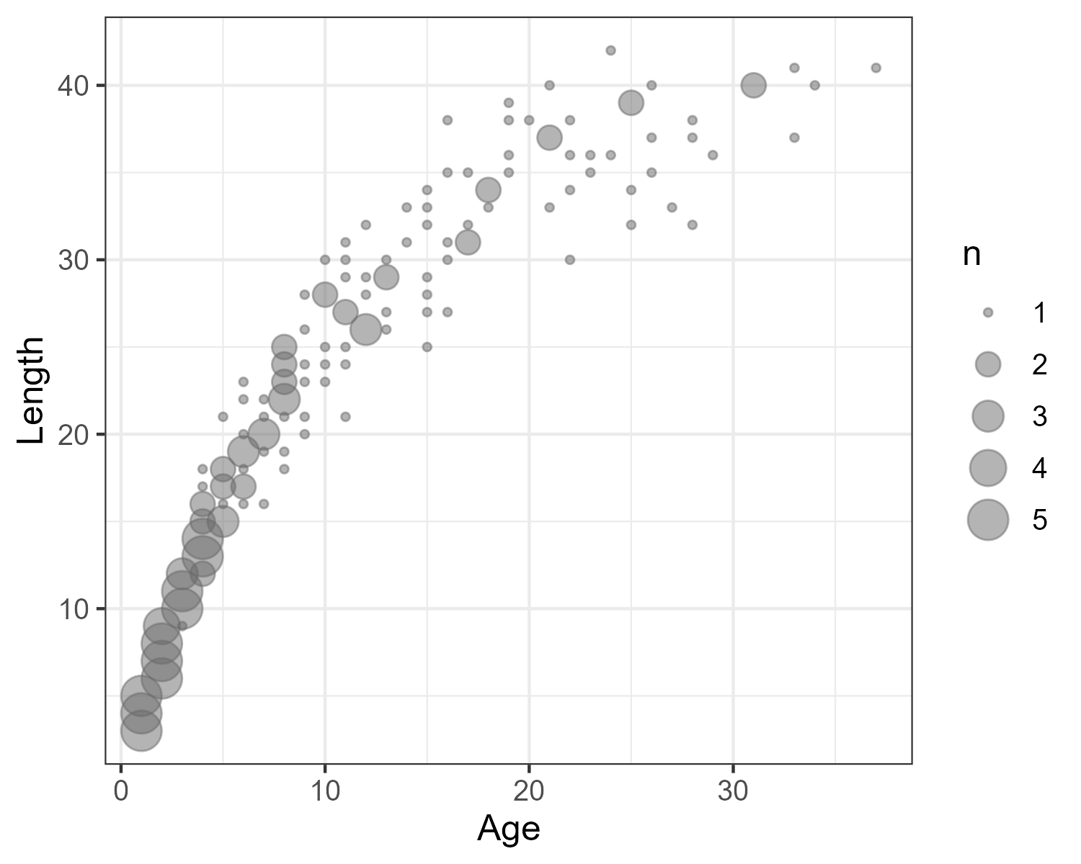
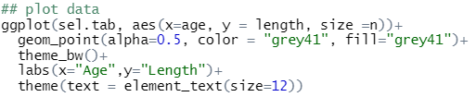
Ex: we’re given a dataset of ages and lengths

Slide 5
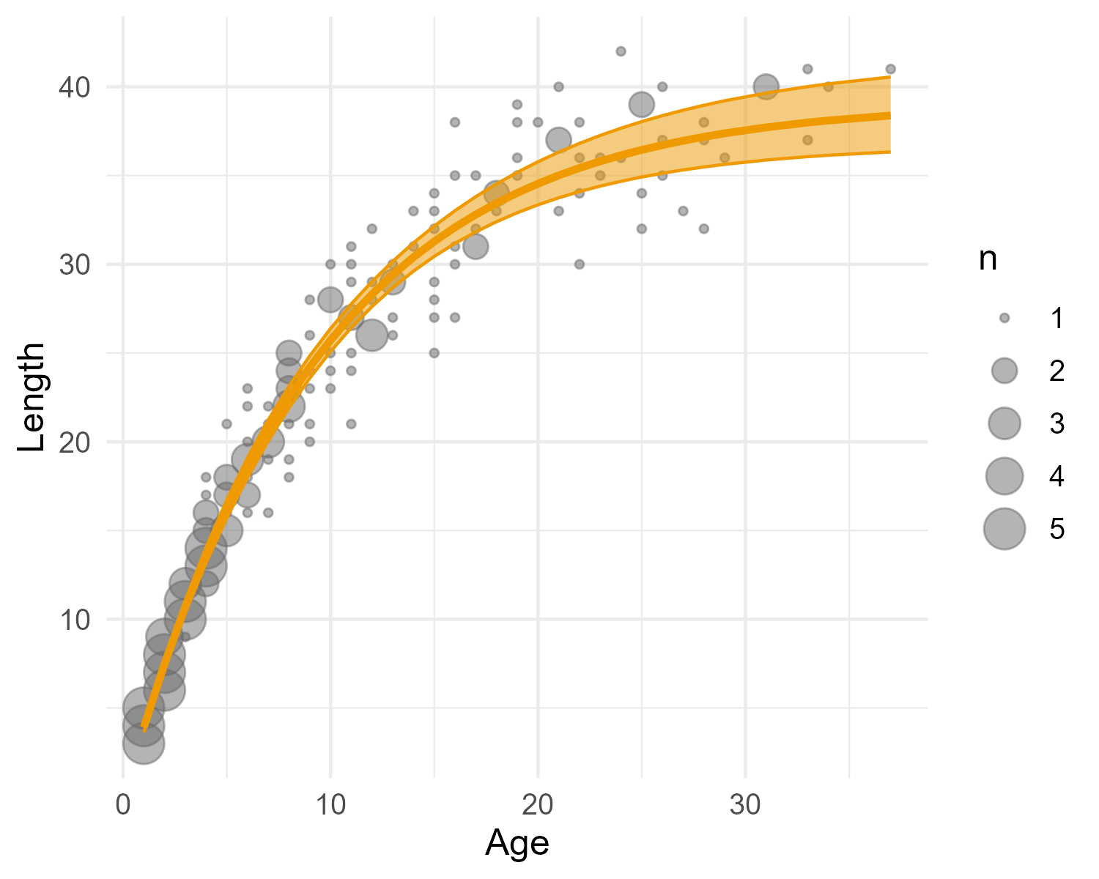


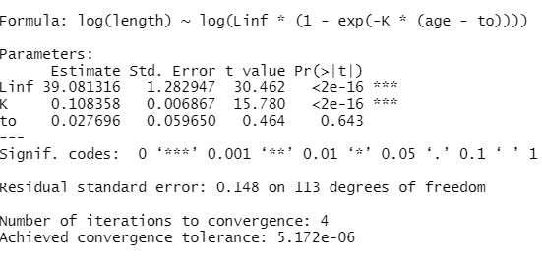
Ex: fit a vonB model

Slide 6
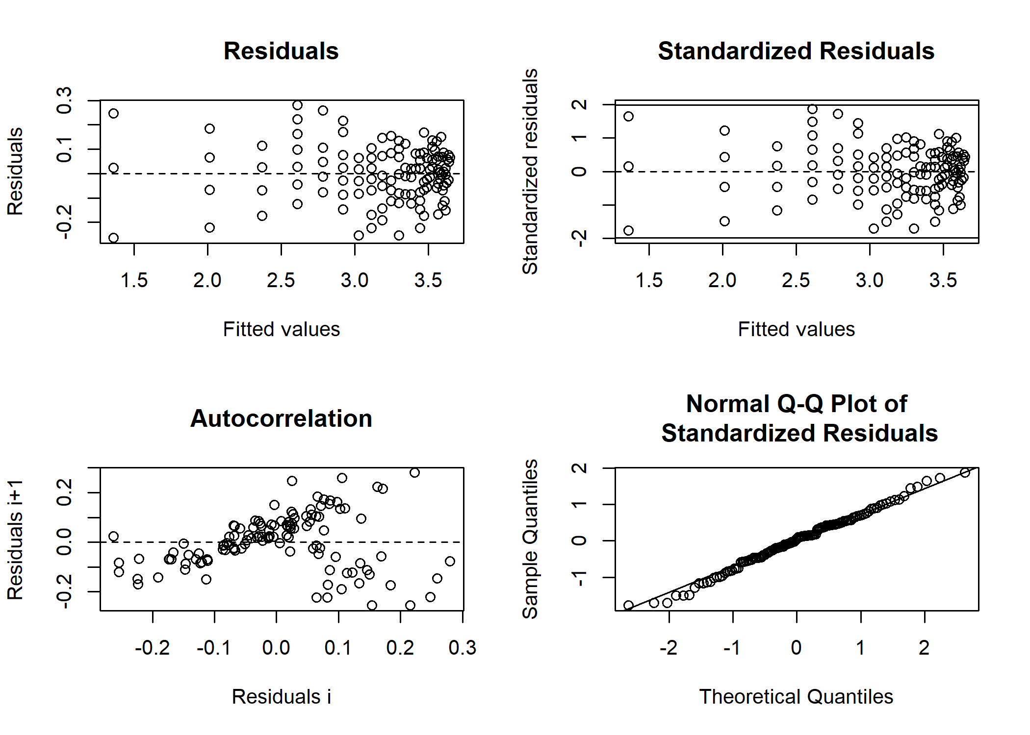

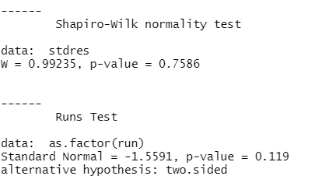
Ex: check diagnostics
vonB looks reasonable here

Slide 7
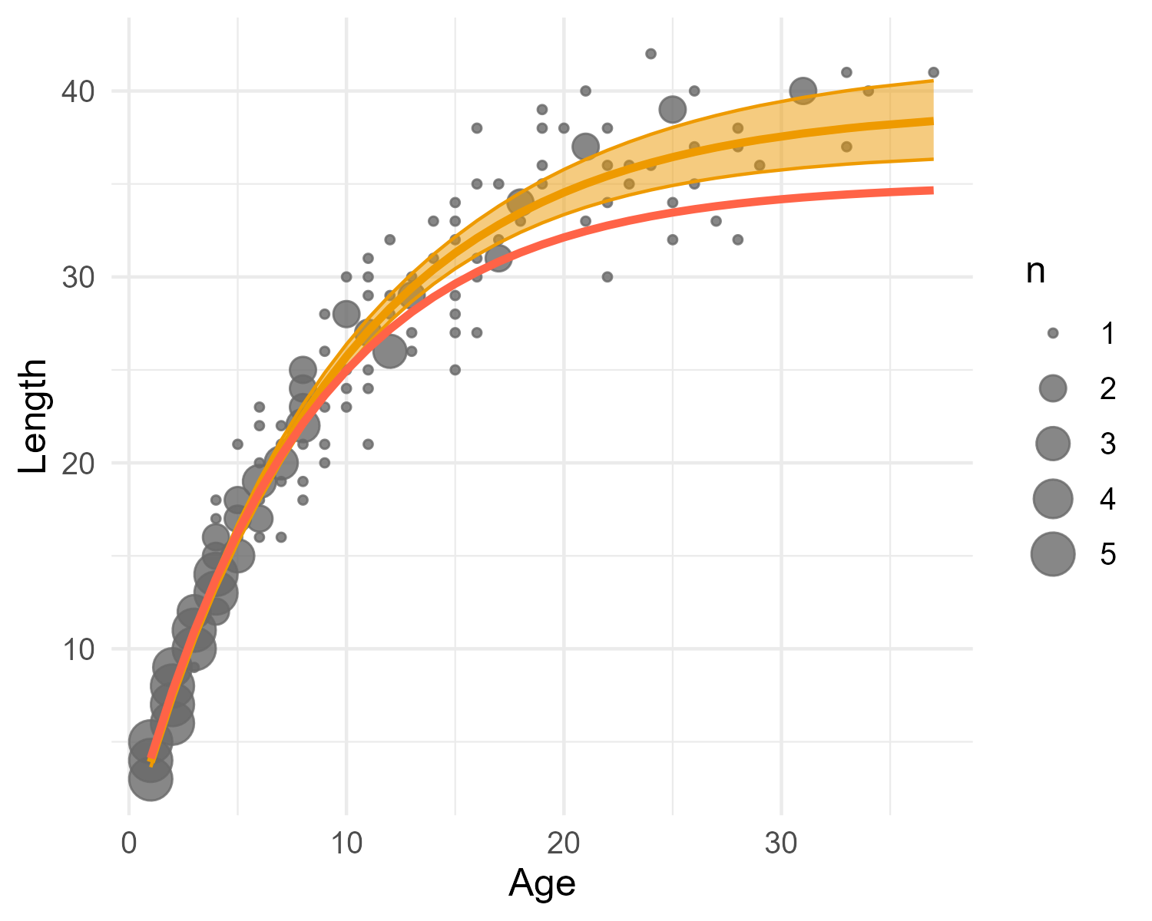
What if we knew the true pop values?
Where did we go wrong?
vonB seemed to fit the data well
diagnostics looked good

Slide 8
What are the impacts of getting it wrong?
Estimates from growth models are used in many ways including:
In age-structured models
to convert numbers to biomass
to convert length-based to age-based selectivity
To derive life history parameters
e.g., natural mortality (Then et al., 2015, Hamel 2015)
Impacts can trickle down to management advice (e.g., SSB)

Slide 9
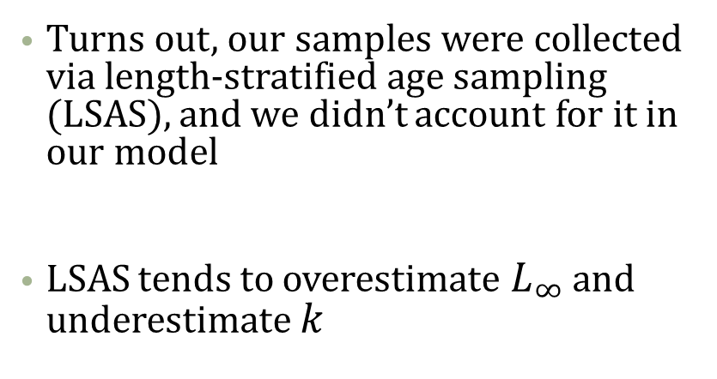
Back to example: what happened?
Turns out, our samples were collected via length-stratified age sampling (LSAS), and we didn’t account for it in our model
LSAS tends to overestimate $L_{∞}$ and underestimate $k$
Perreault, Andrea MJ, Nan Zheng, and Noel G. Cadigan. "Estimation of growth parameters based on length-stratified age samples." CJFAS 77.3 (2019): 439-450.

Slide 10

First: LSAS in a nutshell
First phase sample
2cm 4cm 6cm 8cm 10cm

Slide 11
First: LSAS in a nutshell
First phase sample
Second phase sample
2cm 4cm 6cm 8cm 10cm
2cm 4cm 6cm 8cm 10cm

Slide 12
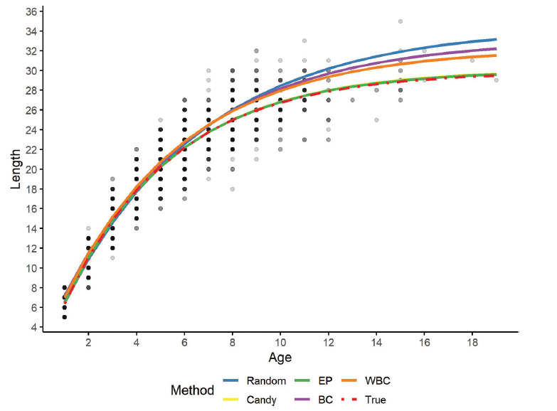
Second: LSAS can we account for it?
Yes!
We performed a simulation study that explored model performance under LSAS
General take homes:
Ignoring it was bad! (blue line)
Approaches that incorporate information from the first and second phase sampling performed the best (green + yellow lines)
From: Perreault et al. 2019

Slide 13


Second: LSAS can we account for it?
Log-likelihood functions to estimate vonB parameters
Random method
EP method

Slide 14
Second: LSAS can we account for it?
EP method is pretty tricky to implement in practice (requires TMB and R)
But! There’s a working package out (fishmethods) that now includes the EP approach!
Caveats: the package doesn’t yet include confidence intervals for the predictions, residual plots and model diagnostics. Have emailed the author and hoping to get that updated soon! Stay tuned!

Slide 15
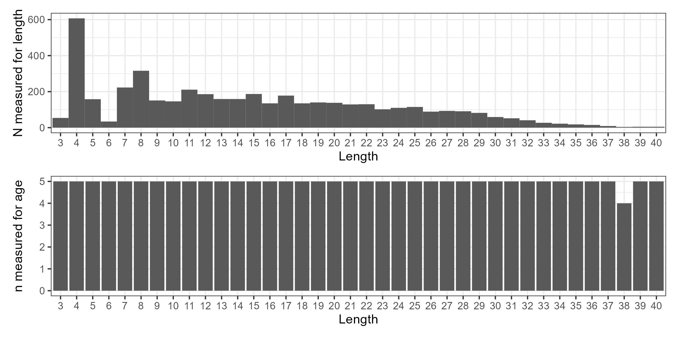

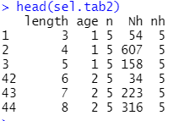
Back to our example!
Turns out we had extra information about the first phase sample!

Slide 16

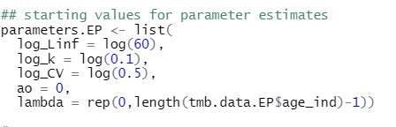
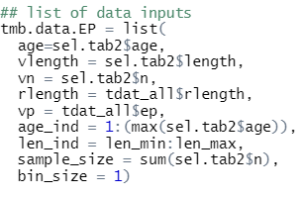
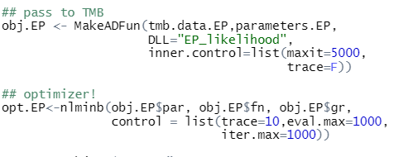
Back to our example!
1)
3)
2)
4)

Slide 17
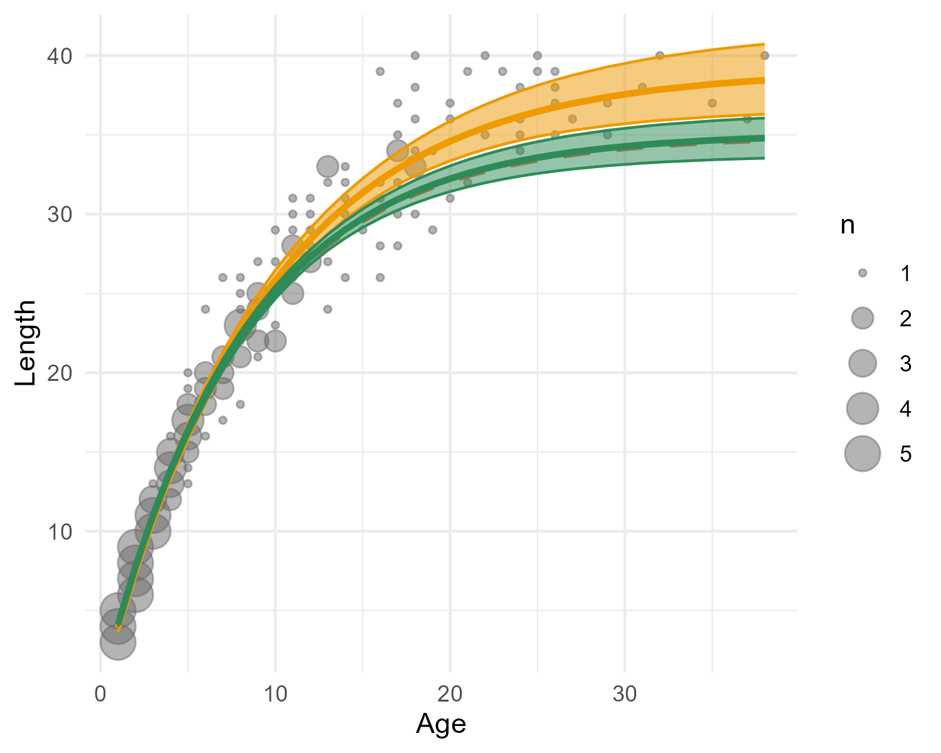
Ex: fit an EP model
Hooray the EP approach captured the true population trends!

Slide 18
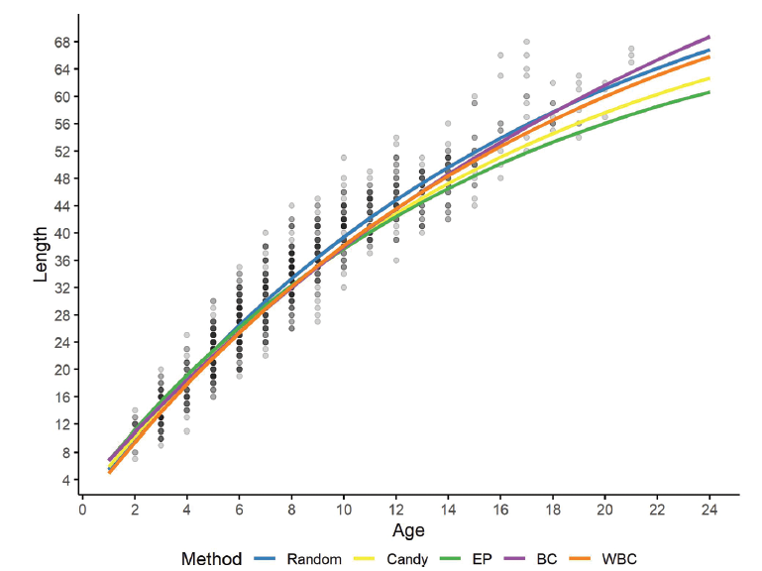
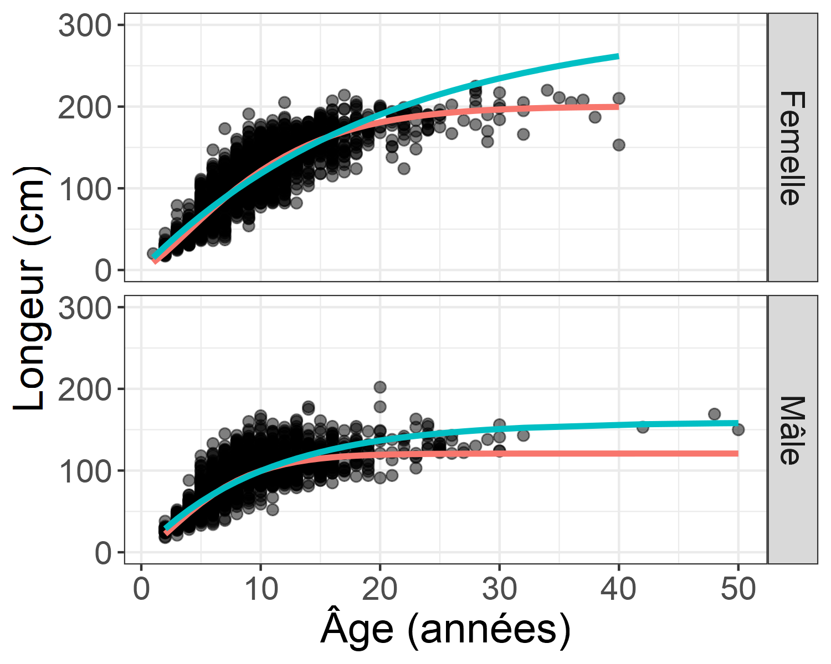
Examples in practice
Atlantic halibut (EP pink, vonB blue)
3LNO American plaice

Slide 19
Some caveats
Pretty tricky methods to implement in practice (requires TMB + R)
But! Working package in progress (I can add updated package to github repo if there’s interest)

Slide 20
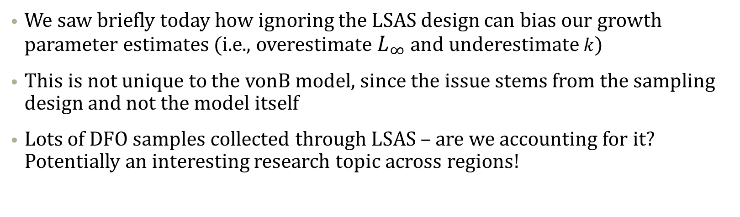
Length-stratified sampling and growth parameter estimates: does it matter?
We saw briefly today how ignoring the LSAS design can bias our growth parameter estimates (i.e., overestimate $L_{∞}$ and underestimate $k$)
This is not unique to the vonB model, since the issue stems from the sampling design and not the model itself
Lots of DFO samples collected through LSAS – are we accounting for it? Potentially an interesting research topic across regions!

Slide 21
Thanks! Questions/comments/discussion?

