Slide 1
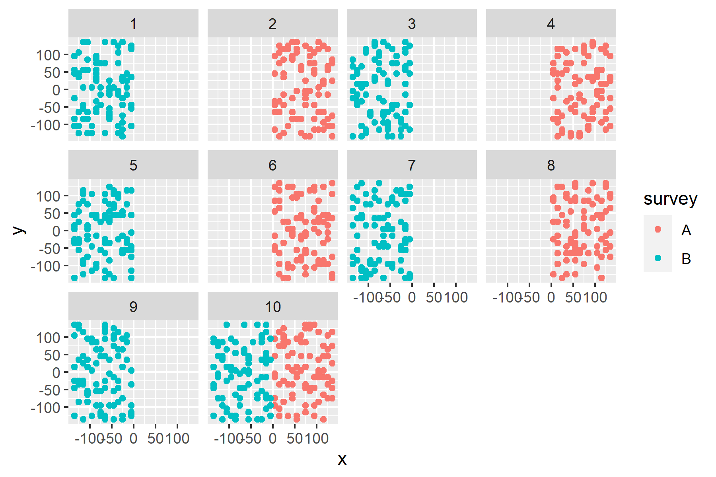
Index stitching – surveys that sample different areas of stock range
Question #4
# 1: Surveys A and B each sample different areas in each year
# 2: Surveys A and B each sample different areas in alternate years
# 3: Surveys A and B each sample different areas in alternate years, both sample their respective areas in terminal year
# 4: Same as #3, also compare to situation where survey A samples entire stock area at half the set density (same effort)
# 5: Surveys A and B each sample different areas in alternate years, both sample the same area in terminal year
# 5: Same vessel samples different areas in alternating years, one year, both surveys sample both areas in terminal year
Catchabilities differ between survey (q_B = 0.66 q_A)
Year

Slide 2
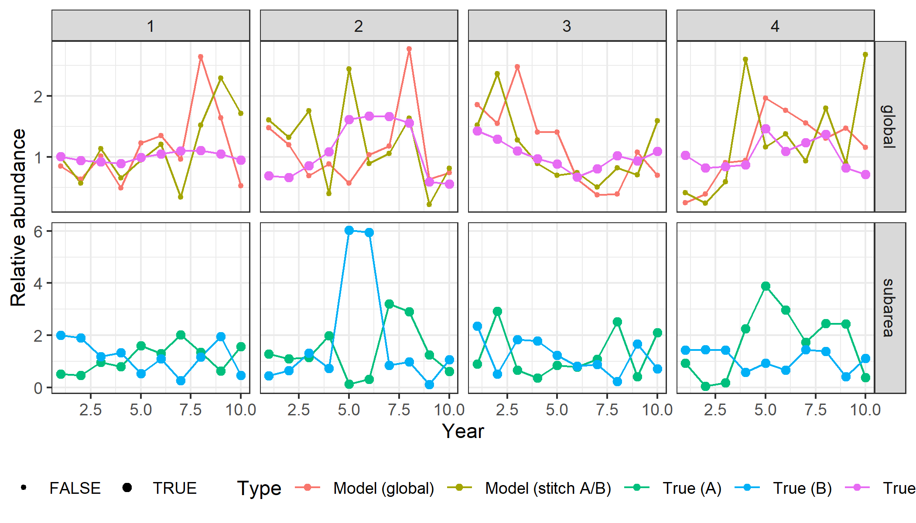
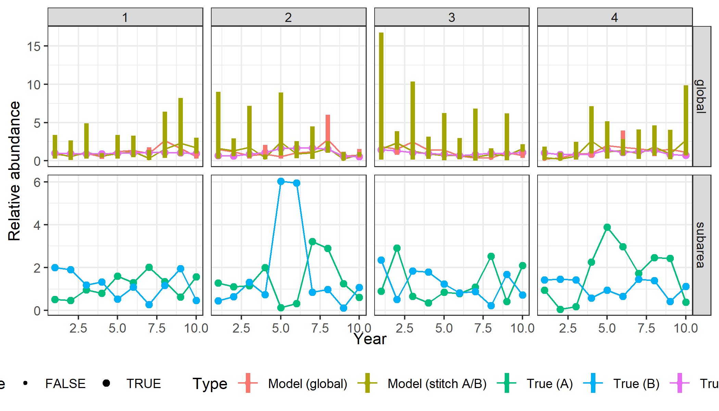
Index stitching
# Question 4:
- Surveys A and B each sample different areas in alternate years, both sample their respective areas in terminal year
- Also compare to situation where survey A samples entire stock area at half the set density (same effort)

Slide 3
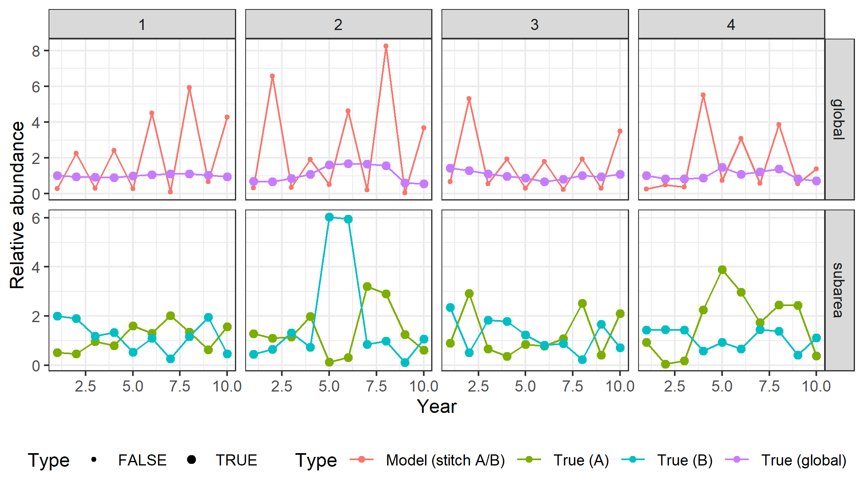
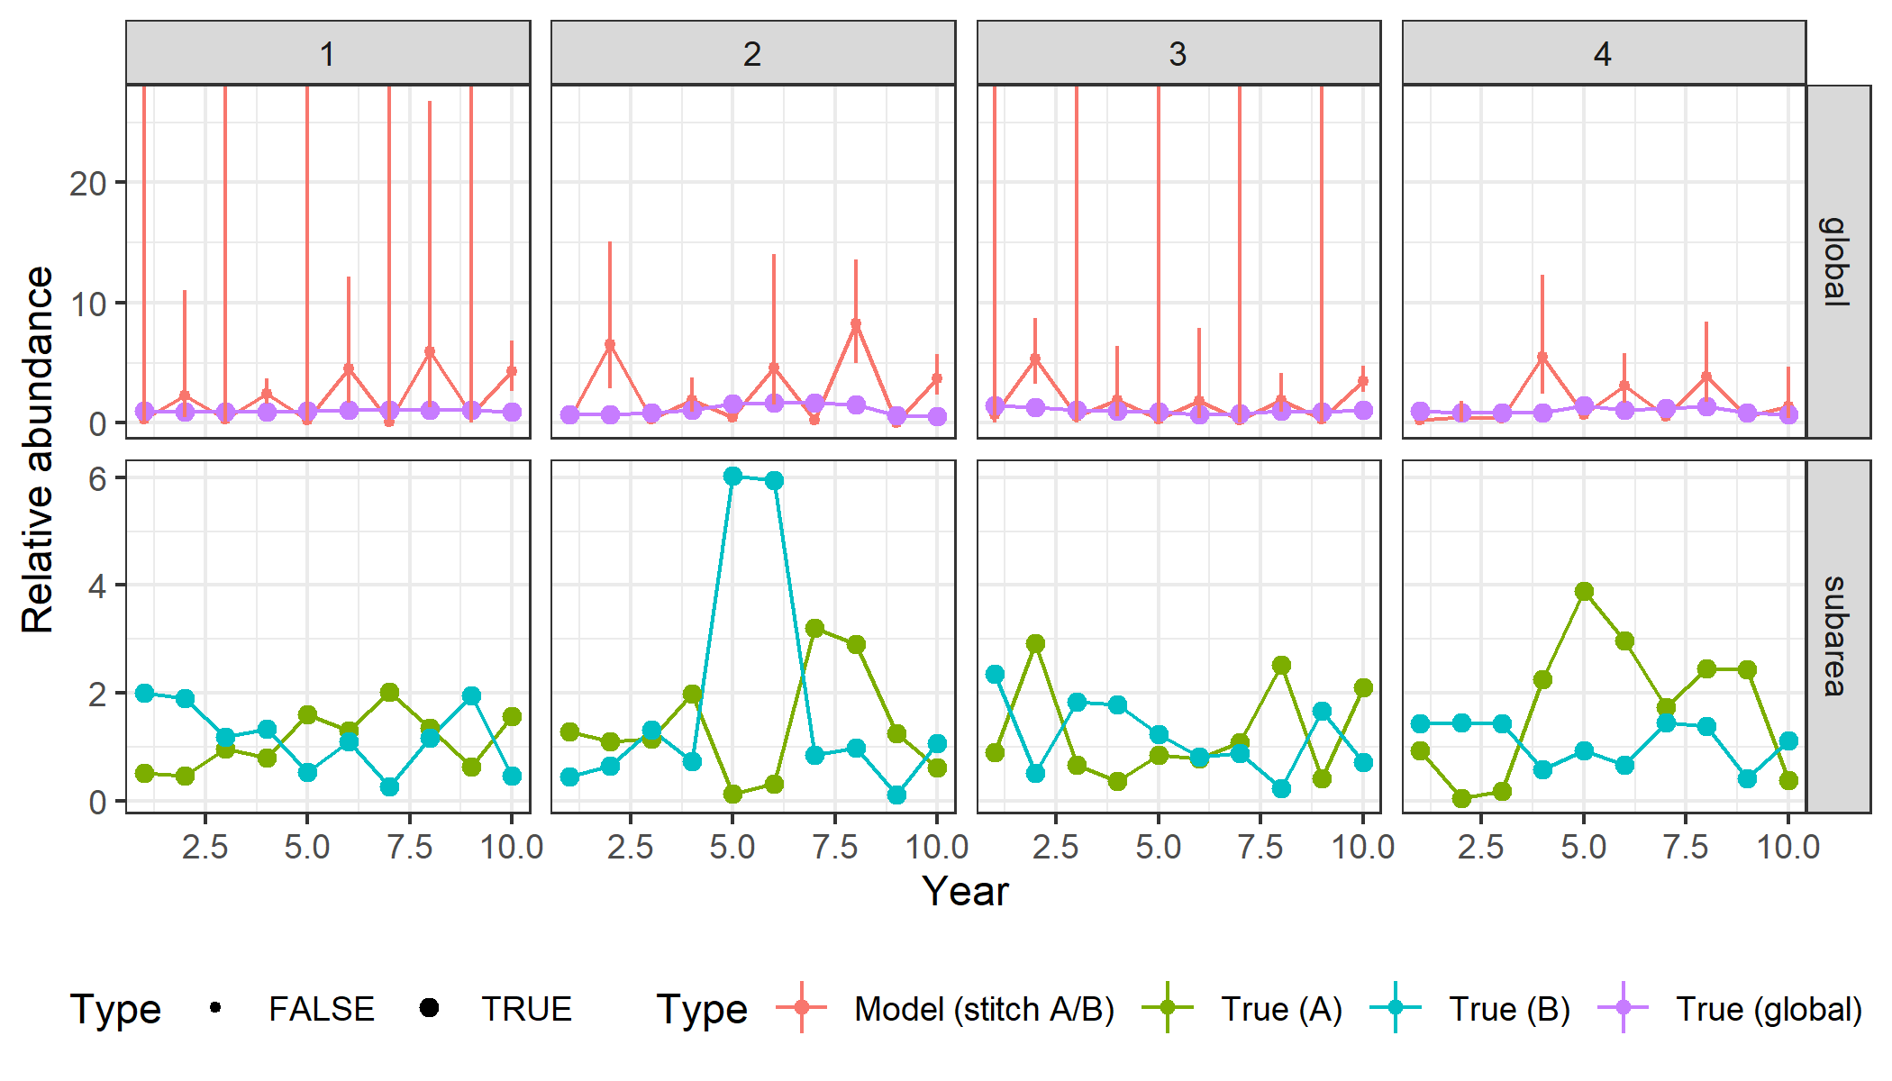
Index stitching
# Question 2:
Surveys A and B each sample different areas in alternate years

