Slide 1
Filling the gaps
Using simulation to test model-based solutions to survey problems

Slide 2
Participants
Sean Anderson (Breakout lead) | Kevin Hedges | Philina English
Paul Regular (Breakout lead) | Kotaro Ono | Quang Huynh
Alex Hanke, | Kyle Gillespie | Rajeev Kumar
Brooke Biddlecombe | Laura Bianucci | Ross Tallman
Dan Ricard | Liza Tsitrin | Shani Rousseau
Daniel Duplisea | Marie-Julie Roux | Shannon Obradovich
Elisabeth Van Beveren | Mark Billard | Stephane Gauthier
Fatemeh Hatefi | Mathieu Boudreau | Tom Bermingham
Hannah Munro | Meghan Burton | Wayne Hajas
Ian Perry | Michelle Fitzsimmons | Xinhua Zhu
Jordan Ouellette-Plante | Michelle Greenlaw

Slide 3
The challenge
General question: can geostatistical models solve common survey problems?
Specific focus topics:
Including covariates. Does including a covariate (depth) increase precision, estimate the right depth relationship, and maintain an unbiased index with greater precision compared to not including any covariates (or any one of these questions)? Are there scenarios where that is or isn’t the case?
Changes to spatial coverage from year to year. E.g. If part of the survey (e.g. multiple strata, half the survey area) is missed in some years, can the model recover the index? This includes “hole” filling.
If two surveys with different catchabilities are conducted in parallel at neighbouring divisions, could a model ‘stitch’ these surveys together to provide a unified estimate of the population?

Slide 4
Other questions
Does using an AR1 spatiotemporal field (without factor levels for years) constrain the model too much and result in hyperstability?
Are there survey designs that result in the model-based index being more or less precise than the design based index?
If the catchability of a survey changed along the time series, say the gear was changed and there was one year of calibration overlap, could the model estimate the catchability (q) offset and provide unbiased estimates of the population available to the contemporary survey as if those gear were used the whole time?
Can we obtain an index at age using a geostatistical model?
Does the model sufficiently account for spatial correlation and/or is it sufficiently free of assumption so as not to be affected by the stratified sampling design of the survey?

Slide 5
Approach taken
Simulate a population and a survey and calculate design-based indices using SimSurvey
Fit a geostistical model to the simulated survey data using sdmTMB to obtain model-based indices
Iterate the population simulation and data analysis
Visually assess the bias and precision of the estimates
Modify the simulation settings (e.g., impose partial survey coverage) and repeat setps 1-4

Slide 6
Key points discussed
The capabilities of SimSurvey and sdmTMB
Tractable topics to explore
Sub-group specific discussions of the focus topics listed in The challenge slide

Slide 7
Successes
Prototype code to help kickstart subgroup explorations
Preliminary results from each subgroup

Slide 8
Challenges
Time flies
Virtual setting
Black-box effect - reverse engineering what is going on
Computational demands
Visualizing high-dimensional problem / summarizing results
Free-form structure - “This bog is thick and easy to get lost in”

Slide 9
How far did we get?
Lots of brainstorming, some preliminary results

Slide 10
Next steps
Use the tools to gain comfortable
Future collaboration to explore important questions

Slide 11
Expected outcomes
Repo with code
Some familiarity with these tools
Ideas for additional functionality of SimSurvey
Sense of potential real-world applications - need more time
Lots of interesting questions raised and could be explored

Slide 12
Preliminary results from sub-groups

Slide 13
Covariates - Philina
simulating relationships with depth benefit from realistic depth profiles

Slide 14
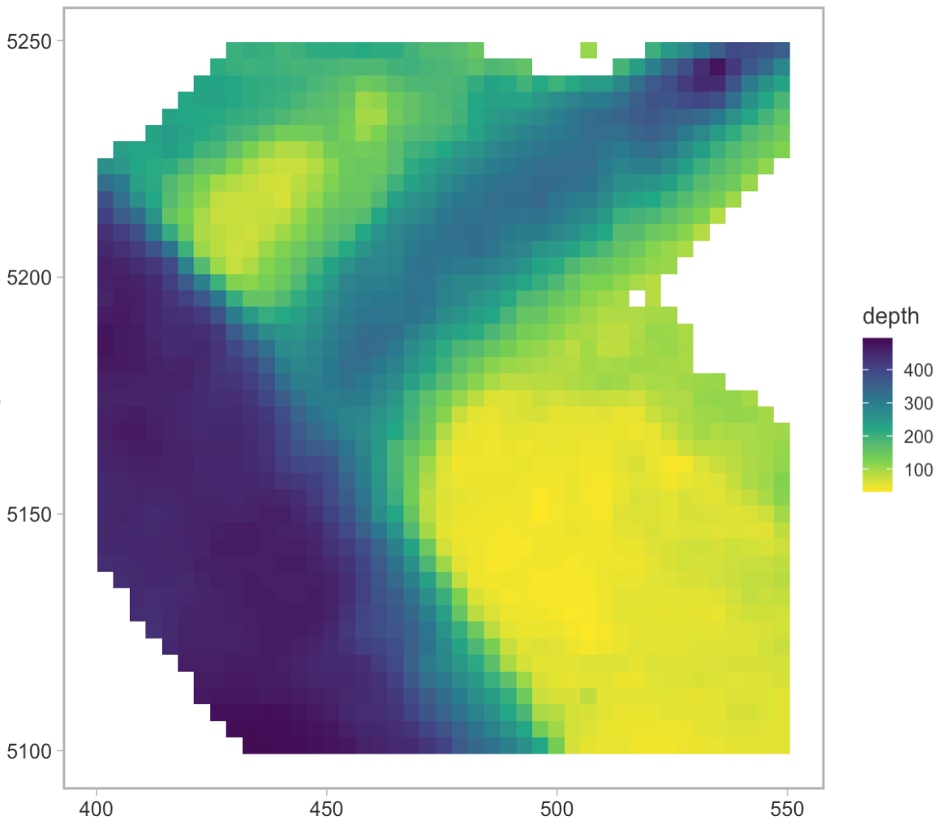

Slide 15
Covariates - Philina
sdmTMB was able to resolve the underlying depth preference (red = true, black = model prediction)

Slide 16
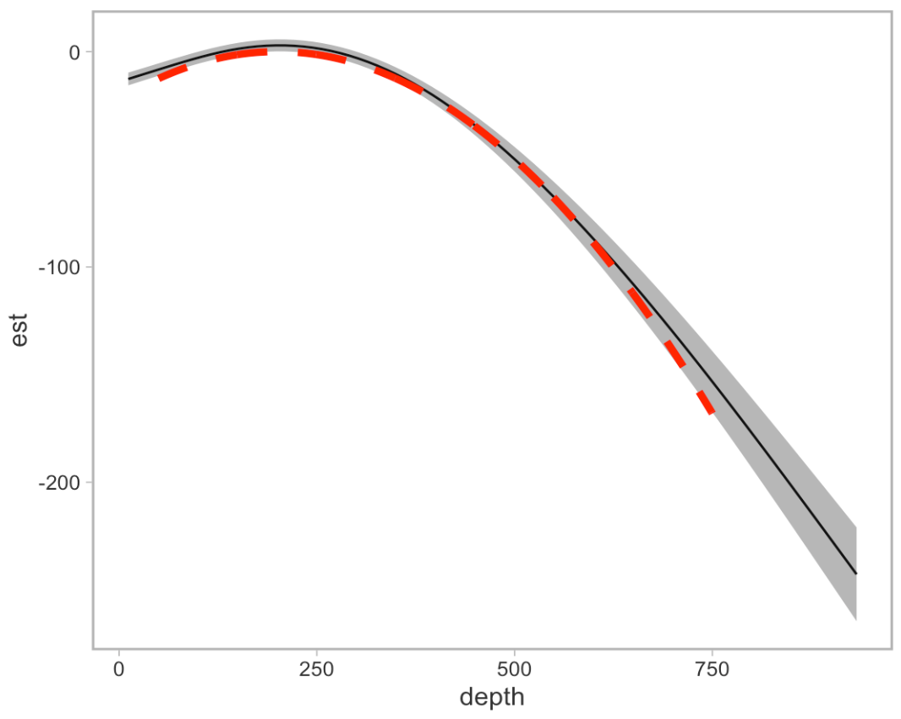

Slide 17
Covariates - Philina
adding depth can narrow uncertainty in model based estimates (at least when data available to model is very limited)

Slide 18
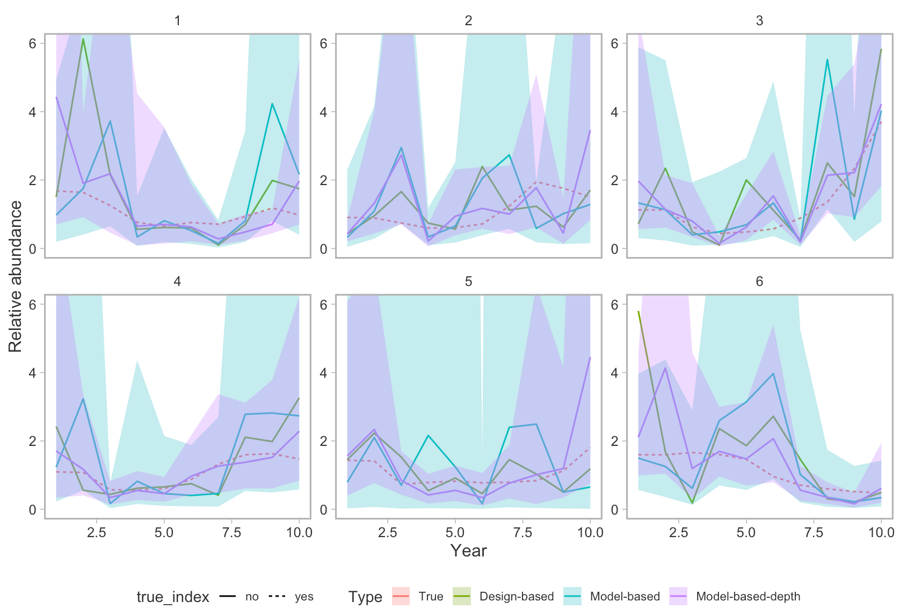

Slide 19
Stitching - Quang
1: Surveys A and B each sample different areas in each year
2: Surveys A and B each sample different areas in alternate years
3: Surveys A and B each sample different areas in alternate years, both sample their respective areas in terminal year
4: Same as #3, also compare to situation where survey A samples entire stock area at half the set density (same effort)
5: Surveys A and B each sample different areas in alternate years, both sample the same area in terminal year
6: Same vessel samples different areas in alternating years, one year, both surveys sample both areas in terminal year
Catchability differ between surveys

Slide 20
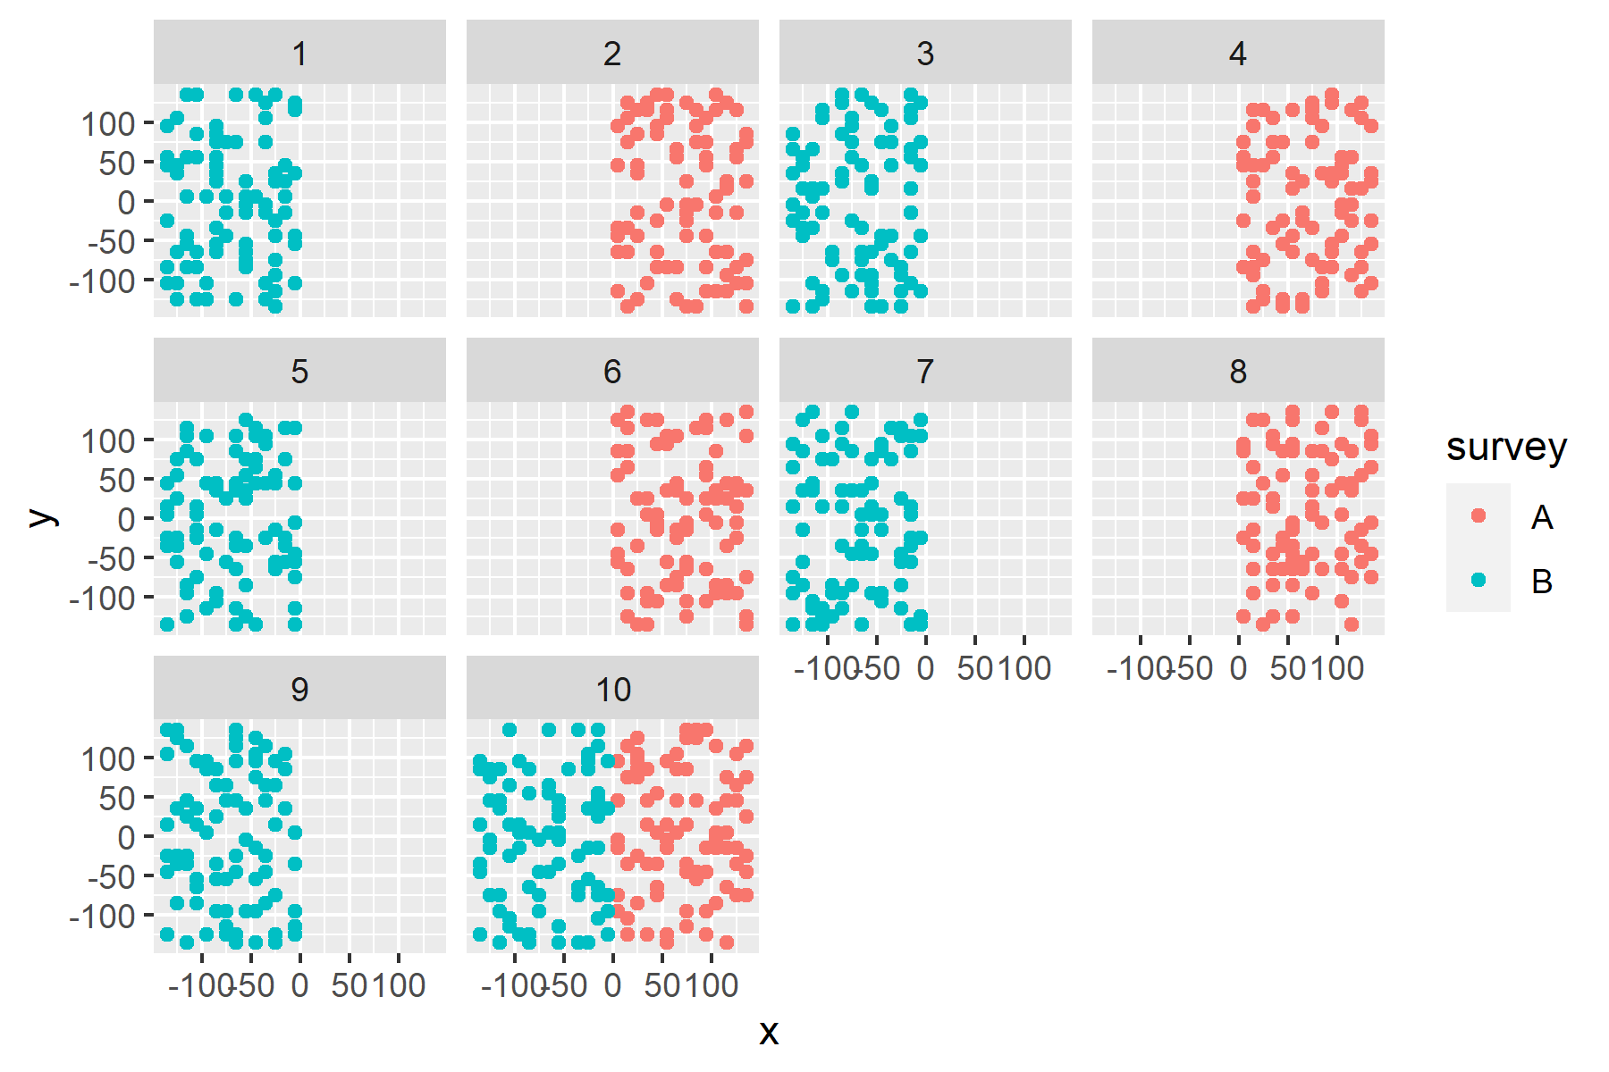
Alternating surveys in alternate years with a calibrating year (Q3-4)

Slide 21
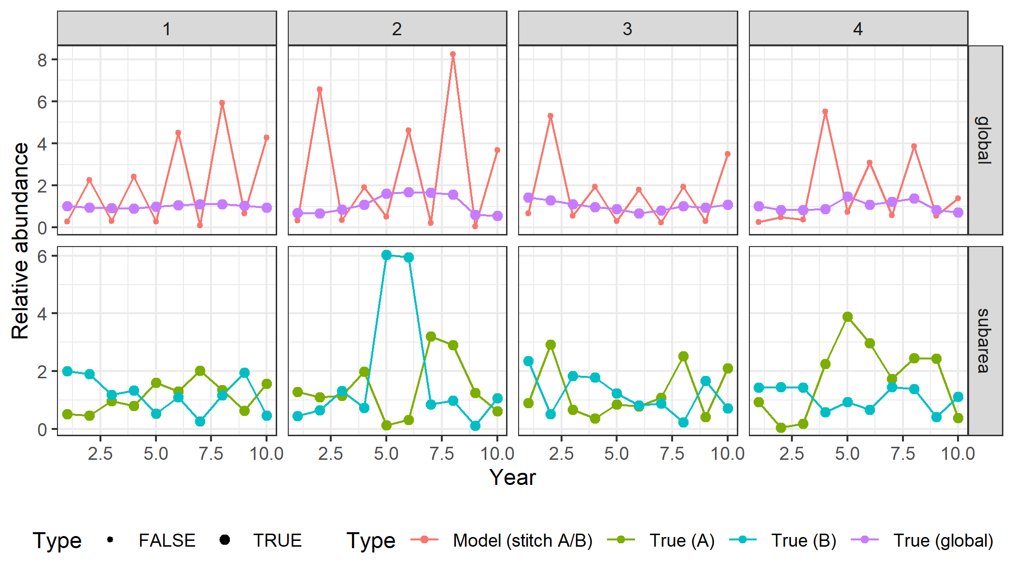
Alternating surveys in alternate years (Q2)

Slide 22
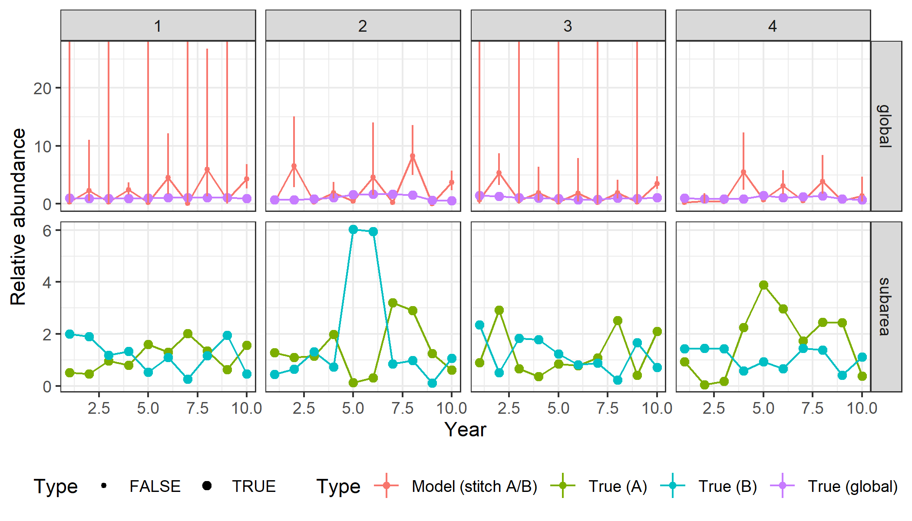
Alternating surveys in alternate years (Q2)

Slide 23
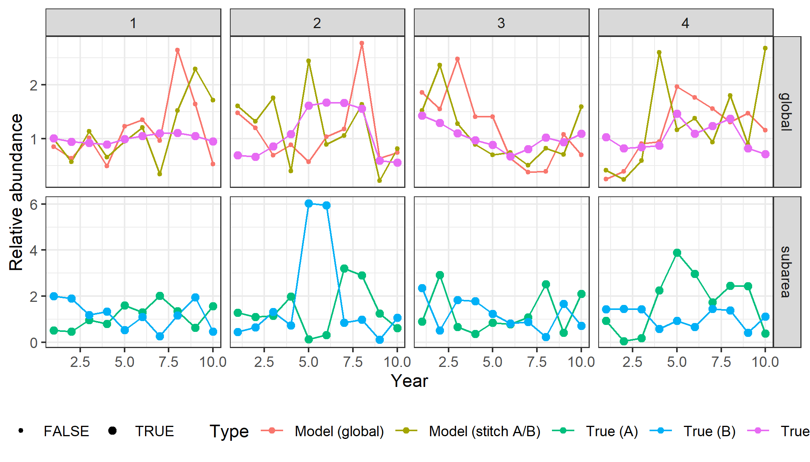
Alternating surveys in alternate years with a calibrating year, compare to global survey (Q4)

Slide 24
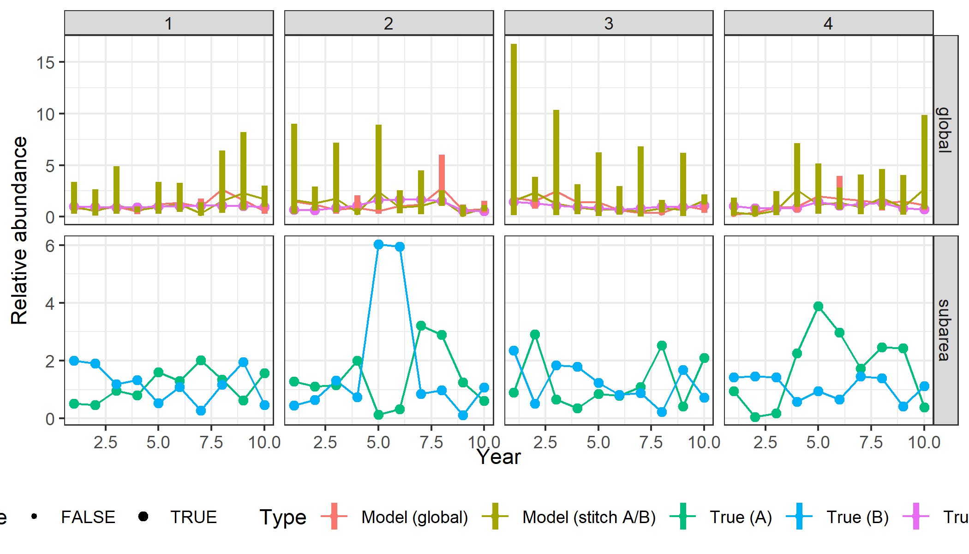
Alternating surveys in alternate years with a calibrating year, compare to global survey (Q4)

Slide 25
Coverage - Kotaro

Slide 26
Covariates - Dan

