Slide 1

Building an Intelligent Curriculum Framework
By
Danial, Hassan, Hichem, Mohammad
Winter 2020

Slide 2
Problem statement
Identify gaps, related and/or conflicting contents, and outdated content from the Canadian School of Public Service's learning curriculum, and
Develop an intelligent curriculum architecture framework.

Slide 3
General idea behind our approach
To identify an automated method for matching the keywords of the new policy with the current courses and some other external courses.
To overcome suggestions with overlaps.

Slide 4
Solution approach
INPUT
PROCESS
OUTPUT
Matching keywords with course title and description
Ranked list of courses based on similarity
If
Matched
Government policy
Keywords (manual)
Overlap
Metadata
GcCampus metadata
Content comparison with given threshold (percentage)
No Match
New Course Development
Matching external resources (Coursera)

Slide 5
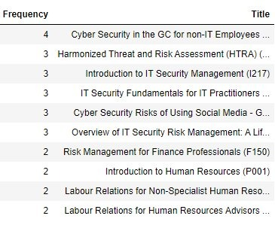
An example for a ranked list

Slide 6
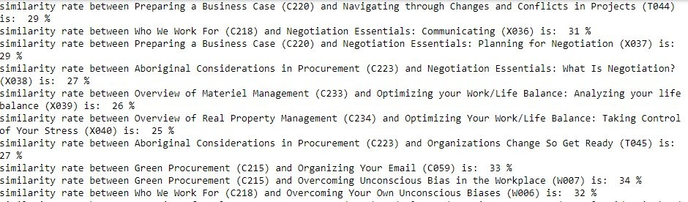
An example showing the overlap

Slide 7
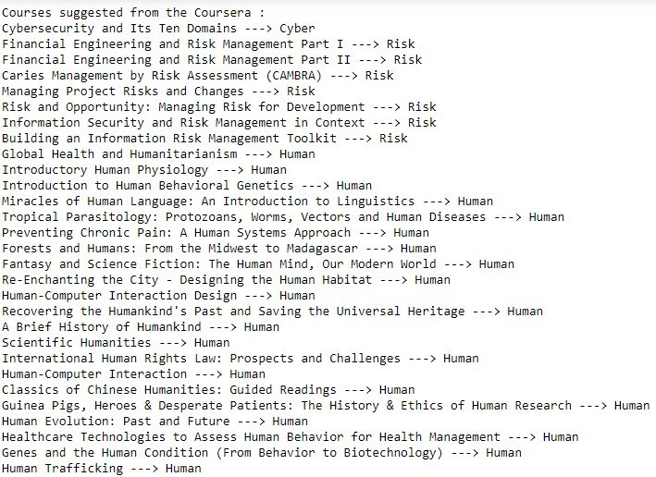
An example for a list of new courses

Slide 8
A general framework for a form
Keywords
Ranked list of available course
Ranked list of external course

Slide 9
Further Development Scope
Scope 1:
Automated curriculum architecture framework development
Method: Text mining- Machine Learning
Scope 2:
Matching the current functional communities with corresponding job titles based on NOC listing
Method: Text mining- Machine Learning
Scope 3:
Automated keywords extraction from the new policies
Method: Text mining- Machine Learning

Slide 10

Any Question?

