Slide 1
AI Model for Enabling Smart Cities
JiChu Jiang, Nima Taherifard, Johan Fernades, Ahmed Omara

Slide 2
Problem
Identifying major contributors that determine a smart city on a Global scale
Identifying features of Canadian communities that satisfy criteria for certain smart technologies
Example: Smart Emergence, smart transportation
How far away are certain cities from being capable of smart cities

Slide 3
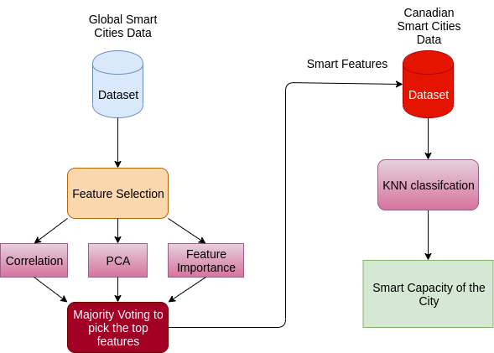
Methodology

Slide 4
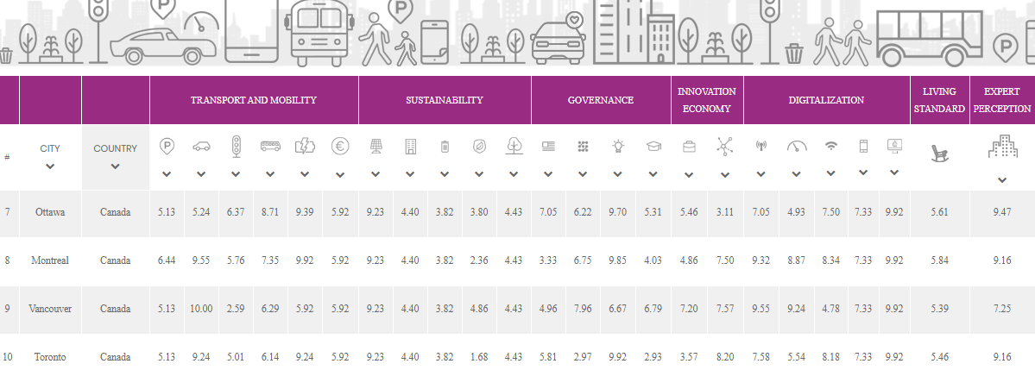
Global Smart City Dataset

Slide 5
Canadian City Geographical Dataset

Slide 6
Results
Most impactful smart technology to smart city ranking:
Smartphone penetration
Living standard
Cyber security
Wifi hotspots
Car sharing/traffic

Slide 7
Application
Globalized Smart City trends
Efficient funding concentration
Value time invested
Canada wide application to create a Smart Canada

Slide 8
Scalability
More features points for comparison
Detailed data on smaller Canadian cities
What investments do certain Canadian cities need to work on to become smart

Slide 9

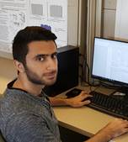

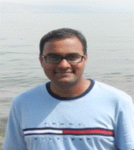
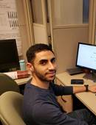
Thank you! Questions?

