Slide 1
Communication and Marketing Dashboard
* Evaluating communications and marketing efforts
* Comparing the effectiveness of various communications channels
* Providing a visual representation of data to guide evidence-based strategy development and decision-making

Slide 2
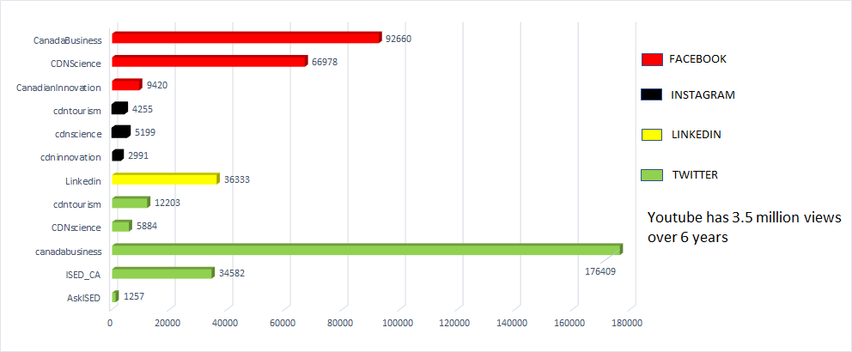
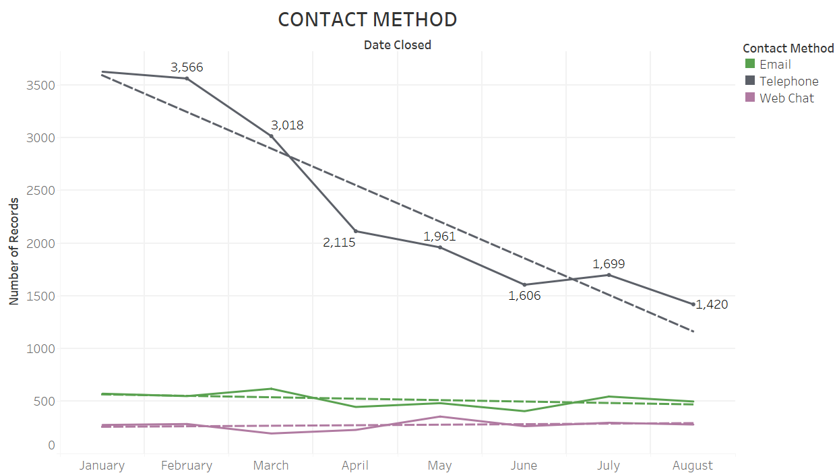
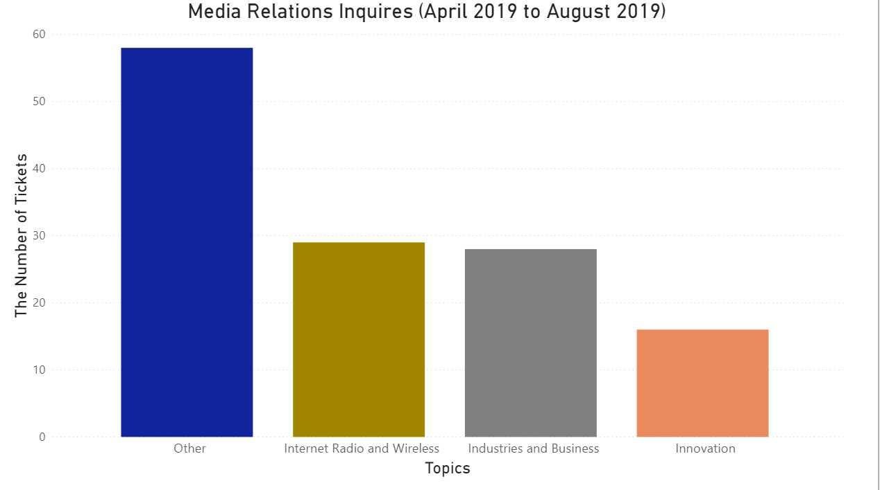
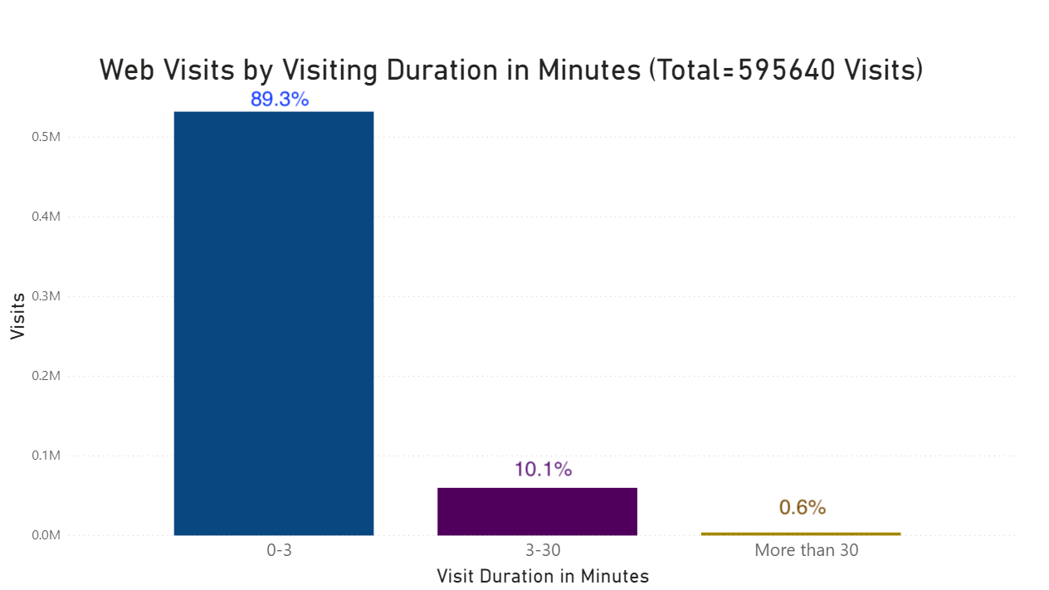
Dashboard
13 Topics

