Slide 1
Communication and Marketing Dashboard
Innovation, Science and Economic Development Canada

Slide 2
Objectives
Evaluating communications and marketing efforts
Comparing the effectiveness of various communications channels
Providing a visual representation of data to guide evidence-based strategy development and decision-making

Slide 3
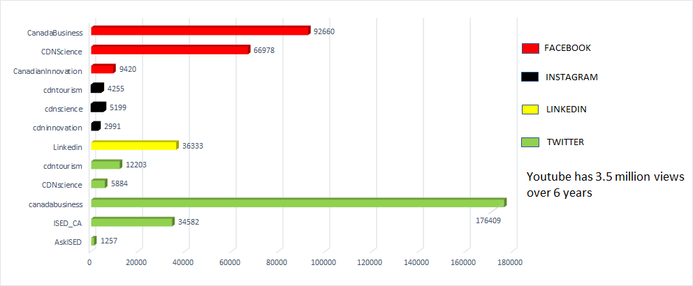
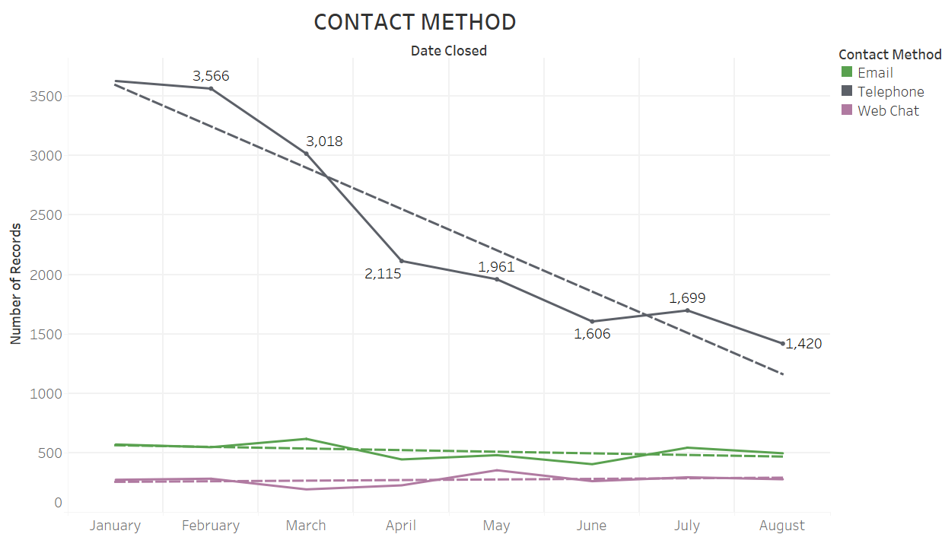
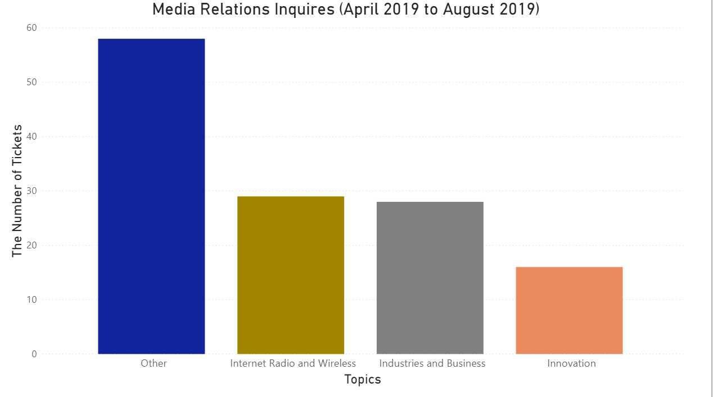
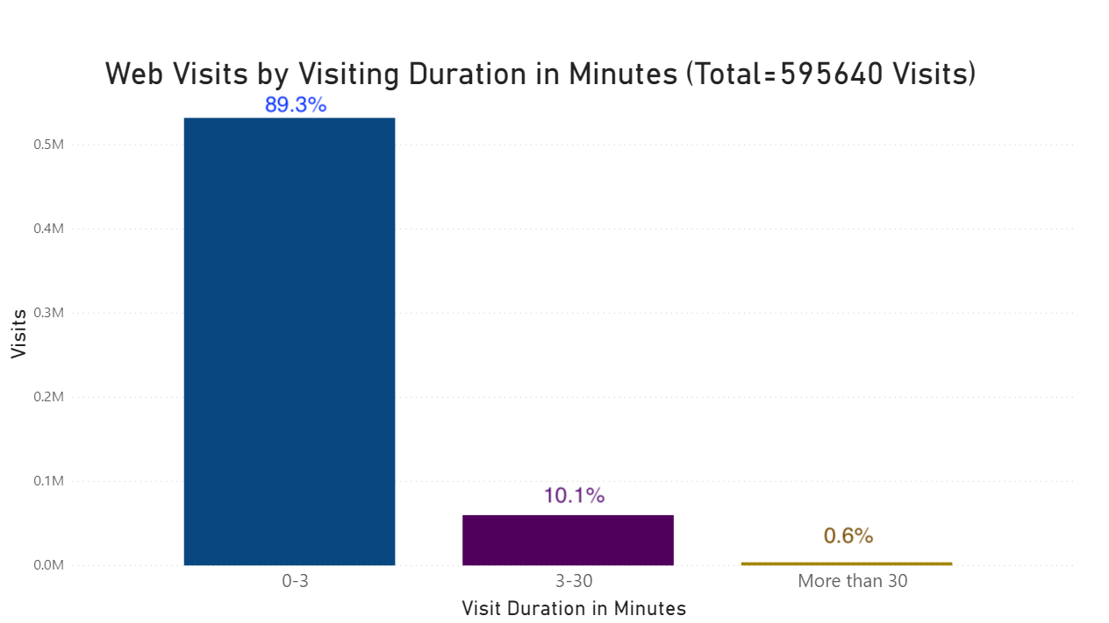
Dashboard
13 Topics

Slide 4
Solutions
Utilize Cloud-based database to collect data among different department
Add Machine Learning Technologies to provide more reliable trends
Utilize UX Design process to revamp the department website to enhance the user experience

