Slide 1
Cyber Preparedness of Critical Infrastructure
Tom Nguyen, Gregory Wilson, Dima Cherepovskyi, Pierfrancesco Cervellini
Notes:
<number>

Slide 2
Ukraine - 2015
First known successful cyber attack on a power grid.
North American power grids use many of the same components
North American Regulators
NERC, CER, Provincial Regulators, Nuclear Safety Commission
CIP Standards for Generation, Distribution and Delivery of Electricity
STATISTICS CANADA CANDEV DATA CHALLENGE
1

Slide 3
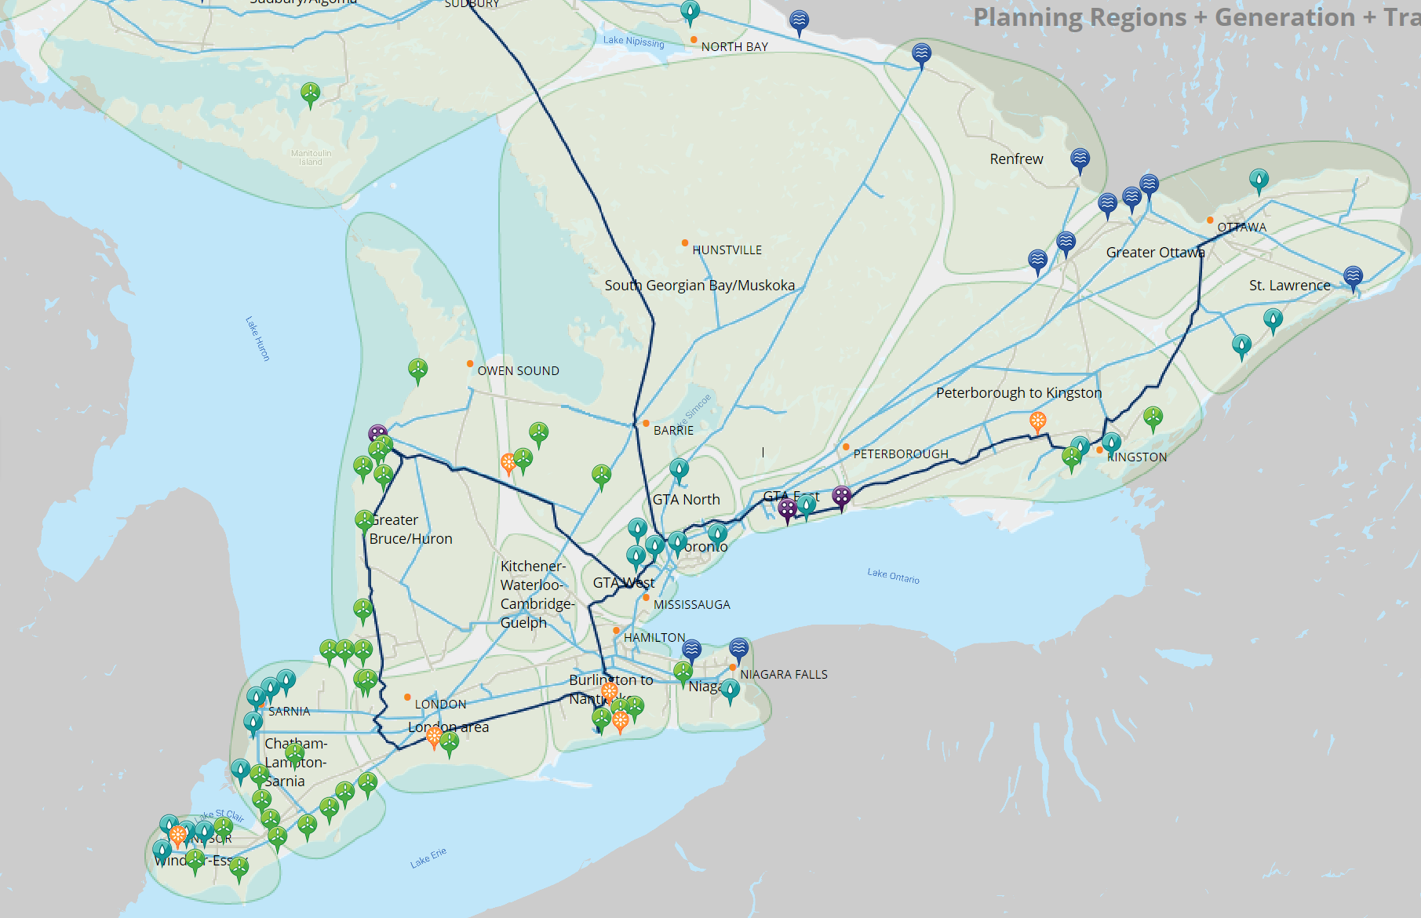
STATISTICS CANADA CANDEV DATA CHALLENGE
1

Slide 4
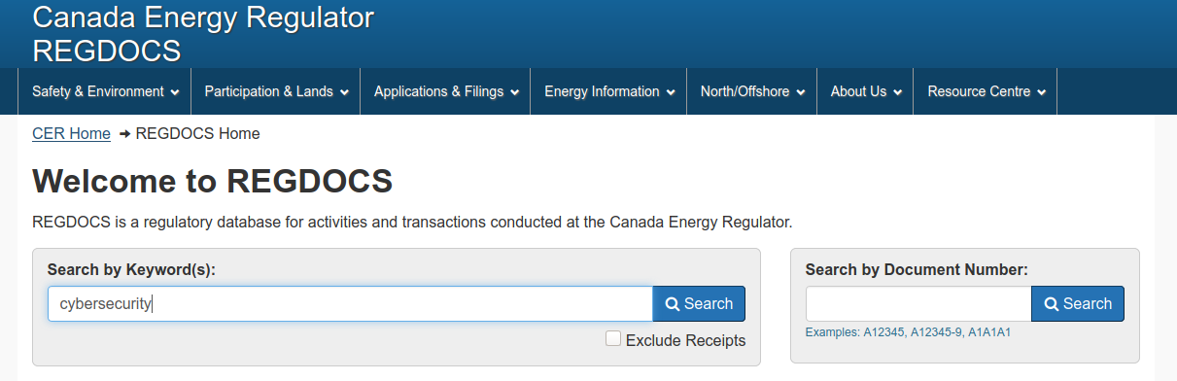
Methodology
STATISTICS CANADA CANDEV DATA CHALLENGE
1

Slide 5
Additional / Future Features
Ranking of most urgent standards to comply with.
Risk assessment based on power contribution to the grid
Geographic mapping of impact of failure due to Cyber attack
STATISTICS CANADA CANDEV DATA CHALLENGE
1

