Slide 1
Cyber Preparedness of Critical Infrastructure
Tom Nguyen, Gregory Wilson, Dima Cherepovskyi, Pierfrancesco Cervellini
Notes:
<number>

Slide 2
Ukraine - 2015
First known successful cyber attack on a power grid.
North American power grids use many of the same components
North American Regulators
NERC, CER, Provincial Regulators, Nuclear Safety Commission
CIP Standards for Generation, Distribution and Delivery of Electricity
STATISTICS CANADA CANDEV DATA CHALLENGE
<number>

Slide 3
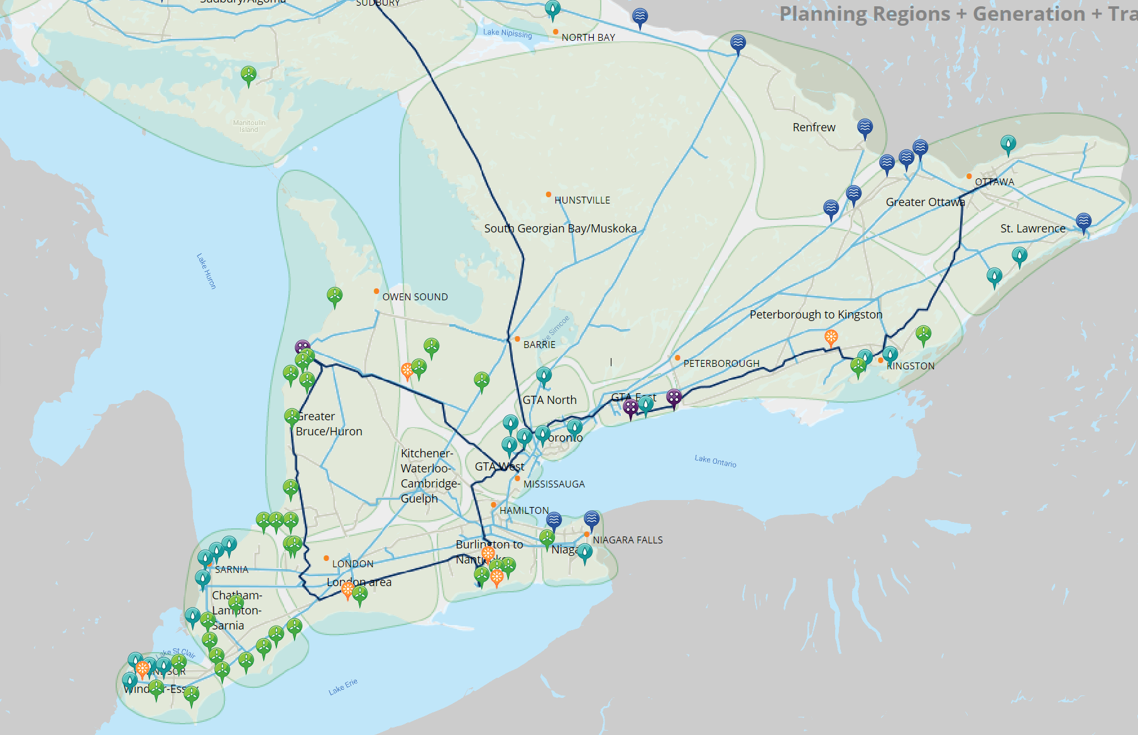
STATISTICS CANADA CANDEV DATA CHALLENGE
<number>

Slide 4
Demo
STATISTICS CANADA CANDEV DATA CHALLENGE
<number>

Slide 5
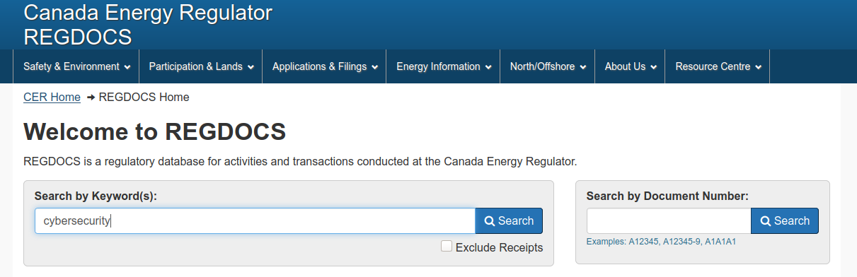
Methodology
STATISTICS CANADA CANDEV DATA CHALLENGE
<number>

Slide 6
2015, Ukraine
First known successful cyber attack on a power grid.
Level two bullet text
Level three bullet text
STATISTICS CANADA CANDEV DATA CHALLENGE
<number>

