Slide 1
Improve user experience on GCcollab : GCcarpool
Team 2166

Slide 2
Problematic
Frequent delay in public transport
Traffic jam on kilometers
Nature pollution
Insufficient parking space for the number of vehicles

Slide 3
Solutions
Set up an economical and fast means of transport for GCcollab users
Create a knowledge network between users
Avoid traffic jams during rush hour
Free parking for visitors

Slide 4
Cost estimate
A. Agreement between employees
B.
Cost estimate | Personal vehicle | STO | OC Transport | Solution GCcarpool
$CA / mois | $140< cost | $99 | $119.50 | $50
STATISTIQUE CANADA CANDEV DÉFI DES DONNÉES
4

Slide 5
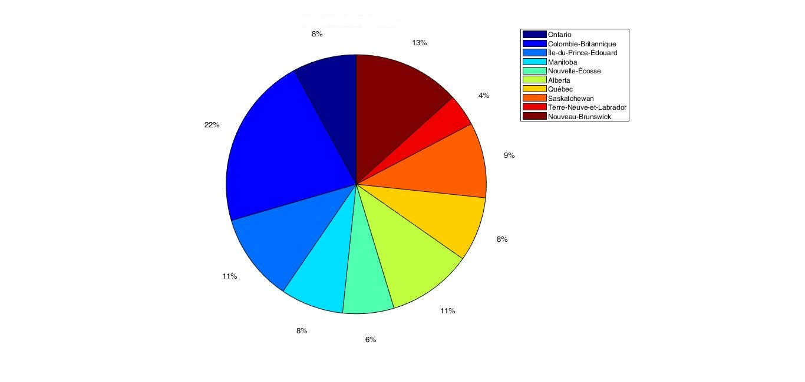
Analytics data

