Slide 1

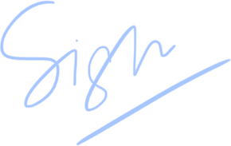
Certificate of Excellence
presented to
Eva Green
for
<image>
Best attendance
Eva Green
Teacher
Date

