Slide 2

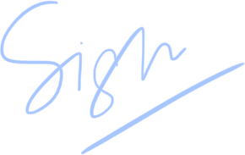
Certificate of Excellence
yash Kumar Singh
presented to
<NAME>
for
yash Kumar Singh
Best attendance
yash Kumar Singh
Teacher
Date

