Slide 1

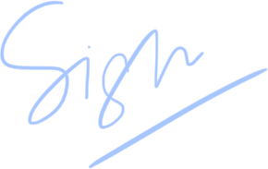
Certificate of Excellence
yash Kumar Singh
presented to
Developer
for
yash Kumar Singh
Best attendance
yash Kumar Singh
Teacher
Date

