Slide 1
Project Report: Calculator Desktop App
Part Leader: Nguyen Huu Dung
Staff: Nguyen Huy Ngo - TEV124020260
Department: Development Team
2024.02.21
Hanoi

Slide 2
1
Introduction
2
Project Objective
3
Software Requirements
4
What I learn?
5
Future enhancement
6
Reference

Slide 3

Introduction
- A calculator that is used to perform both basic and complex operation of arithmetic.
- In this calculator project, I opted for WPF due to its excellent interface customization capabilities. Furthermore, by implementing the MVVM design pattern, the calculator application exhibits characteristics such as easy extensibility, maintainabilitym and loose coupling.

Slide 4
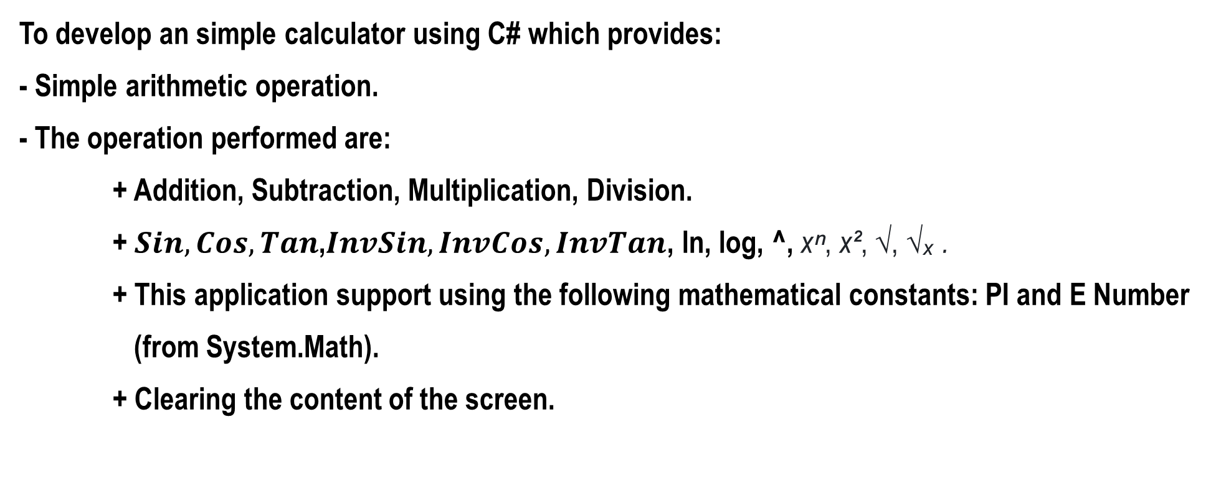
Project Objective
To develop an simple calculator using C# which provides:
- Simple arithmetic operation.
- The operation performed are:
+ Addition, Subtraction, Multiplication, Division.
+ $Sin, Cos, Tan$,$InvSin, InvCos, InvTan$, ln, log, ^, xⁿ, x², √, √ₓ .
+ This application support using the following mathematical constants: PI and E Number (from System.Math).
+ Clearing the content of the screen.

Slide 5
Software requirements
- IDE:
+ Visual Studio 2022.
- Frameworks:
+ .NET 7.0.
+ WPF.
- Packages:
+ Unity (5.11.10)

Slide 6


Methods
- Install .NET 7 on mine machine.
- Install .NET IDE (eg: Visual Studio, Rider).

Slide 7
What I learnt?
- Technical Learning:
+ C# Programming.
+ FrontEnd Slide: Windows Presentation Foundation (WPF) - .NET Core.
+ BackEnd Slide: .NET Core.
+ Visual Studio.
+ Git & Github.
+ Other used modul: Unity DI Container.
- General Learning:
+ How to design and implement coding skills.

Slide 8
Future enhancement
- Expansion of additional complex mathematical functions such as integration, matrices, etc.
- Rectification of keyboard event handling issues to capture all keystrokes accurately.

Slide 9
Reference
- https://learn.microsoft.com/en-us/dotnet/

Slide 10
THANK YOU!

