Slide 1
Git and Github
Texas Engineering world Health

Slide 2
Make sure you’ve got Git/Github set up
Download and install Git: https://git-scm.com/downloads
Make a free Github account on https://github.com

Slide 3

What is Git?

Slide 4
Version Control
A system that keeps a record of changes
Allows for groups to work on the same project/files
Let’s you know what changes have been made and by who
Allows you to roll back any changes and go back to a previous state

Slide 5
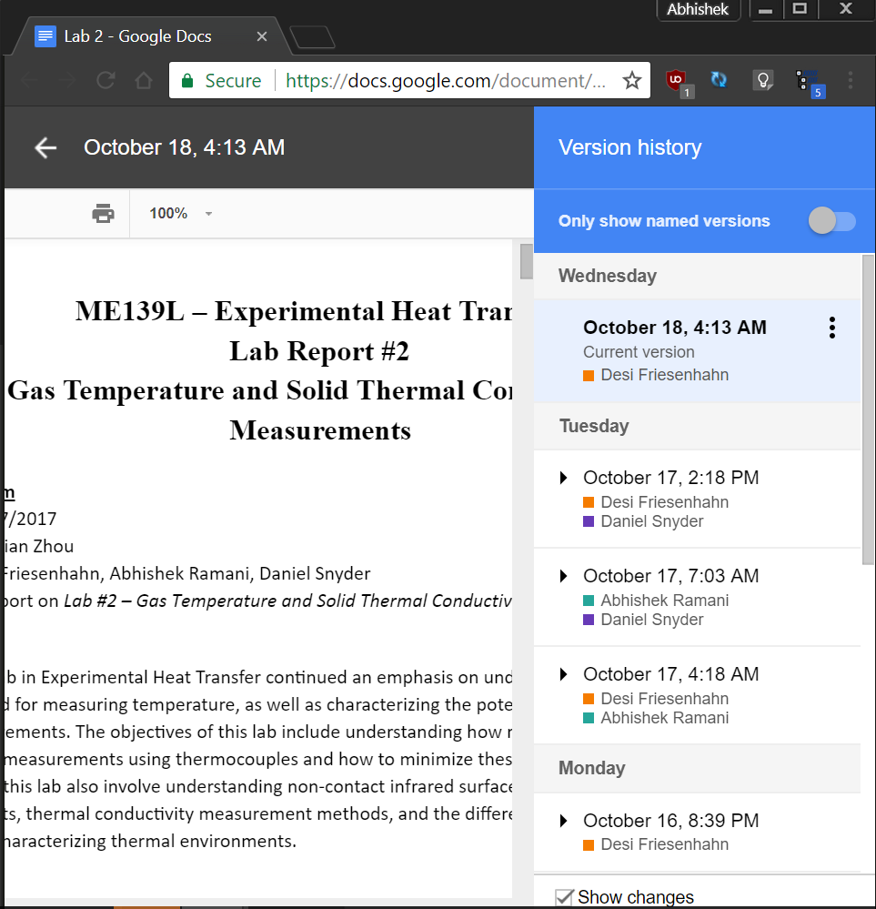
Google Drive
You can work on the same file with others
You can see a history of changes
You can roll back to previous versions

Slide 6
Git
It’s a version control system
Users keep all files/code and history on their computers
You can make changes without being connected to the Internet
(Not pushing and pulling)

Slide 7
Why use git?
You can use whatever text editor you want (Atom, Sublime Text)
Your computer stores the history of changes that you can roll back to at any time (even offline)

Slide 8
Basic Idea
Store all the files for one project in a folder called a “repository” (or repo)
“Master” repositories are stored on a remote server (Github)
You can make a copy of the master repository on your computer (local copy)
After making changes on your computer, you can then “push” those changes and update the master repository (changes the repo stored on the remote server)

Slide 9
Basic git commands
git clone: Makes a Git repository copy from a remote source. Also adds the original location as a remote so you can fetch from it again and push to it if you have permissions.
Example: git clone git@github.com:user/test.git
git add: Adds files changes in your working directory to your index.
Example: git add –A
git commit: Takes all of the changes written in the index, creates a new commit object pointing to it and sets the branch to point to that new commit.
Examples: git commit -m ‘committing added changes’
git status: Shows status of files in the index vs the working directory
git pull: gets changes from the master repository and adds them to you local copy
git log: shows history of commits
git stash: stores away changes that you’ve made

