Slide 1

FACT CHECK
Verify what you read.
Notes:
Have you ever read a news article and stopped to wonder: is this actually true? That question is why I built Fact Check.

Slide 2
FACT CHECK
Why not just use
ChatGPT or Claude?
Notes:
General AI tools can browse and cite sources. But they are open-ended assistants. Fact Check is built around one repeatable verification workflow.

Slide 3
FACT CHECK
A confident answer is not
the same as verified evidence.
Fact Check shows the claim, the reasoning, and the sources.
Notes:
Instead of asking you to engineer a prompt, the platform separates claims, searches for evidence, evaluates each source, and keeps the result inspectable.

Slide 4
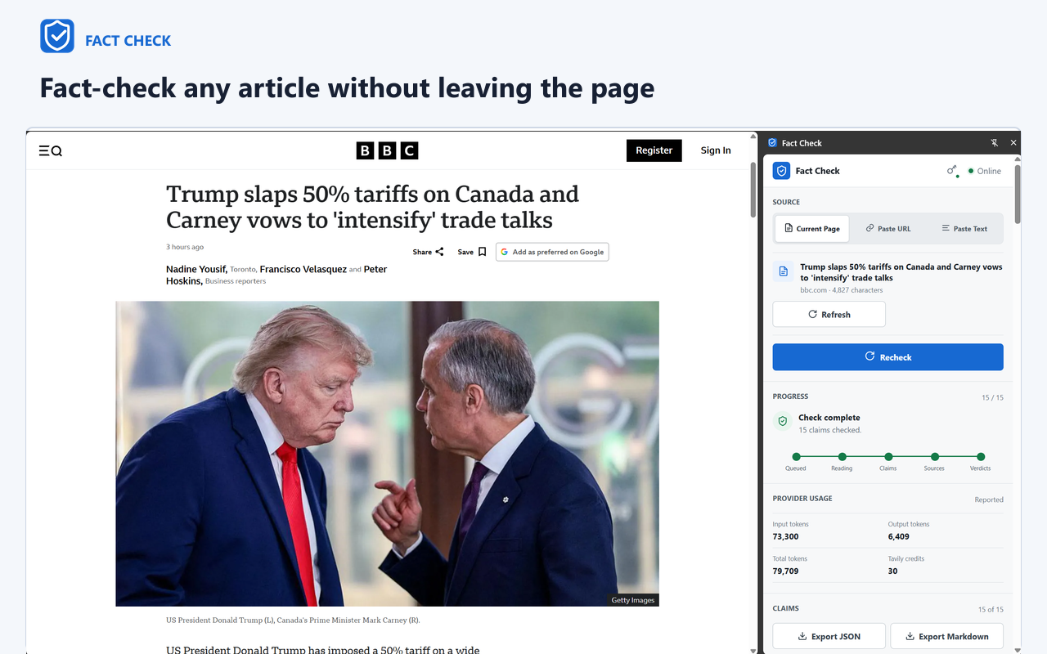
FACT CHECK
Fact-check any article
without leaving the page.
Open the extension. Check the page. Review the evidence.
Notes:
Fact Check works inside the browser. It reads the article, identifies factual claims, and returns the results beside the original content.
[Sources]
- Internal product screenshot: C:/Users/natan/VSC Code/fact-checker/screenshots/01-check-any-page.png

Slide 5
FACT CHECK
Choose what you want to check.
CURRENT PAGE
PASTE A URL
PASTE ANY TEXT
The same evidence workflow for every mode.
Notes:
Users can check the page already open in Chrome, paste an article URL, or paste any paragraph directly.

Slide 6
FACT CHECK
Every claim gets an honest outcome.
TRUE
FALSE
UNVERIFIABLE
Notes:
The platform uses three clear outcomes: true, false, or unverifiable. It does not pretend that every question has a decisive answer.

Slide 7
FACT CHECK
Evidence comes before the verdict.
ARTICLE → CLAIMS → SOURCES → VERDICT
Each source is checked against its own claim.
Notes:
The system extracts factual claims, searches for evidence, evaluates each source, and only then derives the final verdict.

Slide 8
FACT CHECK
No evidence?
No verdict.
When sources are missing or conflicting, Fact Check says so.
Notes:
A safe verification system must be able to say that the available evidence is not enough. Honest uncertainty is better than fabricated confidence.

Slide 9
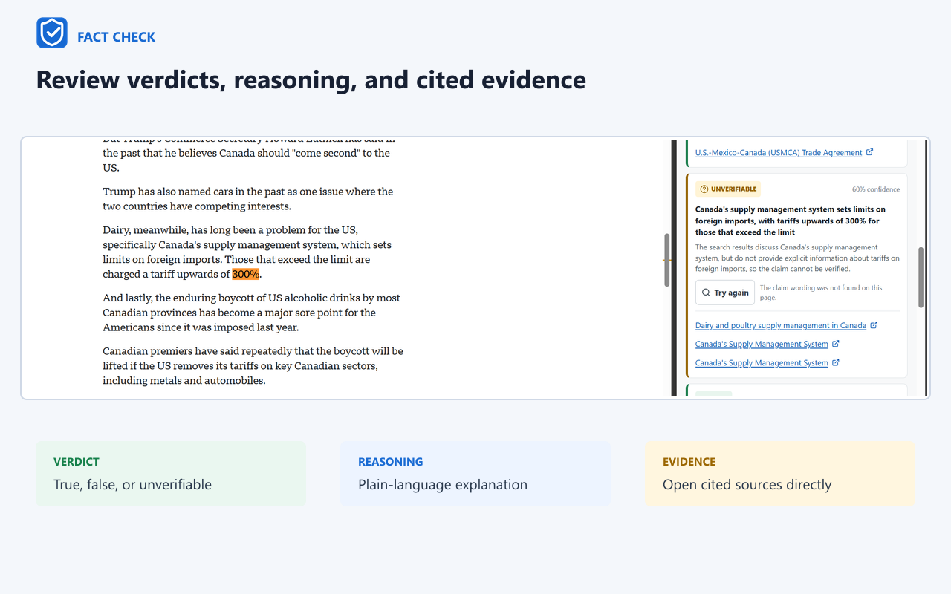
FACT CHECK
Review the reasoning.
Open the sources.
Export the report.
The result stays useful after the check is complete.
Notes:
Every result keeps the claim, explanation, and sources together. Users can open the evidence directly or export the review as Markdown or JSON.
[Sources]
- Internal product screenshot: C:/Users/natan/VSC Code/fact-checker/screenshots/04-verdicts-and-sources.png

Slide 10
FACT CHECK
Read. Question. Verify.
Notes:
The next time you wonder whether something online is true, you should be able to verify it where you found it. That is Fact Check.

