Slide 1
TaskFlow doesn't need more traffic.
It needs its value back.
Prepared by
Oksana Kolisnyk
A stricter, more operator-style turnaround plan
Included:
- designed deck
- PDF
- calculations
- source log
My call
Fix the leak first.
Then earn the right to scale.
Loom
https://www.loom.com/share/ec723b4fa73542679c644feae340f941
My operating rule:
no extra spend before the numbers move.
This is the sentence I would defend in the room.
Sources: Task brief and own analysis.
1
Notes:
0:00-0:20
Hi, my name is Oksana, and today I will briefly present my solution for the TaskFlow case.
I will explain the main reason behind TaskFlow's decline, the market and competitor context, and the strategy I would recommend for the next 12 months.

Slide 2
Start here: the category is fine.
The product is not.
If I had to summarize the case in one line: TaskFlow stopped earning repeat usage.
What is broken
Why it broke
Retention is the clearest signal: D30 fell from 12% to 5%, D90 from 6.5% to 2.3%, and paid churn rose to 18%.
The product feels stale: no major release in 8 months, worse ratings, weak collaboration, no offline mode, repetitive UI.
Why this matters
My management call
Downloads and MAU fell 42%, CPI rose 44%, and burn is still about $150k a month against $60k MRR.
Do not fund a full pivot yet. Narrow the promise, fix first-session value, and scale only after the core numbers move.
Clearer promise. Better first-session value. Less paid dependence until retention recovers.
The real question is not “What else can we add?” It is “Why would users come back tomorrow?”
Sources: Task brief; own calculations; Mordor; Gartner; competitor public pages.
2
Notes:
0:20-0:40
TaskFlow's problem is not a shrinking market.
The main issue is weakening product-market fit, together with lower retention, higher churn, and weaker differentiation.

Slide 3
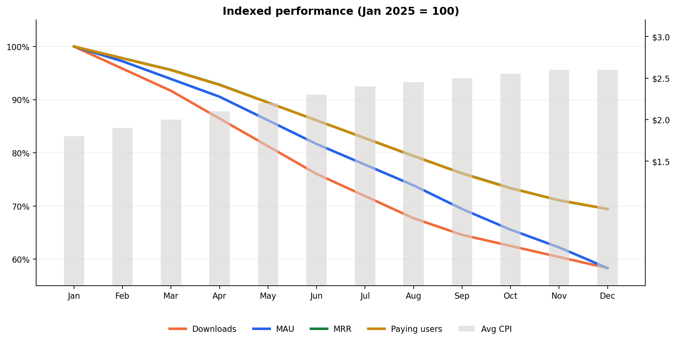
The whole model bent in the same direction
Downloads
48k -> 28k
-42%
MAU
180k -> 105k
-42%
MRR
$86.4k -> $60.0k
-31%
Avg CPI
$1.80 -> $2.60
+44%
Sources: Task brief dataset; own calculations.
3
Notes:
0:40-1:00
In 2025, all core business metrics declined.
Downloads, monthly active users, and monthly recurring revenue fell, while cost per install increased, so the product is shrinking and growth is getting more expensive.

Slide 4
The leak starts after install
1. Retention broke first
2. The product stopped feeling fresh
3. Paid growth became a patch
4. Cheap volume will not save it
Every cohort got weaker. D30 fell 58% and D90 fell 65% vs Q1 2024. That is what a value leak looks like.
Ratings fell from 4.6 to 4.2. Complaints repeat the same basics: weak collaboration, no offline mode, repetitive UI.
81% of installs are paid, and 62% come from Meta. That is too much dependence for a product with weakening retention.
Other markets are 29% of MAU but only 10% of revenue. Cheaper installs there do not repair the model.
This is why I did not blame the market first.
Sources: Task brief dataset; public review themes from case prompt.
4
Notes:
1:00-1:20
I diagnose this primarily as a product and positioning problem.
The strongest evidence is retention decline, lower ratings, weak product freshness, and clearer competitor advantage.

Slide 5
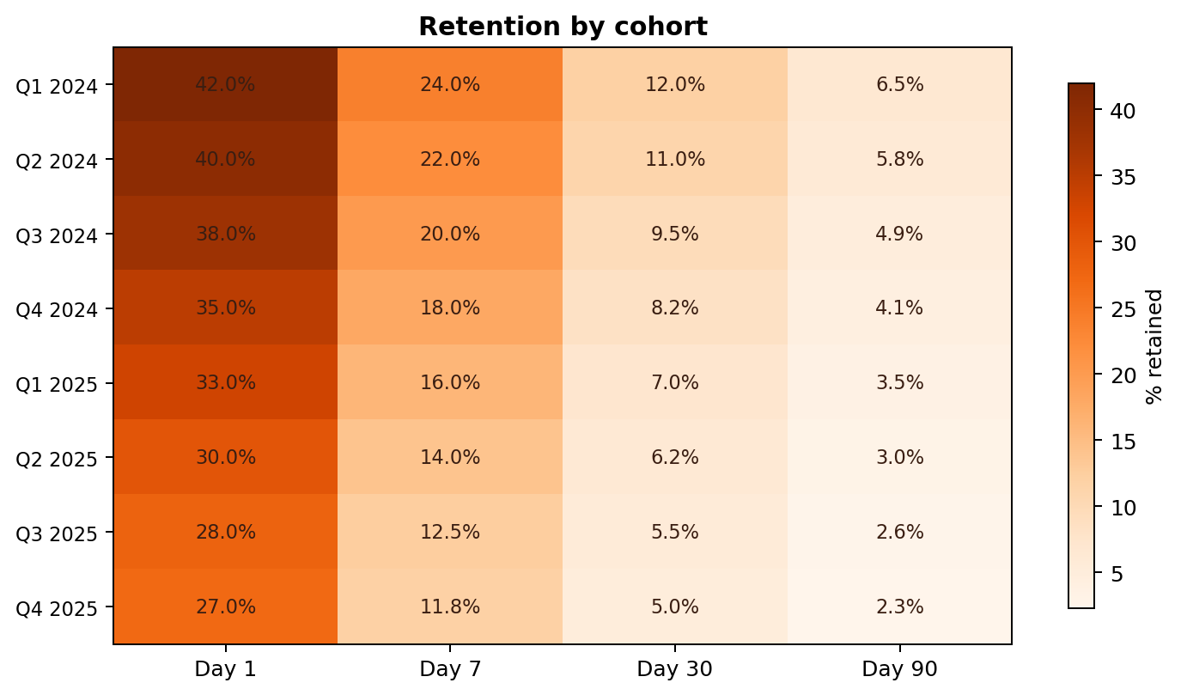
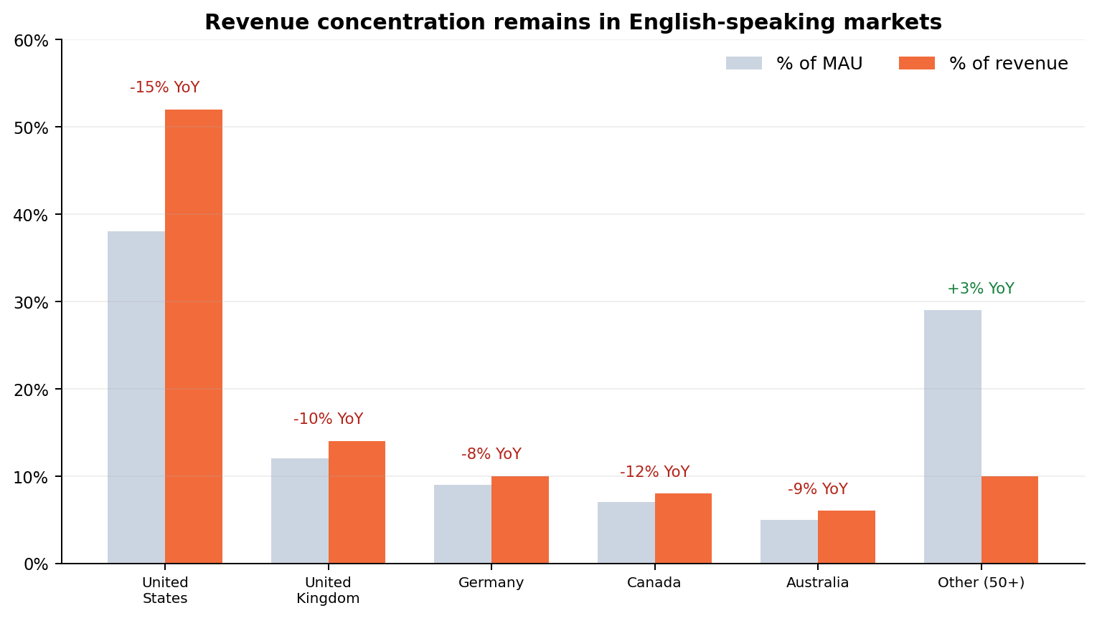
This is why buying more installs now is a trap
Approx. paid CAC
Approx. paid LTV
$26.5
= $2.60 / 9.8%
$26.7
= $4.80 / 18%
So what I would do
At today's conversion and churn, a newly acquired payer barely covers expected subscription value.
Operator rule
Cap weak paid social. Shift energy into activation, retention, ASO and content until the model improves.
Buying more traffic now mostly buys churn.
5
Sources: Task brief dataset; simplified LTV/CAC estimates using provided ARPPU, churn, CPI and free-to-paid conversion.
Notes:
1:20-1:45
This slide shows why paid acquisition is not the answer right now.
Customer acquisition cost is now almost equal to lifetime value, so the company should improve product value before scaling growth.

Slide 6
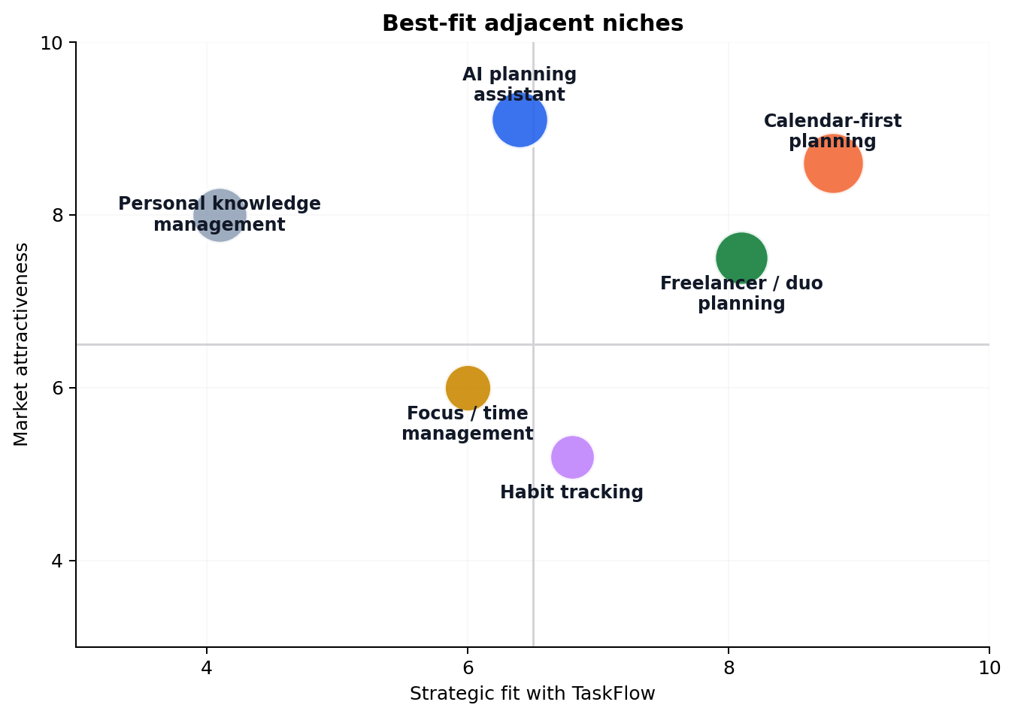
Where I still see upside
Demand still exists
Task management is still growing. The question is not whether demand exists, but where TaskFlow can still win.
The best growth pocket
A narrower calendar-first planning use case fits the product better than generic to-do positioning.
Where I would focus first
US, UK, Canada and Australia already drive most revenue. I would fix the product there before chasing cheaper installs elsewhere.
Sources: Mordor Intelligence; TechCrunch on Sensor Tower State of Mobile 2026; Gartner AI predictions.
6
Notes:
1:45-2:05
The market is still attractive, so I would not recommend leaving productivity.
However, TaskFlow needs a sharper niche, and the strongest fit is calendar-first planning for young professionals, freelancers, and duos.

Slide 7
What stronger players do differently
Public proof points, not just category reputation.
TaskFlow today
Todoist
TickTick
4.2 rating | 105k MAU | 62% Meta mix
4.6 rating | 297k reviews | 10M+ downloads
4.6 rating | 157k reviews | 5M+ downloads
Broad promise, weak collaboration, no offline mode, and a product that feels less fresh than the category leaders.
Templates, integrations and content make it easier to discover and easier to start with a clear job to be done.
Bundled value feels stronger: tasks, calendar, habits and focus tools under attractive annual pricing.
Any.do
Microsoft To Do
4.4 rating | 503k reviews | 10M+ downloads
4.6 rating | 468k reviews | 10M+ downloads
Shared planning is packaged more clearly through Family and Workspace flows, not generic collaboration language.
Distribution comes from the ecosystem itself through Outlook and Microsoft, not rebuilt every month in paid UA.
The gap is not just features. Stronger players are easier to trust, easier to discover, and easier to return to.
Sources: Case data for TaskFlow; Google Play public ratings/review counts; competitor official pages.
7
Notes:
2:05-2:25
Here I compare TaskFlow with Todoist, TickTick, Any.do, and Microsoft To Do.
The benchmark shows that competitors are stronger in collaboration, product maturity, and distribution.

Slide 8
Where TaskFlow still has room to win
1. Faster first value
2. Better micro-collaboration
3. Less paid dependence
4. Product freshness
Onboarding, templates and calendar setup can make the product useful in the first session.
The opening is 2-5 person planning, not complex team workflows.
Competitors use templates, content, referrals and ecosystems. TaskFlow over-relies on paid social.
Shipping visible basics matters. Reviews suggest users no longer trust the product to keep improving.
The opening I would pursue
TaskFlow should not try to out-feature everyone. The opening is a cleaner calendar-first planner for solo professionals, freelancers and very small shared workflows.
This is narrow on purpose.
Sources: Competitor public pages and store listings; case prompt review themes.
8
Notes:
2:25-2:45
TaskFlow should not try to out-feature everyone.
Instead, it should focus on a narrower and cleaner use case where it can realistically compete.

Slide 9
I considered 3 paths.
Only one earns the right to scale.
Option A | Fix and narrow
Option B | Full AI pivot
Option C | Chase cheaper users
Why I would say yes
Attacks the real leak, fits the current team, and can show progress inside 2-3 quarters.
Main downside
Requires discipline to stay narrow.
Why I would hesitate
Attractive theme, but it is a much bigger repositioning with higher product risk, stronger incumbents and extra cost.
Main downside
Too much uncertainty for the current runway.
Why I would say no for now
It may improve install volume and headline CPI, but it does not solve retention and can weaken the revenue mix.
Main downside
Looks like growth without value.
My choice
Fix and narrow first. If the recovery stalls after Q3, reopen the pivot conversation from a stronger fact base.
Sources: Own strategic evaluation based on task brief, market data and competitor benchmark.
9
Notes:
2:45-3:10
I considered three options: a focused turnaround, an AI-first pivot, and growth expansion into lower-cost segments.
The first option is the most realistic and highest-probability path.

Slide 10
If I joined the team on Monday morning
Product
Growth
Customer insight
Support / success
Ops / finance
Rebuild the activation funnel.
Ship offline mode.
Tighten calendar parity.
Improve onboarding by use case.
Pause weak paid social.
Rewrite the store listing and landing page.
Build templates and creator pilots.
Run churn interviews.
Tag support tickets by reason.
Add cancellation survey.
Track D7 and D30 by cohort.
Use lifecycle nudges for stuck trial users.
Build a self-serve help layer.
Turn support into a feedback loop, not only ticket handling.
Freeze non-core work.
Use weekly stop-loss rules on paid.
Limit the team to 3 core bets at a time.
This is a sequencing plan, not a wishlist.
Same thesis, translated into owners.
Sources: Own recommendation based on brief, benchmark and market research.
10
Notes:
3:10-3:35
My recommendation is a turnaround strategy, not a full pivot.
TaskFlow should reposition itself as a calendar-first planner and improve its core workflow, collaboration, packaging, and growth model.

Slide 11
Turnaround roadmap
Q2 2026 | Stop the bleed
Q3 2026 | Prove the core
Q4 2026 | Add AI selectively
Q1 2027 | Scale winners
Activation funnel
Offline mode MVP
Store listing rewrite
Paid stop-loss rules
Collaboration 2.0
Calendar parity
Templates
Free / trial experiments
Smart scheduling
Natural-language capture
Weekly planning summary
Increase spend only on green channels
Referral engine
Wave-2 market tests
My line in the sand: if D30 is still below 7% by the end of Q3, I would revisit a broader pivot.
Sources: Own roadmap recommendation.
11
Notes:
3:35-3:55
The roadmap starts with stabilization, then differentiation, then selective AI features, and only after that scaling.
The sequence matters because retention must improve before growth spend increases.

Slide 12
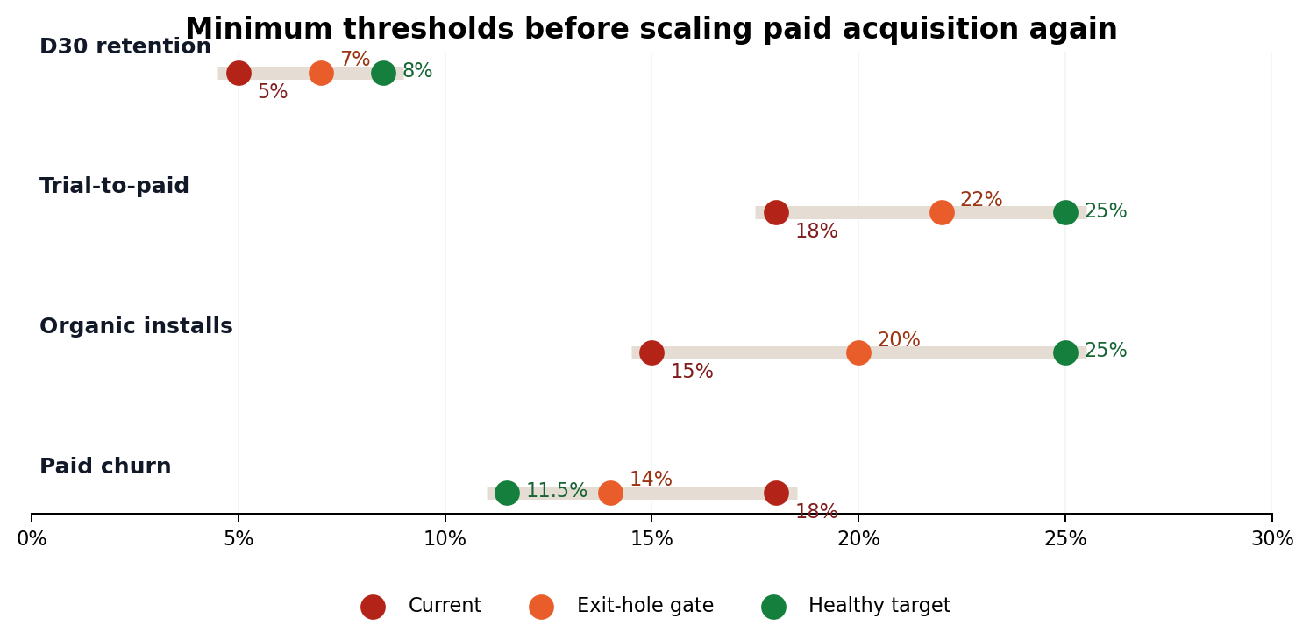
Numbers I'd refuse to ignore before scaling again
Why these gates matter
They force the team to prove product value before buying more top-of-funnel volume.
Economic rule
Paid LTV / CAC should move above about 1.3x before spend increases materially; healthy state is 1.5x or better.
Decision rule
All operating gates should clear for 2 consecutive months before paid budgets go back up.
No cleared gates = no extra spend.
Sources: Own thresholds built from current baselines and simplified unit economics.
12
Notes:
3:55-4:15
Success should be measured not only by top-of-funnel growth, but by stronger product value.
My target metrics are better retention, lower churn, higher organic share, and monthly recurring revenue recovery over 12 months.

Slide 13
What success should feel like,
not just look like
User value
Growth quality
D30 is back above 8%, ratings recover, and complaints about missing basics start fading.
Organic share rises, paid dependence falls, and channel decisions get cleaner.
Revenue quality
Team cadence
Lower churn and better trial conversion lift MRR without forcing a risky price cut.
Product, growth and support work from the same weekly scorecard instead of chasing disconnected fixes.
Strategic option value
Management can keep compounding the recovery or pivot later from a position of strength, not panic.
Sources: Own risk assessment.
13
Notes:
4:15-4:30
I also included the main execution risks, including team bandwidth, competitive pressure, AI risk, runway pressure, and distraction from low-value markets.

Slide 14
Selected sources
Sources (titles)
Links
1. Mordor Intelligence - task management market
2. TechCrunch on Sensor Tower State of Mobile 2026
3. Todoist template gallery
4. Todoist pricing update 2025
5. TickTick upgrade page
6. TickTick ambassador program
7. Any.do pricing and Spaces
8. Microsoft To Do with Outlook Tasks
https://www.mordorintelligence.com/industry-reports/task-management-software-market
https://techcrunch.com/2026/01/21/consumers-spent-more-on-mobile-apps-than-games-in-2025-driven-by-ai-app-adoption/
https://www.todoist.com/templates/getting-things-done
https://www.todoist.com/help/articles/todoist-pricing-and-plans-update-2025-everything-you-need-to-know-Tn6Pg1JKI
https://ticktick.com/upgrade
https://ticktick.com/ambassador_program
https://www.any.do/pricing
https://support.microsoft.com/en-us/office/using-microsoft-to-do-with-outlook-tasks-c7a0253d-b8cc-4054-b94b-c194e0e5308a
Why these sources matter
Together, they show that the market is still healthy, competitors are raising the bar, and TaskFlow’s problem is execution and positioning — not category decline.
Sources: Official market and competitor pages used in the revised deck.
14
Notes:
4:30-4:50
So overall, my conclusion is simple:
TaskFlow should stay in the productivity category, avoid a risky full pivot for now, and focus on restoring product value, sharper positioning, and more efficient growth.
Thank you.

