Slide 1
ANNAMACHARYA INSTITUTE OF TECHNOLOGY & SCIENCES
Presented by
T Eswar Reddy
22AK1A3208
CSD

Slide 2
INPUT AND OUTPUT OPERATIONS

Slide 3
Topics
I/O Basics
Streams
Reading Console Input
Writing Console Output
PrintWriter class
FileWriter and FileReader
Closing a File

Slide 4
I/O Basics
Input/Output
Input from file or Keyboard.
Output to screen or a file.
Java Uses the concept of a stream to make I/O operations fast.
Java.io.package
Comprises almost all classes that a user requires to perform input and output(I/O).

Slide 5
Stream
A Stream is a sequence or series of data. In java ,a stream is composed of bytes
Reading data from Source Writing data to destination
Input stream Output stream
Source
Program
Program
Destination

Slide 6
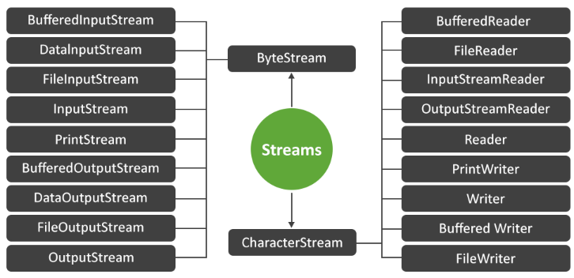

Slide 7
Byte streams
Handling Byte-Oriented I/O.
Byte Streams are used to implement the input and output of 8 bit bytes.
It can be used with any type of Object, including Binary data.
This Versatility makes byte Streams important to many types of program
The byte Stream clasess are topped by
InputStreams
OutputStreams

Slide 8
Input stream
This is used to read data from a source
It is an Abstract class that defines javas model Streaming byte input.
the methods in the class throw an IO Exceptions on error conditions.
Java.io.InputStream
read() – used to read the next byte of data from the input stream
mark() – used to mark the current position of the input stream
reset() – it changes the position of the input stream back to the marked position.
close() – used to close the input stream and releases system resources associated with this stream to Garbage Collector.
skip(long arg) – used to skip and discard arg bytes in the input stream.
markSupported()- tests if the inputStream supports the mark and reset methods.default in false.

Slide 9
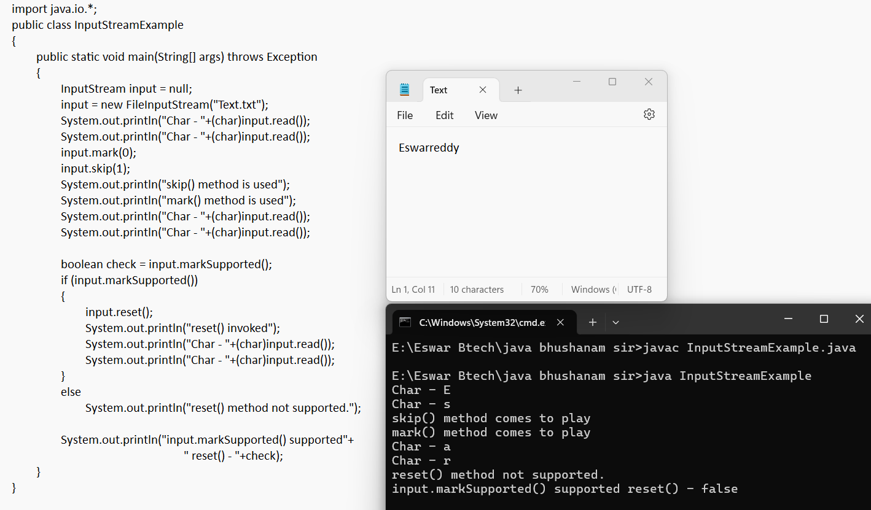

Slide 10
Output stream
This is used to write data to destination
It is also an Abstract class that defines Streaming byte output.
All the Methods in the class return a void value and throw IOException in the case of Errors.
flush() – flushing the OutputStream and forces the buffered output bytes to be written out.
close() – close the OutputStream and to release the system resources affiliated with the stream.
write(int b)- write the specified byte to the outputStream.
write(byte [ ]b)- write bytes of length b.length from the specified byte array to the OutputStream

Slide 11
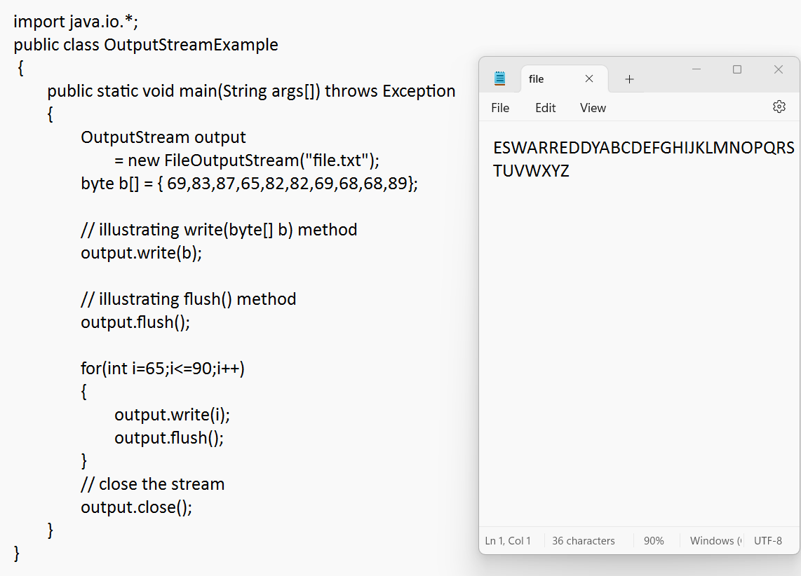

Slide 12
Standard streams
System.in
Keyboard
Screen Screen
Program
System.out
System.err

Slide 13
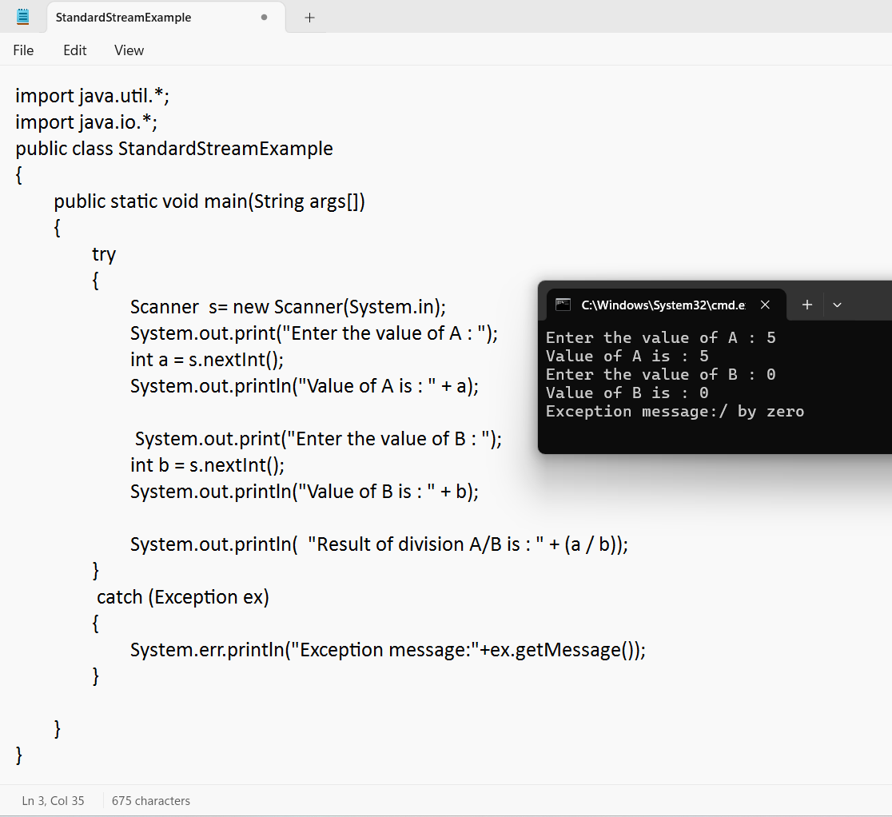

Slide 14
Character Streams
Character Streams are the ones that are used to implement the input and out for 16-bit Unicode
The most commonly used clasess are FileReading and FileWriting.
The FileReader class uses FileInputStream and the FileWriter class uses FileOutputStream. Neverthless , the significant contrast is that FileReader and File Writer read and write two bytes ,respectively.

Slide 15
READING CONSOLE INPUT
It is nothing but reading input from the user in the command lin Environment(Console).
Three ways to read tha console input. They are
BufferedReader class
Scanner class
Console class

Slide 16
Using Buffer Reader classs
import java.io.BufferedReader;
import java.io.IOException;
import java.io.InputStreamReader;
public class Exampl1
{
public static void main(String[] args) throws IOException
{
BufferedReader reader = new BufferedReader( new InputStreamReader(System.in));
// Reading data using readLine
String name = reader.readLine(); Input:
// Printing the read line Java program
System.out.println(name); Output:
} Java program
}

Slide 17
Using Scanner class
import java.util.Scanner;
class Example2
{
public static void main(String args[])
{
Scanner in = new Scanner(System.in);
String s = in.nextLine();
System.out.println("You entered string " + s); Input:
int a = in.nextInt(); Java
System.out.println("You entered integer " + a); 200
float b = in.nextFloat(); 10.6
System.out.println("You entered float " + b); Output:
You entered String java
} You entered Integer 200
} You entered Float 10.6

Slide 18
Using Console input
public class Sample
{
public static void main(String[] args)
{
// Using Console to input data from user
String str = System.console().readLine();
System.out.println("You entered string " + str);
}
}
Input: Output:
CSD You Entered String CSD

Slide 19
WRITING CONSOLE OUTPUT
It means writing output of program to the Command line Environment(Console)
The Methods are used for Console Output
print() – display output in the same line
println() – display output in line by line
write() – for directing output of program to Console

Slide 20
print()
class ExamplePrint
{
public static void main(String[] args)
{
for(i=1;i<=10;i++)
{
System.out.print(i);
}
}
}
Output:
1 2 3 4 5 6 7 8 9 10

Slide 21
println()
class ExamplePrintln
{
public static void main(String[] args) Output:
{ 1
for(i=1;i<=5;i++) 2
{ 3
System.out.println(i); 4
} 5
}
}

Slide 22
write()
class ExampleWrite
{
public static void main(String[] args)
{
int a=100;
String str = “java”;
System.out.write(a);
System.out.write(str);
}
}

Slide 23
PrintWriter Class
PrintWriter is a class used to write any form of data e.g. int, float, double, String or Object in the form of text either on the console or in a file.
System.out.print – it is easier to customize the format as per the specified Local (regional standards).
While PrintWriter class is used for Global applications.
Import java.io.PrintWriter

Slide 24
Syntax:-
Console Output
PrintWriter consoleOutput = new PrintWriter(System.out);
File Output
PrintWriter fileOutput = new PrintWriter(“FileOutput.txt”);

Slide 25
Methods in PrintWriter class
printf(String str,Object arguments);
print(String str);
println(String str);
append(CharSequence cs);
flush();
close();

Slide 26
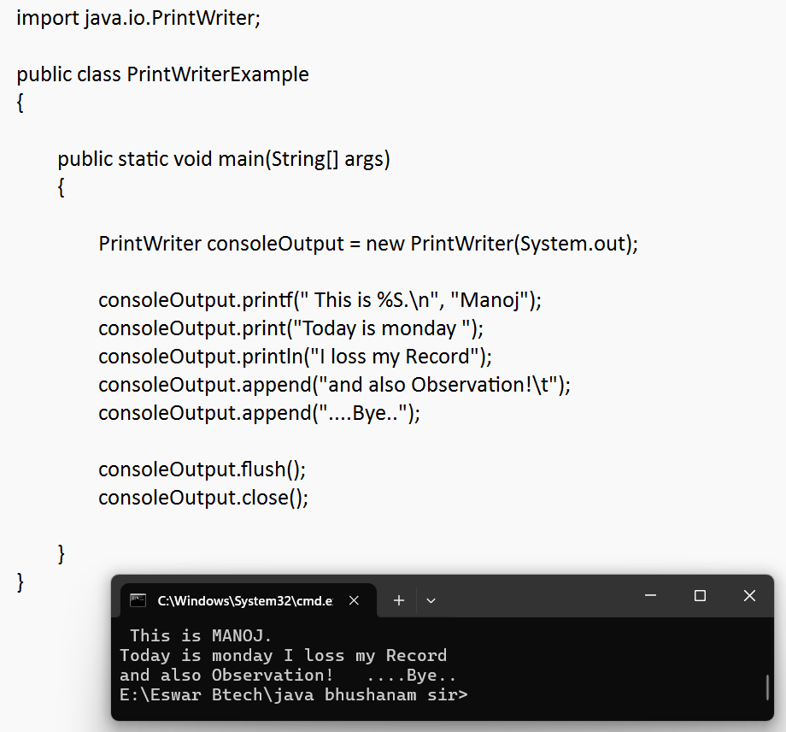

Slide 27
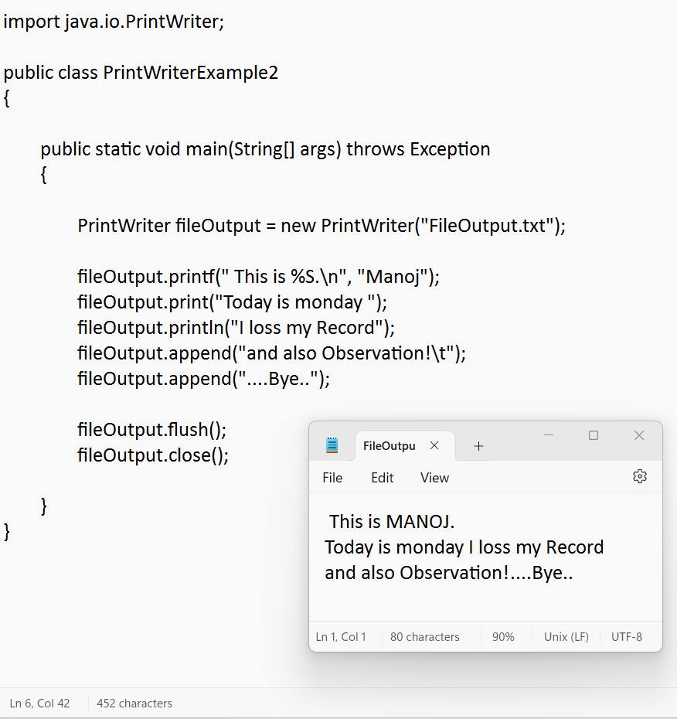

Slide 28
FileWriter
FileWriter is meant writing stream of charecters to the File.
It creates the output file if it id not present already
Methods:
write()
flush()
close()
CLOSING A FILE
close() method is used to close the FileWriter and File Reader

Slide 29
Example
import java.io.FileWriter;
public class FileWriterExample
{
public static void main(String args[])
{
try{
FileWriter fw=new FileWriter("FileWriter.txt");
fw.write("Welcome to java program ");
fw.flush();
fw.close();
}
catch(Exception e){System.out.println(e);}
System.out.println("Success...");
}
}

Slide 30
FileReader
This class is used to read data from the file .It returns data in byte format like FileInputStream.
Example:
import java.io.FileReader;
public class FileReaderExample
{
public static void main(String args[])throws Exception
{
FileReader fr=new FileReader("FileWriter.txt");
int i;
while((i=fr.read())!=-1)
System.out.print((char)i);
fr.close();
}
}

Slide 31
THANK YOU
Eswar Reddy T

