Slide 1
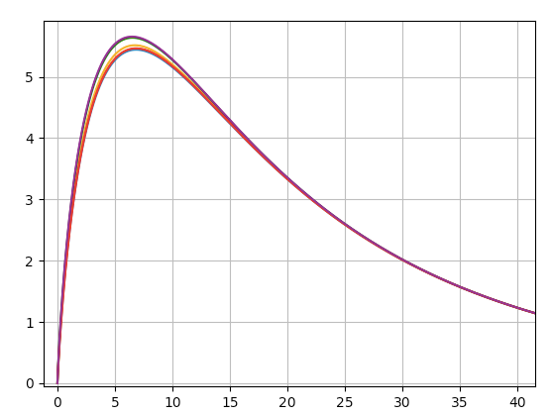
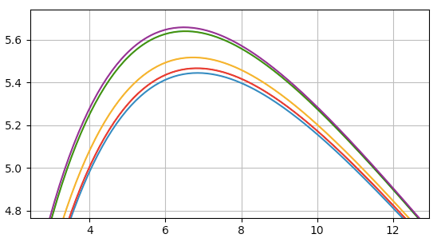

$$rξ(r)$$
r [h⁻¹ Mpc]
r [h⁻¹ Mpc]

