Slide 1
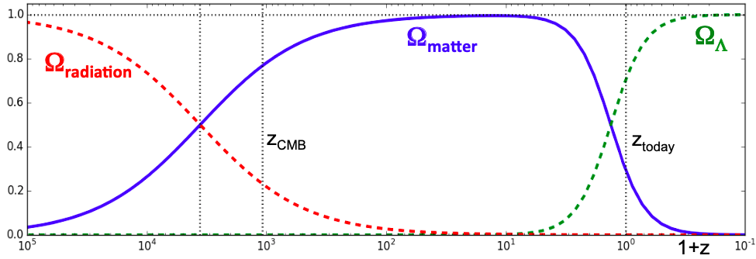







$$Ω_{m}$$
$$Ω_{∧}$$
$$Ω_{r}$$
$$z=0$$
$$z_{∗}$$
$$z_{eq}$$
$$1+z$$

