Slide 1

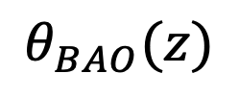
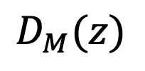


A
$$r_{d}$$
D
C
$$θ_{BAO}(z)$$
O
$$Δz_{BAO}$$
$$D_{M}(z)$$
B

