Slide 1
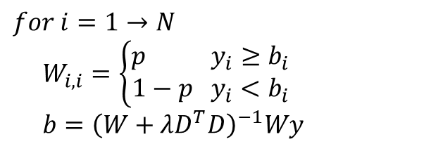
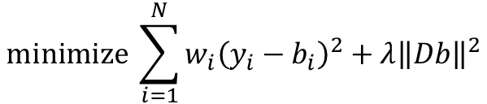

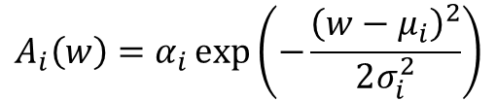
ALSS Baseline correction:
Deconvolution (Gaussians):
$$\text{minimize} \sum_{i=1}^{N}{w_{i}{\left(y_{i}−b_{i}\right)}^{2}+λ{\left\|Db\right\|}^{2}}$$
$$A_{i}\left(w\right)=α_{i}\exp\left(−\frac{{\left(w−μ_{i}\right)}^{2}}{2σ_{i}^{2}}\right)$$
$$for i=1→N$$
$$W_{i,i}=\left\{\begin{aligned}p y_{i}≥b_{i} \\ 1−p y_{i}<b_{i}\end{aligned}\right.$$
$b={\left(W+λD^{T}D\right)}^{−1}Wy$
$${\text{Area}}_{i}=\sqrt{2π}∙α_{i}∙σ_{i}$$

