Slide 1
DRAKE VIDE GAMES
By MORACCHINI Florian, MALLIPOUDY Vencatveer, MASSE Théo

Slide 2


B1-C INFO
DRAKE
We gonna presents to you our snake, that we rename drake

Slide 3
WELCOME!
THE TEAM
Vencat
Théo
Florian

Slide 4
SUMMARY
Introduction
Explanation
Demonstration
Conclusion
1-2
3-10
11-12
13-END

Slide 5
01
WELCOME!
Here we gonna make our introduction to present you the subject of our project
1

Slide 6
Introduction
The subject
We decide
For our python project, we were instructed to make a snake
We decide to use pygame to do it, we have two weeks, we had the right to takes inspiration on others code of snake
2

Slide 7
02
Explanation
Here we gonna show you, our code, and we gonna explain how we made our drake
3

Slide 8
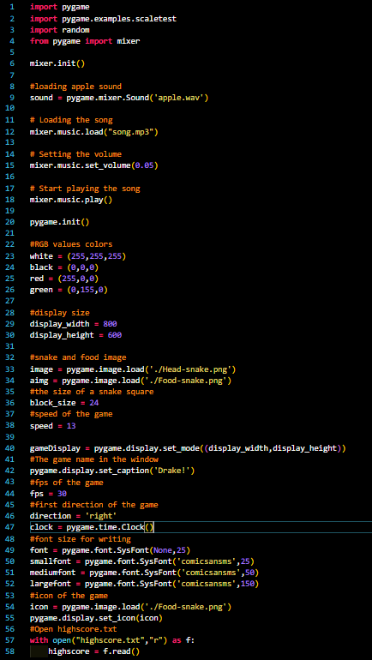
Drake
We decide to make: a principal function for our game-loop
And 6 others functions
4

Slide 9
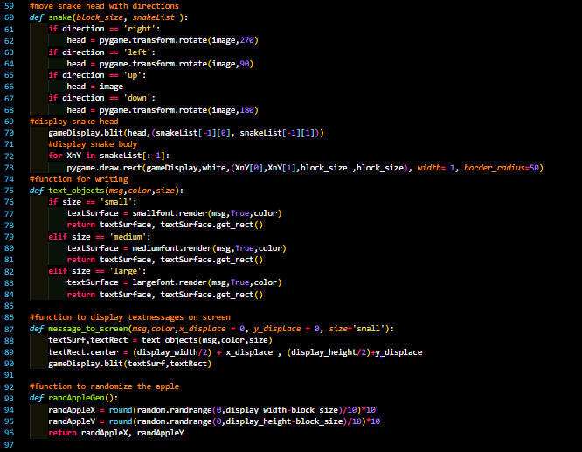
Drake
We decide to make: a principal function for our game-loop
And 6 others functions
5

Slide 10
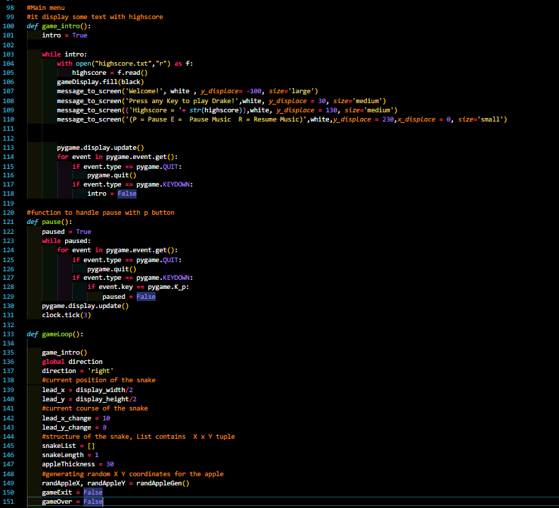
Drake
We decide to make: a principal function for our game-loop
And 6 others functions
6

Slide 11
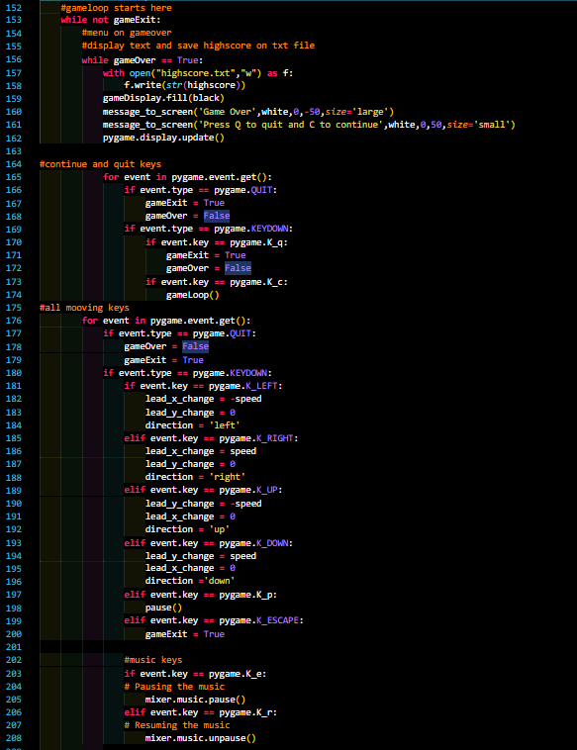
Drake
We decide to make: a principal function for our game-loop
And 6 others functions
7

Slide 12
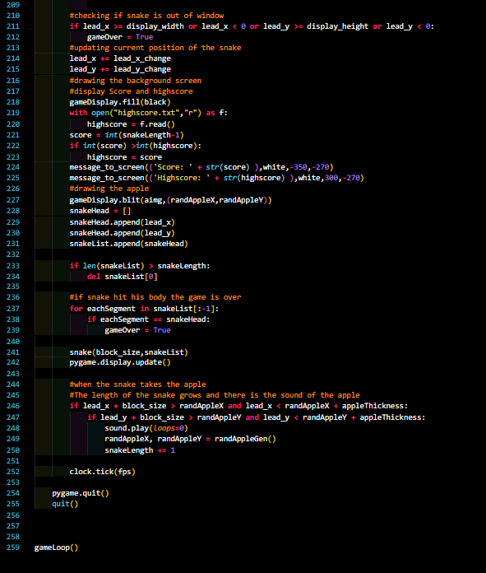
Drake
We decide to make: a principal function for our game-loop
And 6 others functions
8

Slide 13
Our game
100%
100%
Easy to play
Nice to see
Addictive
Of the user like
Advises it
9

Slide 14
In all the world
MAX SMITH
JENNA DOE
JOHN JAMES
“This game is amazing I never see this”
“Very satisfaying to play this game”
“I play like 1 hour it was amazing”
10

Slide 15
03
Demonstration
Here we gonna show you our game
11

Slide 16
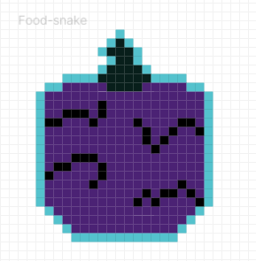

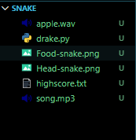


Demonstration
Have fun with it
12

Slide 17
04
CONCLUSION
Here we conclude
Our git is here: https://github.com/TFLR/Snake
13

Slide 18
What we use
Pygame
Figma
Vs-code
The documentation
For the game
For the design of the head and food
To type our game
To help us

Slide 19
RESOURCES
Example of what we use:
https://www.youtube.com/watch?v=QNc7SnHFy6I
https://www.pygame.org/docs/
https://www.youtube.com/watch?v=9bBgyOkoBQ0&ab_channel=Kite
https://gist.github.com/rajatdiptabiswas/bd0aaa46e975a4da5d090b801aba0611
https://freesound.org/people/Koops/packs/1238/
https://downloads.khinsider.com/game-soundtracks/album/metroid/1-04%2520Norfair%2520%2528Mono%2529.mp3

Slide 20
THE END
Thanks for listening to us, now we are ready to answer your questions

