Slide 1
Machine Learning Project Presentation
By: Thomas Fitzgerald, Vladimir Ogloblin, Adam Seliga

Slide 2
Motivation
PROMPT #5: Autonomous Drone Navigation: Design a machine learning algorithm that enables drones to navigate and avoid obstacles autonomously using real time sensor data.
GOAL: Create algorithm based on real time sensor data

Slide 3
Literature Reference
Islam, S., &amp; Razi, A. (2019). A path planning algorithm for collective monitoring using autonomous drones. 2019 53rd Annual Conference on Information Sciences and Systems (CISS). https://doi.org/10.1109/ciss.2019.8693023
Location-based reward function
Goal not in a fixed location

Slide 4
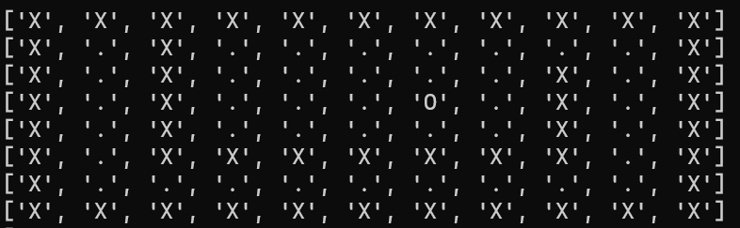
Methodologies – The Maze
Maze Navigation
Determines possible actions based on location
Each possible location is a state
‘X’ – Wall
‘O’ – Goal
‘+’ – Drone
‘.’ – Freespace

Slide 5
Methodologies – Traversing Maze
A node is created for each state visited
Each node contains list of actions
Up, Down, Left, Right
Algorithm removes action if it collides with a wall
First measure of real time data

Slide 6
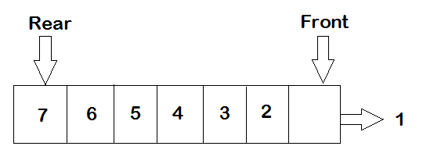
Methodologies – Breadth First Search
Nodes created by drone choosing an action
Nodes chosen from a queue (First In First Out)
Drone listens to sensor data if no collisions with walls

Slide 7
Methodologies – A* Search
Organizes created nodes by a Heuristic
Heuristic calculated by Cost Function + distance from start
Cost function measures distance to goal
Second measure of real time data

Slide 8
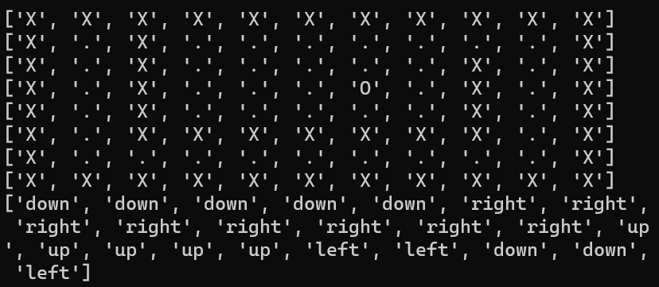
Results
Algorithm prints list of actions taken

Slide 9
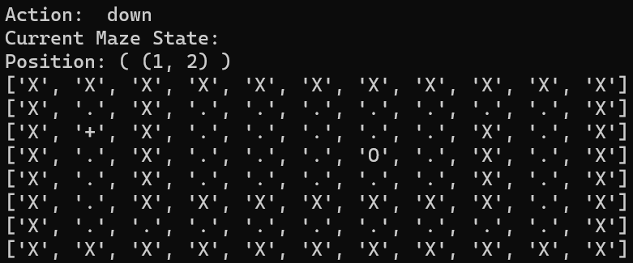
Results
Algorithm then prints the action taken, position, and state for each action taken

Slide 10
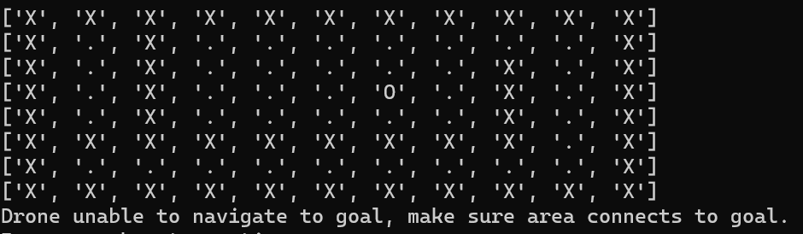
Results
Drone recognizes when it can’t reach the goal

Slide 11
Conclusions
Successfully coded a drone that measures two forms of real time data
Further experiments based on adapting to real drone

