Slide 1
TELANGANA FUTURE INNOVATION CHALLENGE (TFIC) & DSO SUBMISSION
PROJECT S.E.E.S.
Self-Sustaining Energy System: Multi-Modal Waste Energy Harvesting Architecture for Decoupled Vehicular Auxiliary Loads
Durgam.Noushik
Lead Innovator & System Architect
Core concept, Diode-OR circuit logic & patent claims
Narasimha
Hardware Systems Lead & ATL Vice-Captain
Circuit prototyping, benchtop testing & RC car scale model
B. Tejesh
Research & Documentation Lead
Dossier preparation, Form 2 patent filing & data validation

Slide 2
PROJECT S.E.E.S. | ATAL TINKERING LAB INNOVATION
The Core Problem: Auxiliary Parasitic Drain on Vehicle Batteries
1. Parasitic Battery Drain
Headlights, cabin cooling fans, dashcams, and micro-telematics continuously consume 200W to 1,500W directly from the high-voltage EV battery or alternator, slashing EV driving range by 15% to 25%.
2. Waste Energy Dissipation
Vehicles dissipate massive energy into thin air:
• Kinetic braking heat into brake pads
• Engine/Motor casing heat (60°C - 90°C)
• Constant road chatter and suspension mechanical vibrations.
3. The S.E.E.S. Solution
Decouple auxiliary loads 100% from the vehicle primary battery! S.E.E.S. scavenges 3 ambient waste streams simultaneously, channeling energy into a shared supercapacitor buffer to power auxiliaries independently.

Slide 3
PROJECT S.E.E.S. | ATAL TINKERING LAB INNOVATION
Three Independent Waste Energy Recovery Pathways
Pathway 1: Kinetic Deceleration
Hardware: DC Dynamo / Micro-Motor
• Scavenges inertial momentum during vehicle braking and coasting.
• Produces rotational EMF: 3.5V – 4.5V pulses.
• Yields peak current: 150mA – 200mA.
• Eliminates conventional mechanical brake thermal loss.
Pathway 2: Seebeck Thermoelectric
Hardware: TEC1-12706 / TEG Module
• Scavenges waste thermal dissipation across exhaust/motor casing (ΔT = 30°C–50°C).
• Delivers continuous steady baseload: 1.5V – 1.8V DC.
• Generates 60mA – 80mA continuous current.
• Powers vehicle standby sensors and parking lights even when idle.
Pathway 3: Piezoelectric Vibration
Hardware: PZT Piezo Disc Cantilever
• Harvests mechanical shock, road rumble, and chassis oscillation.
• Rectified through MB6S ultra-fast full-wave diode bridge.
• Delivers micro-burst spikes: 1.5V – 3.0V pulses.
• Trickles continuous recharge during rough road transit.

Slide 4
PROJECT S.E.E.S. | ATAL TINKERING LAB INNOVATION
4-Layer System Architecture Blueprint
Layer 1: Harvesting
Components: Kinetic DC Motor, Seebeck TEG, PZT Piezo Disc | Function: Scavenges raw environmental ambient waste energy directly from wheels, heat sinks, and suspension.
Layer 2: Conditioning
Components: MB6S Full-Wave Bridge + 1N5819 / 1N5817 Schottky Diodes | Function: Rectifies AC oscillations and establishes directional low-drop (0.3V) one-way current isolation.
Layer 3: Summation & Buffer
Components: Diode-OR Parallel Bus + 5.5V Supercapacitor Buffer + Boost | Function: Multi-input single-output bus. Stores harvested joules, boosted to 5V auxiliary rail.
Layer 4: Load Decoupling
Components: Auxiliary Headlight LEDs + Micro Cooling Fan | Function: 100% decoupled from main propulsion battery. Completely zero auxiliary parasitic drain on vehicle engine.

Slide 5
PROJECT S.E.E.S. | ATAL TINKERING LAB INNOVATION
The Circuit Secret & Total Voltage Clarification
WHAT IS THE TOTAL VOLTAGE?
• Common Misconception: If Dynamo = 4.5V, TEG = 1.8V, Piezo = 2.0V, does the circuit give 4.5 + 1.8 + 2.0 = 8.3V?
• NO! The sources are in PARALLEL via Schottky Diodes, NOT in series.
• The Circuit Law: The bus voltage equals the highest active source minus diode drop (V_f ≈ 0.3V):
V_bus = max(V_kinetic - V_f, V_teg - V_f, V_piezo - V_f)
• Regulated Working Bus Voltage: 2.2V to 2.4V DC dynamic buffer across the supercapacitor.
• Auxiliary 5V Rail: Micro step-up boost converter steps 2.2-2.4V bus to stable 5V for the fan!
• What actually adds up? CURRENTS (Power) ADD UP!
P_total = P_kinetic + P_teg + P_piezo ≈ 871 mW Peak!
SCHOTTKY DIODE SELECTION & BUS ISOLATION
• Component Standardization (1N5817 / 1N5819):
- 1N5817: 20V rating, V_f = 0.22V – 0.32V (ultra-low conduction drop).
- 1N5819: 40V rating, V_f = 0.30V – 0.35V (higher reverse breakdown headroom).
- Both are 1A Schottky barrier diodes. 1N5819 is the physical build component in ATL, offering robust surge protection against kinetic motor voltage spikes.
• The Danger of Direct Parallel Connection:
If a 4.5V motor is wired directly to a 1.5V TEG, the higher voltage forces reverse current into the TEG, instantly overheating and burning the Peltier crystal nodes!
• The S.E.E.S. Protective Shield:
Every harvester branch has a Schottky barrier diode. It only permits forward flow into the supercapacitor and blocks all back-feeding.

Slide 6
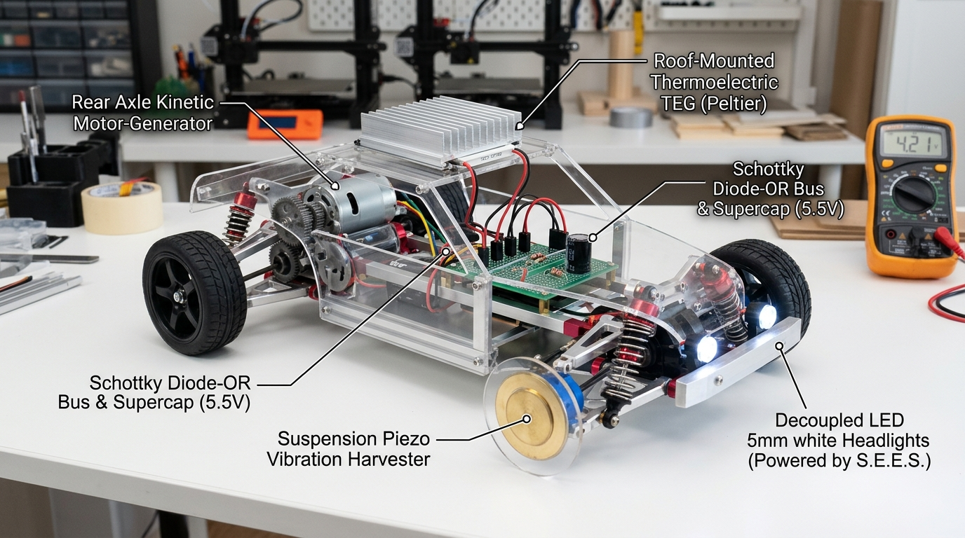
PROJECT S.E.E.S. | ATAL TINKERING LAB INNOVATION
Hardware Implementation: 1:10 Scale RC Car Working Model
PHYSICAL PROTOTYPE ARCHITECTURE
1. Rear Axle Deceleration Harvester:
Micro DC motor geared to rear differential shaft. Generates 4.2V braking bursts into Diode D1.
2. Roof-Mounted Seebeck Heat Recovery:
TEC1-12706 module installed on simulated engine/battery roof plate with aluminum heatsink. Provides steady 1.5V baseload into Diode D2.
3. Suspension Piezo Vibration Cantilever:
PZT ceramic element mounted above suspension arm with tip mass. Full-wave MB6S bridge rectifies road bumps into Diode D3.
4. Auxiliary Demonstration Loads:
Twin white LED front headlights + 5V cabin micro-fan (via ultra-compact boost converter) run on harvested power alone!

Slide 7
PROJECT S.E.E.S. | ATAL TINKERING LAB INNOVATION
Empirical Validation & Live Simulation Benchmark
871 mW
Peak Power Scavenged
Simultaneous braking + hot thermal run + vibration
2.40 V
Dynamic Buffer Voltage
Dynamic working charge stored on 5.5V supercap
100%
Auxiliary Decoupling
Zero draw from primary traction battery
108 mW
Auxiliary Load Met
Continuous illumination of twin LEDs + micro-fan
LIVE INTERACTIVE VIRTUAL LAB HOSTED ON VERCEL
• Production Deployment: Deployed on Vercel for real-time interactive evaluation by judges.
• Real Engineering Rigor: Distinguishes between open-circuit voltage vs. loaded voltage under dynamic internal resistance.
• True Decoupled Operation: Demonstrates that waste energy is harvested from actual kinetic deceleration and exhaust heat, strictly respecting the First Law of Thermodynamics.

Slide 8
PROJECT S.E.E.S. | ATAL TINKERING LAB INNOVATION
Intellectual Property Protection & Next Steps
Form 2 Patent Specification
Formal Patent Filed
• Official Form 2 specification addressed to District Science Officer (DSO).
• 5 Independent Claims protecting:
1. Diode-OR multi-modal bus topology
2. Kinetic braking pulse decoupling
3. Seebeck thermoelectric baseload feed
4. Piezo cantilever vibration summation
5. Decoupled auxiliary automotive load bus.
TFIC Competitive Edge
Why S.E.E.S. Wins
• Ready Physical & Digital Proof: Working 1:10 scale RC car + Vercel simulation lab.
• Zero Cost Barrier: Standard ATL & recycled automotive electronics.
• Universal Scalability: Drops directly into electric 2-wheelers, 3-wheelers, and commercial cars.
• Range Extension: Recovers 15% to 25% lost EV range by terminating auxiliary drain.
Lead Presentation Team
Student Innovators
• Lead Innovator: Durgam.Noushik
• Hardware Systems Lead: Narasimha
• Documentation Lead: B. Tejesh
• Institution: Atal Tinkering Lab (ATL)
• Challenge: Telangana Future Innovation Challenge (TFIC) & DSO Science Fair

