Slide 1

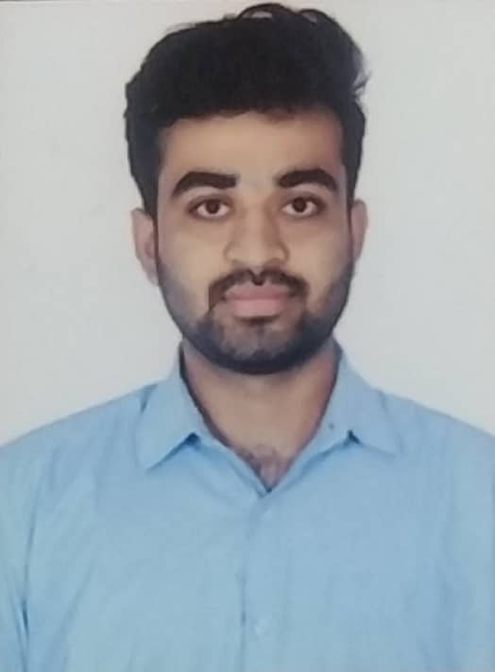


TANMAY GUPTA
Education and certificates
Atria Institute Of Technology, Bangalore, Karnataka
Bachelor of Engineering in
Computer Science and Engineering : 2018-2022
Analyst/Software Engineer
Base Location: Bangalore
Email ID:
Tanmay.b.gupta@capgemini.com
Skills
Mobile No: +919663542164
Grade: A4
EMP ID-46290508
Core Languages JAVA , C++ , C, JavaScript
Spring Boot Spring Boot, Spring Rest Services, Spring Rest-Ful Service
Database PostgreSQL, MongoDB, SQL , Cassandra
Scripting Languages(Frontend) HTML 5 & CSS, JavaScript, ReactJS ,Bootstrap
Tools Git & GitHub , Eclipse, PostMan , VisualStudio Code , SQL shell, git Bash , MongoDb
Add On skills Team Management Communication Adaptability Leadership Quality
Strengths
Full Stack Developer
Good Problem Solving skills.
Achievement
ONLINE CARWASH SYSTEM:-
Completed 6 weeks case study(Upskilling task) on online carwash system using ReactJS , SpringBoot , JAVA and MongoDB tools.
E-COMMERCE APPLICATION:-
Learned and completed 3 months internship Training on SprinBoot and ReactJS and made an E-Commerce application.
•Good Communication skills.
•Always ready to take challenges and solve problems.
•Completed training and internship on React, Spring Boot MS & MongoDB.
Good knowledge of Core languages like C++,JAVA,C.
Hands on experience in developing web pages using HTML5, CSS3, REACT. Good understanding of Document Object Model (DOM) and DOM Functions.
Proficient in creating Single page Web Application in REACT with routing.
Presentation Title | Author | Date © Capgemini 2017. All rights reserved | 1

