Slide 1

miRNA workshop
miRNA target prediction in animals
Thomas Bradley
thomas.bradley@tgac.ac.uk

Slide 2

Background
The miRNA associates with the argonaute protein (Ago) via low-specificity hydrogen bonding of the sugar phosphate backbone to Ago
AGO
AGO-miRNA
+
miRNA
The Ago-miRNA complex is guided to targets by high specificity interactions between the miRNA base pairs and the base pairs of the target

Slide 3
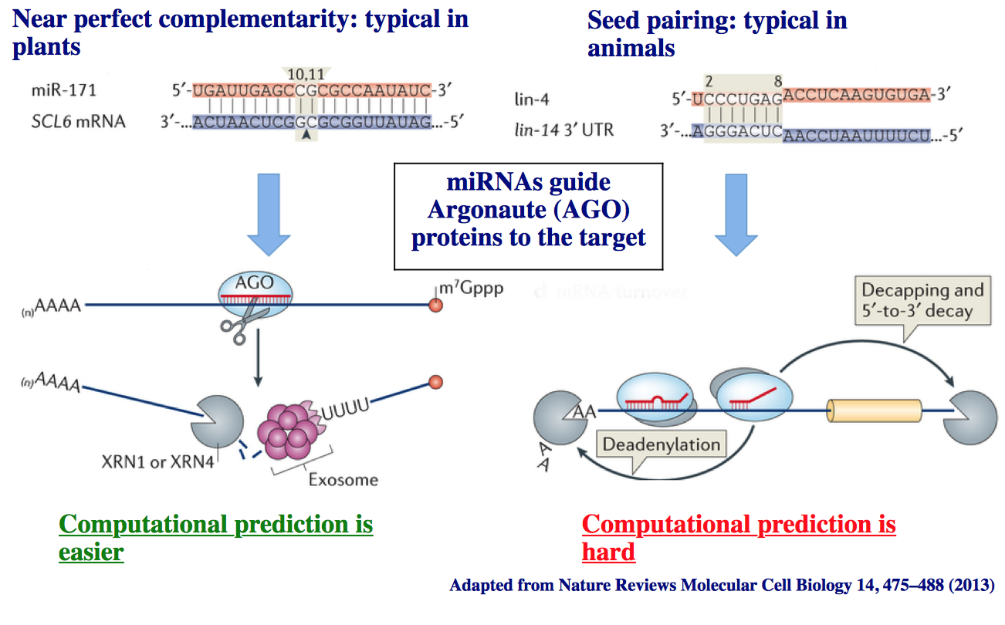
Plants vs. Animals

Slide 4
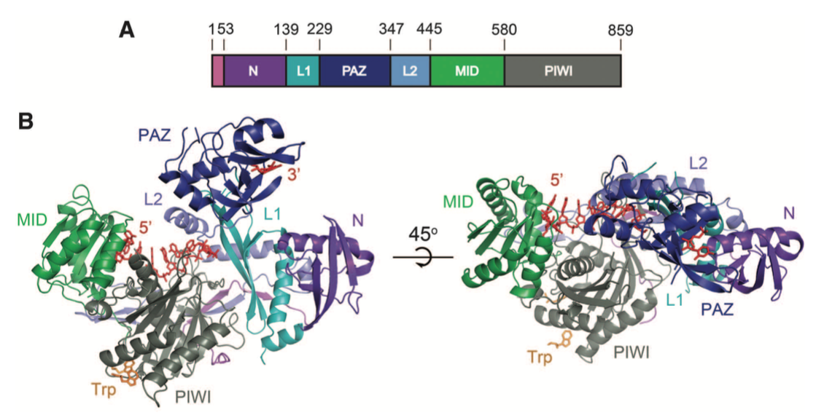
Background
  X-ray crystallography studies supports theories on miRNA action
  Exposed 5’ region of the miRNA molecule
  Before binding, 3’ tail of miRNA is sequestered within Ago molecule
  Conformation change can expose 3’ region of miRNA
Schirle and McRae (2012)

Slide 5
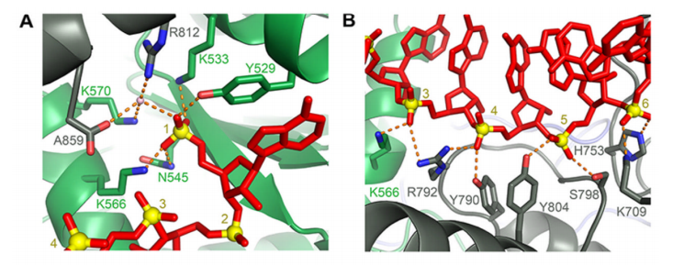
Background
  X-ray crystallography studies supports theories on miRNA action
  5’ of molecule anchored at MID domain
  Extensive hydrogen bonding of protein to seed region
Schirle and McRae (2012)

Slide 6
Background
  Most animal miRNAs (unlike plants) do not mediate transcript cleavage
  Each miRNA can target multiple transcript and vice versa
Transcript A
5’ UTR
Coding Sequence
3’ UTR
AAAAAAA
m⁷G
Alternative Cleavage and Polyadenylation (APA)
miR-X
miR-Y
Transcript B
m⁷G
5’ UTR
Coding Sequence
3’ UTR
AAAAAAA

Slide 7
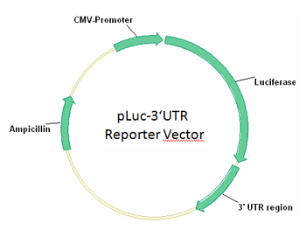
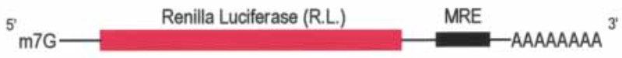
Experimental Validation
There are many different ways to experimentally validate a candidate target which won’t be discussed in great detail here...but it is important to state that:
1. There are multiple different ways of experimentally validating targets (e.g. Luciferase assay, microarrays, RNA-Seq, immunoprecipitation)
2. Each of these methods have their own idiosyncrasies which should be appreciated when analysisng results
3. The process of experimental validation of targets is a rapidly evolving area, with new techniques and protocols being developed year-on-year

Slide 8
Exercise 1a
  1. Visit the Tarbase website (http://diana.imis.athena-innovation.gr/DianaTools/index.php?r=tarbase/index) - or just type ‘tarbase’ into Google if that is easier
  2. Input ‘GNAI3’ as your gene
  3. Click “Submit”
  4. What is the most common method for discovering targets?
  5. How can you find where your gene of interest is expressed?
  6. In which tissue was the top target identified?
  7. Optional/extension: Repeat steps using a different gene symbol

Slide 9
Exercise 1b
  1. Visit the Tarbase website (http://diana.imis.athena-innovation.gr/DianaTools/index.php?r=tarbase/index) - or just type ‘tarbase’ into Google if that is easier
  2. Input ‘has-mir-16-5p’ as your miRNA of interest
  5. What is the most common method for discovering targets?
  6. How can you find where your gene of interest is expressed?
  7. In which tissue was the top target identified?
  8. Optional/extension: Repeat steps using a different miRNA

Slide 10
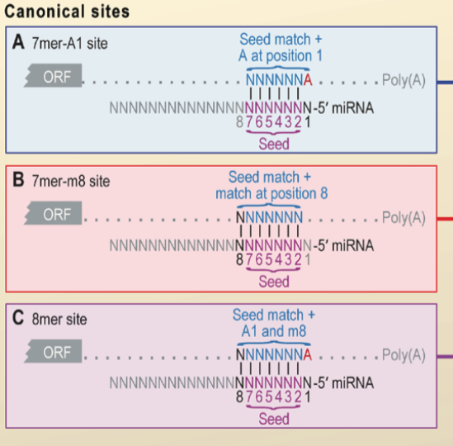
Background
  Most targets bind the miRNA 5’ end seed region
  This denotes a set of different binding subsequences
Bartel (2009)

Slide 11
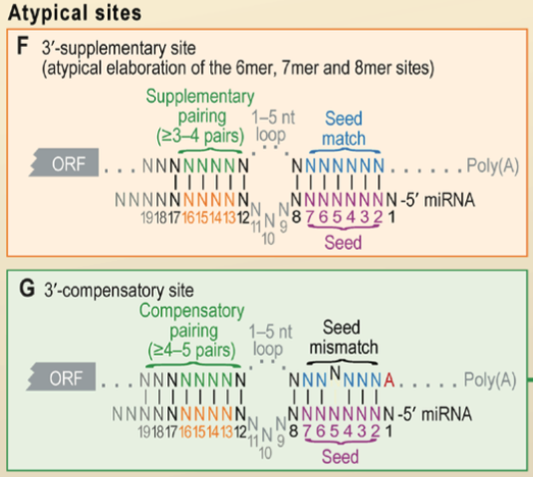
Background
  In the event of seed region mismatch, 3’ compensatory binding can occur
  Supplementary binding can also occur
Bartel (2009)

Slide 12
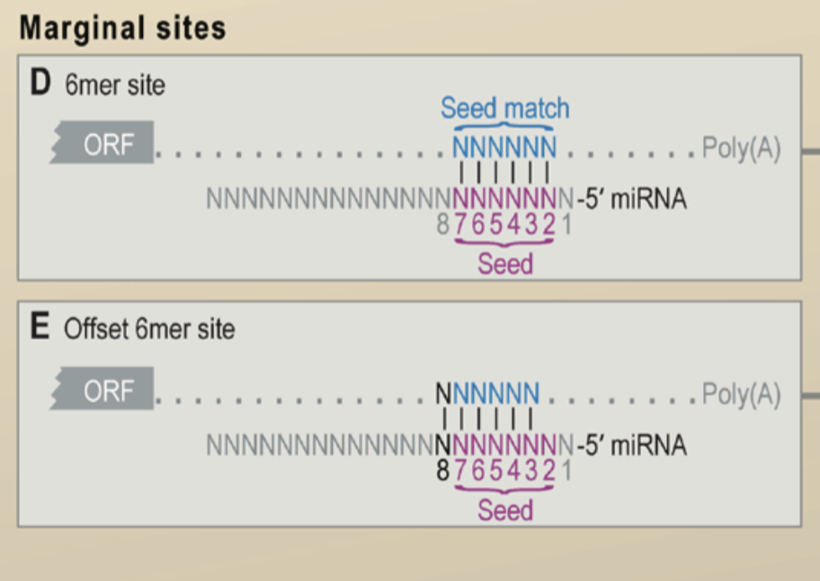
Background
  Most targets bind the miRNA 5’ end seed region
  This denotes a set of different binding subsequences
  In the event of seed region mismatch, 3’ compensatory binding can occur
Bartel (2009)

Slide 13
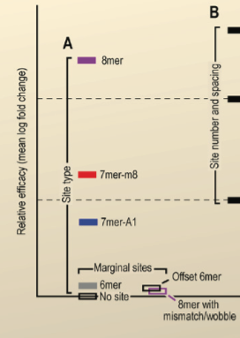
Background
  Most targets bind the miRNA 5’ end seed region
  This denotes a set of different binding subsequences
  In the event of seed region mismatch, 3’ compensatory binding can occur
Bartel (2009)

Slide 14
Exercise 2a
  1. Visit the TargetScan 7 website (http://www.targetscan.org/vert_71/) - or just type ‘targetscan7’ into Google if that is easier
  2. Select the Human species in the first drop down menu
  3. Input ‘GNAI3’ as your human gene symbol
  4. Click “Submit”
  5. Tally the total number of sites of each type
  6. What proportion of sites have higher probability of preferential conservation?
  7. Optional/extension: Repeat step 5 looking at poorly conserved sites
  8. Repeat steps using a different gene symbol

Slide 15
Exercise 2b
  1. Visit the TargetScan 7 website (http://www.targetscan.org/vert_71/) - or just type ‘targetscan7’ into Google if that is easier
  2. Select the Human species in the first drop down menu
  3. Choose ‘mir-9-5p’ as your broadly conserved miRNA family
  4. Click “Submit”
  5. Look at the top 4-5 results
  6. Determine the proportion of conserved sites belonging to each site type
  7. Repeat the process for poorly conserved site types
  8. Optional/extension: Repeat steps using different miRNA families

Slide 16
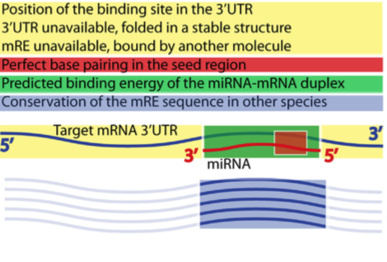
Background
  Most target prediction models score candidate interactions on the following basis
    General sequence features
    Specific base-pairing to the seed region (+ additional 3’ supplementary binding)
    Thermodynamics of binding
    Conservation of the target site (AKA miRNA Response Element – mRE)
Ritchie and Rasko (2014)

Slide 17
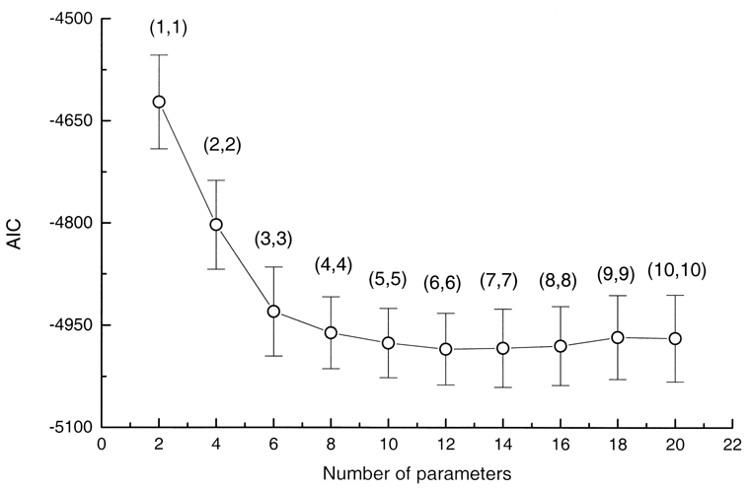
Select features
26 features were selected using manual curation (from published data)
These 26 features were then further processed using a process of stepwise regression using (AIC – Akaike Information Criterion)
AIC = 2k – 2ln(L)

Slide 18
14 Features
The 26 features are reduced to 14 in order to prevent overfitting from occurring
The 14 features are:
  3’-UTR target-site abundance (TA_3UTR)
  Predicted seed-pairing stability (SPS)
  sRNA position 1 (sRNA1)
  sRNA position 8 (sRNA8)
  Site position 8 (site8)
  Local AU content (local_AU)
  3’ supplementary pairing (3P_score)
  Predicted structural accessibility (SA)
  Minimum distance from stop codon or polyadenylation site (min_dist)
  Probability of conserved targeting (P_{CT})
  ORF length (len_ORF)
  3’-UTR length (len_3UTR)
  Number of offset-6mer sites (off6m)
  ORF 8mer sites (ORF8m)

Slide 19
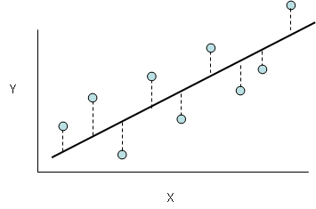
Simple Linear regression
y = β₀ + βx + ε
House Price
output
input
Number of bedrooms

Slide 20
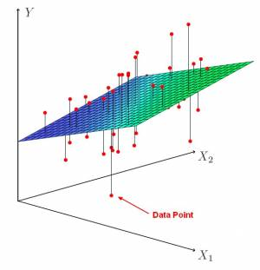
Multilinear regression (2 features)
y = β₀ + β₁x₁ + β₂x₂ + ε
House Price
Size of house (Arbitrary units)
Number of bedrooms

Slide 21
Multilinear regression (14 features)
Sorry, no pretty picture this time!
y = β₀ + β₁x₁ + β₂x₂ + … β₁₄x₁₄ + ε

Slide 22
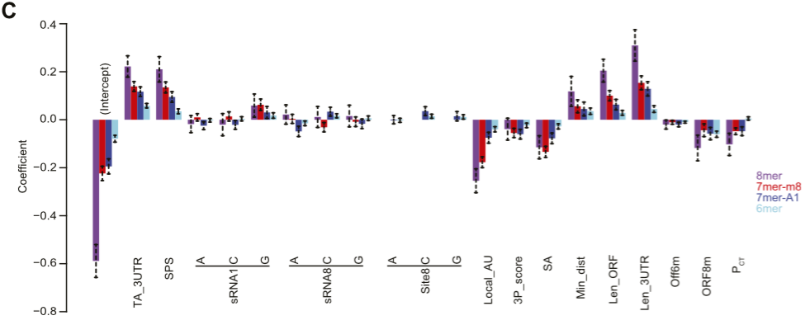
Multi-linear regression
Agarwal et al (2015)

Slide 23
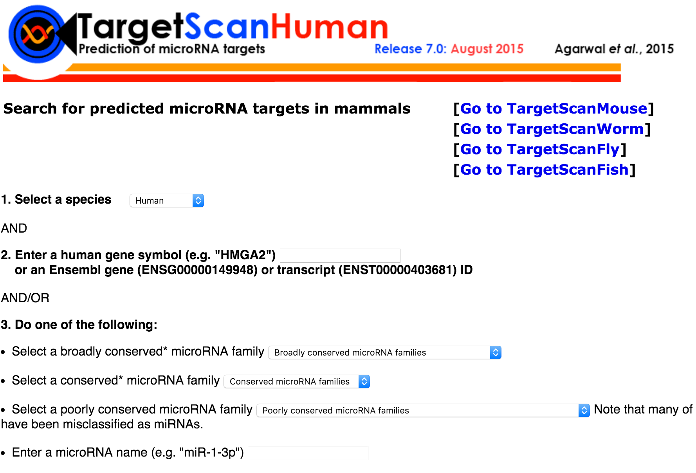
TargetScan7

Slide 24
Exercise 3a
  1. Visit the TargetScan 7 website (http://www.targetscan.org/vert_71/) - or just type ‘targetscan7’ into Google if that is easier
  2. Select the Human species in the first drop down menu
  3. Input ‘GNAI3’ as your human gene symbol
  4. Click “Submit”
  5. For conserved targets, find the average context++ score for each site type
  6. Optional/extension: Repeat step 5 looking at poorly conserved sites
  8. Repeat steps using a different gene symbol

Slide 25
Exercise 3b
  1. Visit the TargetScan 7 website (http://www.targetscan.org/vert_71/) - or just type ‘targetscan7’ into Google if that is easier
  2. Select the Human species in the first drop down menu
  3. Choose ‘mir-7-5p’ as your broadly conserved miRNA family
  4. Click “Submit”
  5. What is the different between ‘cumulative weighted context++’ and ‘total context++’
  7. What is the relationship if any between these two variables and the aggregate P_{CT}?

