Slide 1

Elixir, EXCELERATE and Brassica Information Portal
Carlos Horro

Slide 2
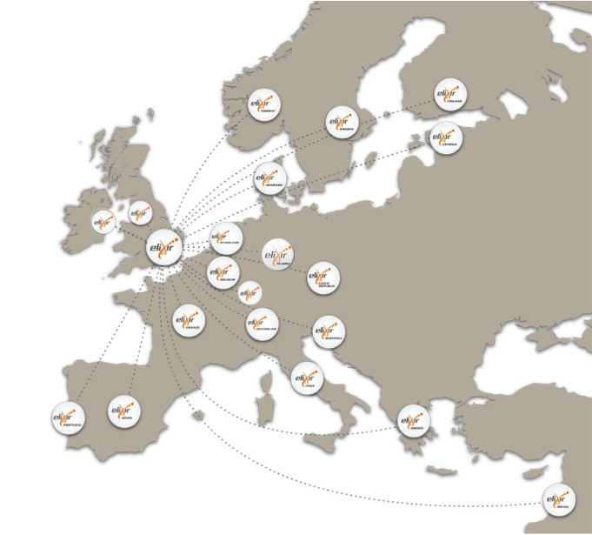











ELIXIR: European infrastructure for
biological information
https://www.elixir-europe.org/
Data infrastructure for Europe’s life-science research:
20 Members
1 Observer
Platforms
Use cases
ELIXIR Hub based
alongside EMBL-EBI
in Hinxton
Data
Interoperability
Tools
Compute
Training
Marine metagenomics
Crop and forest plants
Human data
Rare diseases
www.elixir-europe.org
@ELIXIREurope
Notes:
Elixir links national bioinformatics services into a European infrastructure for life-sciences data.
ELIXIR unites Europe’s leading life science organizations in managing and safeguarding the increasing volume of data being generated by publicly funded research.
ELIXIR provides data infrastructure for Europe’s 500,000 life-science researchers
ELIXIR is organized in:
- Five technical platforms: Data, Interoperability, Tools, Compute and Training.
- Four Use cases: connect the technical activities to the real needs of user communities in the life sciences: Marine metagenomics, Crop and forest plants, Human data, Rare diseases.
The ELIXIR network currently counts 20 Members and 1 Observer.
The Network is coordinated from ELIXIR Hub, based alongside EMBL-EBI in Hinxton, UK

Slide 3
Elixir EXCELERATE: H2020 project
Implement ELIXIR infrastructure
Support early operations of ELIXIR
Develop and connect resources and services (from Nodes)
Build bioinformatics capacity across Europe (Capacity Building and Training)
EUR 19 million; 41 partners
Notes:
How is Elixir funded?
EXCELERATE is part of the European Commission project Horizon 2020, to
- implement ELIXIR infrastructure/platforms.
integrate ELIXIR bioinformatics resources into a coherent infrastructure
Total funding: 19 million euros, 41 partners/institutions

Slide 4
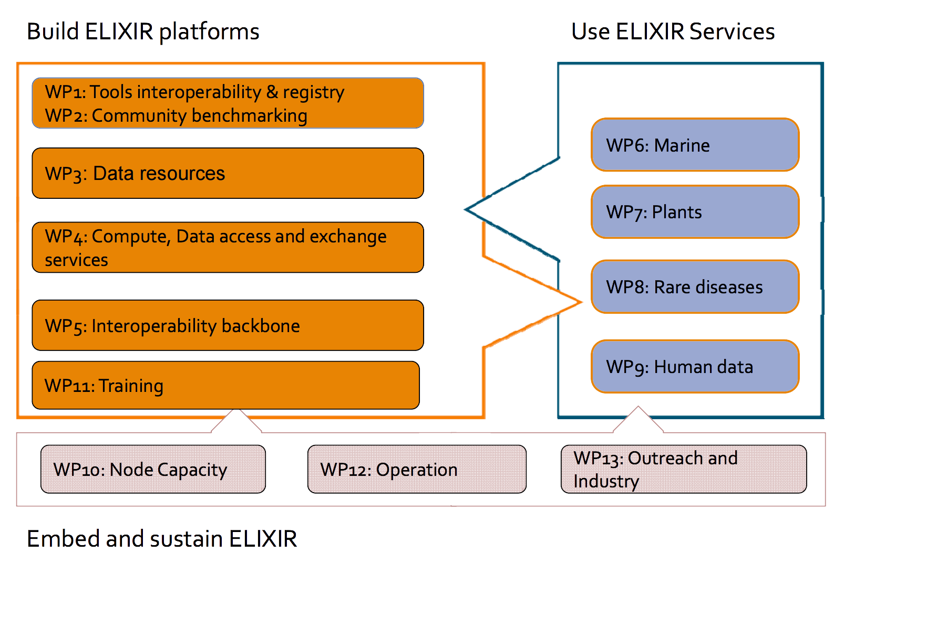
Elixir EXCELERATE structure
Notes:
13 WP in total
Collaborating with WP5 Interoperability Platform and WP7 Plants Use case

Slide 5

Interoperability Platform (WP5): Integration of data and services
Mission: Implement principles for Findable, Accessible, Interoperable and Reusable Data (FAIR principles)
Goals:
Deliver interoperability services for ELIXIR Use cases
Promote interoperability best practices
Activities:
Bring Your Own Data (BYOD) Workshops
Technical services to ensure that data is interoperable, can be accessed programmatically, and contain persistent identifiers.
Ontologies, minimum information standards, vocabularies
ELIXIR Standards Registry
Lead by: Chris Evelo, NL, Carole Goble, UK, Helen Parkinson, EBI
Notes:
-> Promote FAIR principles, for Findable, Accessible, Interoperable and Reusable Data.
Activities to promote them:
Training workshops
Technical services to ensure interoperability and promote persistent identifiers
Common and minimum information standards, vocabularies and ontologies…
Create an ELIXIR Standards Registry

Slide 6

Elixir Plant Science Use Case (WP7): Integrating Genomic and Phenotypic Data for Crop and Forest Plants
Phenotypic variation in most crop and forest plants is enormous, and phenotype characterization data is
often inaccessible
lacks any route of unified access
diverse and non‐standard
Technical infrastructure and associated social practices needed to define an open model for publishing and sharing of plant genotype‐phenotype data
Lead by: Paul Kersey, EBI & Celia Miguel, PT
Notes:
Huge phenotypic differences among crop and forest plants. Also:
Data accessibility problems
Lack on standardization
Mission: facilitate genotype-phenotype analyses for crop and tree species

Slide 7
Elixir Plant Science Use Case (WP7): Main goals
Identify standards for the annotation of plant genomic and phenotypic data sets for the purpose of data interoperability and discovery…
… and annotate exemplar data sets according to standards (D7.1)
Provide an API for data discovery over dispersed repositories (with possible extension to support data retrieval) (D7.2)
Notes:
Develop standards for representation of genotypic and phenotypic data…
Make data discoverable and interoperable through common APIs …

Slide 8
D7.1. Annotating data sets according to standards: MIAPPE https://www.miappe.org
MIAPPE: Minimum Information About a Plant Phenotyping Experiment
MIAPPE is a Minimum Information (MI) standard for plant phenotyping.
Defines a list of attributes that might be necessary to fully describe a phenotyping experiment.
Not all of the elements listed in an MI must be reported in each case. An MI document should rather be considered as a checklist.
Previous version: April 2016, available in PDF.
WP7 is collaborating on the development of an improved MIAPPE version which will be adopted as the official EXCELERATE standard for plant phenotype data.
Notes:
MIAPPE: Minimum Information (MI) standard for plant phenotyping
About 100 properties in total. Not all are need!
Mandatory and optional attributes to describe a phenotyping experiment.
Currently MIAPPE v1.0.

Slide 9
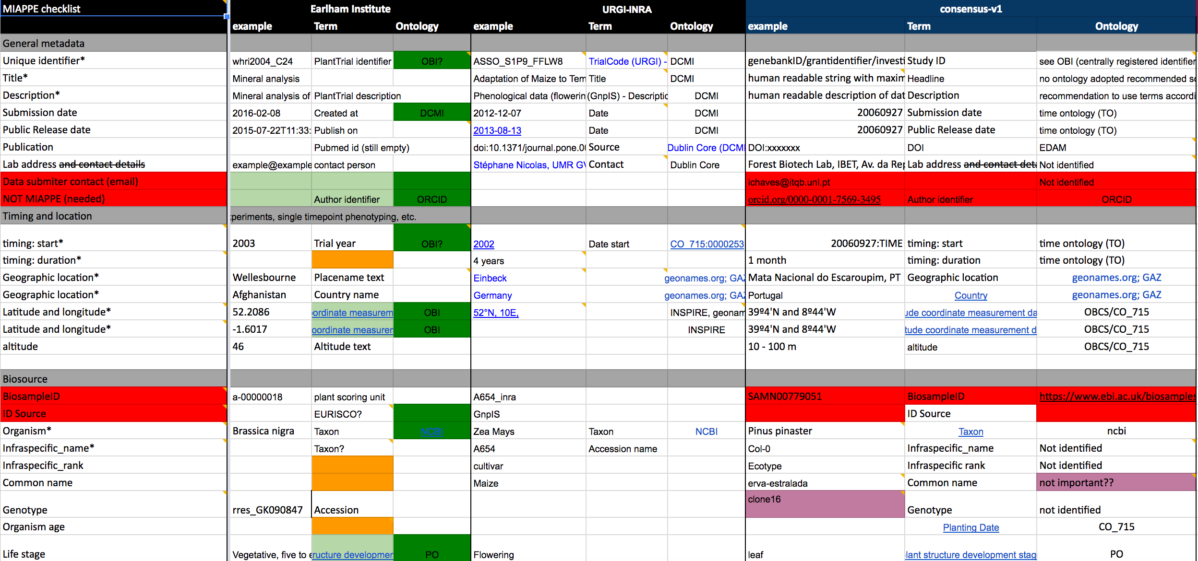
Notes:
Developing MIAPPE 2.0… WORKING DOCUMENT
About 100 properties in total.
Mandatory attributes with a star.
Definition based on: example of each institute, attribute name (for each institute) and ontology used (if so)
Putting together: ontologies, metrics…

Slide 10

D7.2. Provide an API for data discovery over dispersed repositories: BrAPI https://www.brapi.org
The BrAPI (Breeding API) is an effort to create a RESTful (based on basic HTTP operations: GET, POST, DELETE, UPDATE) specification to enable interoperability among plant breeding databases.
BrAPI v1 was released by the end of 2016.
WP7 is adopting only a subset of it.
BrAPI v2 is currently under development with WP7 collaboration.
Elixir API for Plant phenotyping data discovery will be fully compliant with it.
Notes:
Using BrAPI as a starting point to define a common Plant Phenotyping API for Elixir.
Currently implementing some basic calls from BrAPI v1.
Involved into the definition of BrAPI v2, which will be adopted by Elixir.
Next workshop in Ghent at the end of May to work on next version.

Slide 11
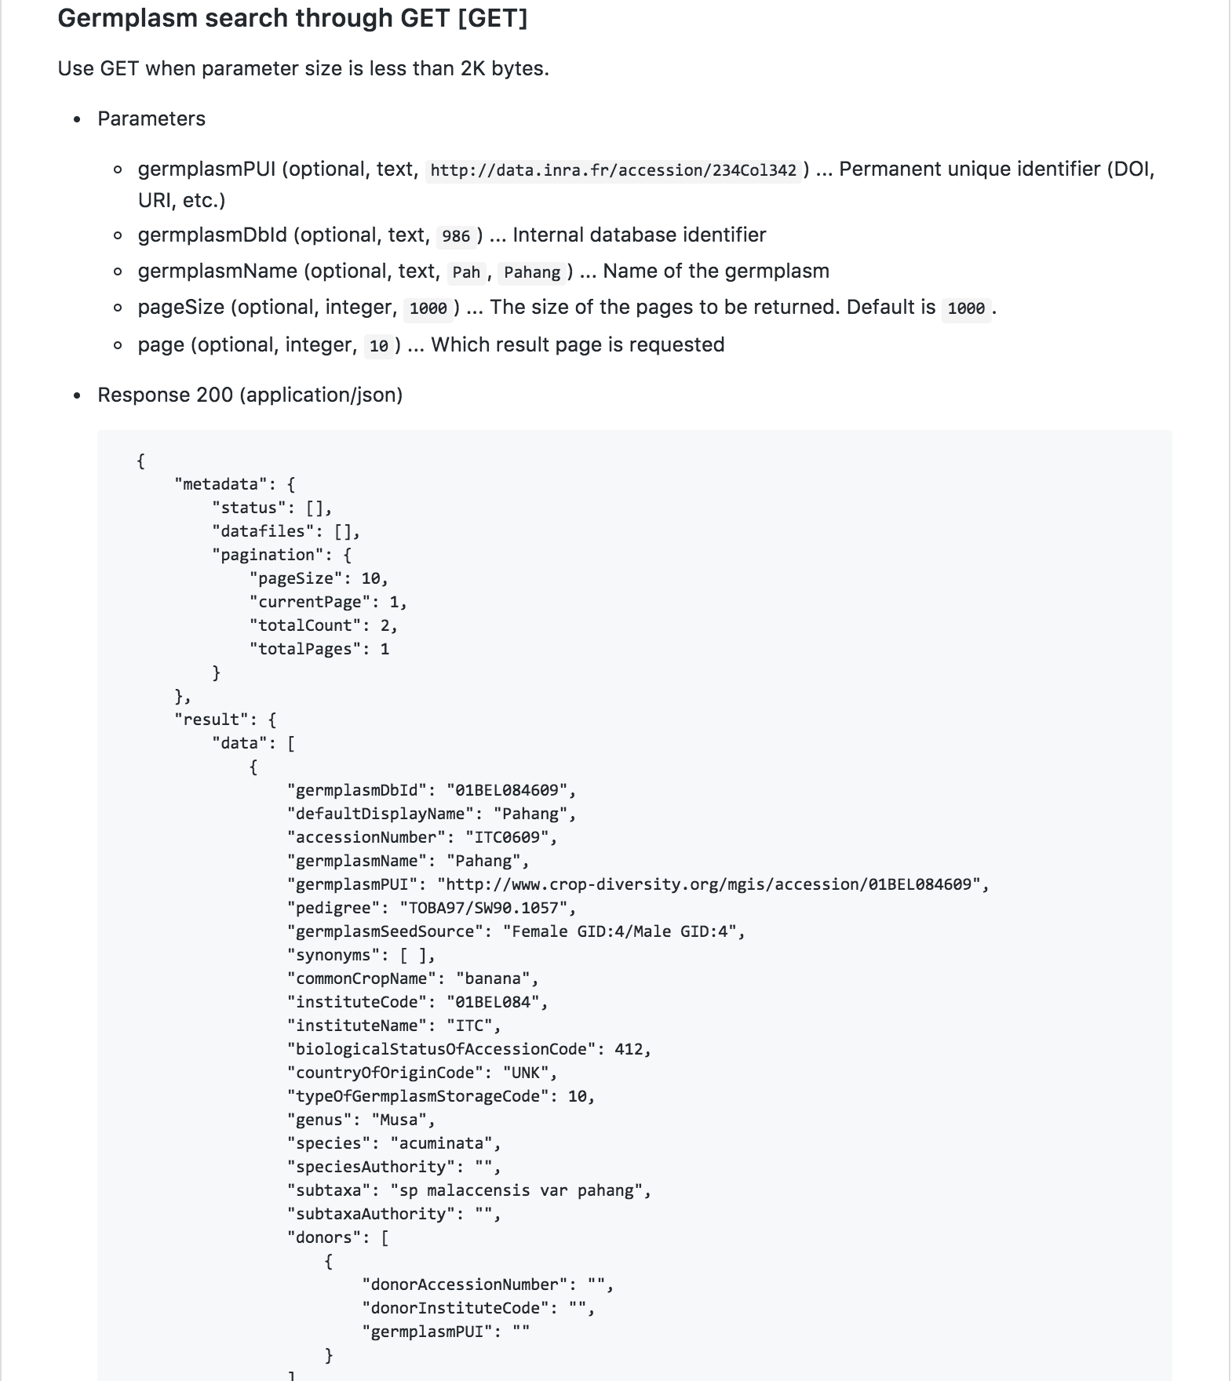
BrAPI v1 example: germplasm-search call
https://github.com/plantbreeding/API/blob/master/Specification/Germplasm/GermplasmSearchGET.md
Specification includes:
Optional and mandatory (input and output) fields
Data type
Maximum size of each data
Default values
Cardinality
Metadata to facilitate navigation around multiple results
Full BrAPI specification:
https://github.com/plantbreeding/API
Notes:
Example of germplasm-search BrAPI v1 call.
Currently close to be published.
Germplasm are living genetic resources such as seeds or tissues that are maintained for the purpose of animal and plant breeding, preservation, and other research uses

Slide 12
Summarizing…
Elixir
International project to unify European bioinformatics infrastructure
EXCELERATE
European Commission funding to implement Elixir
Brassica Information Portal (BIP)
Open access web repository for Brassica phenotyping data
Earlham Institute stakeholder for Elixir EXCELERATE
EI and BIP is involved in:
Elixir Plants Use Case (WP7)
Standard for annotating genotypic-phenotypic data : MIAPPE v2
Common API : BrAPI v2
Elixir Interoperability Platform (WP5)
Findability and Accessibility: BioSchemas
Notes:
Elixir
International project to unify European bioinformatics infrastructure
EXCELERATE
Part of European Commission H2020 project. It funds Elixir to start and implement its infrastructure.
Brassica Information Portal
Open access web repository for Brassica phenotyping data
Implementing EXCELERATE requirements from WP7 and WP5.
Plants Use Case (WP7):
Facilitate genotype-phenotype analyses for crop and tree species
- Develop standards for representation of genotypic and phenotypic data
- Develop Plant Phenotyping API
Interoperability Platform (WP5):
Add semantic meaning to current bioinformatics web pages in order to improve their findability and accessibility

Slide 13


Thanks to
Niklas Blomberg
Interoperability Platform (WP5)
Chris Evelo (NL)
Carlole Goble (UK)
Helen Parkinson (EBI)
Elixir Plants Use Case (WP7)
Paul Kersey (EBI)
Celia de Miguel (PT)
… and all WP7 colleagues ☺
John Hancock
Wiktor Jurkowski
Annemarie Eckes
Rafael Jiménez

