Slide 1
Repeats and composition bias

Slide 2
Repeats

Slide 3
Frequency
14% proteins contains repeats (Marcotte et al, 1999)
1: Single amino acid repeats.
2: Longer imperfect tandem repeats. Assemble in structure.

Slide 4
Definition repeats
Sequence, long, imperfect, tandem
MRAVVKSPIMCHEKSPSVCSPLNMTSSVCSPAGINSVSSTTASF
GSFPVHSPITQGTPLTCSPNVENRGSRSHSPAHASNVGSPLSSPLSSMKSSISSPPSHCSVKSPVSSPNNVTLRSSVSSPANINN

Slide 5
Definition repeats
Sequence, long, imperfect, tandem
MRAVVKSPIMCHEKSPSVCSPLNMTSSVCSPAGINSVSSTTASFGSFPVHSPITQGTPLTCSPNVENRGSRSHSPAHASNVGSPLSSPLSSMKSSISSPPSHCSVKSPVSSPNNVTLRSSVSSPANINN

Slide 6
Definition repeats
Sequence, long, imperfect, tandem
MRAVVKSPIM CHE
KSPSVCSPLN
MTSSVCSPAG INSVSSTTASF
GSFPVHSPIT Q
GTPLTCSPNV EN
RGSRSHSPAH ASN
VGSPLSSPLS S
MKSSISSPPS HCS
VKSPVSSPNN VT
LRSSVSSPAN INN

Slide 7
Definition repeats
Sequence, long, imperfect, tandem
MRAVVKSPIM CHE
KSPSVCSPLN
MTSSVCSPAG INSVSSTTASF
GSFPVHSPIT Q
GTPLTCSPNV EN
RGSRSHSPAH ASN
VGSPLSSPLS S
MKSSISSPPS HCS
VKSPVSSPNN VT
LRSSVSSPAN INN

Slide 8
Tandem repeats fold together

Slide 9
Tandem repeats fold together

Slide 10
Tandem repeats fold together

Slide 11
Tandem repeats fold together

Slide 12
Tandem repeats fold together

Slide 13
Tandem repeats fold together

Slide 14
Definition repeats
Sequence, long, imperfect, tandem
MRAVVKSPIM CHE
KSPSVCSPLN
MTSSVCSPAG INSVSSTTASF
GSFPVHSPIT Q
GTPLTCSPNV EN
RGSRSHSPAH ASN
VGSPLSSPLS S
MKSSISSPPS HCS
VKSPVSSPNN VT
LRSSVSSPAN INN

Slide 15
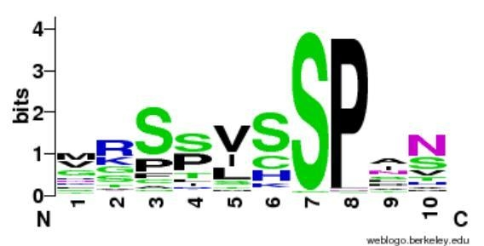
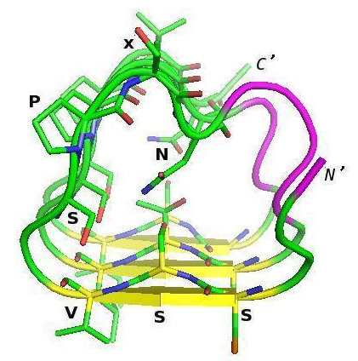
http://weblogo.berkeley.edu
(Vlassi et al, 2013)
Notes:
15

Slide 16
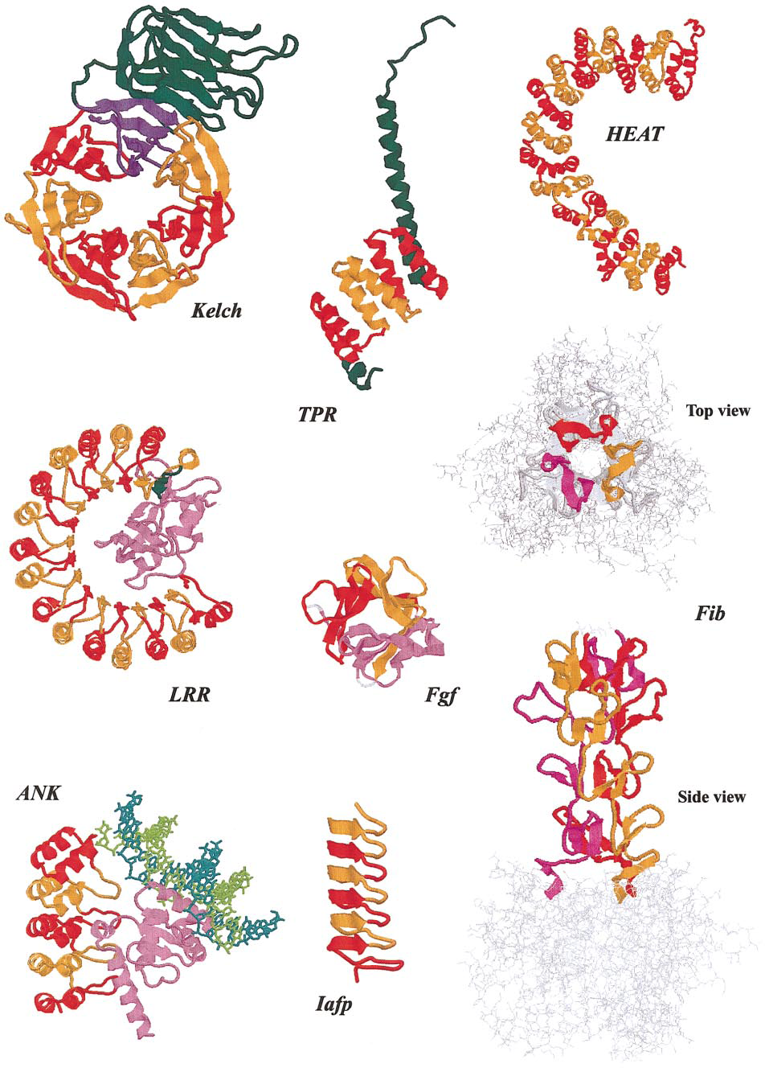
Andrade et al. (2001)
J Struct Biol

Slide 17
Definition CBRs
Perfect repeat: QQQQQQQQQQQ
Imperfect: QQQQPQQQQQQ
Amino acid type: DDDDDEEEDEDEED
Compositionally biased regions (CBRs)
High frequency of one or two amino acids in a region.
Particular case of low complexity region

Slide 18
Detection CBRs
Sometimes straightforward.
N-terminal human Huntingtin.
How many CBRs can you find?
>sp|P42858|HD_HUMAN Huntingtin OS=Homo sapiens MATLEKLMKAFESLKSFQQQQQQQQQQQQQQQQQQQQQPPPPPPPPPPPQLPQPPPQAQP LLPQPQPPPPPPPPPPGPAVAEEPLHRPKKELSATKKDRVNHCLTICENIVAQSVRNSPE FQKLLGIAMELFLLCSDDAESDVRMVADECLNKVIKALMDSNLPRLQLELYKEIKKNGAP RSLRAALWRFAELAHLVRPQKCRPYLVNLLPCLTRTSKRPEESVQETLAAAVPKIMASFG NFANDNEIKVLLKAFIANLKSSSPTIRRTAAGSAVSICQHSRRTQYFYSWLLNVLLGLLV PVEDEHSTLLILGVLLTLRYLVPLLQQQVKDTSLKGSFGVTRKEMEVSPSAEQLVQVYEL TLHHTQHQDHNVVTGALELLQQLFRTPPPELLQTLTAVGGIGQLTAAKEESGGRSRSGSI VELIAGGGSSCSPVLSRKQKGKVLLGEEEALEDDSESRSDVSSSALTASVKDEISGELAA SSGVSTPGSAGHDIITEQPRSQHTLQADSVDLASCDLTSSATDGDEEDILSHSSSQVSAV PSDPAMDLNDGTQASSPISDSSQTTTEGPDSAVTPSDSSEIVLDGTDNQYLGLQIGQPQD EDEEATGILPDEASEAFRNSSMALQQAHLLKNMSHCRQPSDSSVDKFVLRDEATEPGDQE NKPCRIKGDIGQSTDDDSAPLVHCVRLLSASFLLTGGKNVLVPDRDVRVSVKALALSCVG AAVALHPESFFSKLYKVPLDTTEYPEEQYVSDILNYIDHGDPQVRGATAILCGTLICSIL

Slide 19
Detection CBRs
Sometimes straightforward.
N-terminal human Huntingtin.
How many CBRs can you find?
>sp|P42858|HD_HUMAN Huntingtin OS=Homo sapiens MATLEKLMKAFESLKSFQQQQQQQQQQQQQQQQQQQQQPPPPPPPPPPPQLPQPPPQAQP LLPQPQPPPPPPPPPPGPAVAEEPLHRPKKELSATKKDRVNHCLTICENIVAQSVRNSPE FQKLLGIAMELFLLCSDDAESDVRMVADECLNKVIKALMDSNLPRLQLELYKEIKKNGAP RSLRAALWRFAELAHLVRPQKCRPYLVNLLPCLTRTSKRPEESVQETLAAAVPKIMASFG NFANDNEIKVLLKAFIANLKSSSPTIRRTAAGSAVSICQHSRRTQYFYSWLLNVLLGLLV PVEDEHSTLLILGVLLTLRYLVPLLQQQVKDTSLKGSFGVTRKEMEVSPSAEQLVQVYEL TLHHTQHQDHNVVTGALELLQQLFRTPPPELLQTLTAVGGIGQLTAAKEESGGRSRSGSI VELIAGGGSSCSPVLSRKQKGKVLLGEEEALEDDSESRSDVSSSALTASVKDEISGELAA SSGVSTPGSAGHDIITEQPRSQHTLQADSVDLASCDLTSSATDGDEEDILSHSSSQVSAV PSDPAMDLNDGTQASSPISDSSQTTTEGPDSAVTPSDSSEIVLDGTDNQYLGLQIGQPQD EDEEATGILPDEASEAFRNSSMALQQAHLLKNMSHCRQPSDSSVDKFVLRDEATEPGDQE NKPCRIKGDIGQSTDDDSAPLVHCVRLLSASFLLTGGKNVLVPDRDVRVSVKALALSCVG AAVALHPESFFSKLYKVPLDTTEYPEEQYVSDILNYIDHGDPQVRGATAILCGTLICSIL

Slide 20
Detection CBRs
Sometimes straightforward.
N-terminal human Huntingtin.
How many CBRs can you find?
>sp|P42858|HD_HUMAN Huntingtin OS=Homo sapiens MATLEKLMKAFESLKSFQQQQQQQQQQQQQQQQQQQQQPPPPPPPPPPPQLPQPPPQAQP LLPQPQPPPPPPPPPPGPAVAEEPLHRPKKELSATKKDRVNHCLTICENIVAQSVRNSPE FQKLLGIAMELFLLCSDDAESDVRMVADECLNKVIKALMDSNLPRLQLELYKEIKKNGAP RSLRAALWRFAELAHLVRPQKCRPYLVNLLPCLTRTSKRPEESVQETLAAAVPKIMASFG NFANDNEIKVLLKAFIANLKSSSPTIRRTAAGSAVSICQHSRRTQYFYSWLLNVLLGLLV PVEDEHSTLLILGVLLTLRYLVPLLQQQVKDTSLKGSFGVTRKEMEVSPSAEQLVQVYEL TLHHTQHQDHNVVTGALELLQQLFRTPPPELLQTLTAVGGIGQLTAAKEESGGRSRSGSI VELIAGGGSSCSPVLSRKQKGKVLLGEEEALEDDSESRSDVSSSALTASVKDEISGELAA SSGVSTPGSAGHDIITEQPRSQHTLQADSVDLASCDLTSSATDGDEEDILSHSSSQVSAV PSDPAMDLNDGTQASSPISDSSQTTTEGPDSAVTPSDSSEIVLDGTDNQYLGLQIGQPQD EDEEATGILPDEASEAFRNSSMALQQAHLLKNMSHCRQPSDSSVDKFVLRDEATEPGDQE NKPCRIKGDIGQSTDDDSAPLVHCVRLLSASFLLTGGKNVLVPDRDVRVSVKALALSCVG AAVALHPESFFSKLYKVPLDTTEYPEEQYVSDILNYIDHGDPQVRGATAILCGTLICSIL

Slide 21
Detection CBRs
Sometimes straightforward.
N-terminal human Huntingtin.
How many CBRs can you find?
>sp|P42858|HD_HUMAN Huntingtin OS=Homo sapiens MATLEKLMKAFESLKSFQQQQQQQQQQQQQQQQQQQQQPPPPPPPPPPPQLPQPPPQAQP LLPQPQPPPPPPPPPPGPAVAEEPLHRPKKELSATKKDRVNHCLTICENIVAQSVRNSPE FQKLLGIAMELFLLCSDDAESDVRMVADECLNKVIKALMDSNLPRLQLELYKEIKKNGAP RSLRAALWRFAELAHLVRPQKCRPYLVNLLPCLTRTSKRPEESVQETLAAAVPKIMASFG NFANDNEIKVLLKAFIANLKSSSPTIRRTAAGSAVSICQHSRRTQYFYSWLLNVLLGLLV PVEDEHSTLLILGVLLTLRYLVPLLQQQVKDTSLKGSFGVTRKEMEVSPSAEQLVQVYEL TLHHTQHQDHNVVTGALELLQQLFRTPPPELLQTLTAVGGIGQLTAAKEESGGRSRSGSI VELIAGGGSSCSPVLSRKQKGKVLLGEEEALEDDSESRSDVSSSALTASVKDEISGELAA SSGVSTPGSAGHDIITEQPRSQHTLQADSVDLASCDLTSSATDGDEEDILSHSSSQVSAV PSDPAMDLNDGTQASSPISDSSQTTTEGPDSAVTPSDSSEIVLDGTDNQYLGLQIGQPQD EDEEATGILPDEASEAFRNSSMALQQAHLLKNMSHCRQPSDSSVDKFVLRDEATEPGDQE NKPCRIKGDIGQSTDDDSAPLVHCVRLLSASFLLTGGKNVLVPDRDVRVSVKALALSCVG AAVALHPESFFSKLYKVPLDTTEYPEEQYVSDILNYIDHGDPQVRGATAILCGTLICSIL

Slide 22
Detection repeats
Sometimes straightforward.
N-terminal human Huntingtin.
How many repeats can you find?
>sp|P42858|HD_HUMAN Huntingtin OS=Homo sapiens MATLEKLMKAFESLKSFQQQQQQQQQQQQQQQQQQQQQPPPPPPPPPPPQLPQPPPQAQP LLPQPQPPPPPPPPPPGPAVAEEPLHRPKKELSATKKDRVNHCLTICENIVAQSVRNSPE FQKLLGIAMELFLLCSDDAESDVRMVADECLNKVIKALMDSNLPRLQLELYKEIKKNGAP RSLRAALWRFAELAHLVRPQKCRPYLVNLLPCLTRTSKRPEESVQETLAAAVPKIMASFG NFANDNEIKVLLKAFIANLKSSSPTIRRTAAGSAVSICQHSRRTQYFYSWLLNVLLGLLV PVEDEHSTLLILGVLLTLRYLVPLLQQQVKDTSLKGSFGVTRKEMEVSPSAEQLVQVYEL TLHHTQHQDHNVVTGALELLQQLFRTPPPELLQTLTAVGGIGQLTAAKEESGGRSRSGSI VELIAGGGSSCSPVLSRKQKGKVLLGEEEALEDDSESRSDVSSSALTASVKDEISGELAA SSGVSTPGSAGHDIITEQPRSQHTLQADSVDLASCDLTSSATDGDEEDILSHSSSQVSAV PSDPAMDLNDGTQASSPISDSSQTTTEGPDSAVTPSDSSEIVLDGTDNQYLGLQIGQPQD EDEEATGILPDEASEAFRNSSMALQQAHLLKNMSHCRQPSDSSVDKFVLRDEATEPGDQE NKPCRIKGDIGQSTDDDSAPLVHCVRLLSASFLLTGGKNVLVPDRDVRVSVKALALSCVG AAVALHPESFFSKLYKVPLDTTEYPEEQYVSDILNYIDHGDPQVRGATAILCGTLICSIL

Slide 23
Detection repeats
Often NOT straightforward.
N-terminal human Huntingtin.
How many repeats can you find?
>sp|P42858|HD_HUMAN Huntingtin OS=Homo sapiens MATLEKLMKAFESLKSFQQQQQQQQQQQQQQQQQQQQQPPPPPPPPPPPQLPQPPPQAQP LLPQPQPPPPPPPPPPGPAVAEEPLHRPKKELSATKKDRVNHCLTICENIVAQSVRNSPE FQKLLGIAMELFLLCSDDAESDVRMVADECLNKVIKALMDSNLPRLQLELYKEIKKNGAP RSLRAALWRFAELAHLVRPQKCRPYLVNLLPCLTRTSKRPEESVQETLAAAVPKIMASFG NFANDNEIKVLLKAFIANLKSSSPTIRRTAAGSAVSICQHSRRTQYFYSWLLNVLLGLLV PVEDEHSTLLILGVLLTLRYLVPLLQQQVKDTSLKGSFGVTRKEMEVSPSAEQLVQVYEL TLHHTQHQDHNVVTGALELLQQLFRTPPPELLQTLTAVGGIGQLTAAKEESGGRSRSGSI VELIAGGGSSCSPVLSRKQKGKVLLGEEEALEDDSESRSDVSSSALTASVKDEISGELAA SSGVSTPGSAGHDIITEQPRSQHTLQADSVDLASCDLTSSATDGDEEDILSHSSSQVSAV PSDPAMDLNDGTQASSPISDSSQTTTEGPDSAVTPSDSSEIVLDGTDNQYLGLQIGQPQD EDEEATGILPDEASEAFRNSSMALQQAHLLKNMSHCRQPSDSSVDKFVLRDEATEPGDQE NKPCRIKGDIGQSTDDDSAPLVHCVRLLSASFLLTGGKNVLVPDRDVRVSVKALALSCVG AAVALHPESFFSKLYKVPLDTTEYPEEQYVSDILNYIDHGDPQVRGATAILCGTLICSIL

Slide 24
Detection repeats
Often NOT straightforward.
N-terminal human Huntingtin.
How many repeats can you find?
EFQKLLGIAMELFLLCSDDAESDVRMVADECLNKVIKA
CRPYLVNLLPCLTRTSKRP-EESVQETLAAAVPKIMAS NDNEIKVLLKAFIANLKSSSPTIRRTAAGSAVSICQHS
TQYFYSWLLNVLLGLLVPVEDEHSTLLILGVLLTLRYL
PSAEQLVQVYELTLHHTQHQDHNVVTGALELLQQLFRT

Slide 25
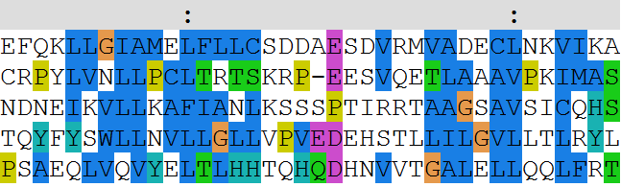
Detection repeats
Often NOT straightforward.
N-terminal human Huntingtin.
How many repeats can you find?
EFQKLLGIAMELFLLCSDDAESDVRMVADECLNKVIKA
CRPYLVNLLPCLTRTSKRP-EESVQETLAAAVPKIMAS NDNEIKVLLKAFIANLKSSSPTIRRTAAGSAVSICQHS
TQYFYSWLLNVLLGLLVPVEDEHSTLLILGVLLTLRYL
PSAEQLVQVYELTLHHTQHQDHNVVTGALELLQQLFRT

Slide 26
Repeats

Slide 27
Frequency repeats
Fraction of proteins annotated with the keyword REPEAT in SwissProt
%
Archaea 27/3428 0.79
Viruses 81/8048 1.00
Bacteria 299/28438 1.05
Fungi 232/8334 2.78
Viridiplantae 153/6963 2.20
Metazoa 1538/28948 5.31
Rest of Eukaryota 92/2434 3.78
(Andrade et al 2001)

Slide 28
Detection of repeats
Dotplots
Comparing a sequence against itself

Slide 29
Detection of repeats
Dotplots
TLRSSVSSPANINNS
NMTSSVCSPANISV

Slide 30
Detection of repeats
Dotplots
TLRSSVSSPANINNS
|
1 match
NMTSSVCSPANISV

Slide 31
Detection of repeats
Dotplots
TLRSSVSSPANINNS
||| |||||
8 matches
NMTSSVCSPANISV

Slide 32
Detection of repeats
Dotplots
TLRSSVSSPANINNS
| |
2 matches
NMTSSVCSPANISV

Slide 33
Detection of repeats
Dotplots
TLRSSVSSPANINNS
|
1 match
NMTSSVCSPANISV

Slide 34
Detection of repeats
Dotplots
TLRSSVSSPANINNS
NMTSSVCSPANISV
8

Slide 35
Detection of repeats
Dotplots
TLRSSVSSPANINNS
NMTSSVCSPANISV
1821

Slide 36
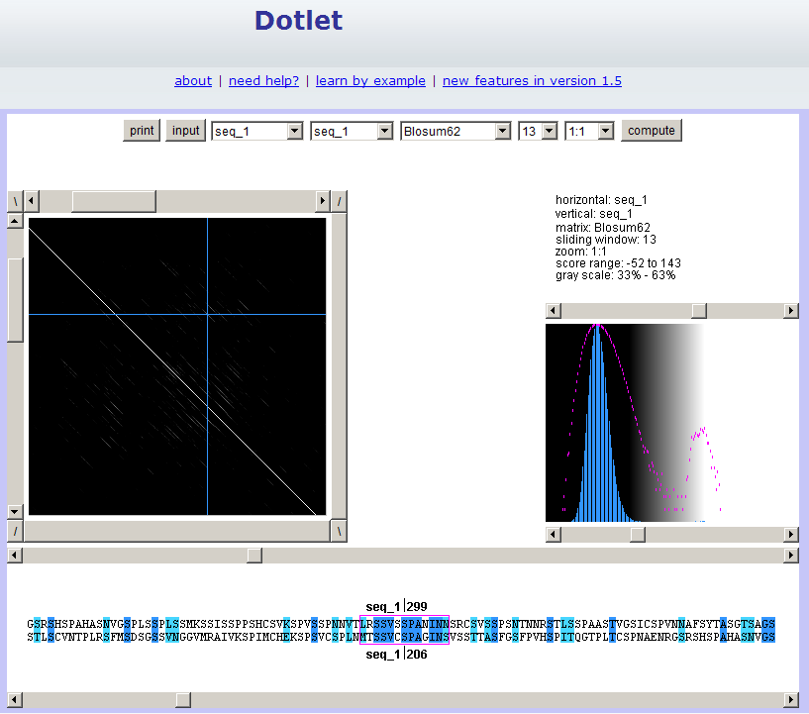
Exercise 1

Slide 37
Exercise 1/3. Using Dotlet with the human mineralocorticoid receptor (MR)
Go to the Dotlet web page: http://myhits.isb-sib.ch/cgi-bin/dotlet
Click on the input button and paste the sequence of the human mineralocorticoid receptor (UniProt id P08235)
Click on the “compute” button
Try to find combinations of parameters that show patterns in the dot plot (Hint: You can adjust this finely using the arrows) (Hint2: Range 27%-36% works well)
Find repetitions clicking in the diagonal patterns: which repeated sequences do you find?

Slide 38
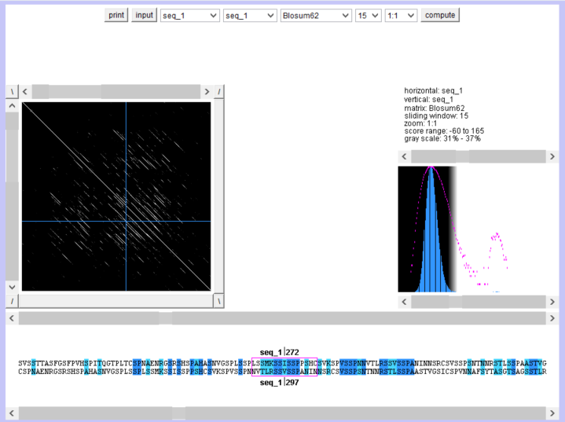
Exercise 1/4. Using Dotlet with the human mineralocorticoid receptor (MR)

Slide 39
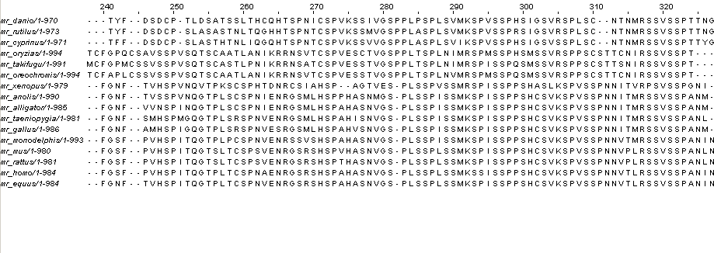
Detection of repeats
Using a multiple sequence alignment helps.
Conserved repeated patterns
JalView with Regular Expression searches

Slide 40
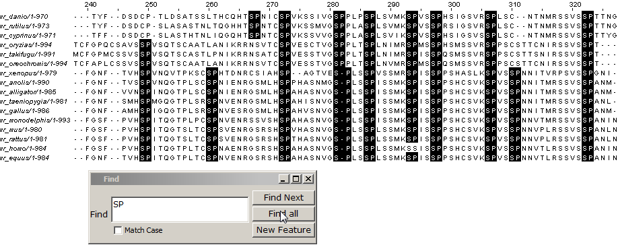
Detection of repeats
Using a multiple sequence alignment helps
Conserved repeated patterns
JalView with Regular Expression searches

Slide 41
Detection of repeats
Using a multiple sequence alignment helps
Conserved repeated patterns
JalView with Regular Expression searches

Slide 42
Detection of repeats
Using a multiple sequence alignment helps
Conserved repeated patterns
JalView with Regular Expression searches
Regular Expressions:
[LS]P.A
matches L or S, followed by P, followed by anything, followed by A

Slide 43
Detection of repeats
Using a multiple sequence alignment helps
Conserved repeated patterns
JalView with Regular Expression searches
Regular Expressions:
[LS]P.A
matches L or S, followed by P, followed by anything, followed by A
Which one is not matched?
LPTA, SPAA, LPPA, LPAP, SPLA

Slide 44
Detection of repeats
Using a multiple sequence alignment helps
Conserved repeated patterns
JalView with Regular Expression searches
Regular Expressions:
[LS]P.A
matches L or S, followed by P, followed by anything, followed by A
Which one is not matched?
LPTA, SPAA, LPPA, LPAP, SPLA

Slide 45
Exercise 2/4. Using JalView with a MSA of the MR with orthologs
Load the multiple sequence alignment of the MR in JalView: MR1_fasta.txt
Use the “Select > find" (of Ctrl+F) option with a regular expression and mark all matches (click the “Find all” option!)
Try to find the expression that matches more repeats. How many repeats do you see? How long are they? Would you correct the alignment based on these findings?

Slide 46
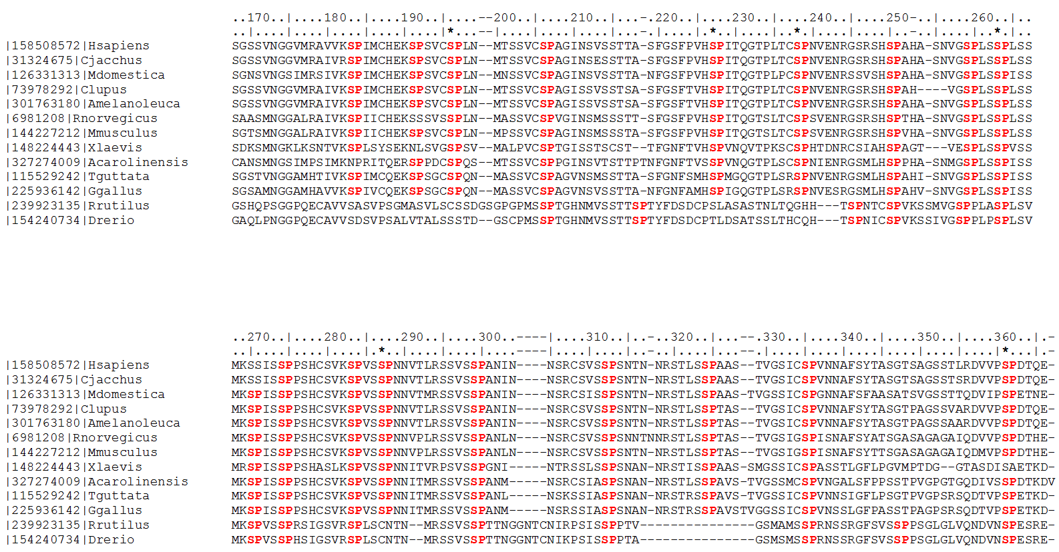
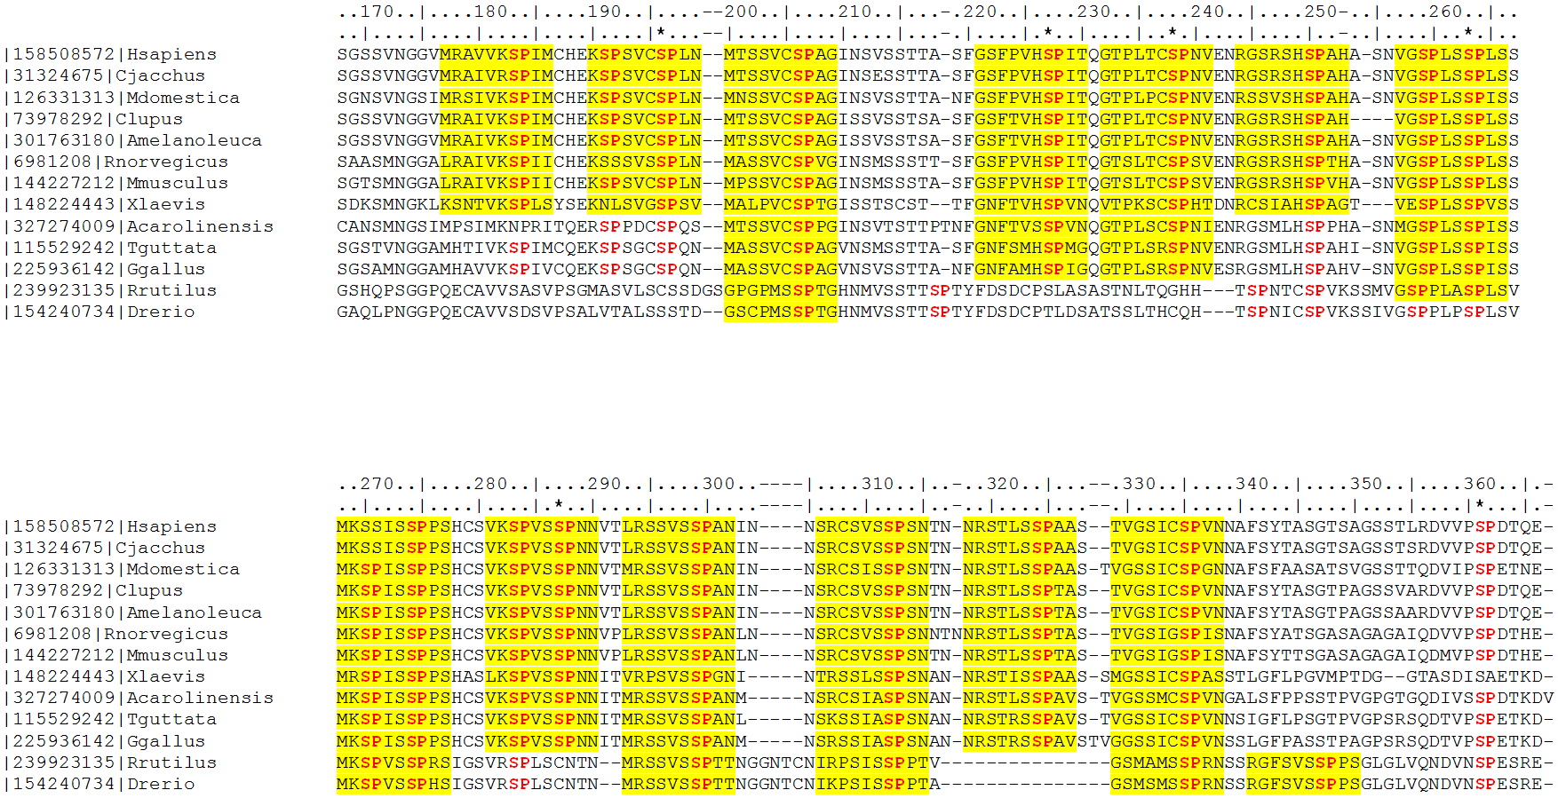
#T1
#T2
#T3
#T4
#T5
#T6
#T7
*
*
*
*
#F1
#F2
#F3
#F4
#T8
#T9
#T10
#T11
#T12
#T13
#T14
#T15
*
*
*
#F5
#F6
#F7
#F8
#F9
#F10
#F11
(Vlassi et al, 2013)
Notes:
46

Slide 47
Composition bias

Slide 48
Definition
14% proteins contains repeats (Marcotte et al, 1999)
1: Single amino acid repeats.
2: Longer imperfect tandem repeats. Assemble in structure.

Slide 49
Definition CBRs
Perfect repeat: QQQQQQQQQQQ
Imperfect: QQQQPQQQQQQ
Amino acid type: DDDDDEEEDEDEED
Compositionally biased regions (CBRs)
High frequency of one or two amino acids in a region.
Particular case of low complexity region

Slide 50
Function CBRs
Conservation => Function
Length, amino acid type not necessarily conserved
Frequency: 1 in 3 proteins contains a compositionally biased region (Wootton, 1994), ~11% conserved (Sim and Creamer, 2004)

Slide 51
Function CBRs
Conservation => Function
Length, amino acid type not necessarily conserved
Functions:
Passive: linkers
Active: binding, mediate protein interaction, structural integrity
(Sim and Creamer, 2004)

Slide 52
Structure of CBRs
Often variable or flexible: do not easily crystalize

Slide 53
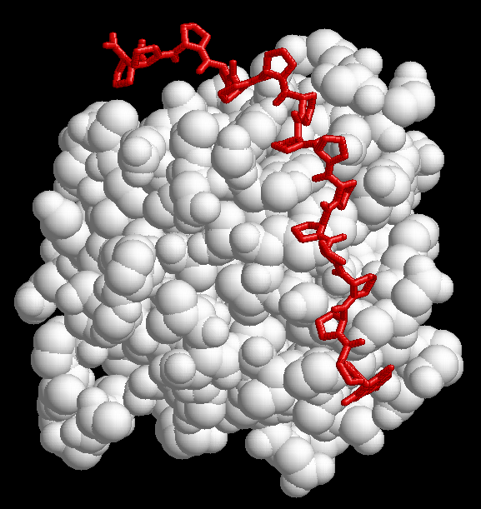
1CJF: profilin bound to polyP

Slide 54
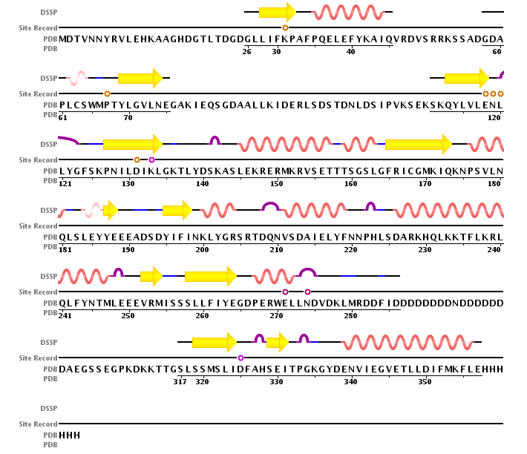
2IF8: Inositol Phosphate Multikinase Ipk2

Slide 55
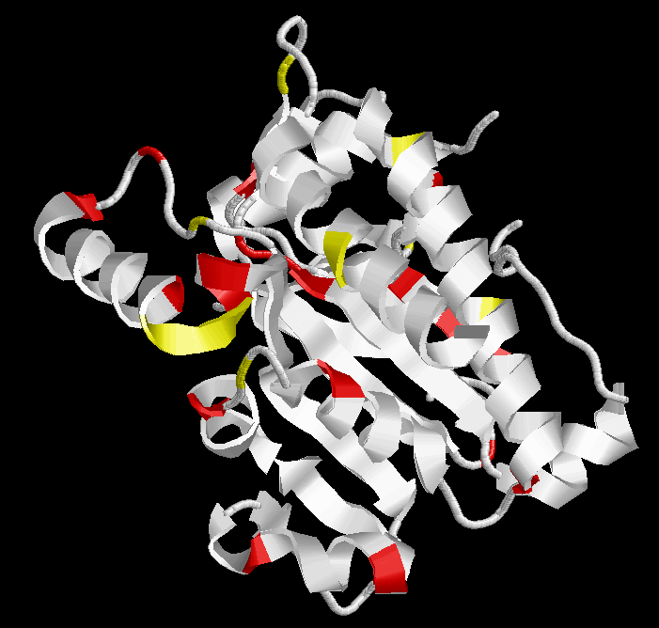
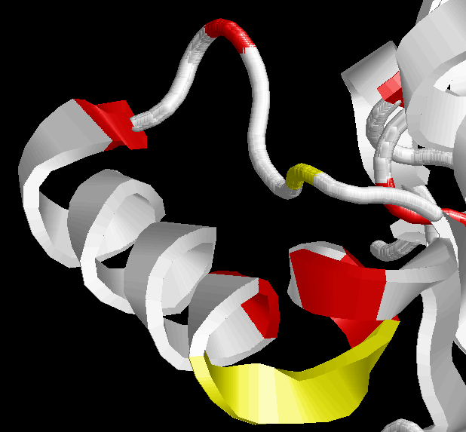
2IF8: Inositol Phosphate Multikinase Ipk2
RVSETTTSGSL

Slide 56
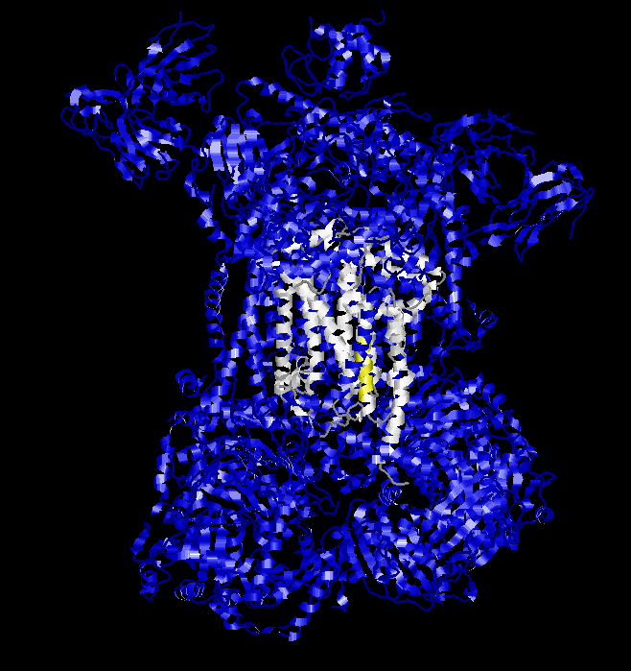
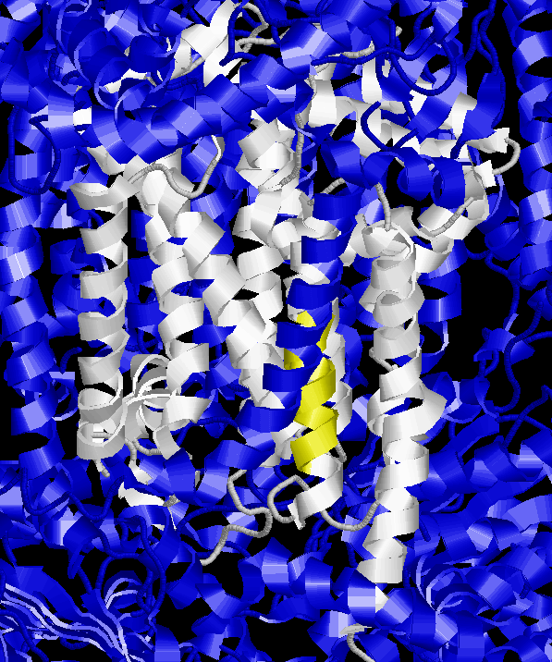
2CX5: mitochondrial cytochrome c
B subunit N-terminal

Slide 57
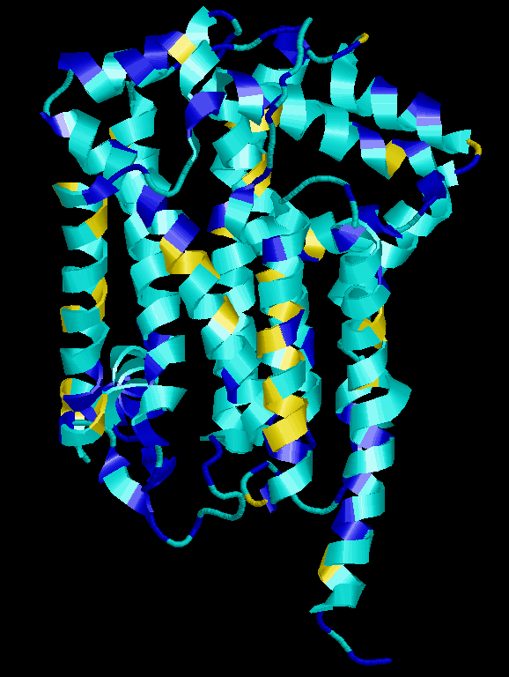
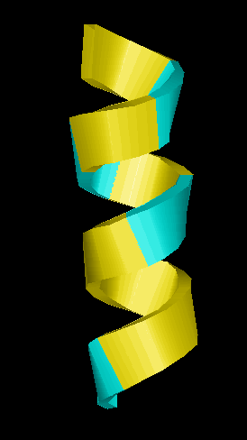
2CX5: mitochondrial cytochrome c
B subunit N-terminal
FFFFIFVFNF

Slide 58
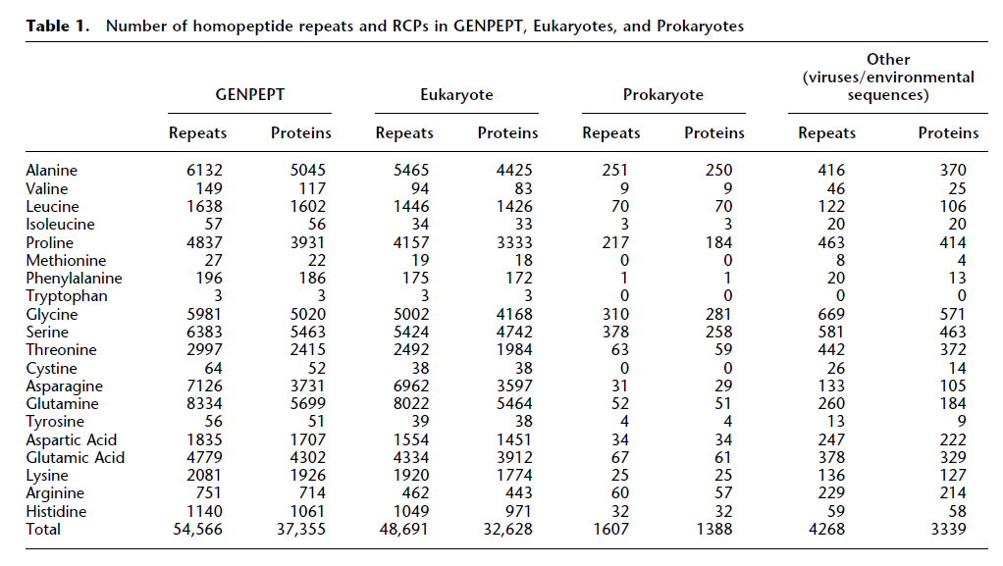
Types of CBRs
More than 6 aa in length, 1.4% of all, 87% of them in Euk (Faux et al 2005)

Slide 59
Types of CBRs
Distribution is not random:
Eukaryota:
Most common: poly-Q, poly-N, poly-A, poly-S, poly-G
Prokaryota:
Most common: poly-S, poly-G, poly-A, poly-P
Relatively rare: poly-Q, poly-N
Very rare or absent in both eukaryota and prokaryota:
Poly-I, Poly-M, Poly-W, Poly-C, Poly-Y
Toxicity of long stretches of hydrophobic residues.
(Faux et al 2005)

Slide 60
Filtering out CBRs
Normally filtered out as low complexity region: they give spurious BLAST hits
QQQQQQQQQQ
||||||||||
QQQQQQQQQQ 10/10 id
IDENTITIES
||||||||||
IDENTITIES 10/10 id

Slide 61
Filtering out CBRs
Normally filtered out as low complexity region: they give spurious BLAST hits
QQQQQQQQQQ
||||||||||
QQQQQQQQQQ Shuffle: 10/10 id
IDENTITIES
||||||||||
IDENTITIES 10/10 id

Slide 62
Filtering out CBRs
Normally filtered out as low complexity region: they give spurious BLAST hits
QQQQQQQQQQ
||||||||||
QQQQQQQQQQ Shuffle: 10/10 id
IDENTITIES
| |
SIINDIETTE Shuffle: 2/10 id

Slide 63
Filtering out CBRs
Option for pre-BLAST treatment
SEG algorithm:
1) Identify sequence regions with low information content over a sequence window
2) Merge neighbouring regions
Eliminates hits against common acidic-, basic- or proline-rich regions
(Wootton and Federhen, 1993)

Slide 64
A particular analysis…
AIR9
(1708 aa)
Ser rich
+ basic
conserved
region
LRR
A9 repeats
Δ1
Δ3
Δ2
Δ15
Δ9
Δ10
Δ6
Δ11
Δ12
Buschmann, et al (2006).
Current Biology.
Buschmann, et al (2007).
Plant Signaling & Behavior
Δ14
Δ16
Microtubule localization of Δx-GFP

Slide 65
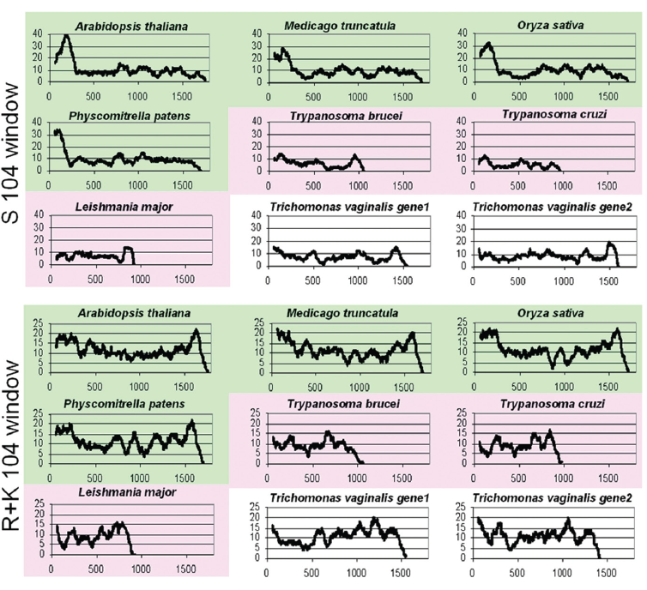
…triggers a tool

Slide 66

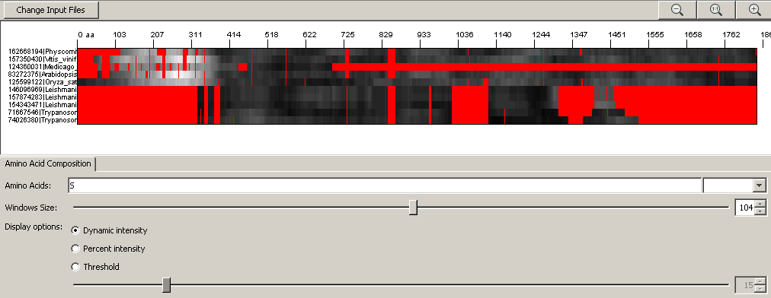
A particular analysis…
…triggers BiasViz
http://biasviz.sourceforge.net/
Huska, et al. (2007). Bioinformatics

Slide 67
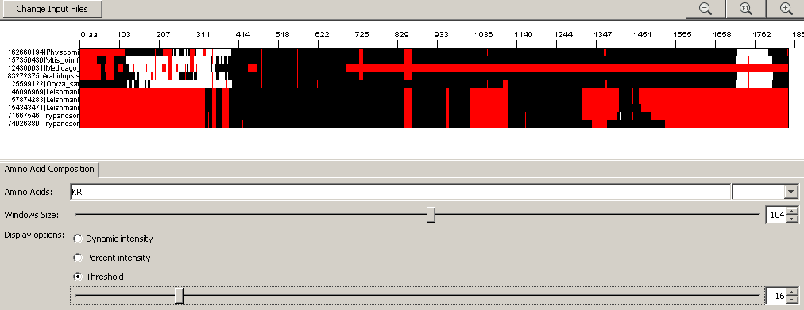
A particular analysis…
…triggers BiasViz
http://biasviz.sourceforge.net/
Huska, et al. (2007). Bioinformatics

Slide 68
Exercise 3/4. Viewing CBRs in an alignment with BiasViz2
Go to the BiasViz2 web page: http://biasviz.souceforge.net/
Launch BiasViz2
Load the alignment little_MSA_fasta.txt on the step 1 section
Hit the "Go to graphical view" button
Try to find combinations of parameters that reveal CBRs
Try hydrophobic residues and window size 10. Remember that this is a transmembrane protein.
What is this result telling you?
Can you see other biased regions?

Slide 69
Exercise 4/4. Viewing CBRs in an alignment with BiasViz2
Exit BiasViz2 and launch it again
Load the alignment MR1_fasta.txt on the step 1 section
Hit the "Go to graphical view" button
Try to find combinations of parameters that reveal CBRs
Can you find a large (>100aa) Serine rich region? (In Display options, try the threshold option with 25% cut-off)

