Slide 1

The Genome Analysis Centre
Building Excellence in Genomics and Computational Bioscience

Slide 2







Building Excellence in Genomics and Computational Bioscience
Introduction to
the Wheat Information System
(WheatIS)
Simon Tyrrell & Xingdong Bian

Slide 3

About
G20 Initiative for food security
Collective building of the WheatIS to better respond to the needs of the international wheat community
Promotion of an open-access model for data exchange
Reliance on a distributed system
Virtual Machines and Cloud Computing technologies to facilitate sharing data and tools
Taken from http://www.wheatis.org/
The Genome Analysis Centre
The Genome Analysis Centre

Slide 4
Issues
Data
Massive sets of data, prohibitive to copy
Geographically distant
Access
Fully open to fully closed
Synchronisation
Collation
How to harvest the data
Services
Different areas of interest
Work together smoothly
The Genome Analysis Centre
The Genome Analysis Centre
Notes:
Geographically disparate data generators each with their own ideas about data sharing (from “none” to “friendly”)

Slide 5
Goals
Distributed services & data
Interoperable
No restriction on data or services
Making data “smarter”
Linking
Aggregation
Automated workflows
Searching
General – standard text
Discipline-specific - Identifying & linking biological terms
The Genome Analysis Centre
The Genome Analysis Centre

Slide 6

Before
The Genome Analysis Centre
The Genome Analysis Centre

Slide 7
After
The Genome Analysis Centre
The Genome Analysis Centre

Slide 8
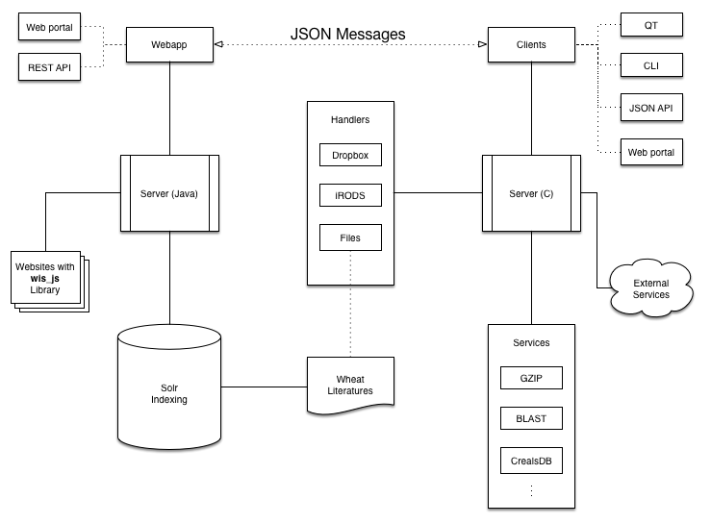
WheatIS Structure
The Genome Analysis Centre
The Genome Analysis Centre

Slide 9
WheatIS Structure
The Genome Analysis Centre

Slide 10
Demo 1
Client
Server
JSON Messages
See what services are available for a resource
The Genome Analysis Centre
The Genome Analysis Centre

Slide 11
Server(s)
The Genome Analysis Centre

Slide 12
Server
General tasks
Authentication
Administration
Manages other components
Messaging
Post Office
Configurable installation
Standalone
Apache Web Server module
The Genome Analysis Centre
The Genome Analysis Centre

Slide 13
Demo 1
Client
Server
JSON Messages
See what services are available for a resource
Get list of services applicable for the resource
The Genome Analysis Centre
The Genome Analysis Centre

Slide 14
Services
The Genome Analysis Centre

Slide 15
Service
A self-contained application exposing
Description
Parameters
Functionality
Can be in any language
Can be run manually or automatically
Able to inspect data to see whether a service is applicable
Each Service has the same API
The Genome Analysis Centre
The Genome Analysis Centre

Slide 16
Handlers
The Genome Analysis Centre

Slide 17
Data Handlers
Each Handler has the same API
Read, write, seek, etc.
Data can be read from & written to multiple sources
Local & remote mounted filesystems
iRods
Http(s)
Dropbox
Google drive
SSH
The Genome Analysis Centre
The Genome Analysis Centre

Slide 18

iRods
Sharable collections of data (iRODS Data Grids)
State information & descriptive metadata enabling search, management, etc.
Federation of multiple iRODS Data Grids, combining independent but collaborating metadata sets
Interoperable with other data management systems e.g. Fedora, Dspace.
Extensible through user-defined rules and micro-services.
The Genome Analysis Centre
The Genome Analysis Centre

Slide 19
Demo 1
Client
Server
JSON Messages
See what services are available for a resource
Get list of services applicable for the resource
Choose which services to run and set their parameters
The Genome Analysis Centre
The Genome Analysis Centre

Slide 20
Server – Client Messaging
The Genome Analysis Centre

Slide 21
Communication
All server-server & server-client communication uses JSON
[
{"path": "Compress service",
"description": "A service to compress data",
"operations": {
"nickname": "Compress service",
"summary": "A service to compress data",
"params": [{
"param": "Input",
"type": "string",
"current_value": {
"protocol": "irods",
"value": "/tgacZone/home/tyrrells/test.fa"
},
"tag": 1,
"default_value": {
"protocol": "irods",
"value": "/tgacZone/home/tyrrells/test.fa"
},
"wheatis_type": 7,
"description": "The input file to read"
},
{"param": "Compression algorithm",
"type": "string",
"current_value": "zip",
"tag": 4294901761,
"default_value": "zip",
"wheatis_type": 5,
"description": "The algorithm to use to compress
the data with",
"enum": [{
"description": "Use Raw",
"value": "z"
}, {
"description": "Use Zip",
"value": "zip"
}, {
"description": "Use GZip",
"value": "gz"
}]
}]
}
}]
The Genome Analysis Centre
The Genome Analysis Centre

Slide 22
Communication
Service - general
[
{"path": "Compress service",
"description": "A service to compress data",
"operations": [{
"nickname": "Compress service",
"summary": "A service to compress data",
"params": [{
"param": "Input",
"type": "string",
"current_value": {
"protocol": "irods",
"value": "/tgacZone/home/tyrrells/test.fa"
},
"tag": 1,
"default_value": {
"protocol": "irods",
"value": "/tgacZone/home/tyrrells/test.fa"
},
"wheatis_type": 7,
"description": "The input file to read"
},
{"param": "Compression algorithm",
"type": "string",
"current_value": "zip",
"tag": 4294901761,
"default_value": "zip",
"wheatis_type": 5,
"description": "The algorithm to use to compress
the data with",
"enum": [{
"description": "Use Raw",
"value": "z"
}, {
"description": "Use Zip",
"value": "zip"
}, {
"description": "Use GZip",
"value": "gz"
}]
}]
}]
}]
The Genome Analysis Centre
The Genome Analysis Centre

Slide 23
Communication
Service - operations
[
{"path": "Compress service",
"description": "A service to compress data",
"operations": [{
"nickname": "Compress service",
"summary": "A service to compress data",
"params": [{
"param": "Input",
"type": "string",
"current_value": {
"protocol": "irods",
"value": "/tgacZone/home/tyrrells/test.fa"
},
"tag": 1,
"default_value": {
"protocol": "irods",
"value": "/tgacZone/home/tyrrells/test.fa"
},
"wheatis_type": 7,
"description": "The input file to read"
},
{"param": "Compression algorithm",
"type": "string",
"current_value": "zip",
"tag": 4294901761,
"default_value": "zip",
"wheatis_type": 5,
"description": "The algorithm to use to compress
the data with",
"enum": [{
"description": "Use Raw",
"value": "z"
}, {
"description": "Use Zip",
"value": "zip"
}, {
"description": "Use GZip",
"value": "gz"
}]
}]
}]
}]
The Genome Analysis Centre
The Genome Analysis Centre

Slide 24
Communication
Service - parameters
[
{"path": "Compress service",
"description": "A service to compress data",
"operations": [{
"nickname": "Compress service",
"summary": "A service to compress data",
"params": [{
"param": "Input",
"type": "string",
"current_value": {
"protocol": "irods",
"value": "/tgacZone/home/tyrrells/test.fa"
},
"tag": 1,
"default_value": {
"protocol": "irods",
"value": "/tgacZone/home/tyrrells/test.fa"
},
"wheatis_type": 7,
"description": "The input file to read"
},
{"param": "Compression algorithm",
"type": "string",
"current_value": "zip",
"tag": 4294901761,
"default_value": "zip",
"wheatis_type": 5,
"description": "The algorithm to use to compress
the data with",
"enum": [{
"description": "Use Raw",
"value": "z"
}, {
"description": "Use Zip",
"value": "zip"
}, {
"description": "Use GZip",
"value": "gz"
}]
}]
}]
}]
The Genome Analysis Centre
The Genome Analysis Centre

Slide 25
Communication
Service - parameter
{"param": "Input",
"type": "string",
"current_value": {
"protocol": "irods",
"value": "/tgacZone/home/tyrrells/test.fa"
},
"tag": 1,
"default_value": {
"protocol": "irods",
"value": "/tgacZone/home/tyrrells/test.fa"
},
"wheatis_type": 7,
"description": "The input file to read"
},
The Genome Analysis Centre
The Genome Analysis Centre

Slide 26
Communication
Service - parameter
"param": "Input",
"type": "string",
"current_value": {
"protocol": "irods",
"value": "/tgacZone/home/tyrrells/wheatis_util.doxy"
},
"tag": 1,
"default_value": {
"protocol": "irods",
"value": "/tgacZone/home/tyrrells/wheatis_util.doxy"
},
"wheatis_type": 7,
"description": "The input file to read"
},
The Genome Analysis Centre
The Genome Analysis Centre

Slide 27
Communication
Service - parameter
{ "param": "Input",
"type": "string",
"current_value": {
"protocol": "irods",
"value": "/tgacZone/home/tyrrells/test.fa"
},
"tag": 1,
"default_value": {
"protocol": "irods",
"value": "/tgacZone/home/tyrrells/test.fa"
},
"wheatis_type": 7,
"description": "The input file to read"
},
The Genome Analysis Centre
The Genome Analysis Centre

Slide 28
Clients
The Genome Analysis Centre

Slide 29
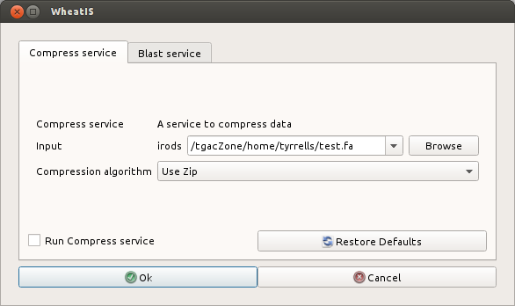
Clients
Built dynamically from server's JSON messages.
Interface of user's choice
Graphical User Interface
Shell
Browser
The Genome Analysis Centre
The Genome Analysis Centre

Slide 30
Demo 1
Client
Server
JSON Messages
See what services are available for a resource
Get list of services applicable for the resource
Choose which services to run and set their parameters
Run chosen services on the resource with the user’s parameters
Show running processes and/or results
The Genome Analysis Centre
The Genome Analysis Centre

Slide 31
WheatIS Structure
The Genome Analysis Centre

Slide 32
WheatIS Structure
The Genome Analysis Centre

Slide 33
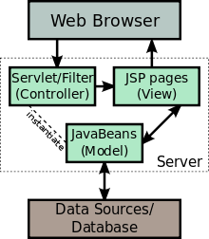




Java Server and Webapp
JaveSever Pages (JSP) & Tomcat webserver
JSPs are translated into servlets at runtime
Dynamic content
Server-side compilation
Plus JavaScript/Ajax Client-side compilation
The Genome Analysis Centre
Notes:
a software architectural pattern for implementing user interfaces

Slide 34
WheatIS Structure
The Genome Analysis Centre

Slide 35

Solr Indexing
Java based
Powerful full-text search,
Hit highlighting,
Faceted search,
Near real-time indexing,
Dynamic clustering,
Database integration,
Rich document (e.g., Word, PDF) handling
Location aware
The Genome Analysis Centre
Notes:
indexing collects, parses, and stores data to facilitate fast and accurate information retrieval.
Faceted search allowing users to explore a collection of information by applying multiple filters
Real-time programs must guarantee response within strict time constraints,
A dynamic cluster is a server cluster that uses weights and workload management to balance the workloads of its cluster members dynamically,

Slide 36
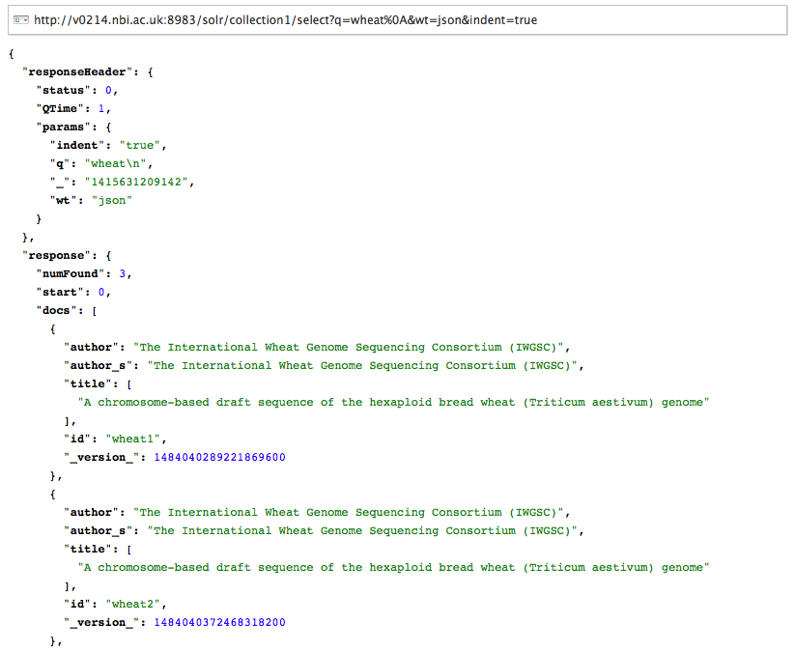
Solr Indexing
The Genome Analysis Centre

Slide 37
WheatIS Structure
The Genome Analysis Centre

Slide 38
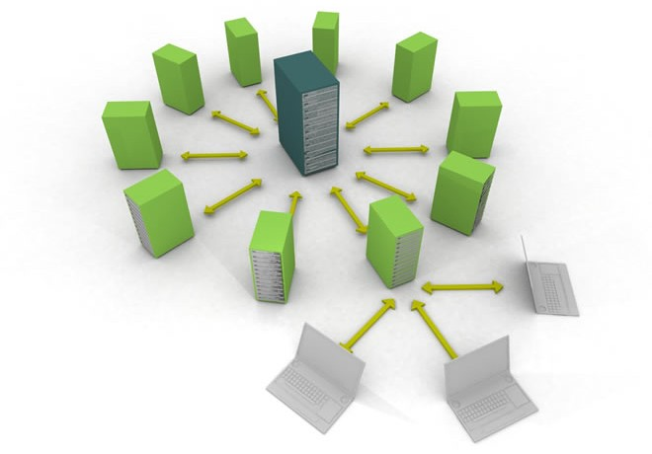


Interoperability
Distributed computing support
OAuth 2 support
WheatIS_JS library
Representational state transfer (REST) API
Image Credit: Webhostinggeeks
The Genome Analysis Centre

Slide 39
WheatIS Structure
The Genome Analysis Centre

Slide 40



CerealsDB
Wheat Genome Database
Information about SNP markers
Blast searches available
JSON API to connect WheatIS
The Genome Analysis Centre

Slide 41
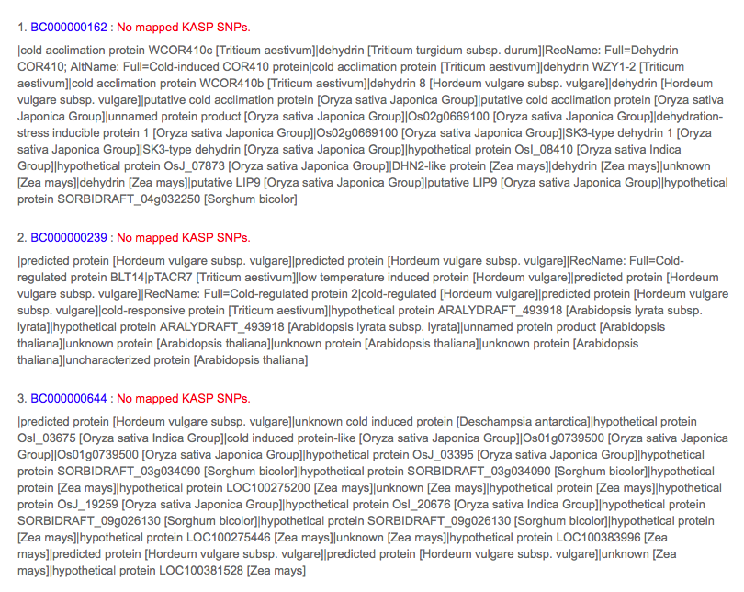
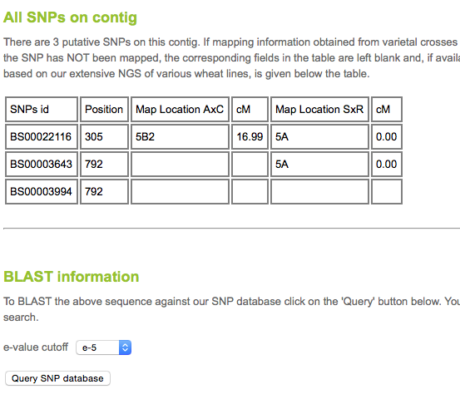
CerealsDB
The Genome Analysis Centre

Slide 42
WheatIS Demo
Demo 2
The Genome Analysis Centre

Slide 43
Acknowledgements
Robert Davey
Mario Caccamo
Jon Wright
Paul Bailey
Paul Wilkinson
Mark Winfield
The Genome Analysis Centre

Slide 44
Building Excellence in Genomics and Computational Bioscience
Thank you.

