Slide 1




Grassroots Architecture
Servers
Services
Operations

Slide 2
Grassroots Components
Server
Httpd module
Clients
Desktop
Web
Mobile
Services library
Server library
Libraries
Utility
Network
DRMAA
iRods
MongoDB
Params
Services
Handler
Blast
iRods
Ensembl
Solr
Web
Elastic
Search
Handlers
f1000
Agris
Base
Http(s)
Dropbox
iRODS

Slide 3
Example
Client
Server
JSON Messages
See what services are available for a resource
Get list of services applicable for the resource
Choose which services to run and set their parameters
Run chosen services on the resource with the user’s parameters
Show running processes and/or results

Slide 4
Grassroots Components
Server
Httpd module
Clients
Desktop
Web
Mobile
Services library
Server library
Libraries
Utility
Network
DRMAA
iRods
MongoDB
Params
Services
Handler
Blast
iRods
Ensembl
Solr
Web
Elastic
Search
Handlers
f1000
Agris
Base
Http(s)
Dropbox
iRODS

Slide 5
Server
A system that can receive & respond via Grassroots JSON schema and API
Independent of:
Server infrastructure
Programming language

Slide 6
Grassroots Components
Server
Httpd module
Clients
Desktop
Web
Mobile
Services library
Server library
Libraries
Utility
Network
DRMAA
iRods
MongoDB
Params
Services
Handler
Blast
iRods
Ensembl
Solr
Web
Elastic
Search
Handlers
f1000
Agris
Base
Http(s)
Dropbox
iRODS

Slide 7
Service
A self-contained application exposing
  Description
  Parameters
  Functionality
Can be in any language
Each Service has the same JSON-based API

Slide 8
Sharing Resources
Irods data can be shared
Servers can be pooled
Services can be pooled

Slide 9
Grassroots Components
Server
Httpd module
Clients
Desktop
Web
Mobile
Services library
Server library
Libraries
Utility
Network
DRMAA
iRods
MongoDB
Params
Services
Handler
Blast
iRods
Ensembl
Solr
Web
Elastic
Search
Handlers
f1000
Agris
Base
Http(s)
Dropbox
iRODS

Slide 10
Handlers
Each Handler has the same API
  Read, write, seek, etc.
Data can be read from & written to multiple sources
  Local & remote mounted filesystems
  iRods
  Http(s)
  Dropbox

Slide 11
Grassroots Components
Server
Httpd module
Clients
Desktop
Web
Mobile
Services library
Server library
Libraries
Utility
Network
DRMAA
iRods
MongoDB
Params
Services
Handler
Blast
iRods
Ensembl
Solr
Web
Elastic
Search
Handlers
f1000
Agris
Base
Http(s)
Dropbox
iRODS

Slide 12
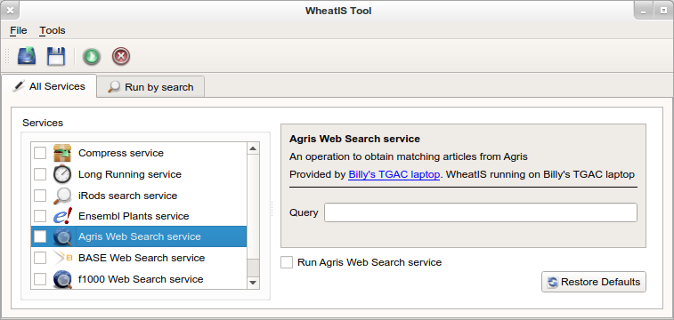
Clients
Built dynamically from server's JSON messages.
Interface of user's choice
Graphical User Interface
Shell
Browser

Slide 13
Grassroots Components
Server
Httpd module
Clients
Desktop
Web
Mobile
Services library
Server library
Libraries
Utility
Network
DRMAA
iRods
MongoDB
Params
Services
Handler
Blast
iRods
Ensembl
Solr
Web
Elastic
Search
Handlers
f1000
Agris
Base
Http(s)
Dropbox
iRODS

Slide 14
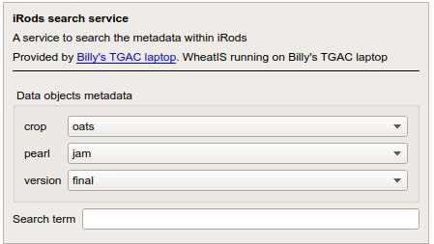
iRods API
File I/O
Searching enhancements
  Modified data objects / collections
  Global search across all metadata

Slide 15
Libraries
DRMAA
  HPC abstraction layer
MongoDB
  Document-based database

