Slide 1
ADS Asmt 2 – Final Model Theory Explainer
Group 8

Slide 2
Key principals of finance
1. time value of money and interest rate: whether $1.05 in future is worth more than $1 today is dependent on the interest rate* and time.
FutureValue = PresentValue/(1+r)^t
*r is sometimes interest rate but also could be rate of return
Actually this formula isn’t exactly precise – but we don’t care about it for our project because although we borrow finance theory, we are not making investment (i.e. literally initial input = 0. we get to pick 100 companies for free – almost like buying 100 stocks for $0)

Slide 3
Cont.
2. More return on less risk:
Just because get return, doesn’t mean its good. i.e., 50% chance get 100 million, 50% chance you lose everything and die; part of the reward in 100 million (if you get it) is in the RISK that you took on for this gamble.
This is THE foundation for our model: we don’t just want high return, we also want stable return. (i.e. less risk == less standard deviation for our return)
Link to reality: all companies want stable cashflow and hopefully stable growth because market dislikes risk. Having stable income and growth is good for this BNPL when it goes onto stock market (THIS IS A STORY WE CAN TELL IN PRESENTATION)
(When risk of stock is higher, people demand higher prices in stocks for compensation).
How do we balance the two: see slide 6

Slide 4
Some key finance terms
Return: the percentage difference between this period’s absolute value and last period’s absolute value
Period: the timeframe of ‘investment’. Each investment period is almost always the same (so that sd and mean can be comparable)
Portfolio: a group of ‘stocks’, in this case companies.
Why portfolios: because each stock’s return have standard deviations, and if we put i.e. two stocks with NEGATIVE COVARIANCE together, it can move to reduce the standard deviation of the entire portfolio – means less risk
Market: the portfolio of all stocks on market(although sometimes it will have to be ‘efficient’ so is not just buy 1/#stocks of each stock)
For our project we will have to loosen definitions and make assumptions

Slide 5
Differences to keep in mind for those who have studied some finance
1. in finance investment, you can choose how much of your wealth (w) to put in to each stock – any number between 0 and 1 – or even higher than 1 if using leverage.
Here: we can only choose w=1 and add up to 100. discrete, and also exceeds 1.
2. when talking about stock market, we measure in return and sd(return); but this proj we look at revenue and sd(revenue), because we didn’t make an initial investment (put money in), and also we want higher revenue in general, not higher growth.

Slide 6
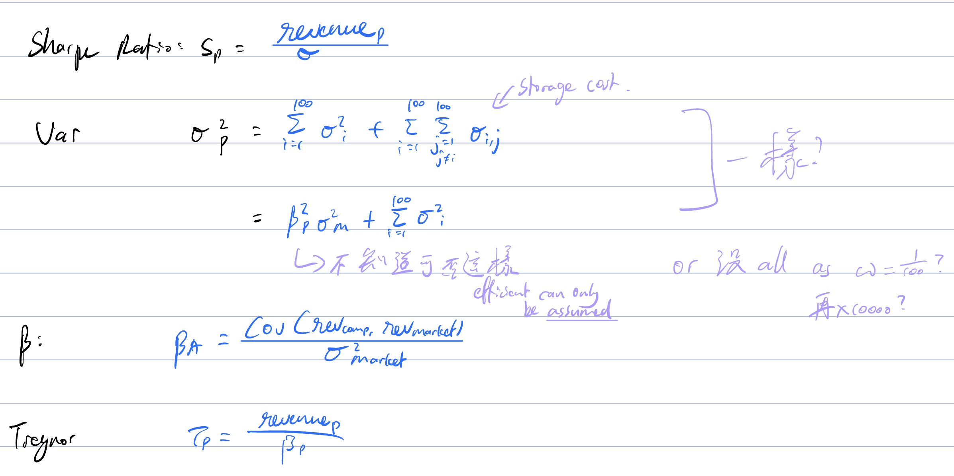
A few equations to get your head around

Slide 7
Model proposal
We want to build a scoring system (for each company) so that the top 100 scoring companies will return a PORTFOLIO with the highest metric
Metric:
1. Sharpe’s ratio* = Portfolio Historic Revenue/portfolio sd
2. Treynor’s ratio* = Portfolio Historic Revenue /Portfolio beta
Beta is covar(portfolio, market)/var(market)
* because we’ve adjusted the formulas from typical stock market
Here, Revenue = company transaction amount using BNPL * take rate

Slide 8
Scoring function
Most basic heuristic function:
h(company_i) = a1 * variable1_i + a2 * variable2_i …
Currently we will h() as a linear function, but later we could put some restrictions/transformations on the variables (i.e. make the function more complex)
How do we find this function?
We will be trying different combinations of {aj}
But it is an unsupervised problem….

Slide 9
Whole process (THIS ENTIRE PROCESS ITSELF IS OUR UNSUPERVISED LEARNING MODEL)
1. Train test split chronologically (but not for the purpose that we typically have for supervised learning)
Splits: 5-5, 6-4, 7-3, 8-2, 9-1…
2. For each combination of {aj} (WHICH WE WILL NEED TO HEURISTICALLY SET BOUNDS FOR):
2.1 calculate h(comp_i) for all companies
2.2 find the top 100 companies based on this score and turn them into a portfolio
2.3 get this portfolio’s VALIDATION SET historical revenue and sd to get their metrics (e.g. Treynor ratio or Sharpe’s ratio)
This is like our hyperparameters for the model
This is like our accuracy for the combination of alpha

Slide 10
Cont.
3. Using the validation metrics (to be determined), we find the best set of hyperparameters {aj}
4. Using this set of hyperparameters, we will implement it on all companies – but now on our entire joint dataset (both train and val) and make this our final portfolio of 100 companies to present to Akira
5. we will calculate its revenue, standard deviation and also ratios for presentation
REMINDER: THIS WHOLE 5 STEPS IS THE MODEL – SORT OF CONFUSING BECAUSE WE’VE DONE TRAIN TEST SPLIT – BUT TTS IS PART OF THE MODEL!!

Slide 11
FAQ
1. Is this overfit?
Answer: yea, but:
A. we are doing unsupervised learning
B. don’t have much data (i.e. if we had 3 years, then we could have used 2 years to build model and get final portfolio based on company performance in the final year). And also, we are going to be using sd as one of our factors in h(), and we want more df with the sd…
C. We are also supposed to be making recommendation over whole dataset – it hurts our model more to only take companies last month or last 2 month transactions and make recommendations than this overfit
(open to rebuttal and debate!)

Slide 12
cont
2. why do we need to train val split?
Answer: we use training data to GET THE TOP 100 COMPANIES FOR THIS {aj}, and evaluate this portfolio of 100 company's performance on the validation data
3. can we do 8-2 split and then do 5 fold cross validation?
Answer: we are doing chronological split because some of our ‘predictive variables’ are predicting the future.
Also, I am sceptical whether it solves our problem of overfit as presented on last slide

Slide 13
How to design the data
Data to be fed into model:
Instance: one instance per company
Label: none – unsupervised learning
Features

Slide 14
Features
1. Mean of historic revenue
Possible choices: weight it based on time? More weight on current?
2. SD of historical revenue
Possible choices: Normalise by mean? Because we are not measuring return, so scale of sd’s are different. BUT: we can make this choice later
3. Beta = cov(company revenue, market revenue)/variance(market revenue)
Possible choices: use 2/3 beta + 1/3 – industry choice to normalise beta
4+. Growth variables
We want to restrict the number of features in h() because tuning would be costly

Slide 15
What is the “market” here?
1. Pretend we can accept all 4000 companies and leave it at that
Since we are just calculating correlation (comovement), it doesn’t rlly matter that market sum(w) = 4000 while portfolio sum(w) = 1
May need to adjust formula, but not a huge issue
As part of outlier analysis, we can get rid of dominated companies (i.e. very high SD but very low return)
Difficult, computationally expensive – recommend just don’t bother – only if really have time

Slide 16
cont
For comparison purposes, can try do do
1. random sample of 100 companies (random baseline)
2. top revenue 100 companies
3. lowest variance 100 companies

Slide 17
Growth variables
Yet to be completely decided. But these will be likely predicted using our persona data and past values using a supervised model
At this stage, thinking max 2 variables: one E(return growth) based, the other is just a generic “other factors” (second likely unsupervised again).
i.e. build a model to predict the E(return) based on personas and historical return (ARIMA/AUTOARIMA model).

Slide 18
Another idea for E(r) based
Look at future value: build model to predict both E(revenue) and E(return), and thus
E(revenue)/E(return) will be all future earnings.
Could use a Bayesian like style to weight the past and future. And how we weight it could be like using R^2 or sd(past return) of the prediction function for E(revenue)/E(return) - as a measure of confidence).
Or, just use R^2 or sd(past return) to weight down our expectations for E(r)

Slide 19
Generic growth variable
could account for growth potential or growth risk, or anything else unaccounted for by E(return)
Most likely unsupervised – create by distribution and scaling and internal relationship mining?
(note to self: only chance of supervised: something like alpha in CAPM?)

Slide 20
What time period granularity?
Weeks? Fortnights? Months?
Ron recommendation is fortnight

Slide 21
Plan here-on-in (different blocks)
0. get aggregated transaction data into the granularity we want (cleaned data 1), so that we can get the first 3 variables
Ron recommendation: don’t remove outliers – their pattern and negativity will be well captured by expectation and standard deviation
This agg will also allow us to get E(r) variables – for the growth variables
Recommendation: each instance is a company’s performance within a time period. Features include: revenue (then join with take rate and take product of two), number of distinct customers (can be created into mean customer spending; mean customer orders), number of transactions (can be created into mean transaction size).
Then take the percentage change between each time period.
Also, Yujie’s idea of loyalty: separate dataset
1. clustering group: get data into format YOU like – and complete
A) 3-5 different categories
B) imputation for some stores – to get take rates and stuff like that

Slide 22
cont
2. Fraud group (to be decided)
Ron recommendation: should we just rid fraud transactions, or get rid of company overall?
3. Growth variables (supervised learning and potentially unsupervised)
Input features: transaction data (Ron recommend look at trend of i.e. number of distinct customers, number of transactions, growth rate etc), loyalty rate, persona.
Other geolocation related things that Anderson suggested?
Ron recommend building supervised learning model where label is E(growth) or E(revenue), input features is as above, instances are COMPANY-PERIOD
What growth vars to use are to be defined by the Growth Variable group – only requirement: don’t make too many thx.

Slide 23
cont
4. Final model (following fraud – don’t need to do too early)
Build the market portfolio (following fraud)
once task 0 and 3 complete, we build dataset 2 to have instances representing entire company.
Then, we can start building the model and hopefully use YangZhou to train
5. prepare presentation of PPT
Story telling
Visualisation?? (need to think about it between)
Rehearse presentation

Slide 24
Key thing to understand regarding the data
WE WILL HAVE MULTIPLE DATASETS FOR DIFFERENT TASKS – SOME TASKS WILL HAVE TWO DATASETS ON THE SAME CONTENT BUT IN DIFFERENT GRANULARITY. IT IS ESSENTIAL TO UNDERSTAND WHAT BELONGS IN WHICH DATASET.
What are metrics that belong only to the instance representing the overall company?
i.e. MEAN growth rate, MEAN revenue, SD of revenue
What are metrics that belong to each the instance representing one period of the company (COMPANY-PERIOD)?
i.e. number of customers this period, transaction amount this period, growth rate since last period
What about the persona data?
Well, technically census data is constant, but because we are reweighting persona per period based on the tally of different customers from each postcode, they are COMPANY-PERIOD SPECIFIC.

Slide 25
As for train test split
Technically for stage 0 don’t bother about train test split – just calculating rates of change between periods; no big deal.
Probably when it comes to task 4, then do TTS before calculating things like SD
Task 3 do own TTS within the overall TTS for step 4?? (to prevent overfit)
Task 1 and 2: not very sure whether to validate unsupervised – up to those groups to workit out. Don’t need to consider overall TTS as we are working based on whole companies for task 1 and task 2 is sort of independent to task 5.

