Slide 1


A R E T A R E T A I L A N A L Y T I C S
From a blank page to a live analytics suite
How I built a fictional outdoor retailer, its data, a Power BI report and a web app, end to end
Tom Goss
Portfolio project · 2026
Notes:
Areta Mountain Systems is a fictional multi-brand outdoor retailer. Everything in the project, from the stores to the sales, is generated by my own Python pipeline, so I could build the full analytics stack without touching anyone's real data.

Slide 2

THE AIM
One retailer, three ways to see the same numbers
I wanted a portfolio piece that looks and works like a real retail analytics suite, built the way I'd build one at work: business questions first, then the data, the model and the reports.
01
The idea and the brief
05
The web app
02
Inventing the business
06
Trusting the numbers
03
Building the data
07
Challenges and learnings
04
The Power BI model and report
08
Outcomes and what's next
02
Notes:
The thread through the whole project is that Power BI, the web app and the SQL suite all read the same warehouse, so the numbers can't drift between them.

Slide 3





01 · THE IDEA
Why build it
01
02
03
04
Background
Objective
My role
Outcome
I work in retail merchandising and wanted to show the whole journey, not just a finished dashboard.
One synthetic retailer feeding a Power BI report, a web app and a SQL suite from the same data.
Everything: the brand, the data generator, the model, the report, the web app and the docs.
A live, documented project that answers real trading questions and shows how I work.
03

Slide 4

02 · INVENTING THE BUSINESS
Meet Areta Mountain Systems
A fictional outdoor retailer with its own brand, stores and range. Real retail structure, none of it real.
4
361
brands
stores and concessions
11
907
European markets
styles, 12,151 SKUs
3.9M
2023
invoice lines
history starts in March
The brand board I designed everything from
04
Notes:
The product photos were generated with ChatGPT from my own prompts, so they show invented Areta products rather than real branded goods.

Slide 5
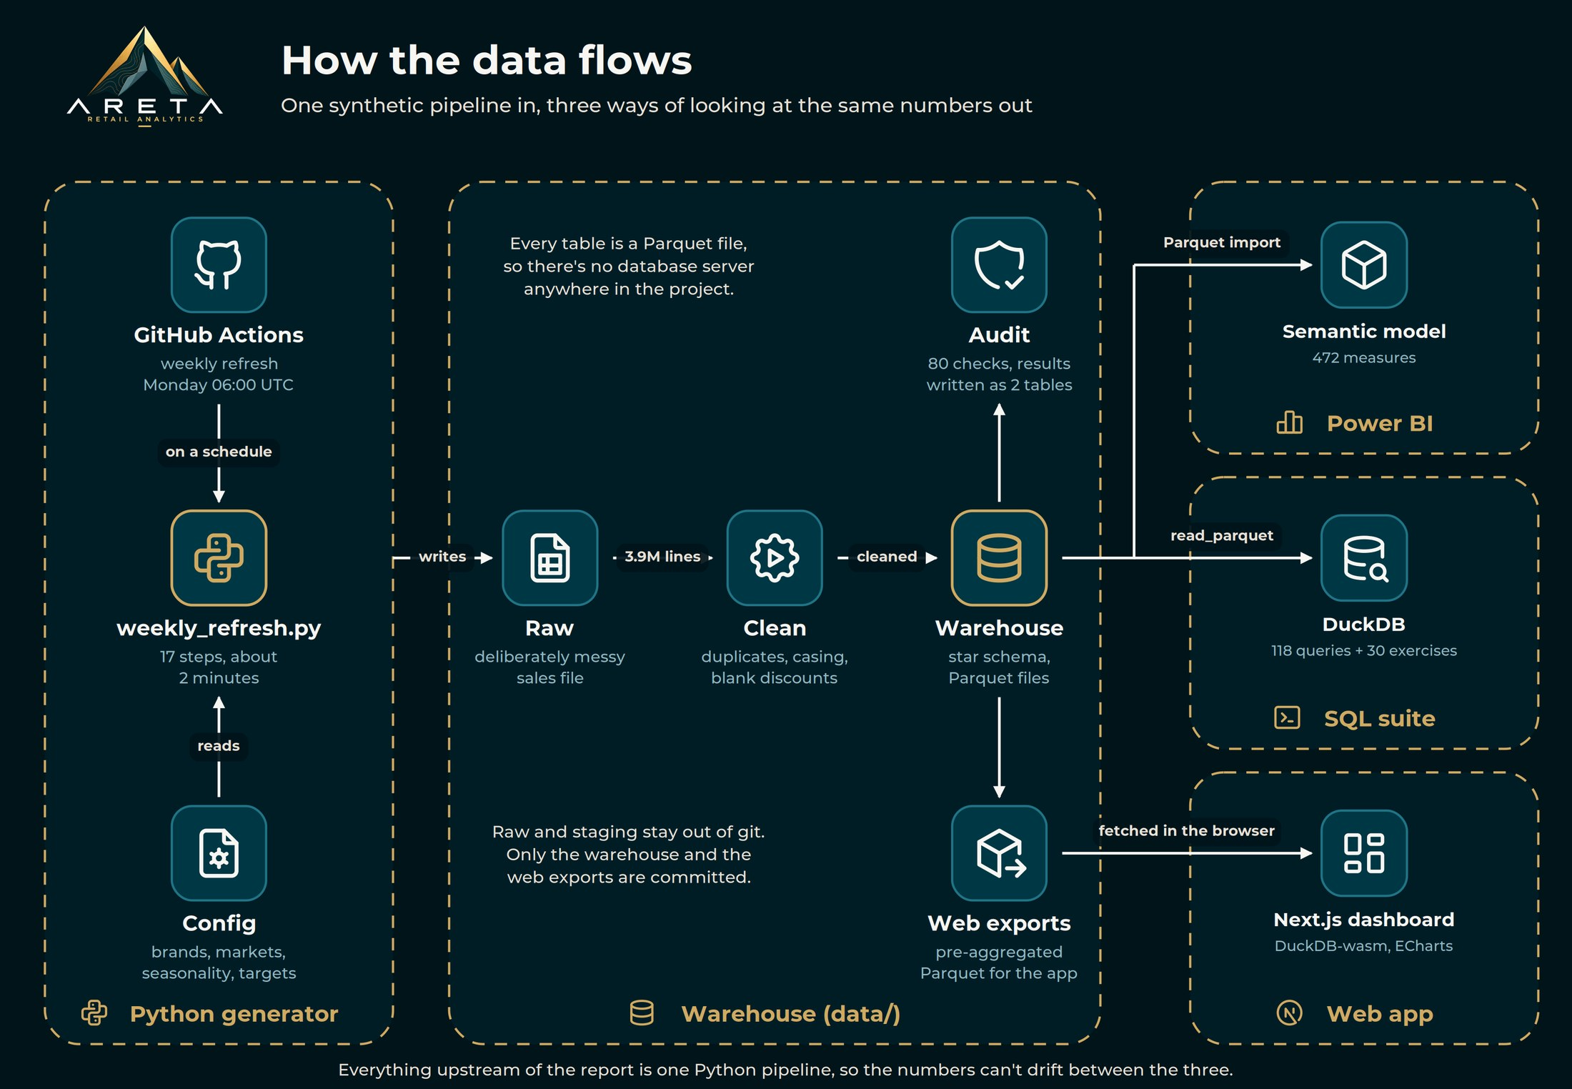



03 · BUILDING THE DATA
One pipeline in, three outputs out
Python generator
17 steps in about two minutes, with a GitHub Action set up to run it every Monday.
Parquet star schema
No database server anywhere. Every table is a file in the warehouse.
Three outputs
Power BI, a Next.js web app and a DuckDB SQL suite all read the same files.
05

Slide 6





03 · BUILDING THE DATA
Making fake data behave like a real business
Foundations
Simulation
Realism rounds
Quality
A 364-day business calendar, stores, a four-brand product range, promotions, currencies and VAT.
Sales at invoice-line level, with seasonality, discounts, multi-buys, returns and store traffic.
Hero styles and a long tail, Black Friday and Christmas, growth that differs by area, and a web funnel.
A deliberately messy raw file, a cleaning step, and an 80-check audit at the end of every run.
1.00×
1.5×
Querying my own data in SQL showed Black Friday trading exactly like any other Friday. The flag was in the calendar, but nothing used it. Testing the data like a real business is what made it realistic.
Black Friday vs a normal Friday
06

Slide 7



04 · THE POWER BI MODEL
A model built on patterns, not one-offs
472
Last year at any grain
Targets below period level
DAX measures
One LY pattern moves the business year back and carries the period, week and weekday across, so it works by year, week or day.
Targets are set per period. Spreading them across days by last year's weekday pattern makes weekly charts honest.
26
tables in a star schema
VAT and currency in one place
Stock as a balance
2
Calculation groups switch every money measure to include VAT or convert it, without a duplicate of each measure.
Stock takes the latest weekly snapshot instead of adding weeks together, and weeks of cover uses the recent rate of sale.
calculation groups
07
Notes:
The model lives in git as a Power BI Project, so every measure is text I can diff and review.

Slide 8
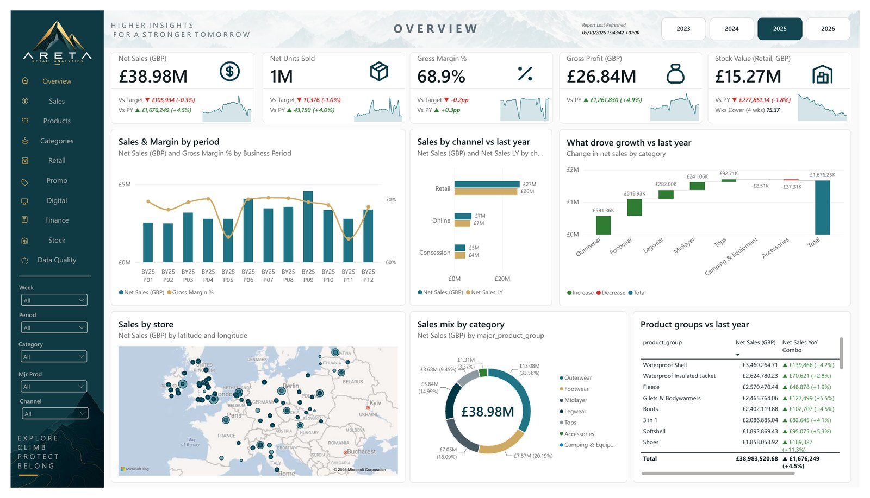
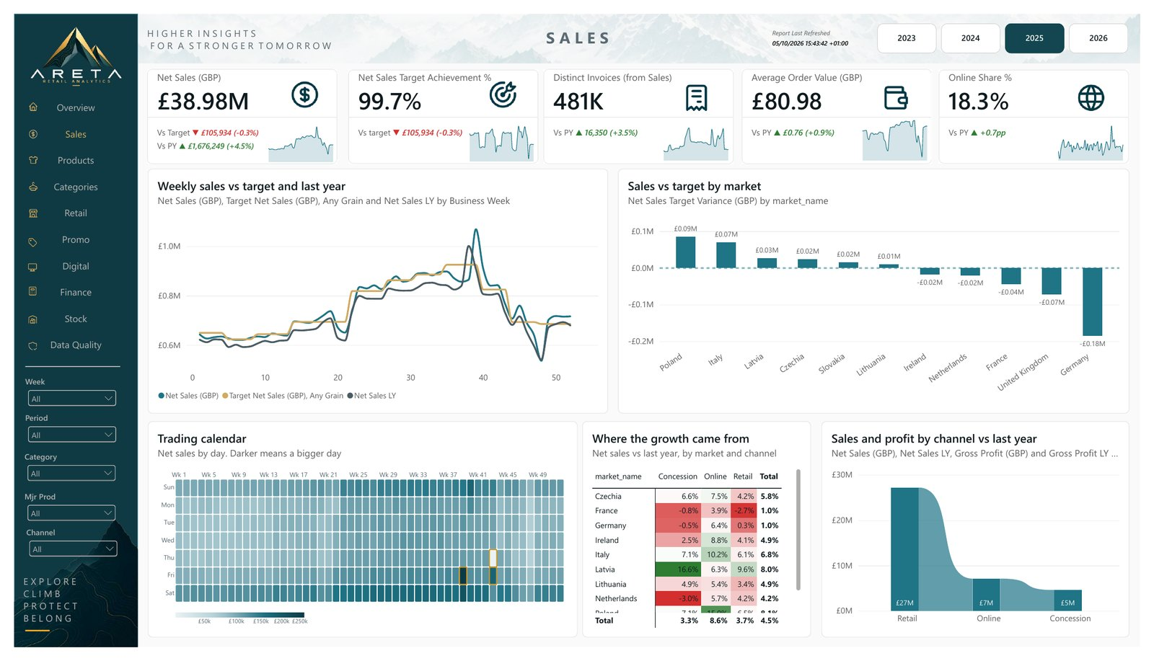
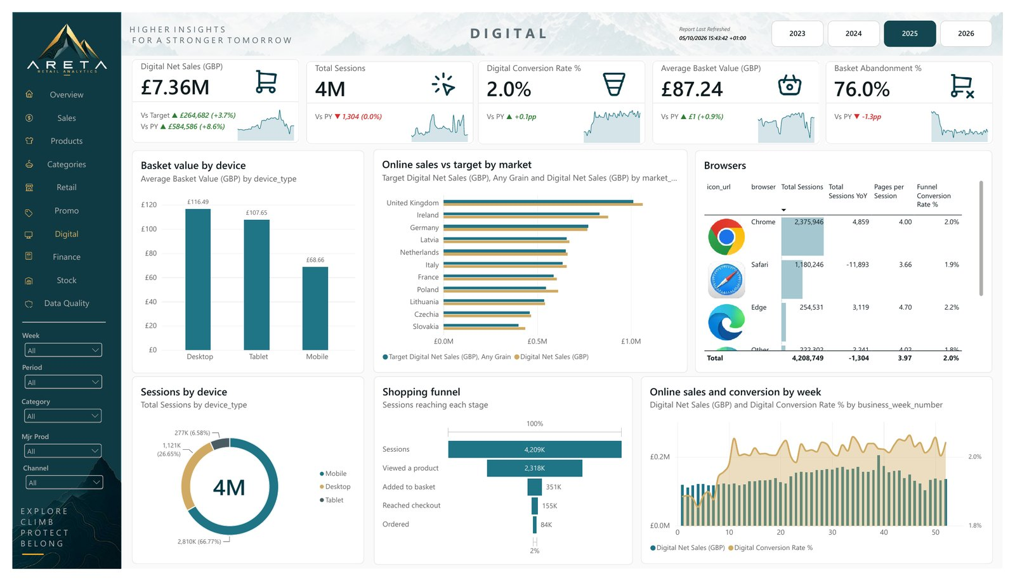
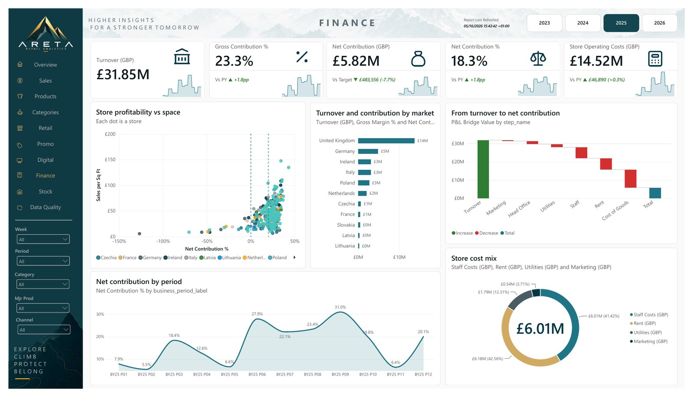
04 · THE POWER BI REPORT
Ten pages, each answering one question
Overview
Sales
How is the business doing, and what drove it?
How are we trading, and where is the growth?
Digital
Finance
Where do shoppers drop out online?
Where does the money go before profit?
Also: Products, Categories, Retail, Promo, Stock and Data Quality
08

Slide 9



04 · THE POWER BI REPORT
Inside one page: Sales
KPI cards that explain themselves
Each card shows the value against last year and target, coloured by direction, with a weekly sparkline.
A trading calendar
A Deneb heatmap of every day in the year. Black Friday and Boxing Day stand out at a glance.
Where the growth came from
Growth by market and channel. Online grows everywhere; French stores go backwards.
09

Slide 10
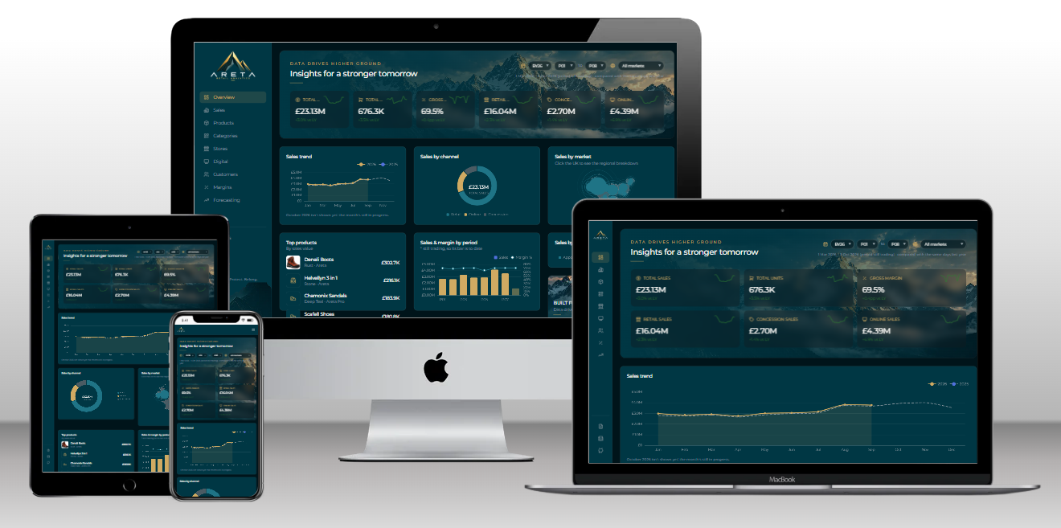




05 · THE WEB APP
The same numbers, in the browser
No server, no database
DuckDB runs inside the browser and reads the Parquet files directly.
Built for any screen
Phone drawer, tablet icon rail and a fit-to-screen desktop layout.
Filters in the URL
Every filtered view is a link you can bookmark or share.
Live on Vercel
Eleven pages, built with Next.js and ECharts.
areta-retail-analytics.vercel.app
10
Notes:
The web app was a deliberate counterweight to Power BI: no licences, nothing to install, and the same warehouse underneath.

Slide 11
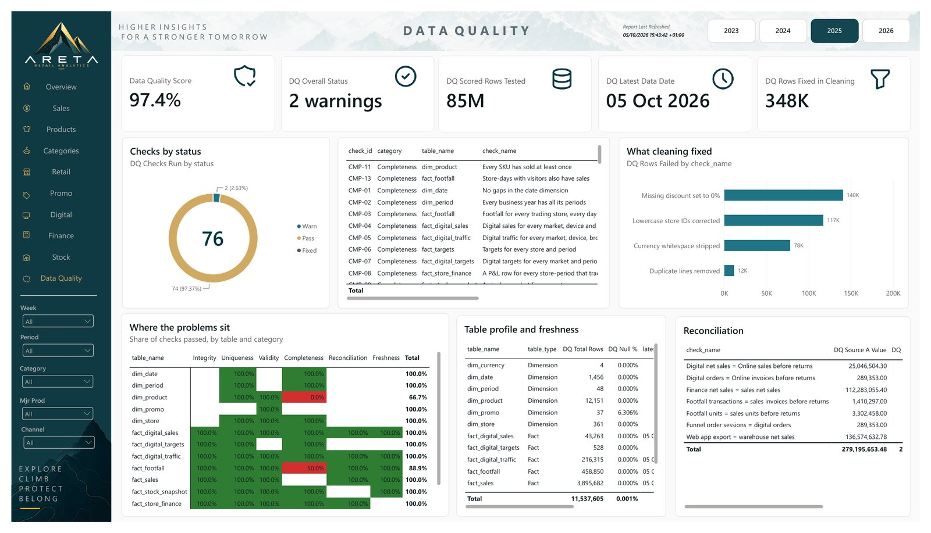
06 · TRUSTING THE NUMBERS
A report that checks its own data
97.4%
of scored checks pass: 74 of 76, with two known warnings I'd want flagged anyway
80
checks every run
7
reconciliations
348K
rows fixed by cleaning
11

Slide 12
07 · CHALLENGES AND LEARNINGS
What went wrong, and what I learnt
CHALLENGE
WHAT I DID
WHAT I LEARNT
Figures three to four times too high, but only with a slicer
Made the date-to-period relationship inactive and carried filters across with TREATAS
Don't fight the relationship graph. Be explicit in the measure instead
Every year came out the same, so every variance read zero
Added growth that differs by channel, category, market and store
Test data has to be able to move the measure you're testing
Stock added four weeks together into one huge number
Stock now takes the last snapshot in the filter
Know whether a measure is a flow or a balance before you sum it
The web app worked in the build but failed in a real browser
Fetched the file bytes and handed them to DuckDB directly
Nothing replaces running it where your users will
12
Notes:
The README has twenty of these, each with what broke, why, and how I fixed it.

Slide 13







08 · OUTCOMES AND WHAT'S NEXT
Where it's landed, and where it goes next
10
11
118
Weekly
Power BI pages
web app pages, live
SQL queries + 30 exercises
refresh, scheduled in GitHub Actions
NEXT
Microsoft Fabric
PL-300 and DP-600
Report polish
A proof of concept: Lakehouse, Direct Lake and a scheduled pipeline
Certifying what the project already shows
VAT and currency toggles on the pages, and the funnel on the web app
13

Slide 14

Thank you
Questions welcome
github.com/TGOSS1984/areta-retail-analytics
areta-retail-analytics.vercel.app

