Slide 1
Seam carving algoritam
- poređenje originalnog i ubrzanog

Slide 2


Seam carving
Accelerated seam carving

Slide 3


Seam carving
Accelerated seam carving

Slide 4
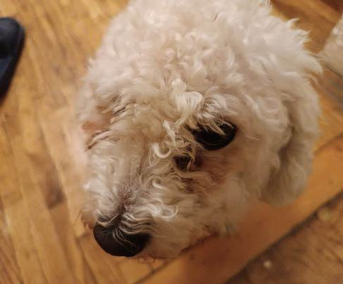
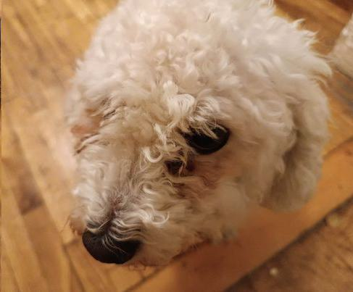
Seam carving
Accelerated seam carving

Slide 5


Seam carving
Accelerated seam carving

Slide 6


Seam carving
Accelerated seam carving

Slide 7
Seam carving
- poređenje originalnog i adaptibilnog ubrzanog

Slide 8

Seam carving
Adaptible accelerated seam carving

Slide 9

Seam carving
Adaptible accelerated seam carving

Slide 10
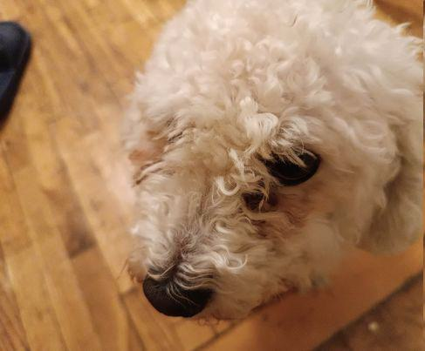
Seam carving
Adaptible accelerated seam carving

Slide 11

Seam carving
Adaptible accelerated seam carving

Slide 12

Seam carving
Adaptible accelerated seam carving

Slide 13
Seam carving
- poređenje dve strategije uvećavanja

Slide 14


Strategija 1
Strategija 2

Slide 15
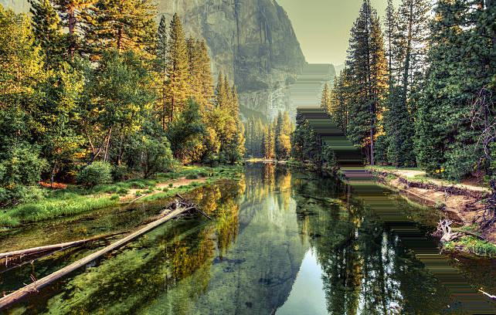

Strategija 1
Strategija 2

Slide 16
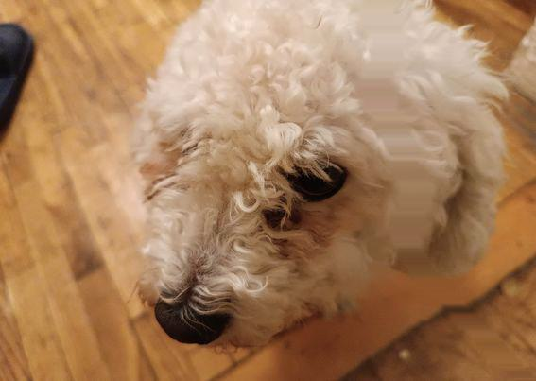

Strategija 1
Strategija 2

Slide 17


Strategija 1
Strategija 2

Slide 18


Strategija 1
Strategija 2

