Slide 1
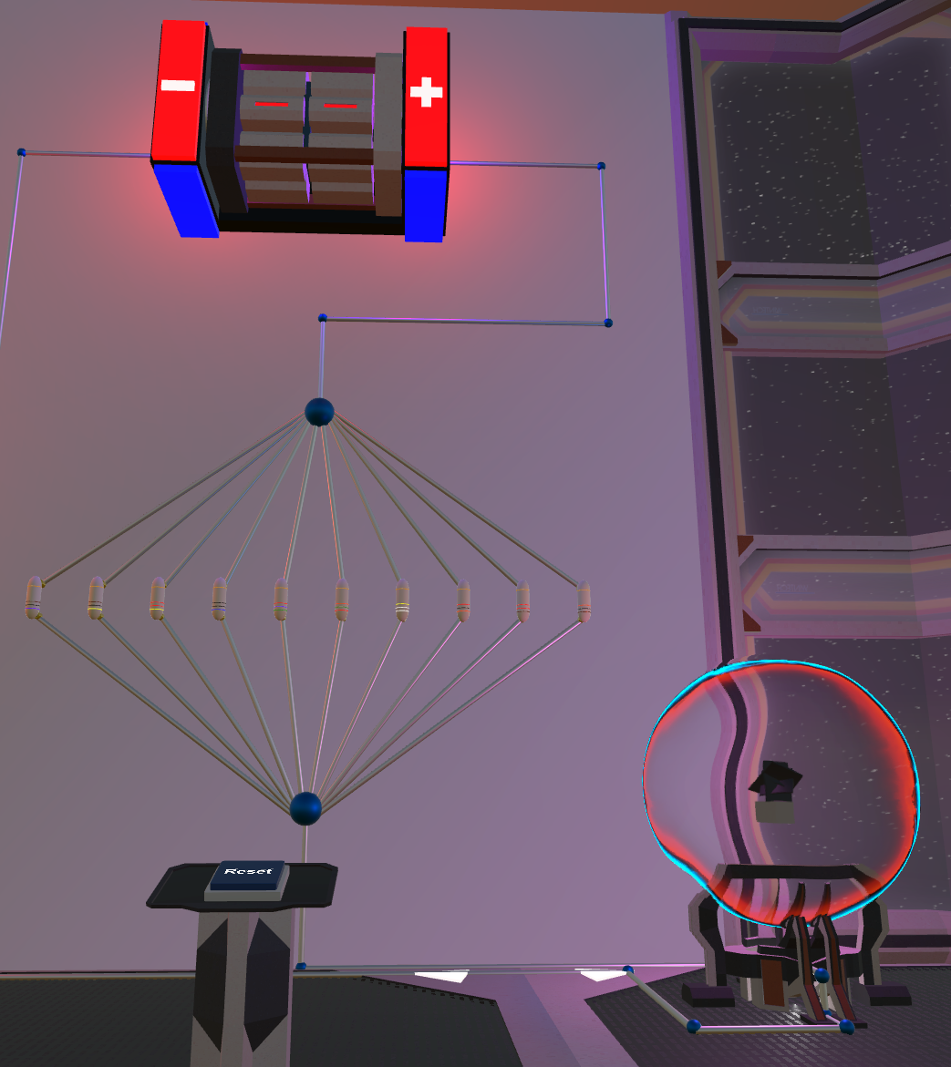
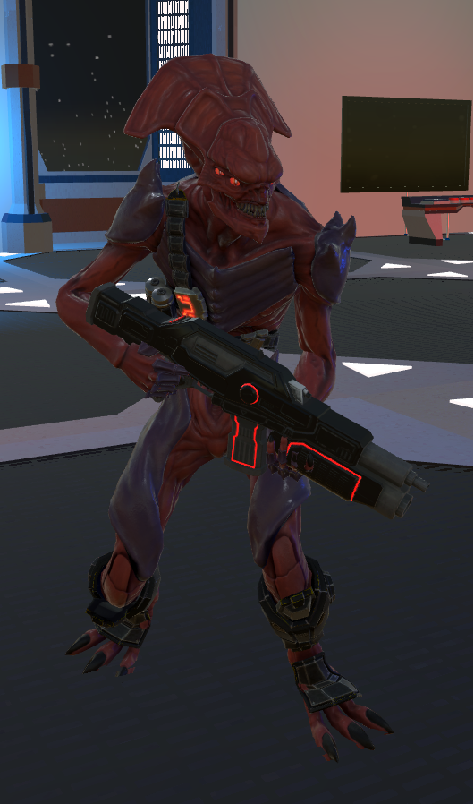

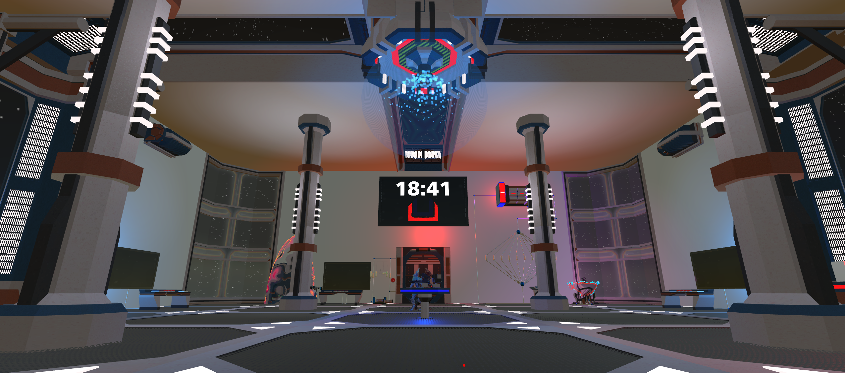
Use your circuit knowledge to solve puzzles to escape
Fend off enemies as they try to stop your mission
The Design of a Virtual Reality Game for STEM Education
By: Tyler Gantz
May 13th, 2019 at 1:15 PM
Can You Escape?

