Slide 1
V2.2.0
New Features and Process

Slide 2
Searching
Previous searches were not returning all matching items
New logic has been added to the search queries and will now return any matches from all available fields for all items
This function has been updated on the Inventory Home Page and on the Sales Cart page when searching for inventory

Slide 3
Settings page
Import Inventory Items from Excel sheet
Previously when completing an Import the locations were restricted to the stores
One location for Calgary and one location for Moose Jaw
Now when completing an upload additional locations have been added

Slide 4
New Feature - Purchase
The system can now track the purchase of Inventory
These purchases do not affect the Sales Margin for that day
There is no GST charged on any purchase
Cheques can be used to make a purchase and the cheque numbers can be logged

Slide 5
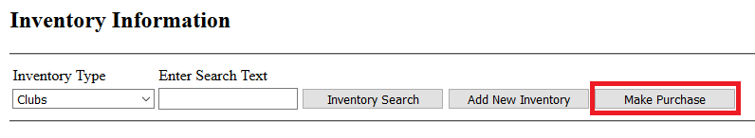
Purchase
A purchase can be initiated by going to the Inventory Home Page
From here there is a new button “Make Purchase”

Slide 6
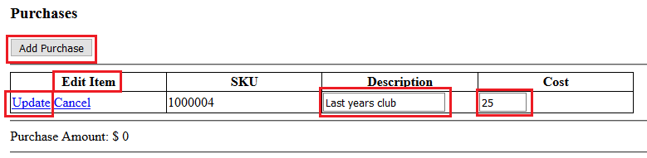
Purchase –Cont.
Currently all purchases will be made under Guest Customer
Click on Add Purchase
Edit the item
Enter description and the cost amount to pay
Click Update

Slide 7
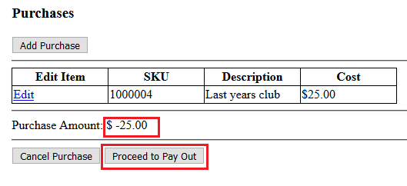
Purchase – Cont.
When the item is updated the purchase amount will display
Now proceed to pay out screen

Slide 8
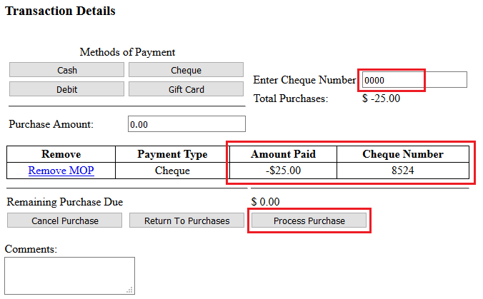
Purchase – Cont.
If paying by Cheque enter a cheque number
Select the Payment type
A list of payments will display showing the payout amounts and cheque numbers
Process Purchase to provide the customer with a receipt

Slide 9
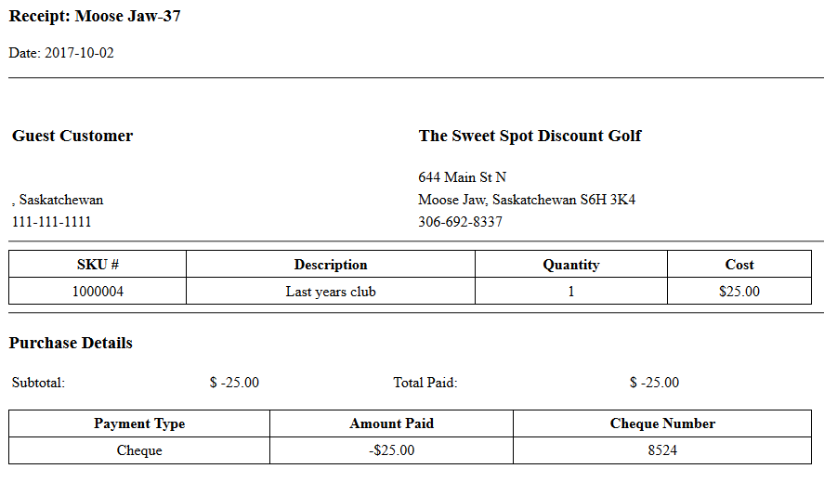
Purchase - Cont.
A full receipt will be displayed and can be printed for the customer

Slide 10
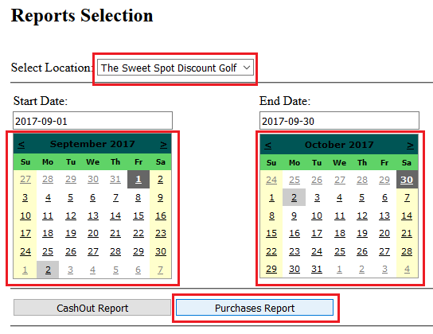
New Process = New Report
With the new process to make purchase comes a new report
From the Reports Home page select the location, date or encompassing dates and click the Purchases Report button

Slide 11
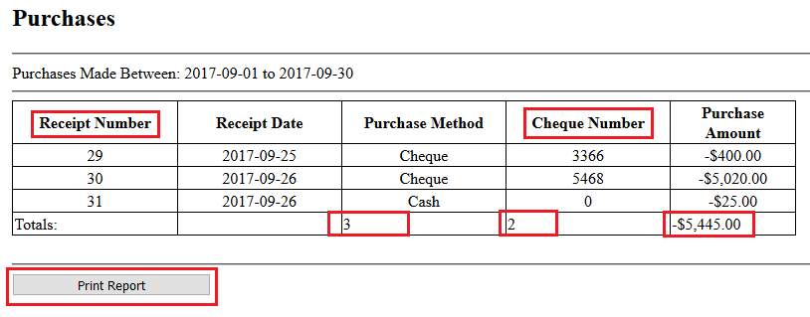
Purchases Report
This report will display:
The Receipt numbers
The Cheque numbers
The total number of purchase
The total number of cheques issued
And the total amount purchased during the selected time period
The report can also be printed

Slide 12
Other Enhancements
You may also notice:
Most of the amounts have now been formatted to display in a currency format
Most of the views are now getting centered making readability easier
Some views are now showing column totals
Cashout Report will now need to be processed before it can be printed

