Slide 1
V2.1.0
What’s new and how to do it

Slide 2

Home page
The location dropdown now allows the user to view both locations sales for the day.

Slide 3
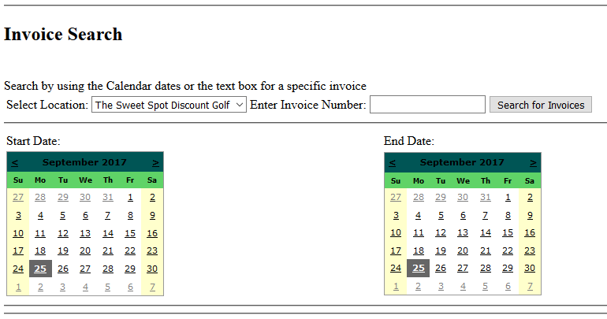
Sales page
New button for process returns.
Invoice search and viewing function moved to the sales page.
Previous location: Reports page

Slide 4
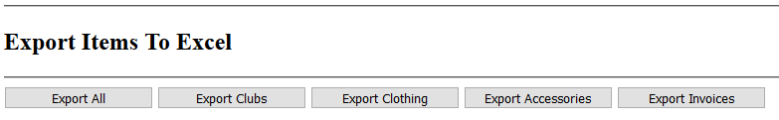
Settings page
The user can now change taxes.
Export invoices button moved here.
Previous location: Reports page

Slide 5

Employee Management
Employees can now have passwords added to their account via the edit employee or add employee screens.
If an employee forgets their password, a new one can also be assigned using the edit employee method.

Slide 6
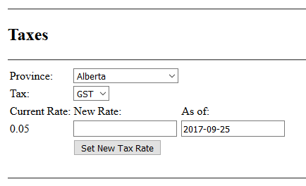
Editing Taxes
Select the province or territory that the tax is changing in.
Select the tax that is changing.
Enter in the new rate.
Modify the as of date as needed.
Click the button to set the new tax rate.

Slide 7
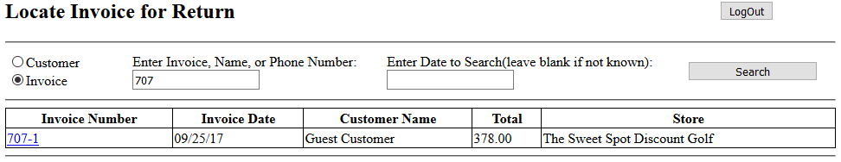
Processing Returns
Choose either to search by customer name or invoice number.
Once the required information is entered, click the search button.

Slide 8
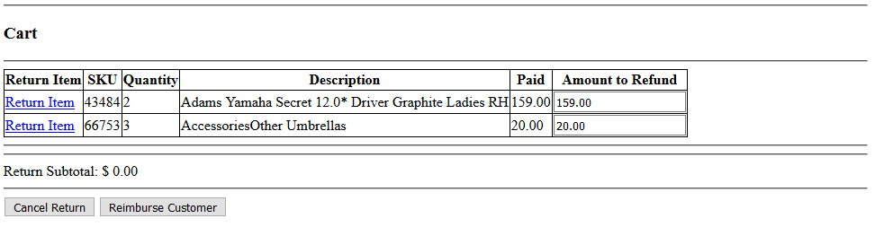
Processing Returns Cont.
After locating the invoice that you want to want to return, click on the invoice number to be taken to a screen that looks like the following:

Slide 9
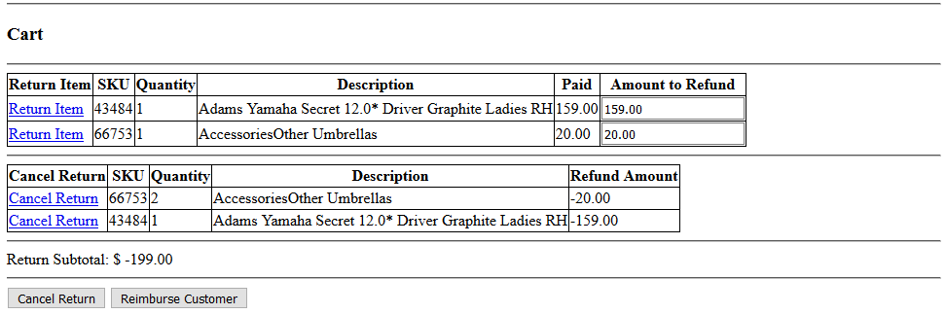
Processing Returns Cont.
Here you can view all items that are on the invoice. It works similar to the cart where the top list is filled with items, and you “add” them to the return cart.
The default return amount is set to 100%, but a custom amount can be entered before adding it to the return cart.
Once the items that are to be returned are in the return cart, continue by clicking reimburse customer.

Slide 10
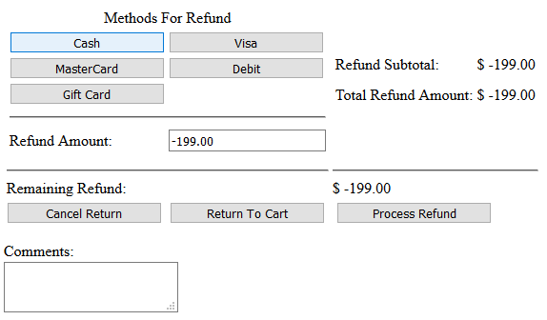
Processing Returns Cont.
Similar to the checkout screen, the user can now select which method(s) they want to use to refund the customer.
After the remaining refund amount is 0, click process refund to generate an invoice for the returned items.

