Slide 1

Family Fuel
Fueling Responsible Money Management
Through Crypto, Blockchain, and Gaming.
Trevor Greenizan

Slide 2
The problem
Current Context
Problem Statement
Solution
Crypto and Blockchain have changed the nature of Commerce.
What is something approachable for both parents and kids.
Even with 500 Versions. Monopoly does not go far enough
How can i teach my Children about this consistently changing World…& Make it Fun?
Avoid the Monopoly pitfall of 3-4 hours of fun followed by an argument/fight.
Something that can be looked back on or transferred.
Crypto currency that can be used as an “allowance”
Token can be used towards Family decisions or converted to be used for Family Game night

Slide 3
Challenges deep-dive
Challenge 1
Challenge 2
Challenge 3
Token Foundation
Build Token to be used as an allowance.
Current focus is ERC20.
*want to look at ERC1155 for future project
Ease of Use
Must appeal to my Wife, and usable by her.
*can't assume Parents are knowledgeable.
Fun Fun Fun
This will need to be fun. Science shows you learn way better when you're having fun.
Easy for parents Fun for kids.

Slide 4
Solution
Our Goal:
Build a smart contract and develop a web based front end interface system.
Execution:
earnable ERC20 tokens (EKTO) to be used as allowance for Children
Economy:
EKTO tokens can be used as additional votes in Family decisions.
EKTO can also be exchanged for additional currency or items on Family Game night. 1 EKTO = 10 “GOLD” *at GM discretion
*ERC1155 potentially to be used for DnD type campaigns (possibility they can take characters to other games and still use there EKTO tokens.)

Slide 5
Implementation

Slide 6
L - 1
L - 2
L - 3
Remix & Solidity
  ERC20 contract, EKTO token.
  SafeMath added for security
  Decimals=0
  Deployment completed on Rinkeby
Contract: 0x166c19759ea8289abcbe07c83ea7f47eeef05ed6
Python
  Os
  JSON
  Web3
  Pathlib
  Dotenv
  Pandas
  Streamlit
Streamlit
  Mint
  Burn/convert
  Export .csv for reference until signature issue is fixed.

Slide 7
Build an ERC20 Token that can be used for Allowance
Beta Testing with my own Family
Continue to work with OpenAPI, Unity & Foundry VTT API
0.1.0
0.1.2
0.1.5
1.1.1
1.1.5
Create Website interface for Token supply and usage.
Have accounts for each member
Build ERC1155 Token for additional options.

Slide 8
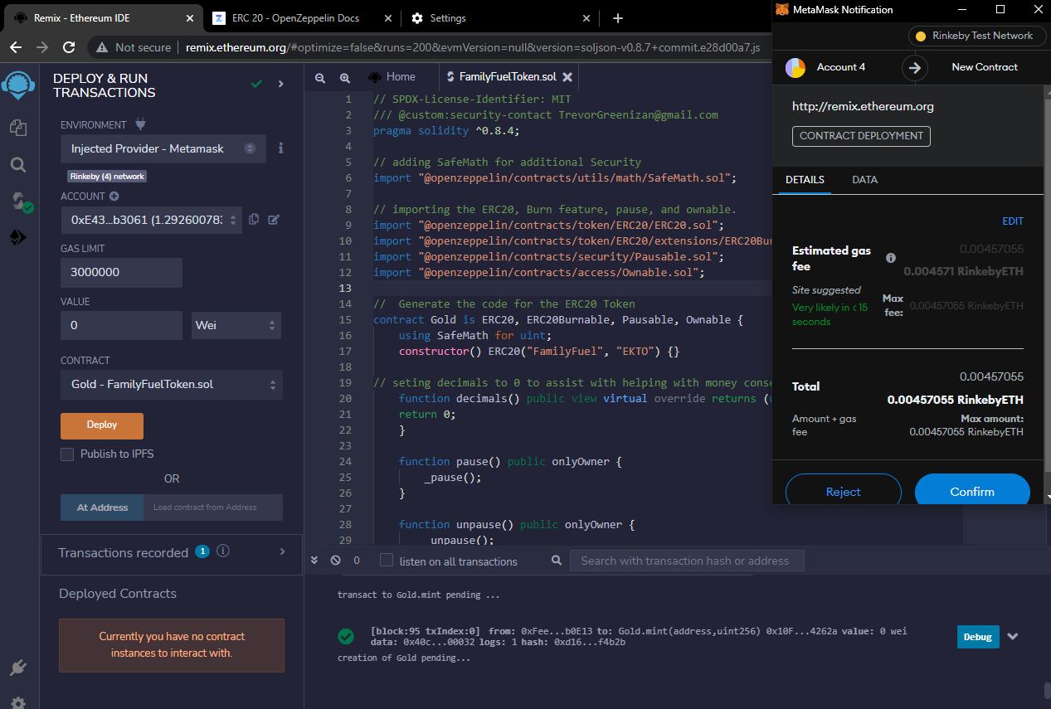

Slide 9
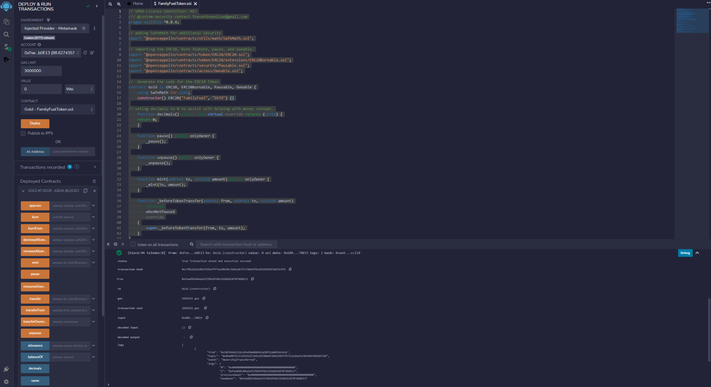

Slide 10
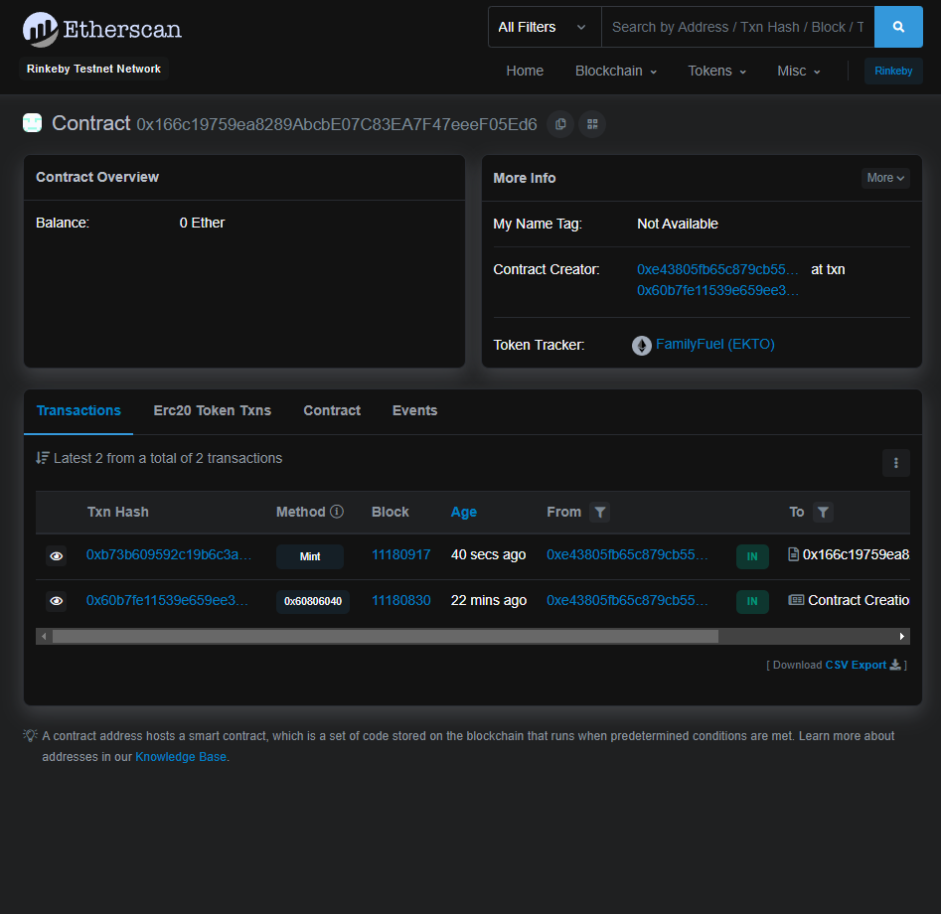
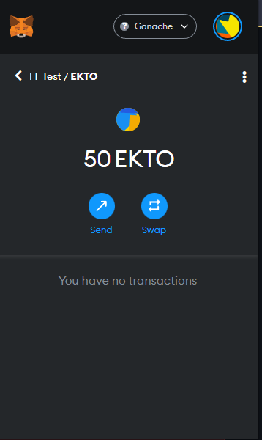
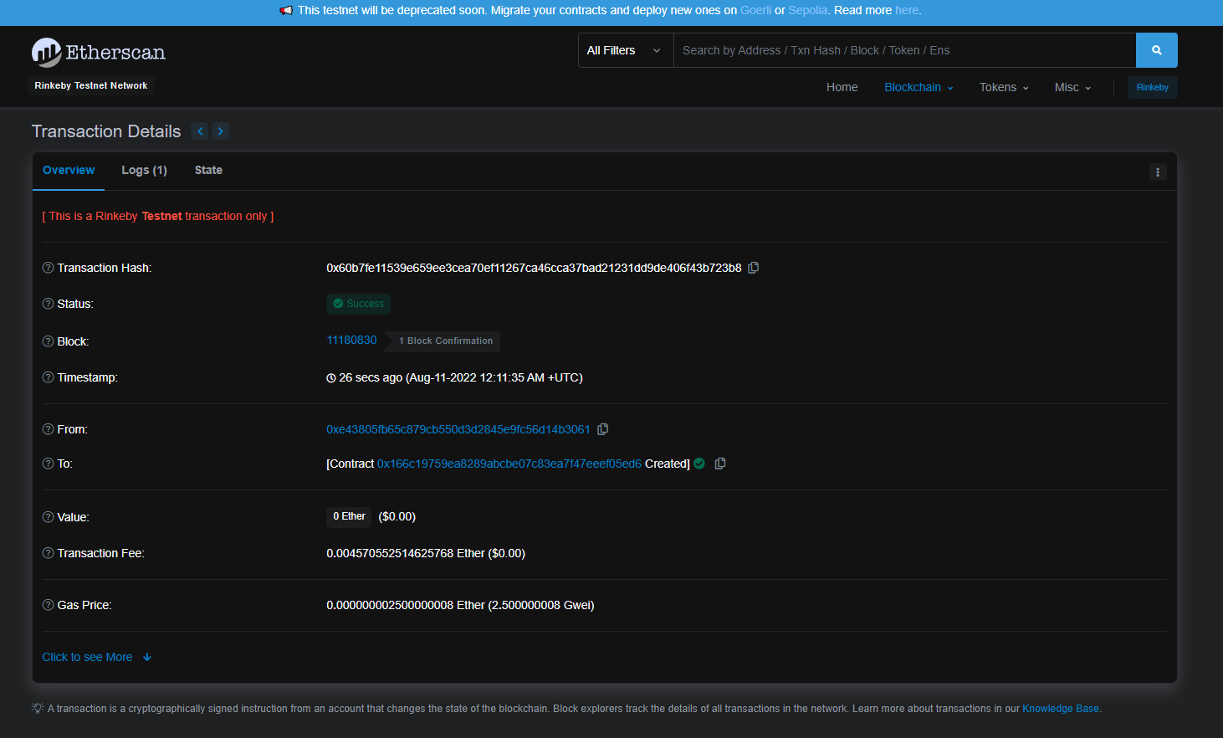

Slide 11
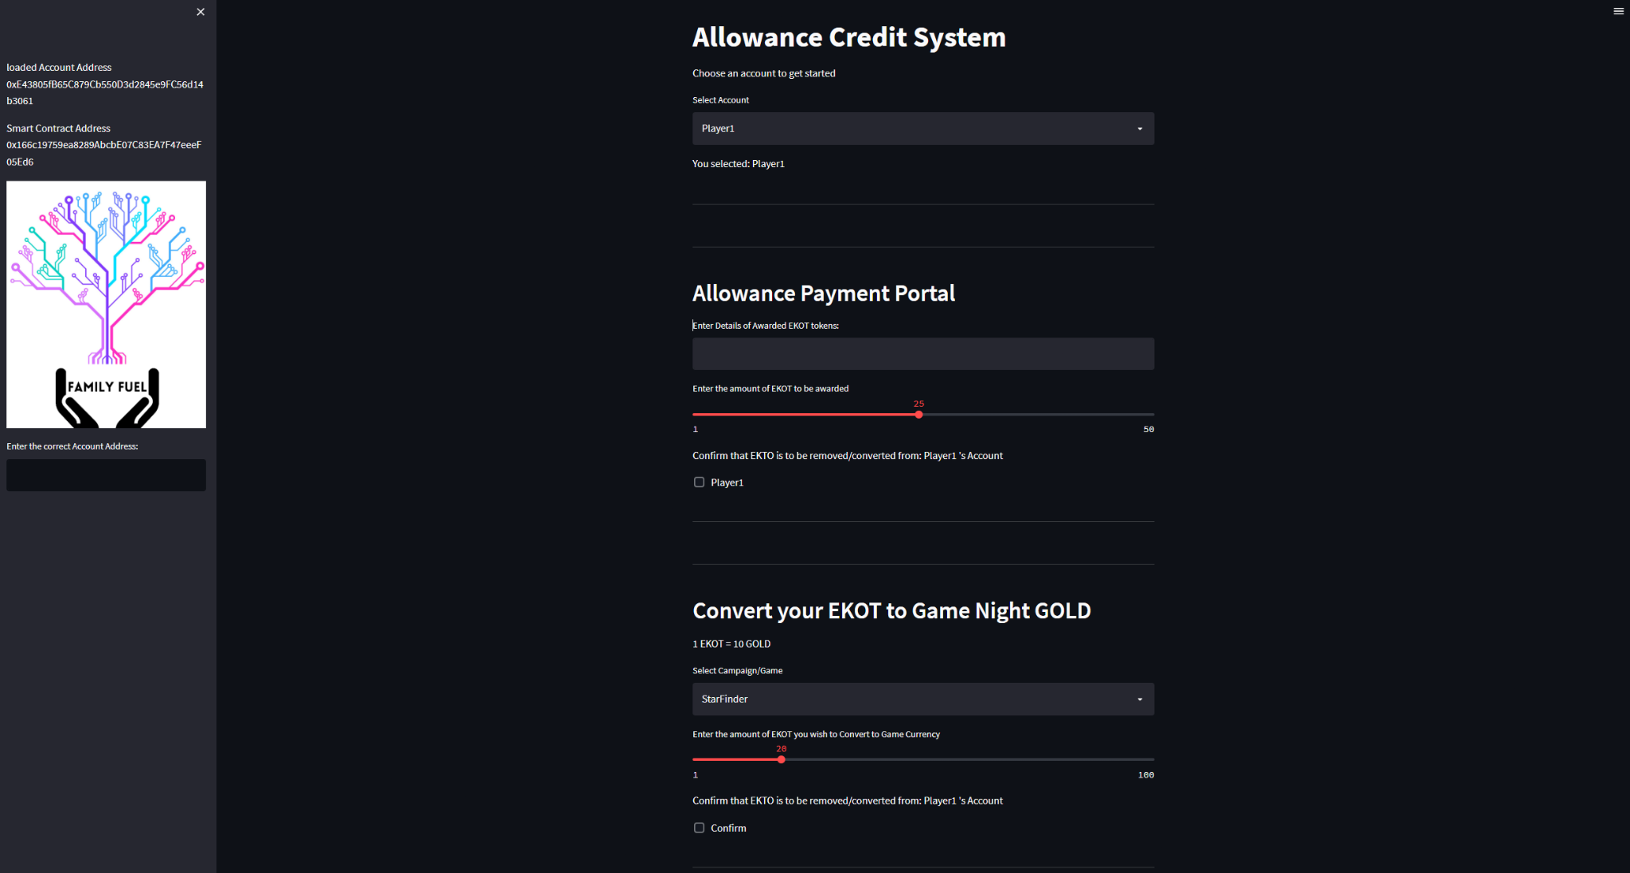

Slide 12
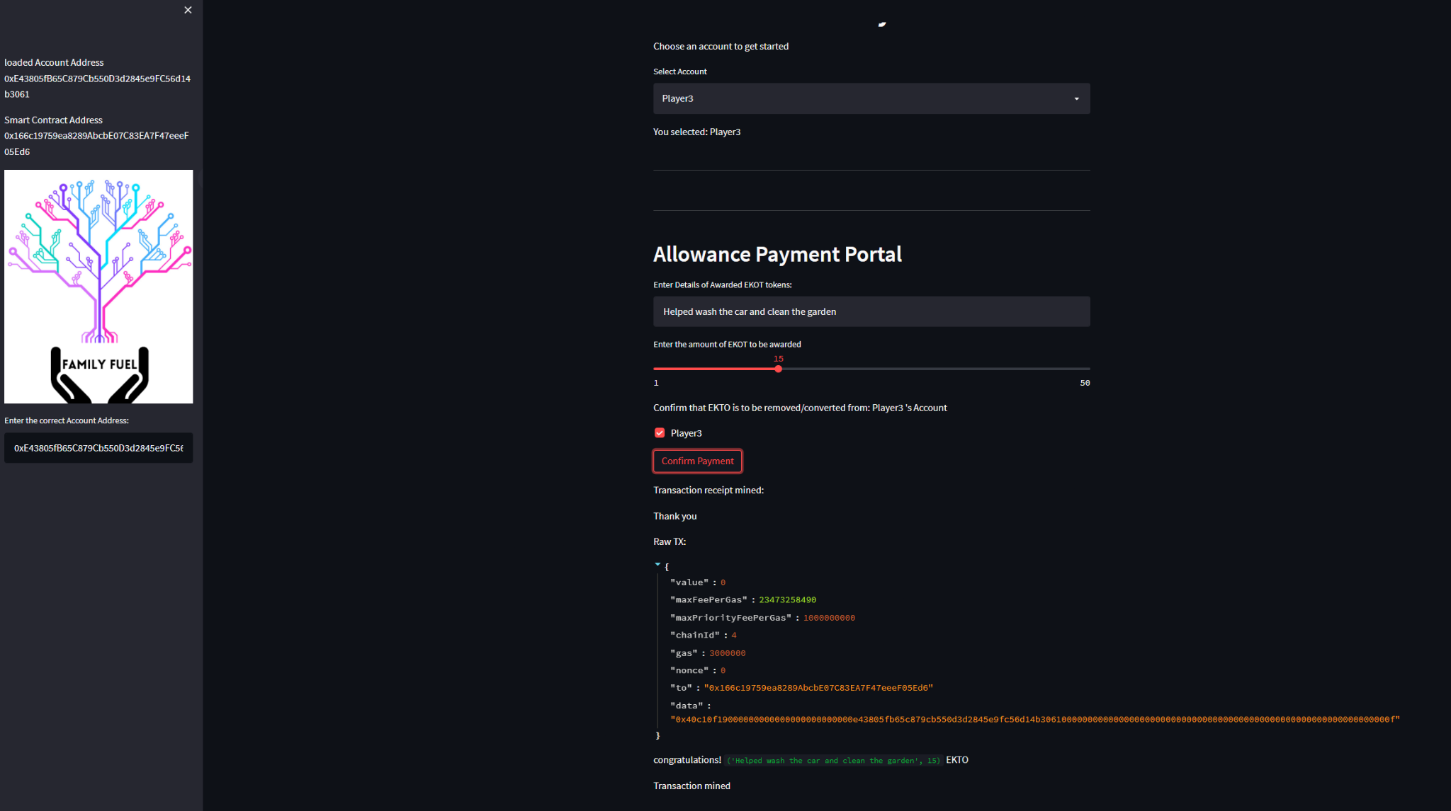

Slide 13
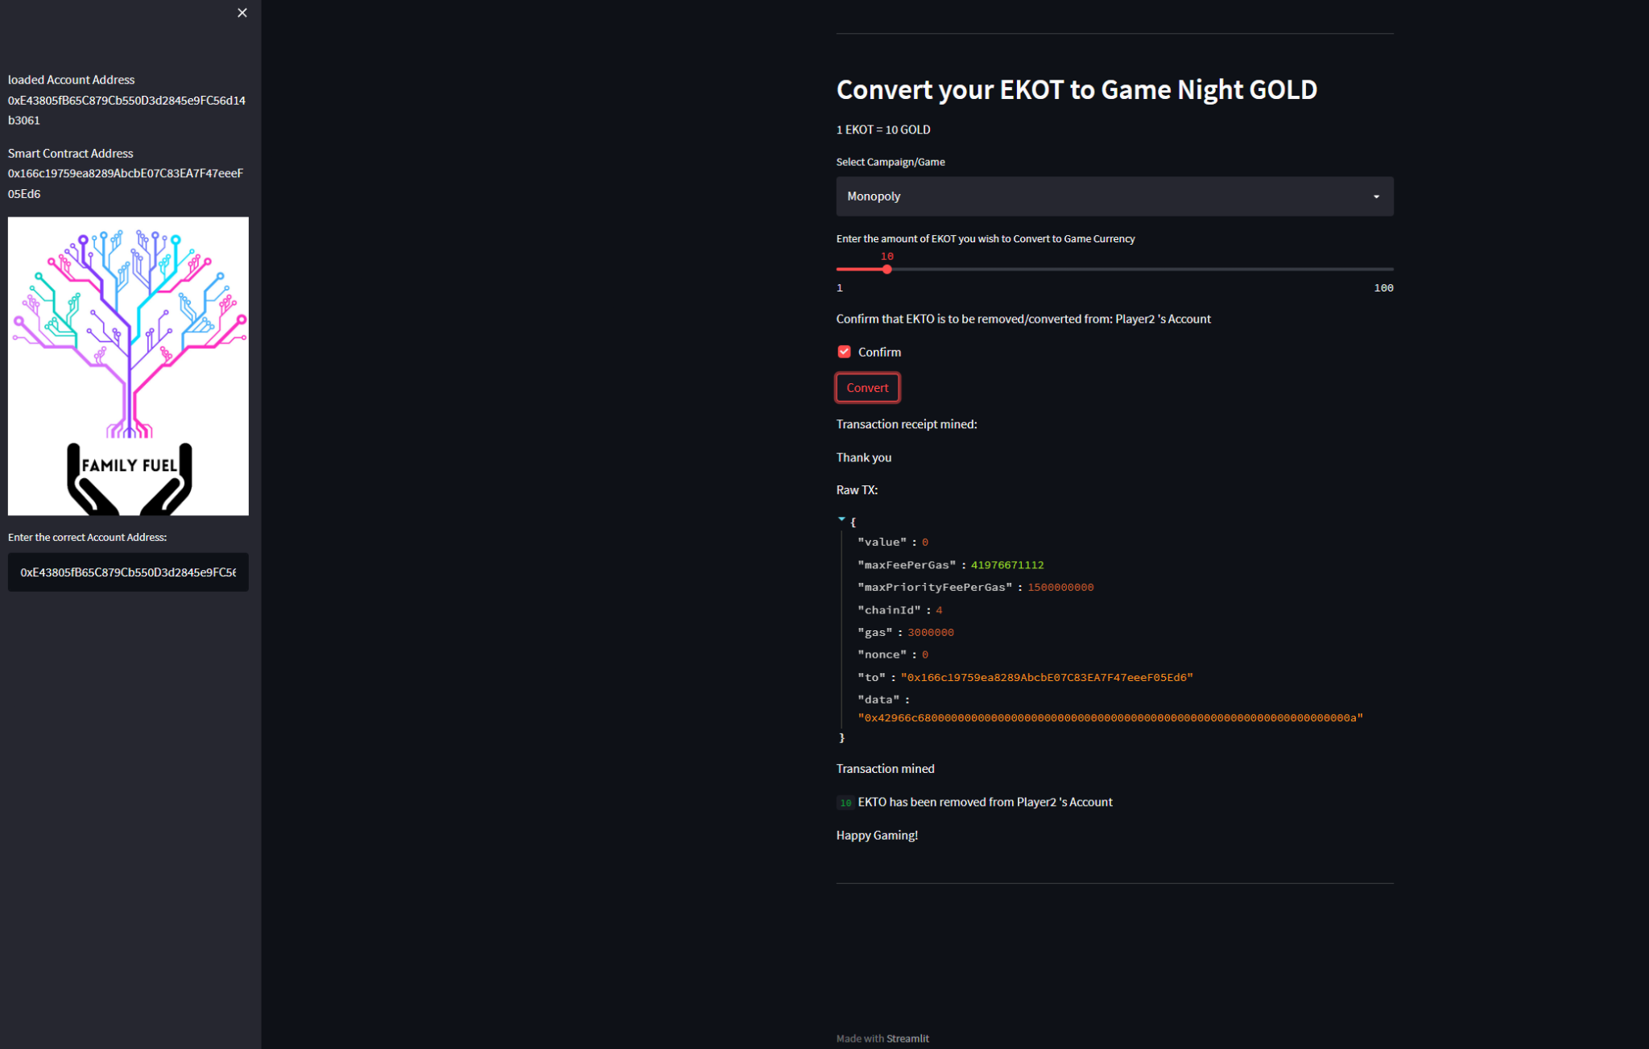

Slide 14
Next Steps
Decide on ERC1155 or Cronos token (for lower gas) might be a direction.
Finalize current roadmap and end goal.
Mainnet launch of EKTO token
Update front end
  Login Feature
  Multiple pages/tabs
  Link account address to Player name.
  Increase function’s adding NFT minting
  Add transfer function
Additional research to be completed
  OpenAI (content, art, chat & more)
  Moralis & PlayFab
  Foundry VTT API
  Unity
  ios/android

Slide 15
Questions?
Thank You all
Stay safe and be well
max growth
Trevor Greenizan

