Slide 1
Problem Statement
Automation of Right Ascension fine tuner of telescope for stargazing

Slide 2
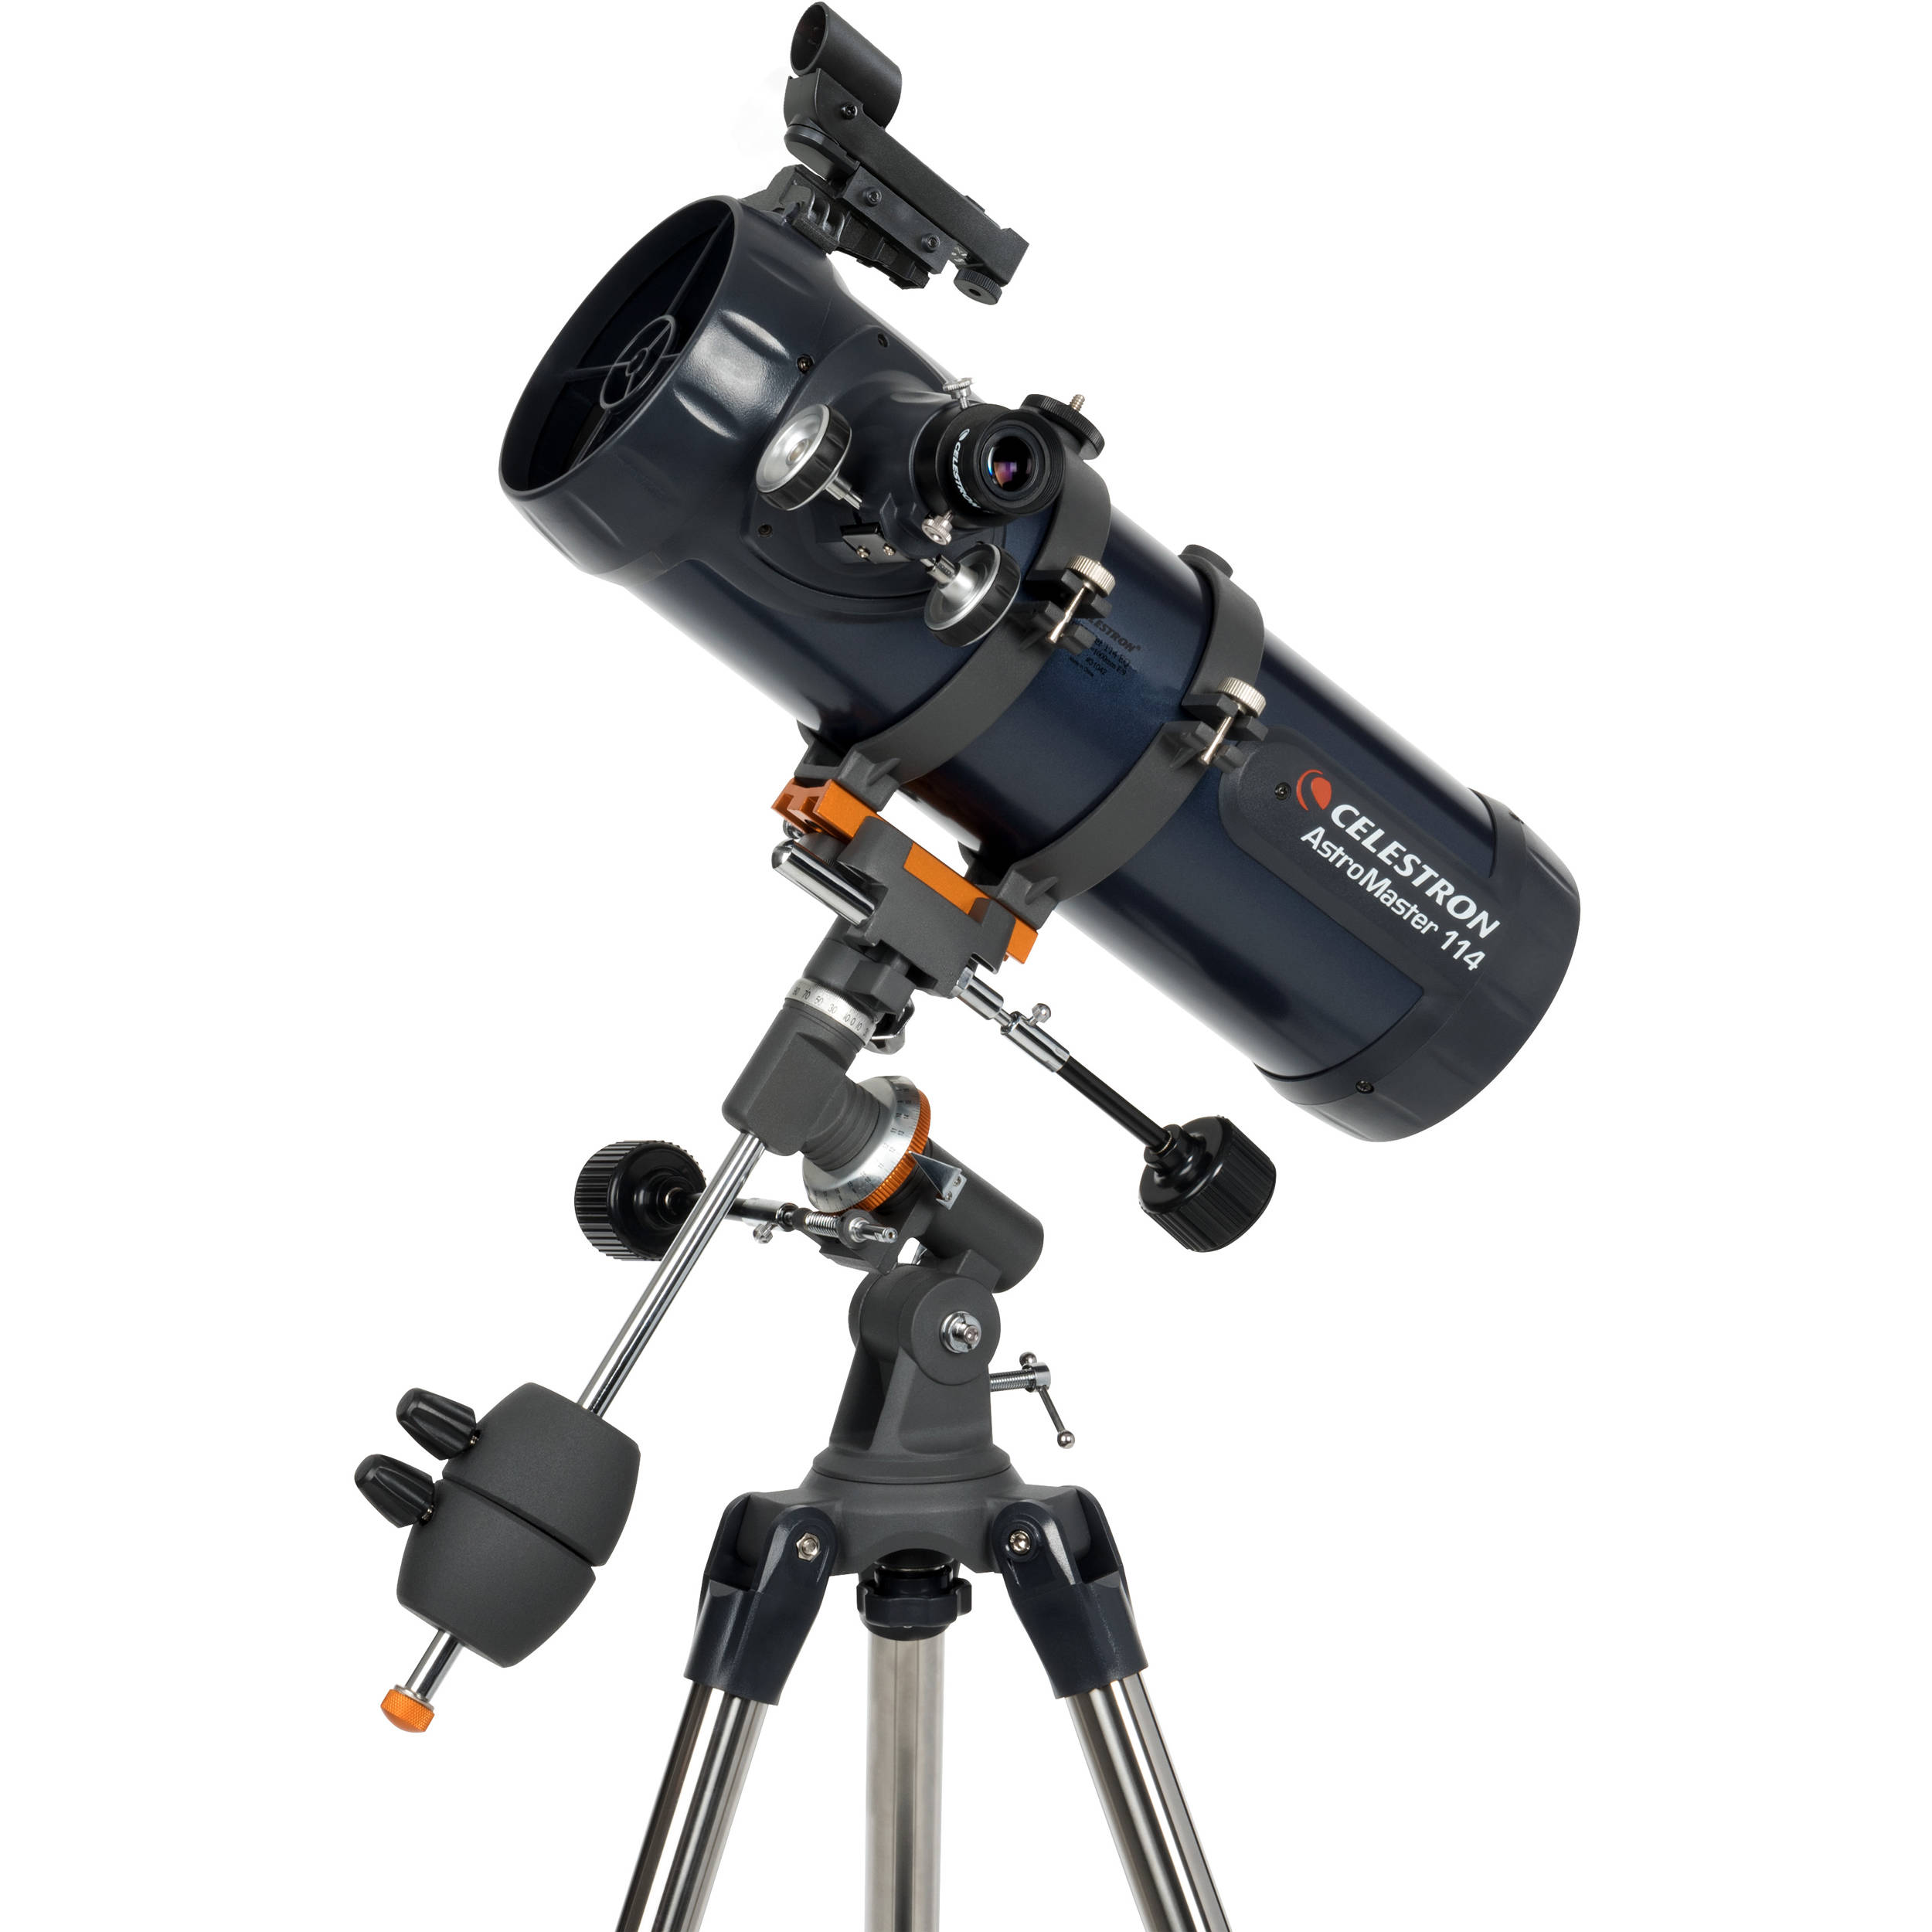
Introduction
Telescope : Celestron Astromaster 114 eq reflector telescope

Slide 3
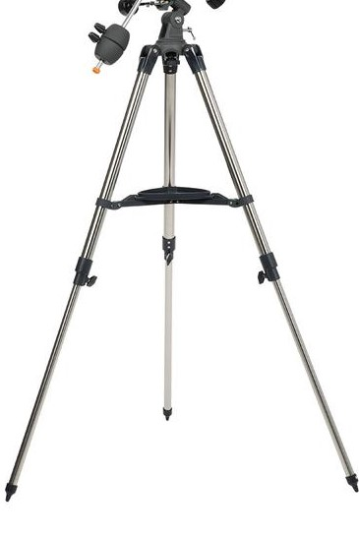
Introduction
Tripod Stand :
Scope and Mount head sit on it.
Height Adjustment.
Central Accessory Tray to be set
to fix this.

Slide 4
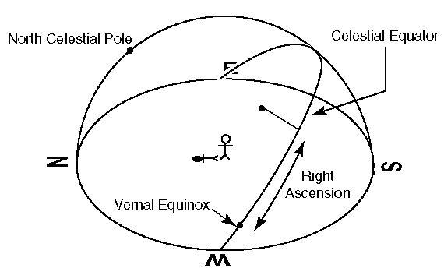
Introduction
Right Ascension:
It locates where a star is along the
celestial equator.
Zero point(Vernal Equinox) is chosen to be
where the line straight down from the
Greenwich observatory in England
meets the equator.
Follow an hour circle straight down from
star to celestial equator to get RA of star.
The angle from vernal equinox eastward to the foot of that hour circle is the star’s RA.
It is measured in hours ,minutes and seconds(1hr = 15 ̊).

Slide 5
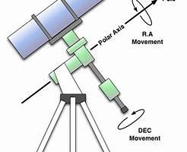
AXIS IN TELESCOPE
MOTION IN RIGHT ASCENSION(polar axis)
MOTION IN DECLINATION(declination axis)
Since the angle of declination of trajectory of a given star does not change so once fixed we need not to change the angle of declination.
So we need to move only Right Ascension.

Slide 6
Suppose telescope rotation
Earth rotation
Compensation of earth rotation
So, I can see the star on focus only if--
(rate of rotation of earth)=(rate of rotation of my telescope) but in opposite direction.
NOTE : We can’t use this calculations for planets as planets nearby and they are revolving around sun.
Since stars are quite far away their motion can be neglected.

Slide 7
Measurements-Manual
Earth’s Rotation : 360 ̊/24hr = 0.25 ̊/min
We need 0.25 ̊/min in opposite direction to compensate this.
Right Ascension of telescope moves 2.5 ̊ for every full rotation of the fine tuner
Required movement of fine tuner : 360 ̊ per 10 minutes
,i.e., 0.6 ̊ per second

Slide 8
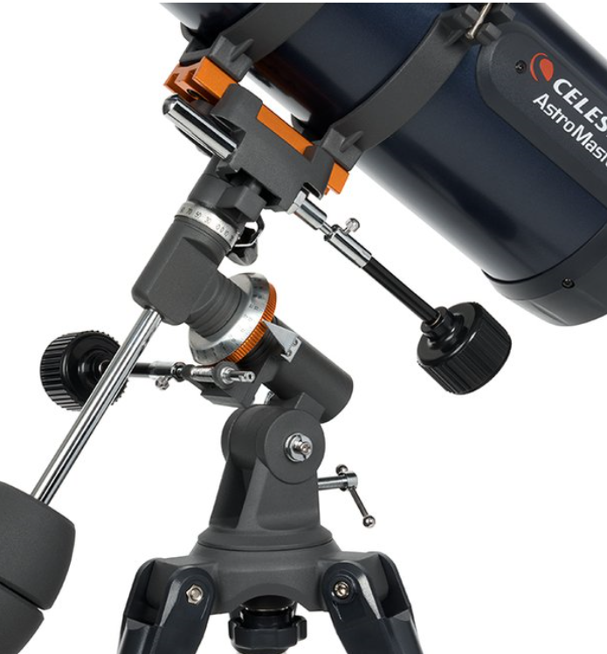
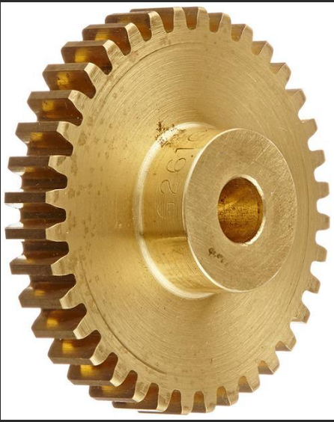
MEASUREMENTS through mechanical way
FINE TUNER
HOW MANY TEETH ARE THERE IN MY WHEEL??
COUNTER WEIGHT
WORM AND WORM WHEELS

Slide 9
->Rotation of earth=360°per day.
Let say,
There are total n1 teeth in worm wheel and in one rotation of fine tuner n2 teeth goes forward.
Angle moved by telescope when one teeth goes forward = 360°/n1
So, angle moved by telescope in one complete rotation of fine tuner = (360/n1)*n2
By unitary method,
For moving 1 degree of telescope = n1/(360 °*n2) revolution of fine tuner is required

Slide 10
(we already shown that ; Rate of telescope=rate of earth )
Rate of fine tuner is (360/24)*1/(360/n1)*n2 revolution per hour
So by counting n1=135, n2=1
By solving,
Rate of rotation of fine tuner knob of right ascension is 6 revolution per hour
means, 1 rev per 10 min
means 0.6 degree per sec.
Rate of rotation of motor should be 0.6 ̊per sec.

Slide 11
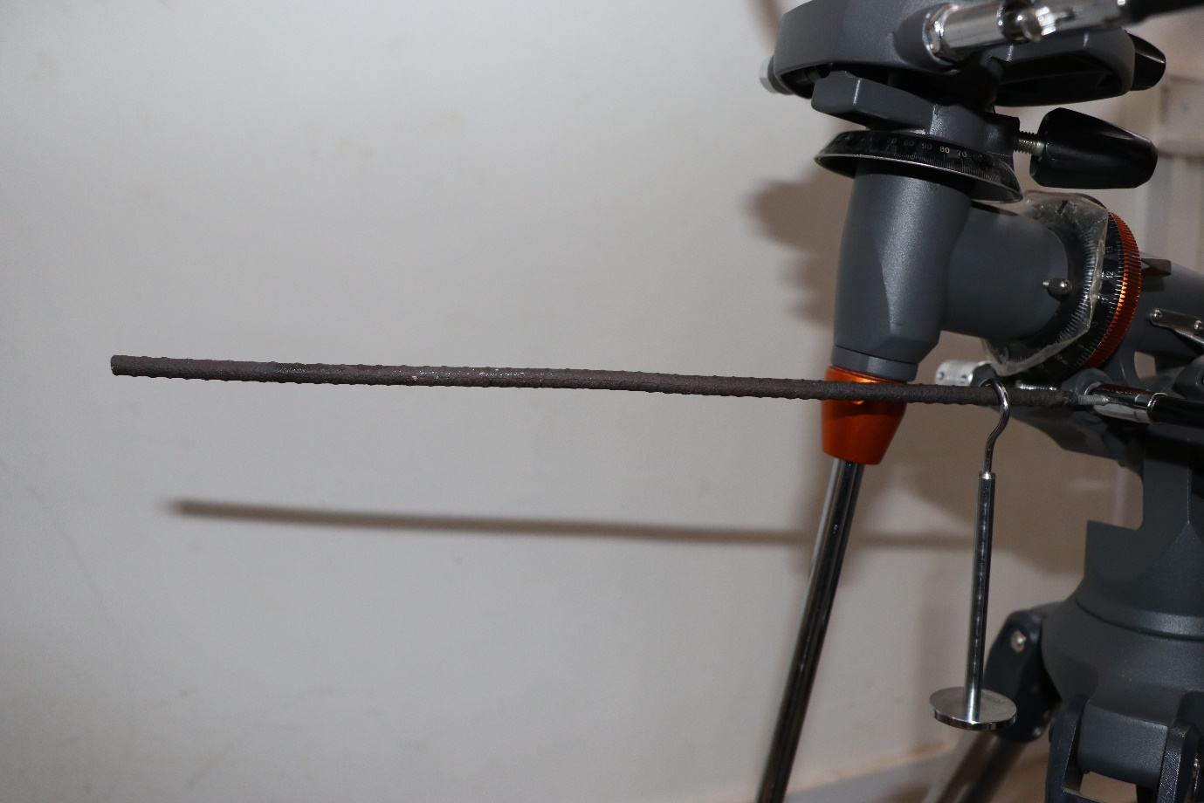
Torque calculation
Length of rod = l = 34.5 cm
Mass of rod = m_{r} = 77.4 g
Mass of load = m_{l} = 51.4 g
Distance of load from pivot = d = 4.4 cm
Torque = ((m_{r}*l)/2 + m_{l} *d)*g = 15.3 N cm
Torque of motor = 41.16 N cm = 1.56 kg cm
L = 34.5 cm
d = 4.4 cm
Fine tuner axis
Load (51.6 g)

Slide 12
Basic Idea
Idea is to rotate the right ascension fine tuning knob with help of motor
Using a microprocessor to control angular speed and the direction of rotation of the motor
All above components are kept inside a box out of which power wires come out.
A battery to power the entire circuit

Slide 13
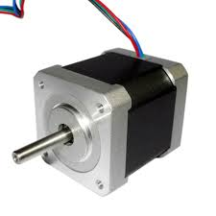
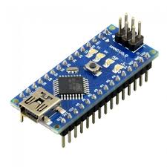
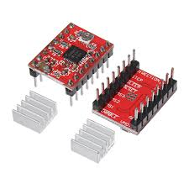
Details of the model
Motor should be able to provide sufficient torque (1.56 kg cm*) and precision (1.8⁰ in 3sec). So we are using a Stepper motor – NEMA 17 (rated torque : 4.2 kg cm*)
We are using Arduino Nano and Stepper motor driver – A4988 to program the speed of the motor.
* Torque in motors is measured in kg cm

Slide 14

Details of the model
Battery installation must not be complicated so that old battery can be easily replaced. We are using Li Polymer 11.1 V 3500mAh.
User should have the switch to change the direction of rotation. Due the symmetry of the tripod stand the user may attach the motor on any two sides of the fine tuner axis.

Slide 15
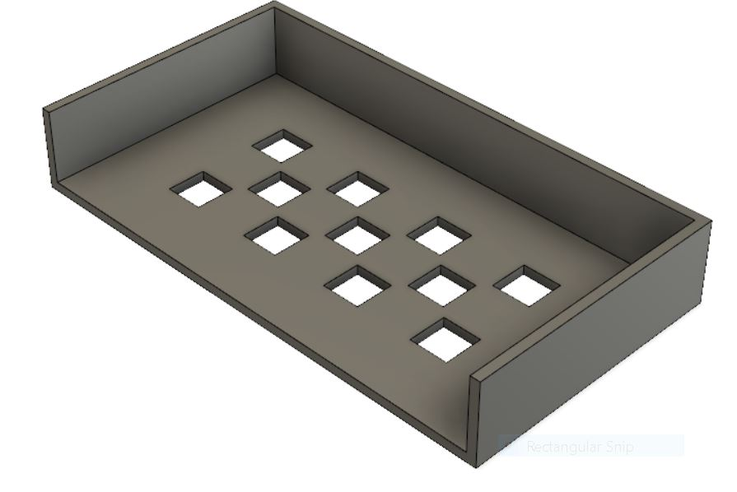
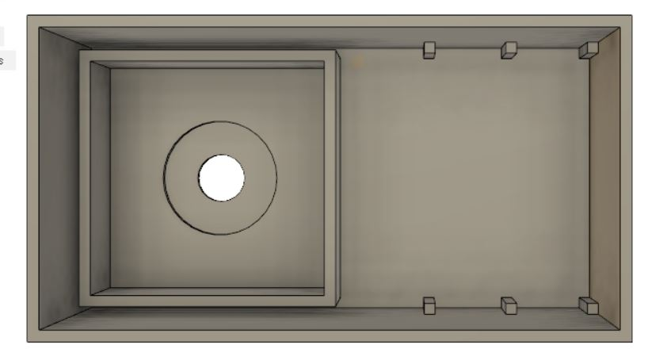
Design of Box
Lid
All the components including the box should be light weight so that it does not damage the stand or disturb the alignment of any axis. Thus, we planned to 3-D print the box.
Walls to hold motor
Ventilation holes
Studs to screw the circuit securely

Slide 16
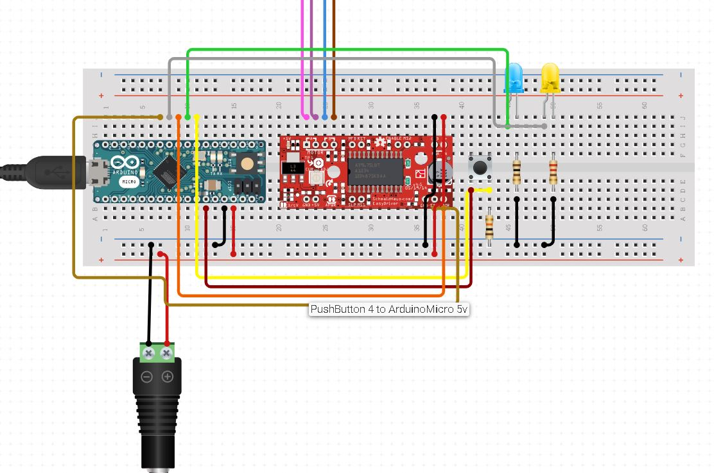
Circuit Diagram
Led
Motor pins
Arduino Nano
Push button
A4988 driver
11.1 V
stepper\code.docx

Slide 17
Future of the project
Different modes for tracking of planets
More Precision
More versatile w.r.t. different tripod stands
Automation of other axes

Slide 18
Thankyou
Special Thanks To Faculty Advisors:
Prof. D. Narsimha
Prof. Sangamesh Deepak

