Slide 1
Handwritten Alphabet Recognition with MLP, CNN, and SVM
Introduction
Data
Methodology
Results
Conclusion
Limitation
Tong Gu
V00890534
ECE 470 A02

Slide 2

Handwritten Alphabet Recognition with MLP, CNN, and SVM
Data
Methodology
Results
Conclusion
Limitation
Task:
Given a picture of a handwritten character in alphabet, the agent recognizes which character it is.
Data:
A-Z Handwritten Alphabets in .csv format | Kaggle
Technique:
Deep learning
Supervised learning
Classification Problem
Models:
Multi-layer Perceptron (MLP)
Convolutional Neural Network (CNN)
Support Vector Machines (SVM)
Tong Gu
V00890534
ECE 470 A02
https://www.kaggle.com/sachinpatel21/az-handwritten-alphabets-in-csv-format
Introduction
Notes:
Task.
This is a easy task.
Data
Technique (python, keras, scikit-learn, GPU accelerate)
This is too easy.
Models.

Slide 3
Evaluation
Data
Methodology
Results
Conclusion
Limitation
validity
accuracy
Speed
Does it work at all?
How likely will it classify the picture correctly?
How long does it take to train the model?
Introduction
Notes:
3 scales

Slide 4
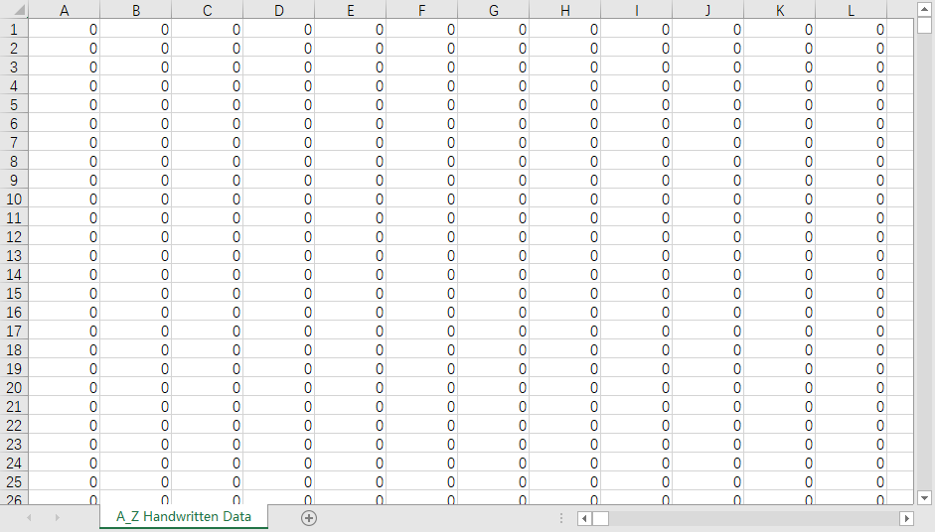
Methodology
Results
Conclusion
Limitation
A_Z Handwritten Data.csv
CSV file
372451 rows * 785 columns
372451 entries
784 features
Introduction
Data

Slide 5
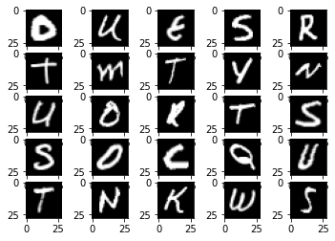
data
Methodology
Results
Conclusion
Limitation
Each row is a sample.
The first column is a integer in [0, 25], representing 26 characters.
The rest 784 columns are integers in [0, 255], representing 784 pixels in a 28*28 grey scale image.
Introduction
Data

Slide 6

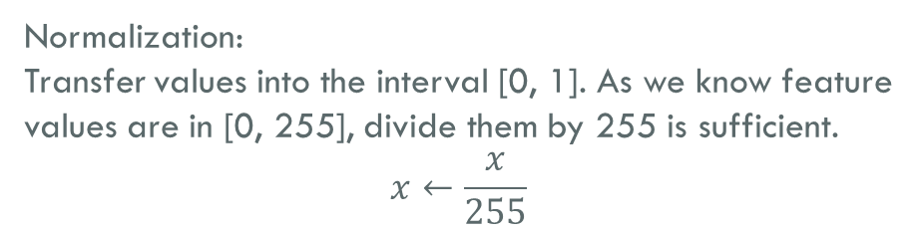
Preprocessing
Methodology
Results
Conclusion
Limitation
Normalization:
Transfer values into the interval [0, 1]. As we know feature values are in [0, 255], divide them by 255 is sufficient.
$$x←\frac{x}{255}$$
Load as a NumPy array
Split features and label
Normalize feature values (divide by 255)
Categorize labels (for MLP and CNN)
Categorizing:
In keras, the labels should be a categorical vector. For example, if labels have 5 possible values (0-4) and a label is 1, the categorical vector would be (0, 1, 0, 0, 0).
$$y←(z_{0},z_{1},…,z_{25})$$
$$z_{i}=\left\{\begin{aligned}1, i=y \\ 0, i≠y\end{aligned}\right.$$
Introduction
Data

Slide 7
Results
Conclusion
Limitation
compare
MLP
CNN
SVM
Optimizer(sgd, adam, rmsprop)
Activation(sigmoid, relu)
Dropout(0, 0.2)
Batch size (128, 256, 512)
Epochs(5, 10, 20)
Hard margin / soft margin
gamma
Introduction
Data
Methodology
Notes:
Sgd = Stochastic Gradient Descent
Adam = Adaptive Moment Estimation
Rmsprop = Root Mean Square Prop

Slide 8
Neural network
Results
Conclusion
Limitation
mlp
cnn
SVM
784 nodes in input layers
3 hidden layers, each with 128 nodes
26 nodes in output layer (SoftMax)
Batch size = 256
Epochs = 10
1 convolution layer, 1 pooling layer, 1 fully connected layer
26 nodes in output layer (SoftMax)
32 filters, 5*5 kernel size, 2*2 pool size
Optimizer: Adam
Activation function: ReLU
rbf kernel
Introduction
Data
Methodology
Notes:
Rbf = Radial Based Function

Slide 9
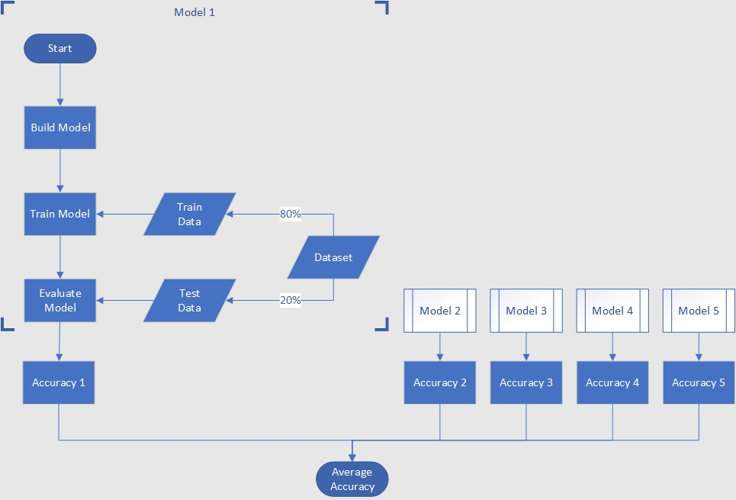

evaluation
Results
Conclusion
Limitation
5-fold cross validation:
For a certain combination of hyperparameters, split dataset into 5 pieces.
For each $i∈\left[1,5\right]$, train a model with all pieces except the $i^{th}$ piece. Then use this model to predict $i^{th}$ piece and calculate the accuracy.
Finally, calculate the average of the 5 accuracies from the last step.
Introduction
Data
Methodology

Slide 10
Conclusion
Limitation
2000 YEARS
LATER
Introduction
Data
Methodology
Results

Slide 11
MLP
Conclusion
Limitation
Introduction
Data
Methodology
Results
Notes:
With same epochs, sgd has a low accuracy. Adam and rmsprop has no significant difference on accuracy.

Slide 12
MLP
Conclusion
Limitation
Introduction
Data
Methodology
Results
Notes:
Adam is faster than rmsprop.

Slide 13
CNN
Conclusion
Limitation
Introduction
Data
Methodology
Results
Notes:
Both accuracy and training time decreases as batch size increases. More epochs are needed when large batch size is used. Overall, larger batch size takes less time to reach the same accuracy.

Slide 14
MLP vs. CNN
Conclusion
Limitation
Optimizer: adam
Activation function: ReLU
No dropout
Batch size = 256
Epochs = 10
Introduction
Data
Methodology
Results
Notes:
There is only a difference of 0.5 on accuracy. However, CNN takes 20 more seconds. Does it mean MLP is faster? No! 0.5 is not a small difference. Let’s see the same CNN at 5 epochs.

Slide 15
MLP vs. CNN
Conclusion
Limitation
Optimizer: adam
Activation function: ReLU
No dropout
Batch size = 256
MLP Epochs = 10
CNN Epochs = 5
Introduction
Data
Methodology
Results
Notes:
CNN only uses 41 seconds to exceed MLP’s accuracy.

Slide 16
SVM
Conclusion
Limitation
How about using only 0.25% percent (9311 samples) as training set?
Introduction
Data
Methodology
Results
Notes:
SVM is different. When I try to train it with the whole data set, it seems that the program will never reach an end. Actually, I have never seen anyone using a SVM classifier on this dataset. However, I have used it on MNIST. Perhaps it is simply because there are too many samples?

Slide 17
SVM
Conclusion
Limitation
Introduction
Data
Methodology
Results
Notes:
Hard margin is good enough. Soft margin only makes it slower.

Slide 18
CNN, again
Conclusion
Limitation
What if I only use only 0.25% percent (9311 samples) as training set?
Introduction
Data
Methodology
Results

Slide 19
CNN, again
Conclusion
Limitation
Introduction
Data
Methodology
Results
Notes:
CNN, wins again.

Slide 20
Limitation
All 3 algorithms can handle this task
CNN has a slight advantage among 3 models
SVM does not work well on enormous dataset
We do not always have to use the majority of a dataset for training
Introduction
Data
Methodology
Results
Conclusion

Slide 21
Really, how am I supposed to choose hyperparameters?
Okay, you are correct, but why?
I know you are hungry, but that’s all my data.
There are not only entities, but also relations.
Introduction
Data
Methodology
Results
Conclusion
Limitation
Notes:
We can only try again and again.
Lack of explanatory value.
The cost of data collecting and preprocessing are even more difficult than the process.

Slide 22

Really, how am I supposed to choose hyperparameters?
Okay, you are correct, but why?
I know you are hungry, but that’s all my data.
There are not only entities, but also relations.
Thank you!
Introduction
Data
Methodology
Results
Conclusion
Limitation

