Slide 1
The multidimensional nightmare!
Notes:
I

Slide 2
Volume =
length x height x width
Notes:
I

Slide 3
Surface =
length x width
Notes:
I

Slide 4
length =
length
Notes:
I

Slide 5
Volume =
length x height x width
Surface =
length x height
Length =
length
Notes:
I

Slide 6
Renaming dimensions:
Volume =
PC1 x PC2 x PC3
Surface =
PC1 x PC2
Length =
PC1
Notes:
I

Slide 7
Renaming dimensions:
Volume =
Dim.1 x Dim.2 x Dim.3
Surface =
Dim.1 x Dim.2
Length =
Dim.1
Notes:
I

Slide 8
Renaming metrics:
Volume 3D =
Dim.1 x Dim.2 x Dim.3
Volume 2D =
Dim.1 x Dim.2
Volume 1D =
Dim.1
Notes:
I

Slide 9
Adding more dimensions
Volume 4D =
Dim.1 x Dim.2 x Dim.3 x Dim.4
Volume 3D =
Dim.1 x Dim.2 x Dim.3
Volume 2D =
Dim.1 x Dim.2
Volume 1D =
Dim.1
Notes:
I

Slide 10
Notes:
I

Slide 11
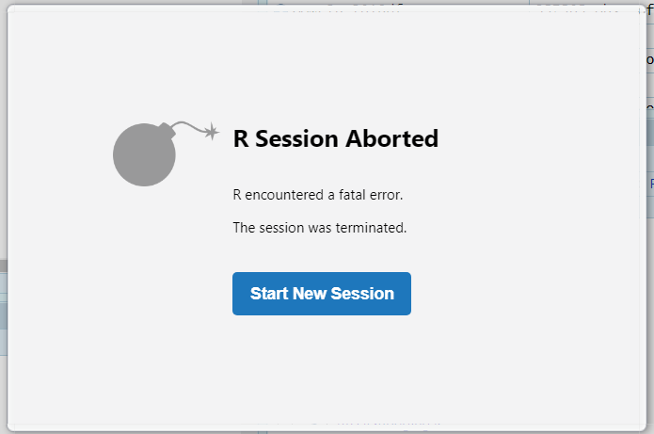
Notes:
I

Slide 12
Generalising:
Volume nD =
product of dimensions
Notes:
I

Slide 13
Reducing dimensionality
Notes:
I

Slide 14
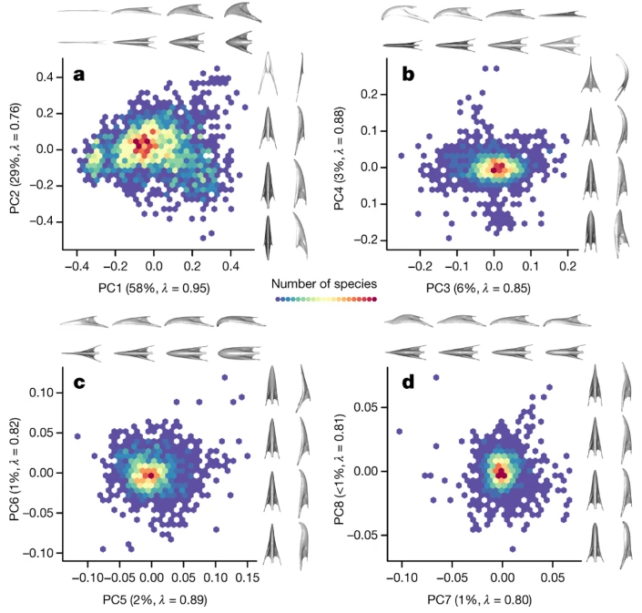
Cooney et 2017 - Nature

Slide 15
Cooney et 2017 - Nature
87% of the data’s variation

Slide 16
Cooney et 2017 - Nature
96%...
87% of the data’s variation

Slide 17
Cooney et 2017 - Nature
96%...
87% of the data’s variation
99%!

Slide 18
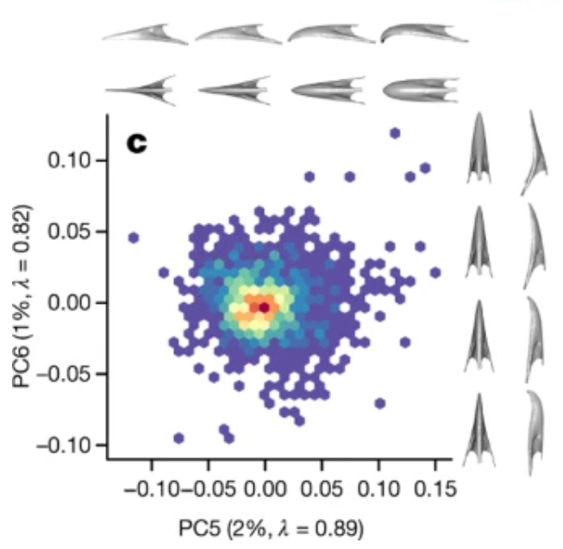
Only 2% of the data’s variation!

Slide 19
The Duck axis?
Only 2% of the data’s variation!

Slide 20
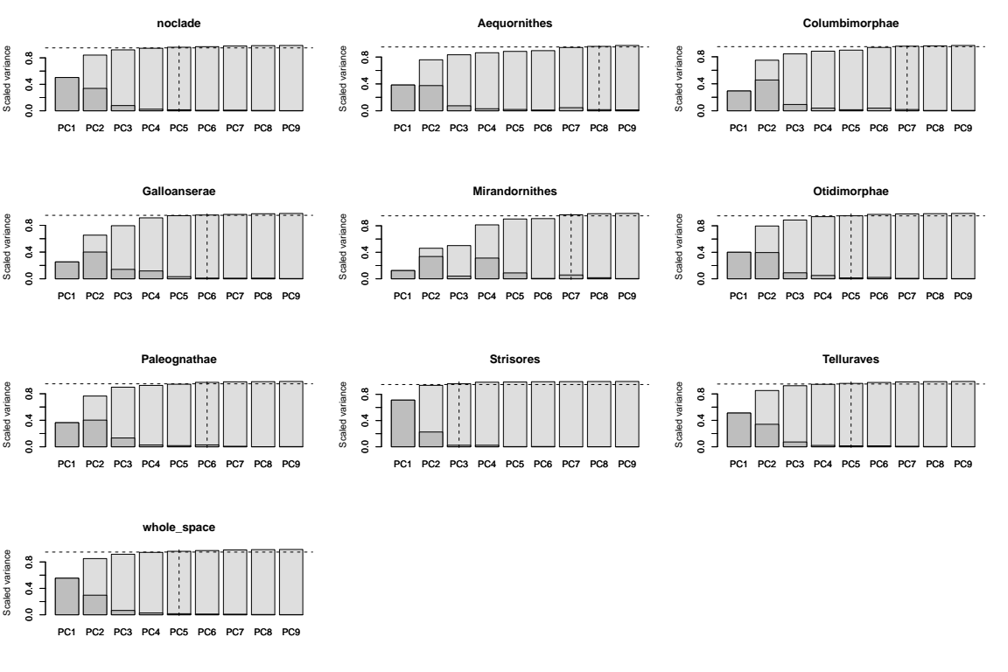
dispRity::select.axes

Slide 21
5D needed
8D needed
8D needed
7D needed
6D needed
7D needed
7D needed
5D needed
6D needed
3D needed
5D needed
5D needed
dispRity::select.axes

Slide 22
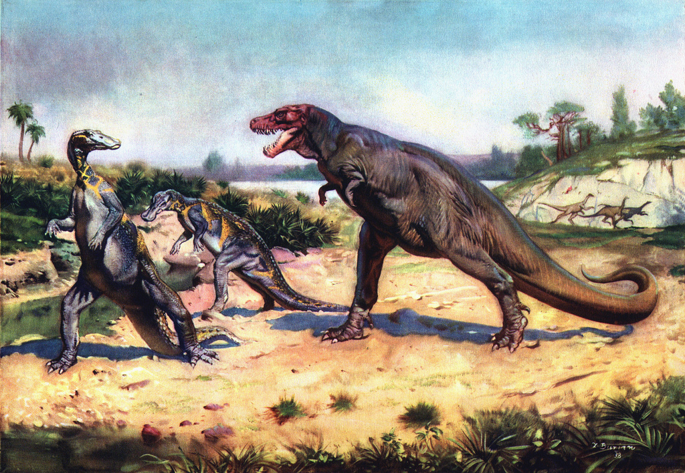
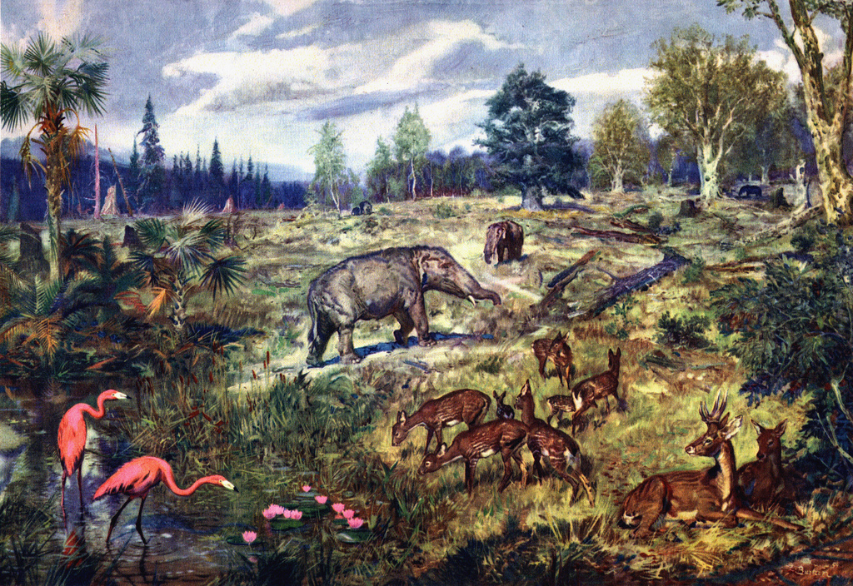
Why do environments
change through time?
Notes:
Sort the silhouettes along the axis (e.g. body mass/color)

Slide 23
Why do environments
change through time?
Why = mechanism
(turnover, selection, competition)
Notes:
Sort the silhouettes along the axis (e.g. body mass/color)

Slide 24
Why do environments
change through time?
Why = mechanism
(turnover, selection, competition)
Notes:
Sort the silhouettes along the axis (e.g. body mass/color)

Slide 25
Competition (why):
How does it change through time?
Notes:
Sort the silhouettes along the axis (e.g. body mass/color)

Slide 26
Competition (why):
How does it change through time?
Competition (why):
How does it change through time?
Number of species through time:
Dinosaurs = ; Dinosaurs =
Mammals = ; Mammals =
Notes:
Sort the silhouettes along the axis (e.g. body mass/color)

Slide 27
Competition (why):
How does it change through time?
Number of species through time:
Dinosaurs = 3 ; Dinosaurs =
Mammals = 0 ; Mammals =
Notes:
Sort the silhouettes along the axis (e.g. body mass/color)

Slide 28
Competition (why):
How does it change through time?
Number of species through time:
Dinosaurs = 3 ; Dinosaurs = 1
Mammals = 0 ; Mammals = 3
Notes:
Sort the silhouettes along the axis (e.g. body mass/color)

Slide 29
Competition (why):
How does it change through time?
Number of species through time:
Dinosaurs = 3 ; Dinosaurs = 1
Mammals = 0 ; Mammals = 3
Notes:
Sort the silhouettes along the axis (e.g. body mass/color)

Slide 30
Competition (why):
How does it change through time?
Number of species through time:
Dinosaurs = 3 ; Dinosaurs = 1
Mammals = 0 ; Mammals = 3
Competition?
Notes:
Sort the silhouettes along the axis (e.g. body mass/color)

Slide 31
Competition through time:
What is changing?
Pattern through time:
Dinosaurs = 3 ; Dinosaurs = 1
Mammals = 0 ; Mammals = 3
Notes:
Sort the silhouettes along the axis (e.g. body mass/color)

Slide 32
Competition through time:
What is changing?
Competition?
Change of pattern through time
Notes:
Sort the silhouettes along the axis (e.g. body mass/color)

Slide 33
Competition through time:
What is changing?
Competition? pattern through time
pattern = number of species per group
pattern = total number of species
Notes:
Sort the silhouettes along the axis (e.g. body mass/color)

Slide 34
Competition through time:
What is changing?
Competition? pattern through time
pattern = number of species per group
pattern = total number of species
Notes:
Sort the silhouettes along the axis (e.g. body mass/color)

Slide 35
Competition through time:
What is changing?
Pattern through time:
species = 3 ; species = 4
Competition???
Notes:
Sort the silhouettes along the axis (e.g. body mass/color)

